Slide 1
HTML
TUTORIAL: https://www.w3schools.com/html/default.asp
EXERCIZE: https://www.w3schools.com/html/exercise.asp

Slide 2

HTML | What is?
HTML (Hypertext Markup Language) is a markup language that defines the structure of your content, is the standard markup language for creating Web pages.
It describes the structure of a Web page
HTML consists of a series of elements, which you use to enclose, or wrap, different parts of the content to make it appear a certain way. It Tell the browser how to display the content
NOT Case Sensitive

Slide 3
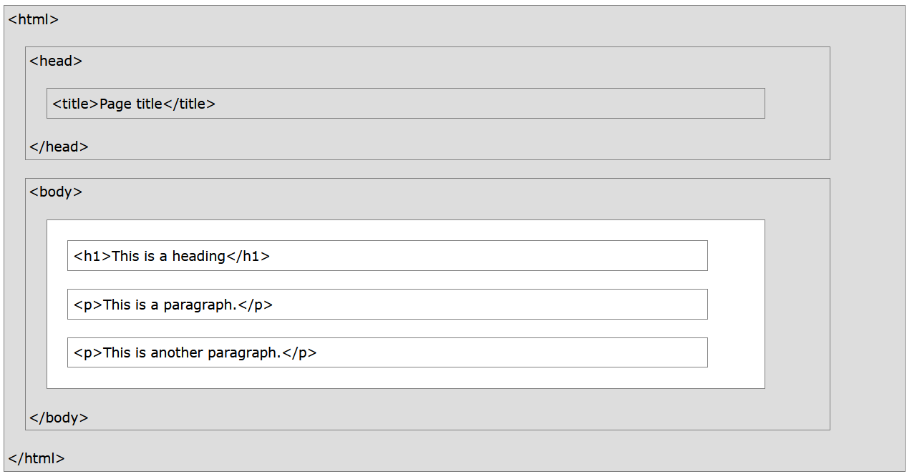
HTML | Page Structure

Slide 4
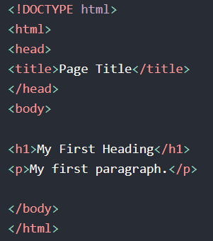
HTML | Anatomy of Document
doctype: it is a required preamble. In the mists of time, when HTML was young (around 1991/92), these days, they don't do much and are basically just needed to make sure your document behaves correctly.
<html></html>: this element wraps all the content on the entire page and is sometimes known as the root element.
<head></head>: this element acts as a container for all the stuff you want to include on the HTML page that isn't the content you are showing to your page's viewers. This includes things like keywords and a page description that you want to appear in search results, CSS to style our content, character set declarations, and more.
<title></title>: this sets the title of your page, which is the title that appears in the browser tab the page is loaded in.
<body></body>: this contains all the content that you want to show to web users when they visit your page.
<h1></h1>: element defines a large heading
<p></p>: element defines a paragraph

Slide 5
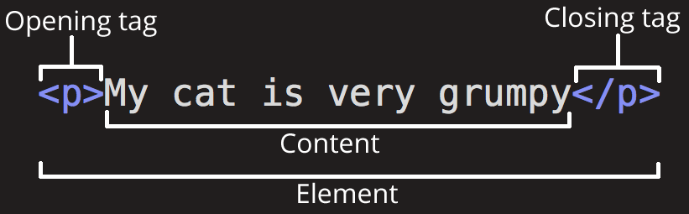
HTML | Anatomy of Element
The opening tag: This consists of the name of the element (in this case, p), wrapped in opening and closing angle brackets. This states where the element begins or starts to take effect.
The closing tag: This is the same as the opening tag, except that it includes a forward slash before the element name. This states where the element ends
The content: This is the content of the element, which in this case, is just text.
The element: The opening tag, the closing tag, and the content together comprise the element.

Slide 6
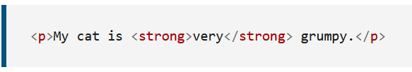
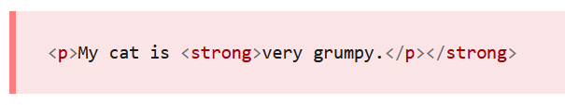
HTML | Nesting Elements
You can put elements inside other elements too, this is called nesting.
If we wanted to state that our cat is very grumpy, we could wrap the word "very" in a <strong> element, which means that the word is to be strongly emphasized.
You do however need to make sure that your elements are properly nested

Slide 7

HTML | Comments
Notice that there is an exclamation point (!) in the start tag, but not in the end tag.

Slide 8
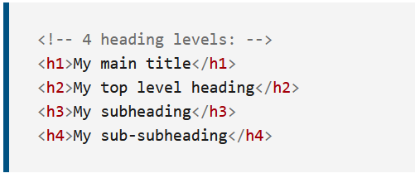
HTML | Heading
Heading elements allow you to specify that certain parts of your content are headings, or subheadings.
HTML contains 6 heading levels, <h1>–<h6>

Slide 9

HTML | Paragraph
<p> elements are for containing paragraphs of text; you'll use these frequently when marking up regular text content.
A paragraph always starts on a new line, and browsers automatically add some white space (a margin) before and after a paragraph.

Slide 10
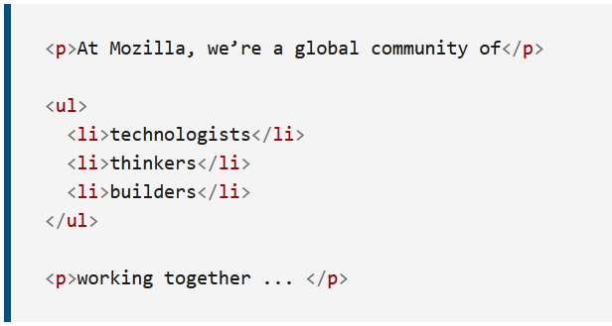
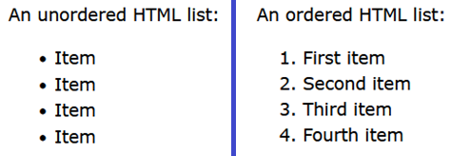
HTML | Lists
A lot of the web's content is lists and HTML has special elements for these, the most common list types are ordered and unordered lists:
Unordered lists are for lists where the order of the items doesn't matter, such as a shopping list. These are wrapped in a <ul> element.
Ordered lists are for lists where the order of the items does matter, such as a recipe. These are wrapped in an <ol> element.

Slide 11
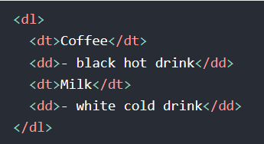
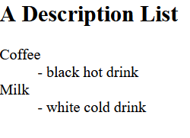
HTML | Description List
A description list is a list of terms, with a description of each term. The <dl> tag defines the description list, the <dt> tag defines the term (name), and the <dd> tag describes each term:

Slide 12
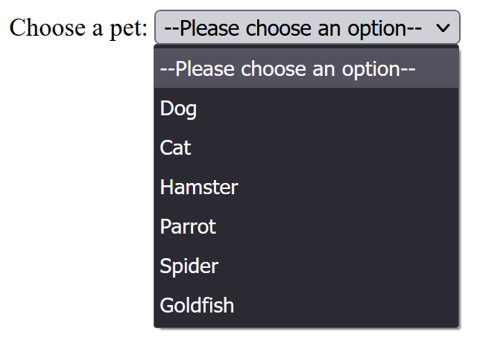
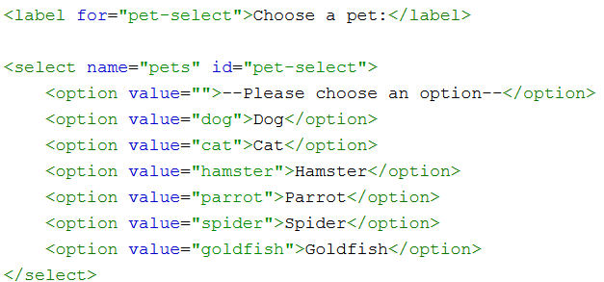
HTML | Drop Down List
The <select> HTML element represents a control that provides a menu of options:

Slide 13
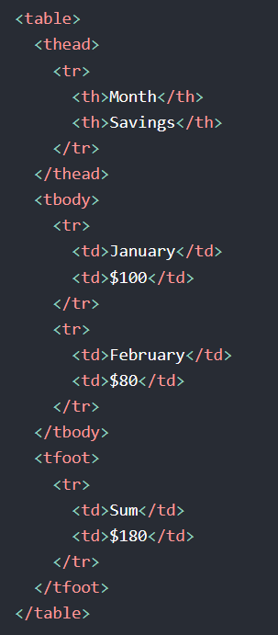
HTML | Tables
HTML tables allow web developers to arrange data into rows and columns.
tr tag defines a table row
table tag define a HTML table
td defines a table cell
th defines a tables header cell
thead tag is used to group header content in an HTML table.
tbody tag is used to group the body content in an HTML table.
tfoot tag is used to group footer content in an HTML table.

Slide 14
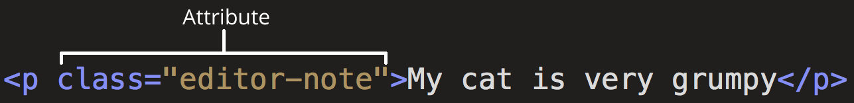
HTML | Anatomy of Element
All HTML elements can have attributes
Attributes provide additional information about elements
Attributes are always specified in the start tag
Attributes usually come in name/value pairs like: name="value"
Attributes contain extra information about the element that you don't want to appear in the actual content.
Here, class is the attribute name and editor-note is the attribute value.

Slide 15
HTML | images
HTML images are defined with the <img> tag.
The source file (src), alternative text (alt), width, and height are provided as attributes:
EMPTY
ELEMENT
the width and height attributes specifies the width and height of the image (in pixels)
the required alt attribute specifies an alternate text for an image. If the image for some reason cannot be displayed.

Slide 16
HTML | src attribute
The <img> tag is used to embed an image in an HTML page. The src attribute specifies the path to the image to be displayed:
There are two ways to specify the URL in the src attribute:
Absolute URL: links to an external image that is hosted on another website. Example: src="https://www.w3schools.com/images/img_girl.jpg".
Relative URL: links to an image that is hosted within the website. Here, the URL does not include the domain name. If the URL begins without a slash, it will be relative to the current page. Example: src="img_girl.jpg". Example: src="/images/img_girl.jpg".

Slide 17
HTML | Links
The <a> tag defines a hyperlink. Links are very important they are what makes the web a web!
To add a link, we need to use a simple element "a" being the short form for "anchor".
The target attribute can have one of the following values:
_self (default): opens the document in the same window/tab as it was clicked
_blank: opens the document in a new window or tab
_parent: opens the document in the parent frame
_top: opens the document in the full body of the window

Slide 18
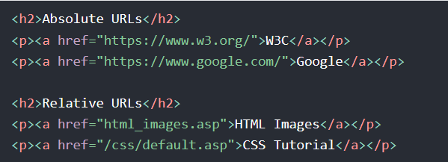
HTML | href attribute
The href attribute specifies the URL of the page the link goes to.
Both examples above are using an absolute URL (a full web address) in the href attribute.
A local link (a link to a page within the same website) is specified with a relative URL (without the "https://www" part):

Slide 19
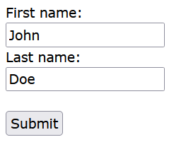
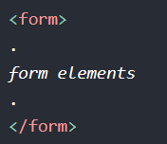
HTML | Forms
An HTML form is used to collect user input. The user input is most often sent to a server for processing.
The <form> element is a container for different types of input elements, such as:
text fields
Checkboxes
radio buttons
submit buttons
etc.

Slide 20
HTML | Input
The HTML <input> element is the most used form element.
An <input> element can be displayed in many ways, depending on the type attribute.
Type | Description
<input type="text"> | Displays a single-line text input field
<input type="radio"> | Displays a radio button (for selecting one of many choices)
<input type="checkbox"> | Displays a checkbox (for selecting zero or more of many choices)
<input type="submit"> | Displays a submit button (for submitting the form)
<input type="button"> | Displays a clickable button

Slide 21
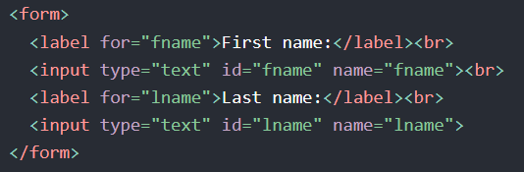
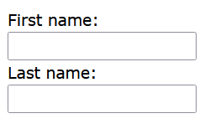
HTML | Input text
The <input type="text"> defines a single-line input field for text input.
The <label> tag defines a label for many form elements.
The <label> element also help users who have difficulty clicking on very small regions (such as radio buttons or checkboxes), because when the user clicks the text within the <label> element, it toggles the radio button/checkbox.
The for attribute of the <label> tag should be equal to the id attribute of the <input> element to bind them together.

Slide 22
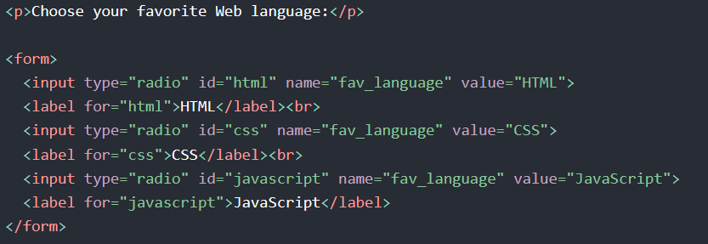
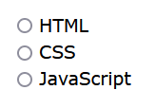
HTML | Input Radio Buttons
The <input type="radio"> defines a radio button.
Radio buttons let a user select ONE of a limited number of choices.

Slide 23
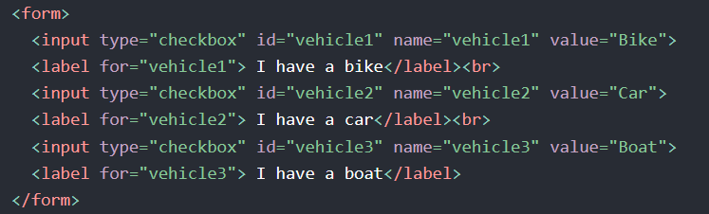
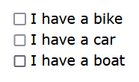
HTML | Input Checkboxes
The <input type="radio"> defines a radio button.
Radio buttons let a user select ONE of a limited number of choices.

Slide 24
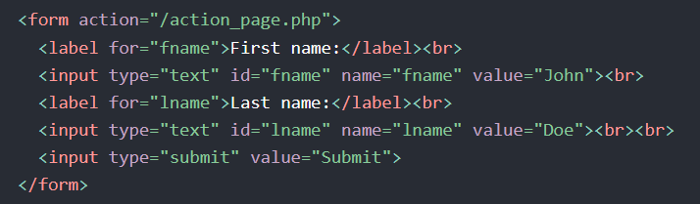
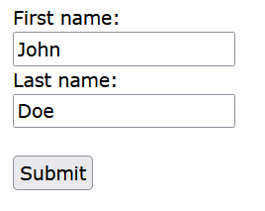
HTML | Submit Button
The <input type="submit"> defines a button for submitting the form data to a form-handler.
The form-handler is typically a file on the server with a script for processing input data.
The form-handler is specified in the form's action attribute.

Slide 25
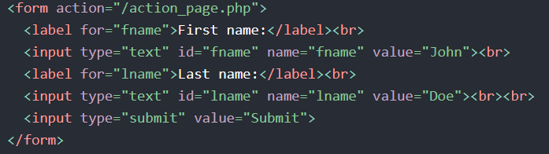
HTML | Action attribute
The action attribute defines the action to be performed when the form is submitted.
Usually, the form data is sent to a file on the server when the user clicks on the submit button.
In the example below, the form data is sent to a file called "action_page.php". This file contains a server-side script that handles the form data:
If the action attribute is omitted, the action is set to the current page.

Slide 26
HTML | Target attribute
The target attribute specifies where to display the response that is received after submitting the form.
The target attribute can have one of the following values:
Value | Description
_blank | The response is displayed in a new window or tab
_self | The response is displayed in the current window
_parent | The response is displayed in the parent frame
_top | The response is displayed in the full body of the window
framename | The response is displayed in a named iframe
The default value is _self

Slide 27
HTML | Method attribute
The method attribute specifies the HTTP method to be used when submitting the form data.
The form-data can be sent as URL variables (with method="get") or as HTTP post transaction (with method="post").
Notes on GET:
Appends the form data to the URL, in name/value pairs
NEVER use GET to send sensitive data!
The length of a URL is limited (2048 characters).
Useful for form submissions where a user wants to bookmark the result
GET is good for non-secure data, like query strings.
Notes on POST:
Appends the form data inside the body of the HTTP request.
POST has no size limitations, and can be used to send large amounts of data.
Form submissions with POST cannot be bookmarked.
The default value is _GET

Slide 28
HTML | all attribute
Attribute | Description
accept-charset | Specifies the character encodings used for form submission
action | Specifies where to send the form-data when a form is submitted
autocomplete | Specifies whether a form should have autocomplete on or off
enctype | Specifies how the form-data should be encoded when submitting it to the server (only for method="post")
method | Specifies the HTTP method to use when sending form-data
name | Specifies the name of the form
novalidate | Specifies that the form should not be validated when submitted
rel | Specifies the relationship between a linked resource and the current document
target | Specifies where to display the response that is received after submitting the form

Slide 29
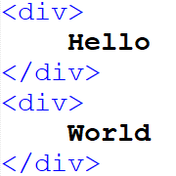
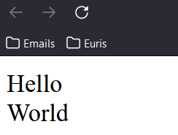
HTML | div Element
defines a division or a section in an HTML document.
is used as a container for HTML elements, which is then styled with CSS or manipulated with JavaScript.
is easily styled by using the class or id attribute.
any sort of content can be put inside it!
DISPLAY
BLOCK

Slide 30
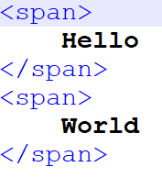
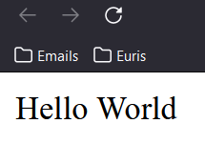
HTML | span Element
is an inline container used to mark up a part of a text, or a part of a document.
is easily styled by CSS or manipulated with JavaScript using the class or id attribute.
the <span> tag is much like the <div> element, but <div> is a block-level element and <span> is an inline element.

Slide 31

HTML | style Attribute
Setting the style of an HTML element, can be done with the style attribute.
The property is a CSS property.
The value is a CSS value.

Slide 32
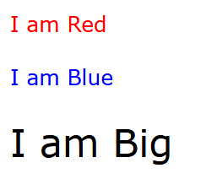

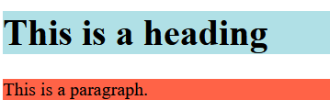
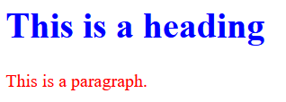

HTML | style Attribute
The HTML style attribute is used to add styles to an element, such as color, font, size, and more.

Slide 33
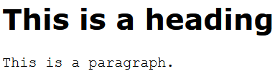
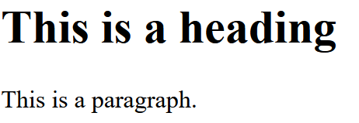

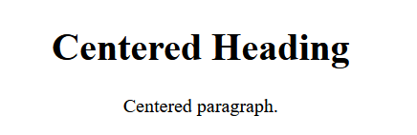

HTML | style Attribute
Background-color
Color
Font-family
Font-size
Text-align

Slide 34
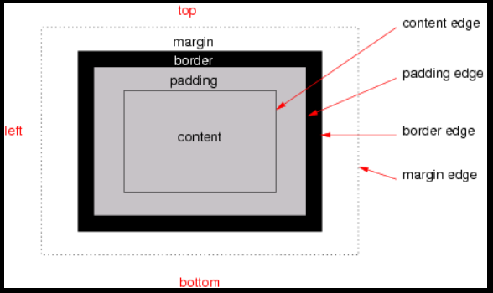
HTML | Boxing
Each box has a content area (which contains its content) and optional surrounding padding, border, and margin areas; the size of each area is specified by corresponding properties, and can be zero (or in the case of margins, negative).

Slide 35
HTML | Boxing
content edge or inner edge: the content edge surrounds the rectangle given by the width and height of the box, which often depend on the element’s content and/or its containing block size.
padding edge: the padding edge surrounds the box’s padding. If the padding has zero width on a given side, the padding edge coincides with the content edge on that side. The four sides of the padding edge together define the box’s padding box, which contains both the content and padding areas.
border edge the border edge surrounds the box’s border. If the border has zero width on a given side, the border edge coincides with the padding edge on that side. The four sides of the border edge together define the box’s border box, which contains the box’s content, padding, and border areas.
margin edge or outer edge: the margin edge surrounds the box’s margin. If the margin has zero width on a given side, the margin edge coincides with the border edge on that side. The four sides of the margin edge together define the box’s margin box, which contains the all of the box’s content, padding, border, and margin areas.

