Slide 1

CSS
Notes:
The World Wide Web became popular because ordinary people can use it to do really useful things with minimal training. But behind the scenes, the Web is also a powerful platform for distributed computing.
The principles that make the Web usable by ordinary people also work when the “user” is an automated software agent.
The Web is based on three technologies:
the URL naming convention,
the HTTP protocol,
HTML document format.
For now, I want to focus on URL and HTTP, and use HTML solely as an example.

Slide 2
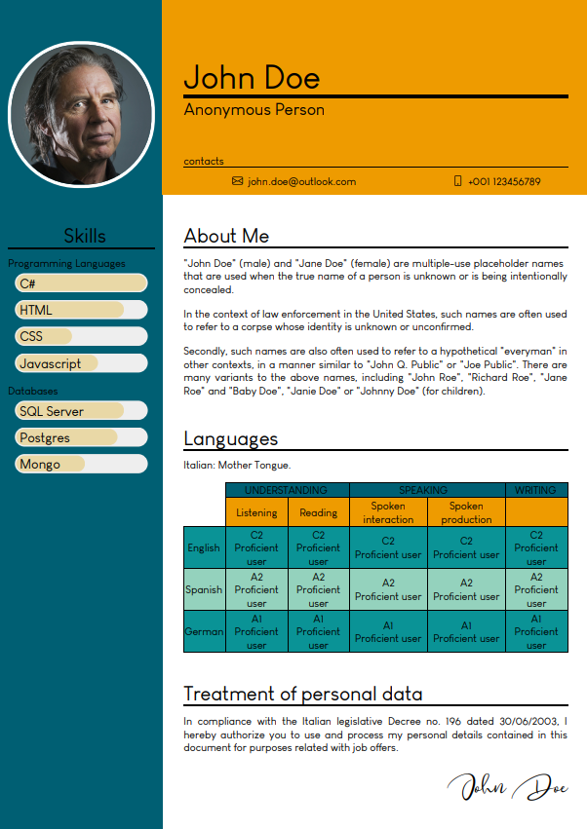
CSS | Curriculum Vitae

Slide 3
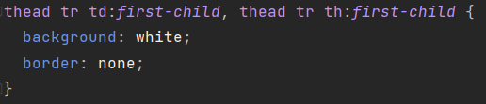

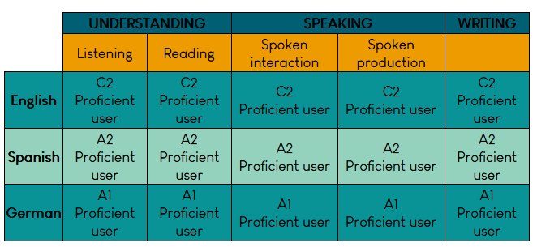



CSS | Advanced Selector
colspan=“2”

Slide 4
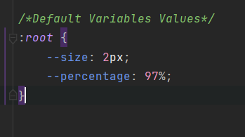
CSS | Variables
Declare Variable inside style element:
Use Variable in CSS file:
Default variables value

Slide 5
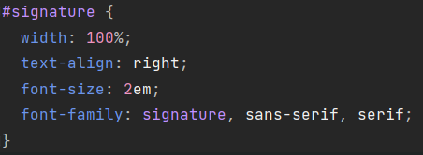


CSS | custom fonts
Web fonts allow Web designers to use fonts that are not installed on the user's computer.
Your "own" fonts are defined within the CSS @font-face rule.

Slide 6
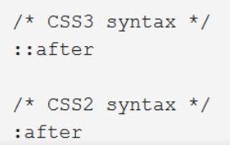

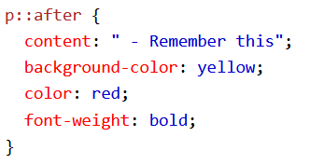
CSS | ::after ::before
The ::after selector inserts something after the content of each selected element(s).
The ::before selector inserts something before the content of each selected element(s).
Use the content property to specify the content to insert.

Slide 7

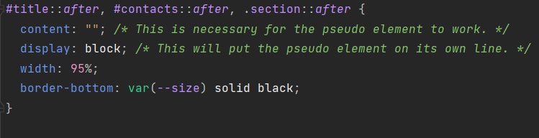

CSS | underline

Slide 8
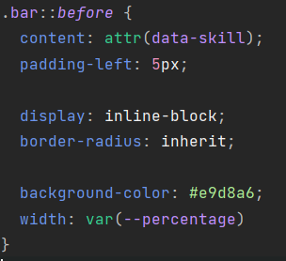

CSS | bar

Slide 9
CSS | repo
https://github.com/aviezzi/john-doe

