Slide 1

the WEB
Notes:
The World Wide Web became popular because ordinary people can use it to do really useful things with minimal training. But behind the scenes, the Web is also a powerful platform for distributed computing.
The principles that make the Web usable by ordinary people also work when the “user” is an automated software agent.
The Web is based on three technologies:
the URL naming convention,
the HTTP protocol,
HTML document format.
For now, I want to focus on URL and HTTP, and use HTML solely as an example.

Slide 2

the WEB: Agenda
Internet e WWW
Funzionamento
Tecnologie coinvolte
Architettura client-server
Principali protocolli
HTTP
Richieste e risposte
Status code
Struttura pagine web
Basi di HTML, CSS

Slide 3

the WEB
3 TECNOLOGIE
URL
Naming Convention
HTTP
Protocol
HTML
Document Format
Il Web è una potente e diffusa piattaforma per l'elaborazione distribuita
www: World Wide Web
URL: Uniform Resource Locator
HTTP: Hypertext Transfer Protocol
HTML: Hypertext Markup Language
Notes:
The World Wide Web became popular because ordinary people can use it to do really useful things with minimal training. But behind the scenes, the Web is also a powerful platform for distributed computing.
The principles that make the Web usable by ordinary people also work when the “user” is an automated software agent.
The Web is based on three technologies:
the URL naming convention,
the HTTP protocol,
HTML document format.
For now, I want to focus on URL and HTTP, and use HTML solely as an example.

Slide 4


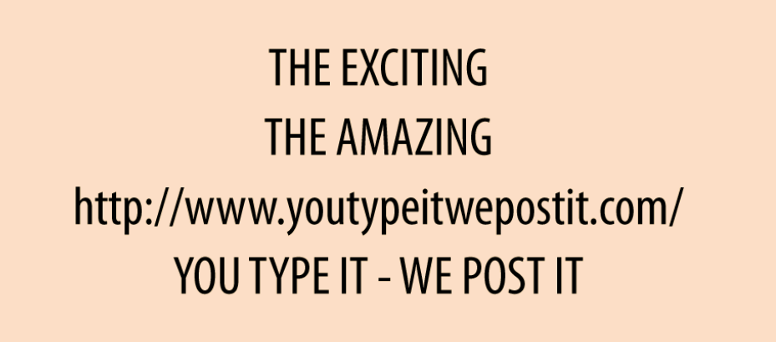
the WEB | Episode 1: the Billboard
Un giorno Alice passeggiando vede un poster.
Alice è una giovane donna e ricorda benissimo la metà degli anni '90 e la reazione del pubblico quando gli URL hanno fatto la loro prima apparizione sui cartelloni pubblicitari.
Inizialmente, le persone prendevano in giro questi bizzarri codici dall'aspetto strano.
Non era chiaro cosa significasse «http://"o"youtypeitwepostit.com»
Ma 30 anni dopo, tutti sanno cosa fare con un URL. Basta digitarlo nella barra degli indirizzi del tuo browser web e premere Invio.
Ed è quello che fa Alice: prende il cellulare e inserisce http://www.youtypeitwepostit.com/ nella barra degli indirizzi del browser.
?
Cosa c'è all'altra estremità di quell'URL?
Notes:
One day Alice is walking around town and she sees a billboard.
Alice is old enough to remember the mid-1990s, so she recalls the public’s reaction when URLs started showing up on billboards. At first, people made fun of these weird-looking strings. It wasn’t clear what “http://” or “youtypeitwepostit.com” meant. But 20 years later, everyone knows what to do with a URL: you type it into the address bar of your web browser and hit Enter.
And that’s what Alice does: she pulls out her mobile phone and puts http://www.youtypeitwepostit.com/ in her browser’s address bar. The first episode of our story ends on a cliffhanger: what’s at the other end of that URL?

Slide 5
the WEB | Resources
Il browser web di Alice sta per inviare una richiesta HTTP a un server web, in particolare all'URL http://www.youtypeitwepostit.com/.
Un server Web può ospitare molti URL diversi e ogni URL concede l'accesso a un bit diverso di dati sul server.
Un URL è l'URL di qualcosa: un prodotto, un utente, la home page.
Il termine tecnico per l'oggetto denominato da un URL è
RESOURCE
L'URL http://www.youtypeitwepostit.com/ identifica una risorsa, probabilmente la home page del sito web pubblicizzato sul poster.
Ma lo scopriremo solo quanto il browser web di Alice invierà la richiesta HTTP.
Notes:
Sorry for interrupting the story, but I need to introduce some basic terminology.
Alice’s web browser is about to send an HTTP request to a web server—specifically, to the URL http://www.youtypeitwepostit.com/. One web server may host many different URLs, and each URL grants access to a different bit of the data on the server.
We say that a URL is the URL of some thing: a product, a user, the home page. The technical term for the thing named by a URL is resource.
The URL http://www.youtypeitwepostit.com/ identifies a resource—probably the home page of the website advertised on the billboard. But you won’t know for sure until we resume the story and Alice’s web browser sends the HTTP request.

Slide 6

the WEB | Representations
CLIENT
(browser WEB)
REQUEST
SERVER
(resource)
RESPONSE
DOCUMENT
RAPRESENTAZIONE DELLA RISORSA
Ogni URL identifica una risorsa. Quando un client effettua una richiesta HTTP a un URL, ottiene una rappresentazione della risorsa sottostante.
Il client non vede mai una risorsa direttamente
Notes:
When a web browser sends an HTTP request for a resource, the server sends a document in response (usually an HTML document, but sometimes a binary image or something else).
Whatever document the server sends, we call that document a representation of the resource.
So each URL identifies a resource. When a client makes an HTTP request to a URL, it gets a representation of the underlying resource.
The client never sees a resource directly.

Slide 7
the WEB| Addressability Principle
Un URL identifica una e una sola risorsa.Se un sito Web contiene due elementi concettualmente diversi, ci aspettiamo che il sito li tratti come due risorse con URL diversi.Ci sentiamo frustrati quando un sito web viola questa regola.
PRINCIPIO DI INDIRIZZABLITÀ
=
Ogni risorsa dovrebbe avere il proprio URL
Se qualcosa è importante per la tua applicazione, dovrebbe avere un nome univoco, un URL, in modo che tu e i tuoi utenti possiate farvi riferimento senza ambiguità.
Notes:
A URL identifies one and only one resource.
If a website has two conceptually different things on it, we expect the site to treat them as two resources with different URLs.
We get frustrated when a website violates this rule.
The principle of addressability just says that every resource should have its own URL. If something is important to your application, it should have a unique name, a URL, so that you and your users can refer to it unambiguously.

Slide 8
the WEB | Episode 2: the Home Page
Invia una richiesta HTTP su Internet al server web all'indirizzo http://www.youtypeitwepostit.com/
That GET in the request is an HTTP method, also known as an HTTP verb.
The HTTP method is the client’s way of telling the server what it wants to do to a resource.
“GET” is the most common HTTP method. It means “give me a representation of this resource.” For a web browser, GET is the default.
Alice inserisce l’URL che legge sul cartellone pubblicitario nella barra degli indirizzi del suo browser.
GET / HTTP/1.1
www.youtypeitwepostit.com/
Notes:
Back to our story.
When Alice enters the URL from the billboard into her browser’s address bar, it sends an HTTP request over the Internet to the web server at http://www.youtypeitwepostit.com/:
GET / HTTP/1.1
Host: www.youtypeitwepostit.com

Slide 9
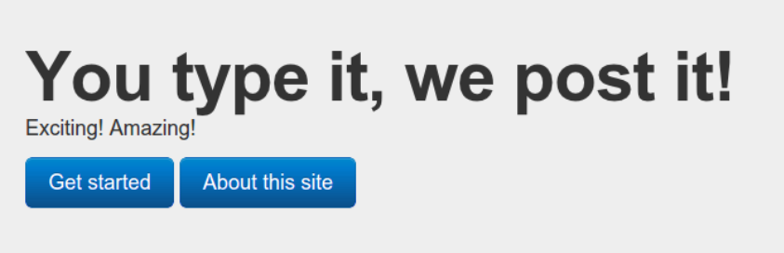
the WEB | Episode 2: response
The web server handles this request (neither Alice nor her web browser need to know how) and sends a response:
HTTP/1.1 200 OK
Content-type: text/html
<!DOCTYPE html>
<html>
<head>
<title>Home</title>
</head>
<body>
<div>
<h1>You type it, we post it!</h1>
<p>Exciting! Amazing!</p>
<p class="links">
<a href="/messages">Get started</a>
<a href="/about">About this site</a>
</p>
</div>
</body>
</html>
The 200 at the beginning of the response is a status code, also called a response code. It’s a quick way for the server to tell the client approximately what happened to the client’s request. 200 (OK) means that the request was fulfilled with no problems.

Slide 10
the WEB | statelessness
HTTP sessions last for one request. The client sends a request, and the server responds.
Alice could leave this web page open in her phone for six months, and when she finally clicks on a link, the web server would respond as if she’d only waited a few seconds. The web server isn’t sitting up late at night worrying about Alice. When she’s not making an HTTP request, the server doesn’t know Alice exists.
This principle is sometimes called statelessness.
The term “statelessness” is getting at the fact that the server doesn’t care what state the client is in

Slide 11
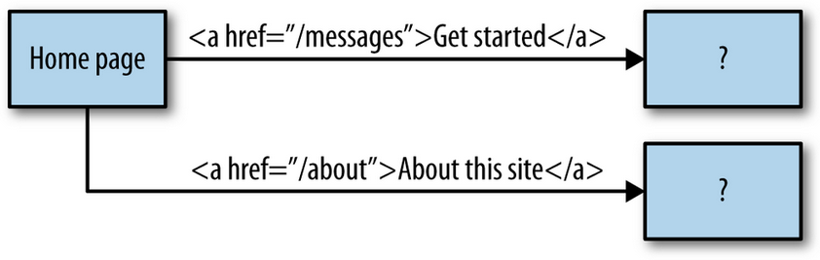
the WEB | self descriptive messages
It’s clear from looking at the HTML that this site is more than just a home page.
The markup for the home page contains two links:
/about (i.e., to http://www.youtypeitwepostit.com/about)
/messages (i.e., http://www.youtypeitwepostit.com/messages).
The server is slowly revealing its structure to her.
What’s on the other end of the /messages and /about links?
The only way to be sure is to follow them and find out.
When you request a web page, the HTML document you receive doesn’t just give you the immediate information you asked for.
The document also helps you answer the question of what to do next.

Slide 12
the WEB | Episode 3: the Link
Of course, whenever you click a link in your web browser, you’re telling your web browser to make an HTTP request.
That GET in the request is an HTTP method, also known as an HTTP verb.
The HTTP method is the client’s way of telling the server what it wants to do to a resource.
“GET” is the most common HTTP method. It means “give me a representation of this resource.” For a web browser, GET is the default.
Alice clicks the link that says “Get started.”
GET / HTTP/1.1
www.youtypeitwepostit.com/messages

Slide 13
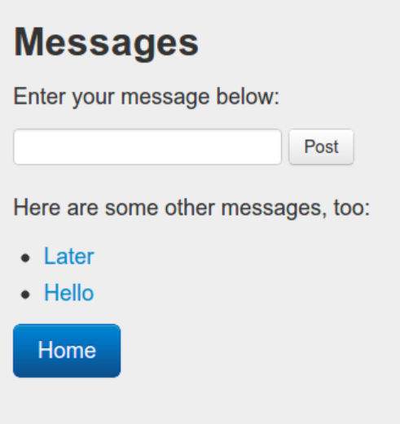
the WEB | Episode 3: response
HTTP/1.1 200 OK
Content-type: text/html
<!DOCTYPE html>
<html>
<head>
<title>Messages</title>
</head>
<body>
<div>
<h1>Messages</h1>
<p> Enter your message below: </p>
<form action="http://youtypeitwepostit.com/messages" method="post">
<input type="text" name="message" value="" required="true“ maxlength="6"/>
<input type="submit" value="Post" />
</form>
<div>
<p>Here are some other messages, too:</p>
<ul>
<li><a href="/messages/32740753167308867">Later</a></li>
<li><a href="/messages/7534227794967592">Hello</a></li>
</ul>
</div>
<p class="links"><a href="http://youtypeitwepostit.com/">Home</a></p>
</div>
</body>
</html>

Slide 14
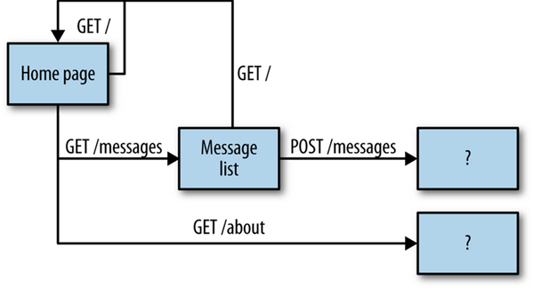
the WEB | Episode 3: APPLICATION STATE
Now we’ve revealed a little more about how the server works

Slide 15
the WEB | Episode 4: the From
Back to our story. Alice is tempted by the form on the microblogging site. She types in “Test” and clicks the Post button
Here’s a bit of HTML in the latest representation that will trigger an HTTP POST request if Alice clicks the Post button.
The HTTP standard (RFC 2616) defines eight methods a client can apply to a resource. focus on five of them: GET, HEAD, POST, PUT, and DELETE.
POST /messages HTTP/1.1
www.youtypeitwepostit.com/messages
Content-type: application/x-www-form-urlencoded
message=Test&submit=Post

Slide 16
the WEB | Episode 4: redirect
Status code 303 tells Alice’s browser to automatically make a fourth HTTP request, to the URL given in the Location header. Without asking Alice’s permission, her browser does just that:
HTTP/1.1 303 See Other
Content-Type: text/html http://www.youtypeitwepostit.com/messages/1
GET /messages/1 HTTP/1.1
www.youtypeitwepostit.com/

Slide 17
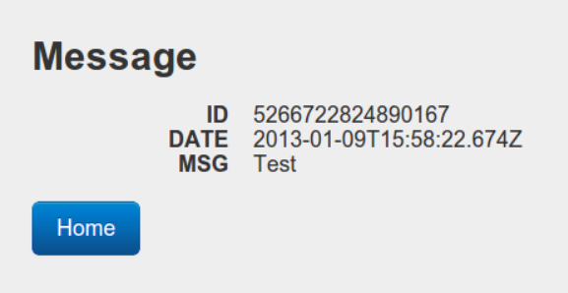
the WEB | Episode 4: response
HTTP/1.1 200 OK
Content-type: text/html
<!DOCTYPE html>
<html>
<head>
<title>Message</title>
</head>
<body>
<div>
<h2>Message</h2>
<dl>
<dt>ID</dt><dd>2181852539069950</dd>
<dt>DATE</dt><dd>2014-03-28T21:51:08Z</dd>
<dt>MSG</dt><dd>Test</dd>
</dl>
<p class="links">
<a href="http://www.youtypeitwepostit.com/">Home</a>
</p>
</div>
</body>
</html>

Slide 18
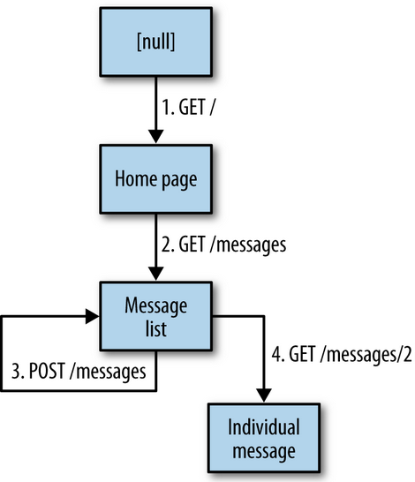
the WEB | Episode 4: APPLICATION STATE
Every state in this diagram corresponds to a particular page (or to no page at all) being open in Alice’s browser window.
In REST terms, we call this bit of information
APPLICATION STATE.

Slide 19
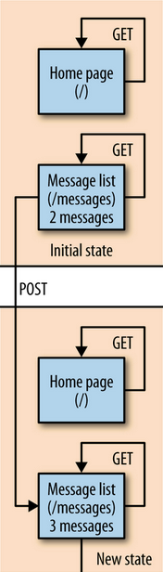
the WEB | Episode 4: RESOURCE STATE
The server manages two resources: the home page (served from /) and the message list (served from /messages). The state of these resources is called, simply enough, resource state.
When the story begins, there are two messages in the message list: “Hello” and “Later.”
Sending a GET to the home page doesn’t change resource state
Sending a GET to the message list won’t change the state either.
But when Alice sends a POST to the message list, it puts the server in a new state.
Now the message list contains three messages. As before, sending a GET to the home page or message list won’t change anything.
But sending another POST to the message list will add a fourth message to the list.

Slide 20
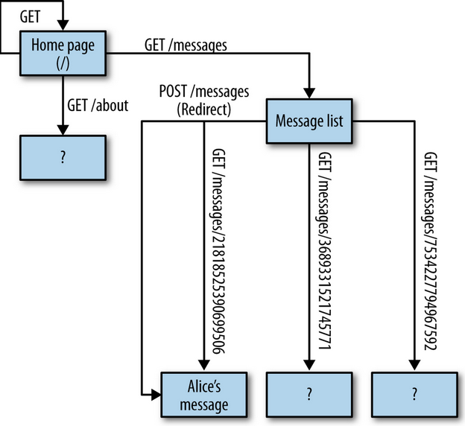
the WEB | HATEOAS
In the story, Alice made four HTTP requests, and she got three HTML documents in return.
Although Alice didn’t follow every single link in those documents, we can use those links to build a rough map of the website from the client’s perspective
Each web page tells you how to get to the adjoining pages which is better known as
“hypermedia as the engine of application state,”

Slide 21
the WEB | HYPERMEDIA
Hypermedia
Is the techniques a server uses to explain to a client what it can do next.
HTML is an example of Hypermedia, another example can be JSON.

Slide 22

the WEB | REQUEST
HTTP VERB
HTTP defines a set of request methods to indicate the desired action to be performed for a given resource.
TARGET URL
http://www.mystie.com/
REQUEST HEADER These are a series of key-value pairs describing the entity-body and the HTTP response in general.
ENTITY BODY This is a document written in some data format, which the client is expected to understand
REQUEST
The most important HTTP header is:
Content-Type: which tells the HTTP client how to understand the entity-body.
We say the value of the Content-Type header is the entity-body’s media type.
It’s also called the “MIME type” or “media type”.

Slide 23
the WEB | RESPONSE
STATUS CODE
This is a three-digit number that summarizes how the request went. The response code is the first thing an API client sees, and it sets the tone for the rest of the response. Here, the status code was 200 (OK)
RESPONSE
RESPONSE HEADER
These are a series of key-value pairs describing the entity-body and the HTTP response in general.
ENTITY BODY This is a document written in some data format, which the client is expected to understand

Slide 24
the WEB | FAMILIES OF STATUS CODES
1xx
2xx
3xx
4xx
5xx
Informational: these response codes are used only in negotiations between an HTTP client and server.
Successful: whatever state transition the client asked for has happened.
Redirection: the state transition the client asked for has not happened. But if the client is willing to make a slightly different HTTP request, that request should do what the client is asking for.
Client Error: the state transition the client has asked for has not happened, due to a problem with the HTTP request. The request was malformed, incoherent, self-contradictory, or one that the server cannot accept.
Server Error: the state transition the client has asked for has not happened, due to a problem on the server side. There’s probably nothing the client can do but wait for the problem to be fixed.

Slide 25
the WEB | REST
REST is not a protocol.
It’s a set of design constraints: statelessness, hypermedia as the engine of application state, and so on.
Collectively, we call these the Fielding Constraints
Underlying the three web technologies URL, HTTP, HTML are two essential concepts: resources and representations.

Slide 26
the WEB | RESOURCE
A resource is anything that’s important enough to be referenced as a thing in itself, is usually something that can be stored on a computer.
The only restriction is that every resource must have a URL.
Giving something a URL turns it into a resource.
The client never sees a resource. All it ever sees are URLs and representations.

Slide 27
the WEB | REPRESENTATION
When a client issues a GET request for a resource, the server should serve a document that captures the resource in a useful way.
That’s a representation a machine-readable explanation of the current state of a resource.
A representation can be any machine-readable document containing any information about a resource.

Slide 28

the WEB | BACK AND FORTH: GET
The client then sent an HTTP GET request, asking for a representation of the new entry:
GET /messages/1 HTTP/1.1
www.youtypeitwepostit.com/
HTTP/1.1 200 OK
Content-Type: application/json
body: { “Messgae” : “Ciao” }
The server responded with a representation in application/json format.

Slide 29
the WEB | BACK AND FORTH: POST
The one the client sent to the server in the first place, along with the POST request. That was also an application/vnd.collection+json document,
POST /messages HTTP/1.1
www.youtepyitwepostot.com/
Content-Type: application/x-www-form-urlencoded
body: { “Message” : “Ciao” }
HTTP/1.1 301 OK
Content-Type: text/html
body: <div>Ciao</div>
The server responded with a representation in application/json format.

Slide 30
the WEB | PROTOCOL SEMANTIC
In a RESTful system, clients and servers interact only by sending each other messages that follow a predefined protocol.
The HTTP standard defines eight different kinds of messages. These four are the most commonly used:
GET
DELETE
POST
PUT
PATCH
Get a representation of this resource.
Destroy this resource.
Create a new resource underneath this one, based on the given representation.
Replace this state of this resource with the one described in the given representation.
Modify part of the state of this resource based on the given representation.

Slide 31
the WEB | PROTOCOL SEMANTIC
These two methods are mostly used as a client explores an API:
HEAD
OPTIONS
Discover which HTTP methods this resource responds to.
Get the headers that would be sent along with a representation of this resource, but not the representation itself.

Slide 32

the WEB | SAFE & IDEMPOTENT
SAFE: Method that not has effect on resource state
IDEMPOTENT: Multiplying by 1 is a safe operation, the way HTTP GET is supposed to be safe. You can multiply a number by 1 all day long, and nothing will change.
Every safe operation is also idempotent.

Slide 33
the WEB | GET VERB
It’s just a request for information.
Sending a GET request to the server should have the same effect on resource state as not sending a GET request, a client should never make a GET request hoping that it will change the resource state.
COMMON REPONSE: The most common response code to a GET request is 200 (OK). Redirect codes like 301 (Moved Permanently) are also common.
SAFE
IDEMPOTENT

Slide 34
the WEB | POST VERB
The client wants the server to destroy the resource and never refer to it again. Of course, the server is not obliged to delete something it doesn’t want to.
If a DELETE request succeeds, the possible status codes are 204 (No Content, i.e., “it’s deleted, and I don’t have anything more to say about it”), 200 (OK, i.e., “it’s deleted, and here’s a message about that”); and 202 (Accepted, i.e., “I’ll delete it later”).
If a client tries to GET a resource that has been DELETEd, the server will return an error response code, usually 404 (Not Found) or 410 (Gone):
IDEMPOTENT

Slide 35
the WEB | POST-to-append VERB
POST is the other HTTP method you’ve surely used before.
The POST method has two jobs, which I’ll cover separately.
The first is POST-to-append, in which sending a POST request to a resource creates a new resource underneath it.
When a client sends a POST-to-append request, it sends a representation of the resource it wants to create in the request’s entity-body.
COMMON REPONSE: The most common response code to a GET request is 200 (OK). Redirect codes like 301 (Moved Permanently) are also common.

Slide 36
the WEB | PUT VERB
A PUT request is a request to modify resource state.
The client takes the representation it got from a GET request, modifies it, and sends it back as the payload of a PUT request.
The most common response code to a POST-to-append request is 201 (Created). It lets the client know that a new resource was created. The Location header lets the client know the URL to this new resource. Another common response code is 202 (Accepted), which means that the server intends to create a new resource based on the given representation, but hasn’t actually created it yet.
IDEMPOTENT

Slide 37
the WEB | PATCH VERB
Representations can get really big. “Modify the representation and PUT it back” is a simple rule, but if you just want to change one little bit of resource state, it can be pretty wasteful.
The PATCH method allows for this.
Instead of PUTting a full representation, you can create a special “diff” representation and send it to the server as the payload of a PATCH request.

Slide 38
the WEB | HEAD VERB
HEAD is a safe method. In fact, it’s best to think of HEAD as a lightweight version of GET.
The server is supposed to treat a HEAD request exactly the same as a GET request, but send the HTTP status code and the headers:
SAFE
IDEMPOTENT

Slide 39
the WEB | OPTION VERB
OPTIONS is a primitive discovery mechanism for HTTP. The response to an OPTIONS request contains the HTTP Allow header, which lays out which HTTP methods the resource supports.
SAFE
IDEMPOTENT

Slide 40
the WEB | THE END

