Slide 1

CSS
Notes:
The World Wide Web became popular because ordinary people can use it to do really useful things with minimal training. But behind the scenes, the Web is also a powerful platform for distributed computing.
The principles that make the Web usable by ordinary people also work when the “user” is an automated software agent.
The Web is based on three technologies:
the URL naming convention,
the HTTP protocol,
HTML document format.
For now, I want to focus on URL and HTTP, and use HTML solely as an example.

Slide 2
CSS | What is?
CSS stands for Cascading Style Sheets
CSS describes how HTML elements are to be displayed on screen, paper, or in other media
CSS saves a lot of work. It can control the layout of multiple web pages all at once
External stylesheets are stored in CSS files

Slide 3
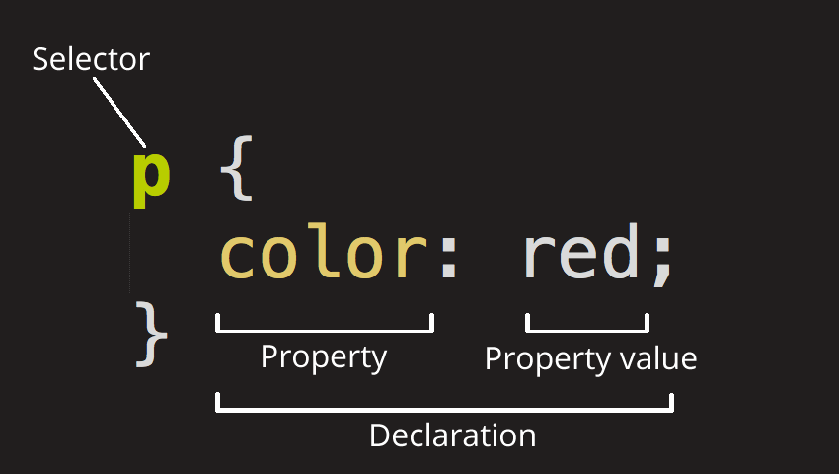
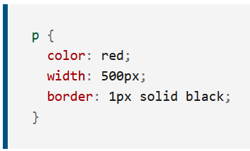
CSS | Anatomy
Selector
This is the HTML element name at the start of the ruleset. It defines the element(s) to be styled (in this example, <p> elements). To style a different element, change the selector.
Declaration
This is a single rule like color: red;. It specifies which of the element's properties you want to style.
Properties
These are ways in which you can style an HTML element. (In this example, color is a property of the <p> elements.) In CSS, you choose which properties you want to affect in the rule.
Property value
To the right of the property—after the colon—there is the property value. This chooses one out of many possible appearances for a given property. (For example, there are many color values in addition to red.)

Slide 4
CSS | Add to HTML page
There are three ways of inserting a style sheet:
External CSS
Internal CSS
Inline CSS

Slide 5
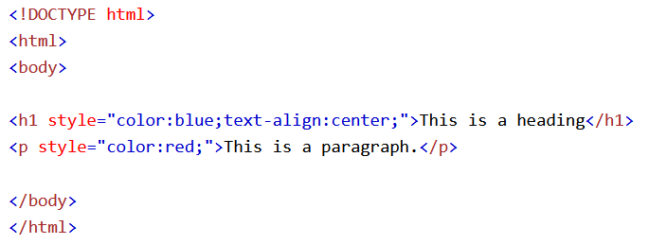
CSS | Inline CSS
An inline style may be used to apply a unique style for a single element.
To use inline styles, add the style attribute to the relevant element.
The style attribute can contain any CSS property.

Slide 6
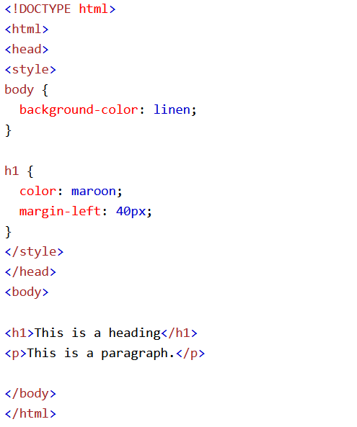
CSS | Internal CSS
An internal style sheet may be used if one single HTML page has a unique style.
The internal style is defined inside the <style> element, normally inside the head section.

Slide 7
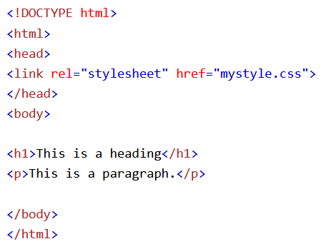
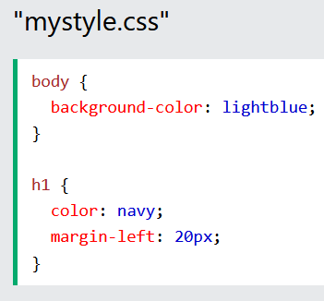
CSS | External CSS
With an external style sheet, you can change the look of an entire website by changing just one file!
Each HTML page must include a reference to the external style sheet file inside the <link> element, inside the head section.

Slide 8
CSS | Multiple Style Sheets
If some properties have been defined for the same selector (element) in different style sheets, the value from the last read style sheet will be used.
What style will be used when there is more than one style specified for an HTML element?
All the styles in a page will "cascade" into a new "virtual" style sheet by the following rules, where number one has the highest priority:
Inline style (inside an HTML element)
External and internal style sheets (in the head section)
Browser default
So, an inline style has the highest priority, and will override external and internal styles and browser defaults.

Slide 9
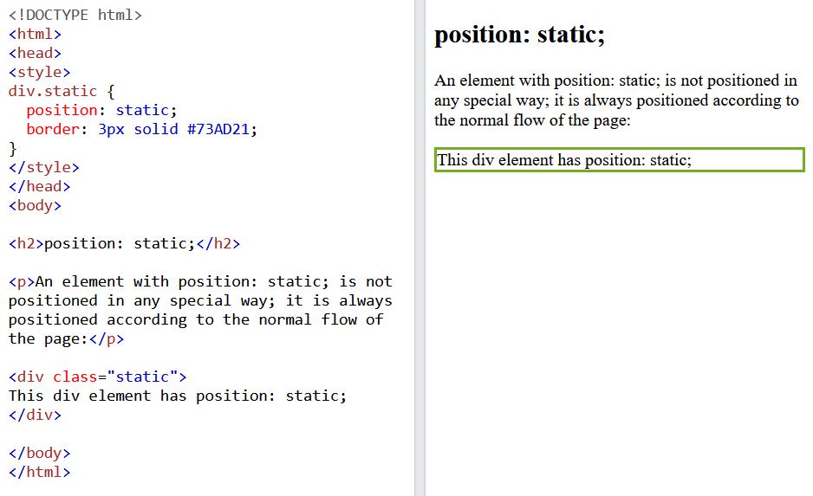
CSS | Position static

Slide 10
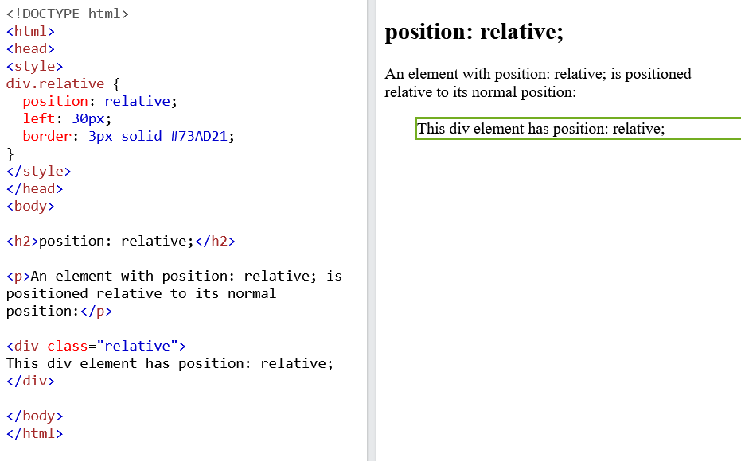
CSS | Position relative

Slide 11
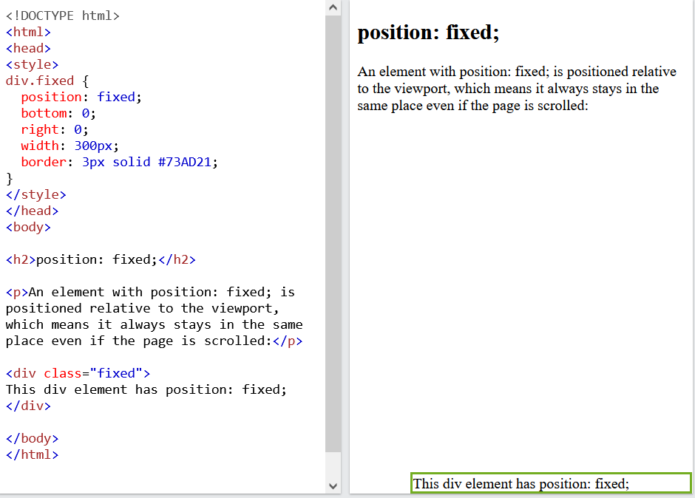
CSS | Position fixed

Slide 12
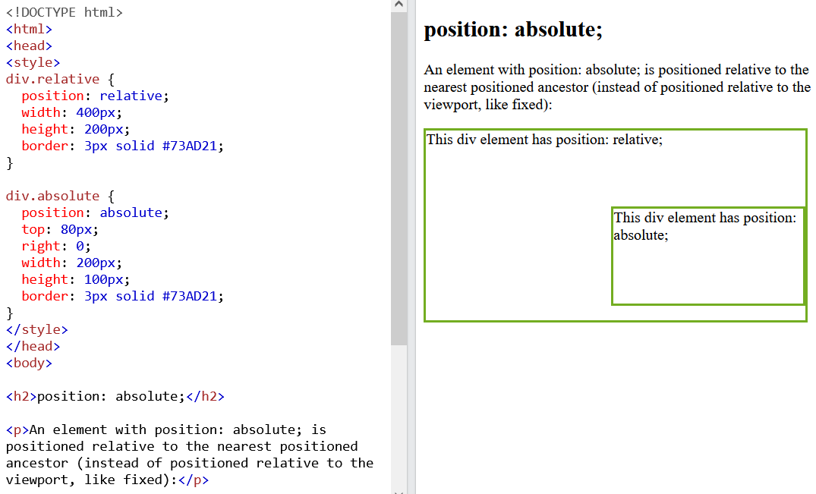
CSS | Position absolute

Slide 13
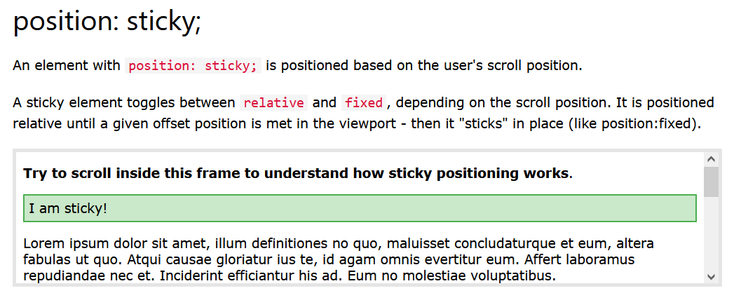
CSS | Position sticky

Slide 14
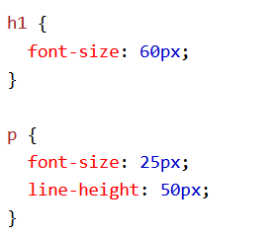
CSS | Unit
CSS has several different units for expressing a length.
Many CSS properties take "length" values, such as width, margin, padding, font-size, etc.
Length is a number followed by a length unit, such as 10px, 2em, etc.
https://www.w3schools.com/css/css_units.asp

Slide 15
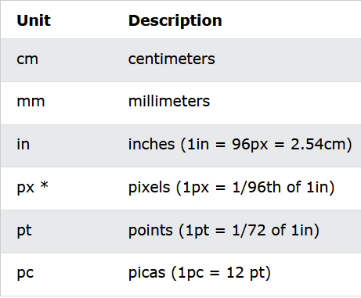
CSS | Absolute lengths
The absolute length units are fixed and a length expressed in any of these will appear as exactly that size.
Absolute length units are not recommended for use on screen, because screen sizes vary so much. However, they can be used if the output medium is known, such as for print layout.

Slide 16
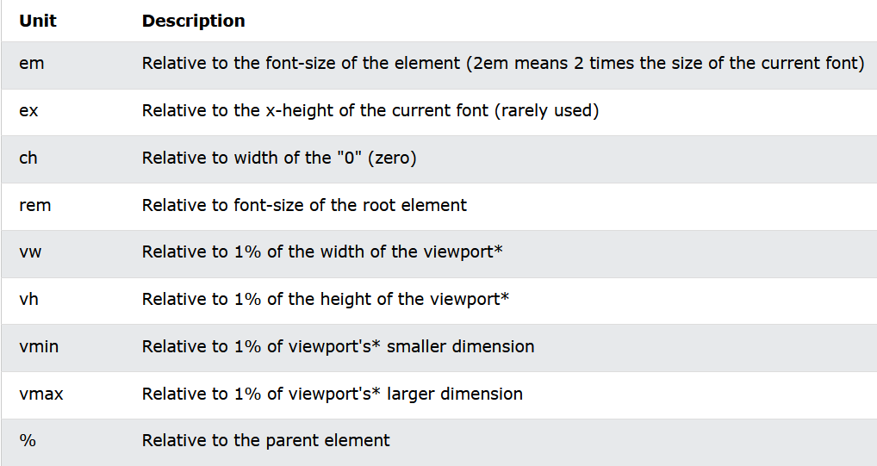
CSS | Relatives lengths
Relative length units specify a length relative to another length property. Relative length units scales better between different rendering mediums.
CSS Viewport is defined as the visible area on a window screen which refers to the displays of the mobile devices.

Slide 17
CSS | Selectors
CSS selectors are used to "find" (or select) the HTML elements you want to style.
We can divide CSS selectors into FIVE categories:
Type | Description
Simple selectors | select elements based on name, id, class
Combinator selectors | select elements based on a specific relationship between them
Pseudo class selectors | select elements based on a certain state
Pseudo-elements selectors | select and style a part of an element
Attributes selectors | select elements based on an attribute or attribute value

Slide 18
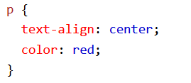
CSS | Element selectors
SIMPLE
SELECTOR
The element selector selects HTML elements based on the element name.

Slide 19
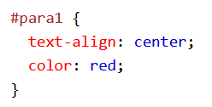
CSS | Id selectors
SIMPLE
SELECTOR
The id selector uses the id attribute of an HTML element to select a specific element.
The id of an element is unique within a page, so the id selector is used to select one unique element.
To select an element with a specific id, write a hash (#) character, followed by the id of the element.

Slide 20
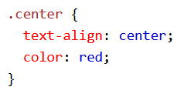
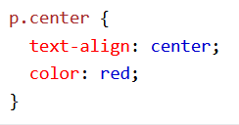
CSS | Class selectors
SIMPLE
SELECTOR
The class selector selects HTML elements with a specific class attribute.
To select elements with a specific class, write a period (.) character, followed by the class name.
You can also specify that only specific HTML elements should be affected by a class.

Slide 21
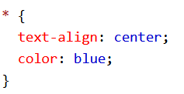
CSS | Universal selectors
SIMPLE
SELECTOR
The universal selector (*) selects all HTML elements on the page.

Slide 22
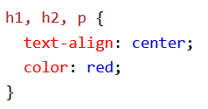
CSS | Grouping selectors
SIMPLE
SELECTOR
The universal selector (*) selects all HTML elements on the page.

Slide 23
CSS | Combinator selectors
COMBINATOR
SELECTOR
A CSS selector can contain more than one simple selector. Between the simple selectors, we can include a combinator.
There are four different combinators in CSS:
descendant selector (space)
child selector (>)
adjacent sibling selector (+)
general sibling selector (~)

Slide 24
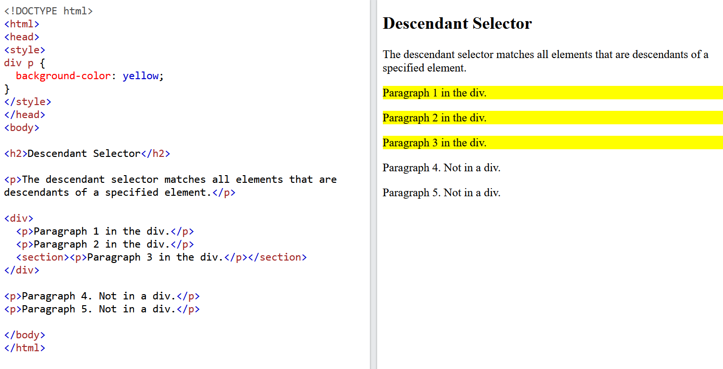
CSS | Descendent Selector
COMBINATOR
SELECTOR
Desc
Selector

Slide 25
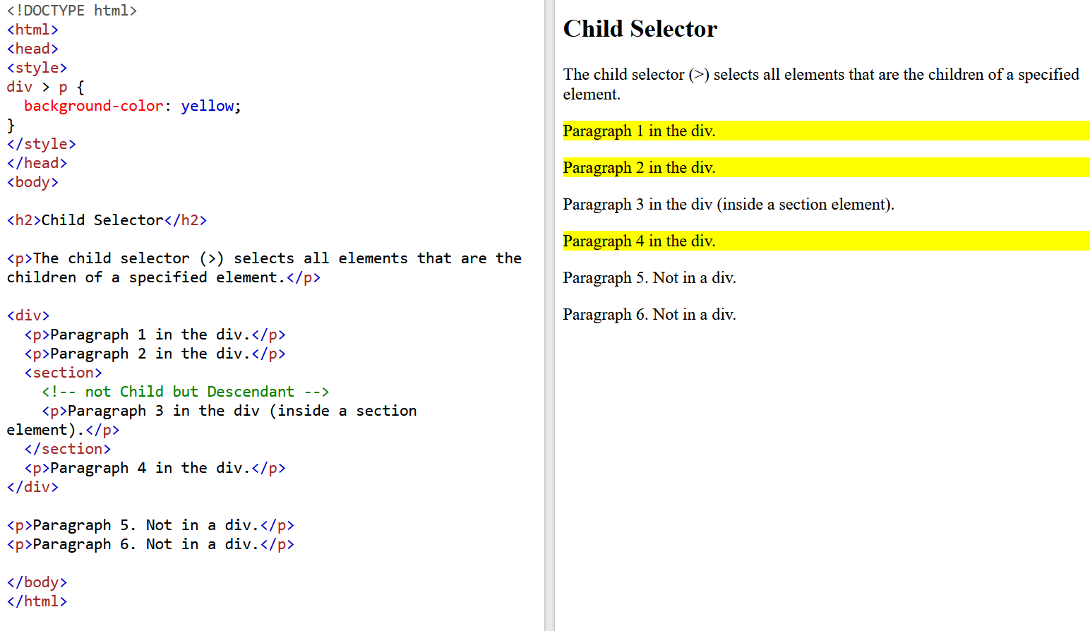
CSS | Child Selector
COMBINATOR
SELECTOR
Desc
Selector

Slide 26
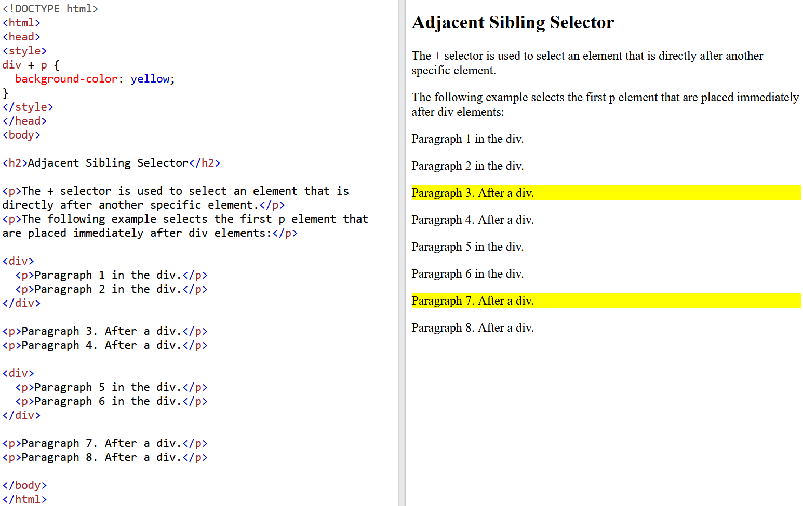
CSS | Adjacent Sibling Selector (+)
Desc
Selector
COMBINATOR
SELECTOR

Slide 27
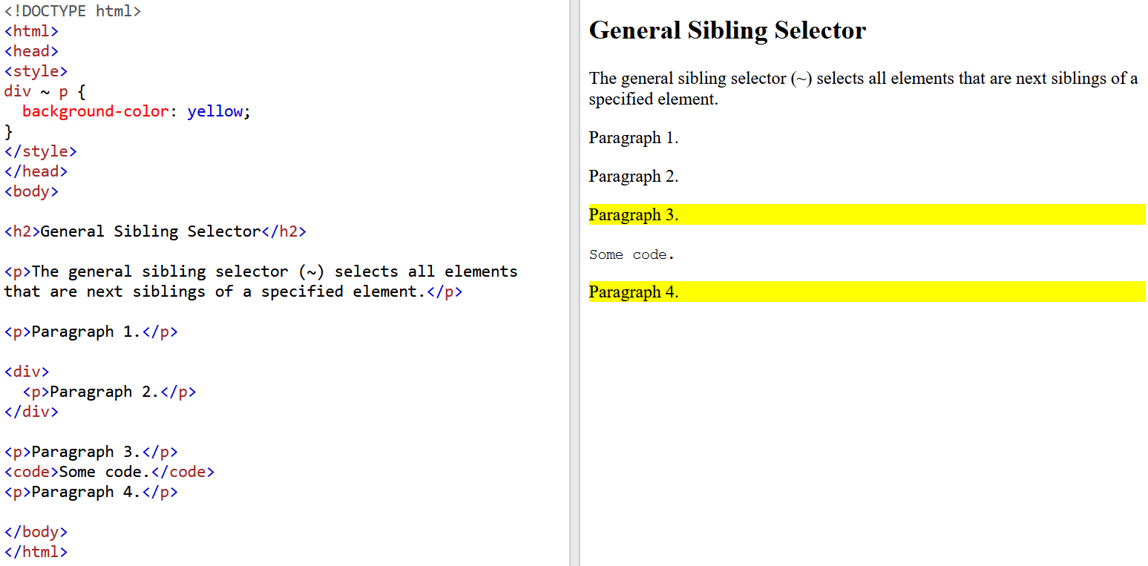
CSS | General Sibling Selector (~)
Desc
Selector
COMBINATOR
SELECTOR

Slide 28
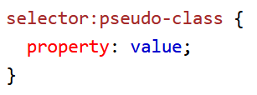
CSS | Pseudo Classes Selector
A pseudo-class is used to define a special state of an element.
For example, it can be used to:
Style an element when a user mouses over it
Style visited and unvisited links differently
Style an element when it gets focus
Syntax:
PSEUDO CLASSES SELECTOR
https://www.w3schools.com/css/tryit.asp?filename=trycss_pseudo-class_links

Slide 29
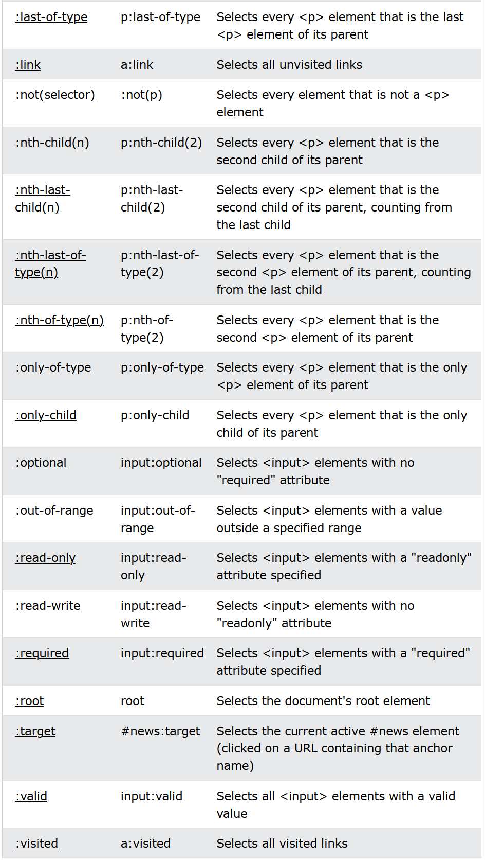
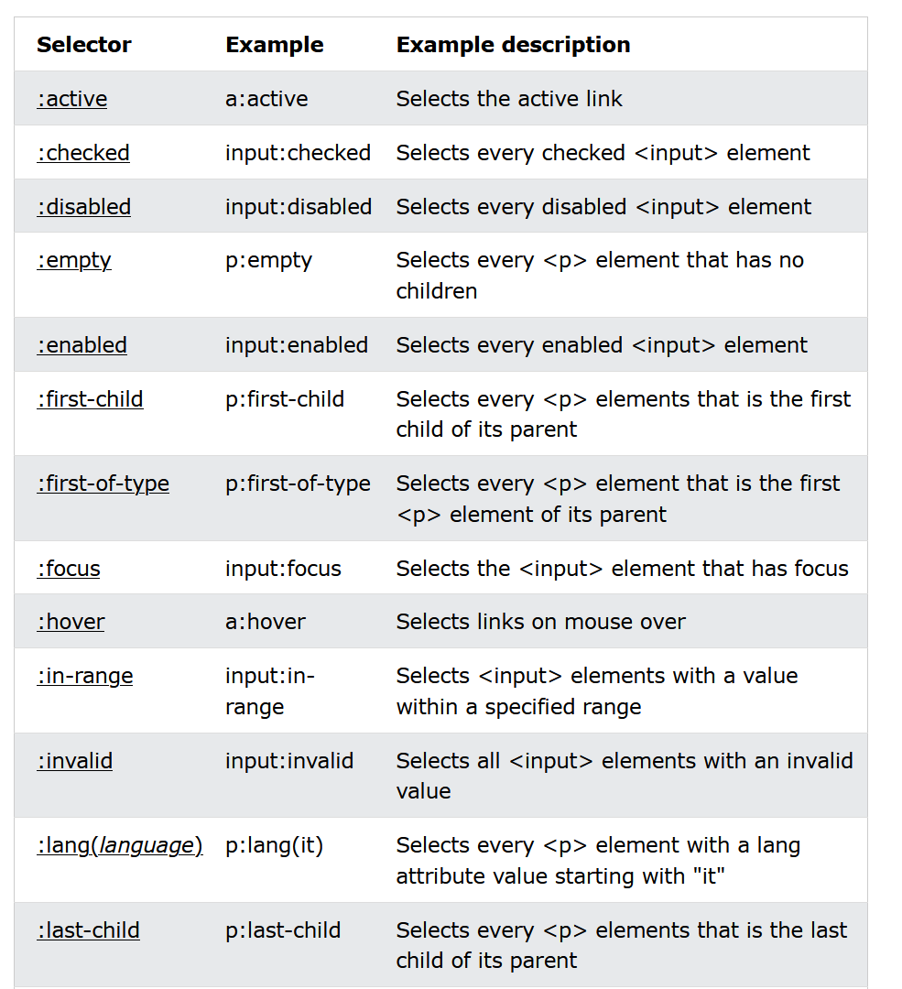
CSS | All Pseudo Classes
PSEUDO ELEMENT SELECTOR

Slide 30
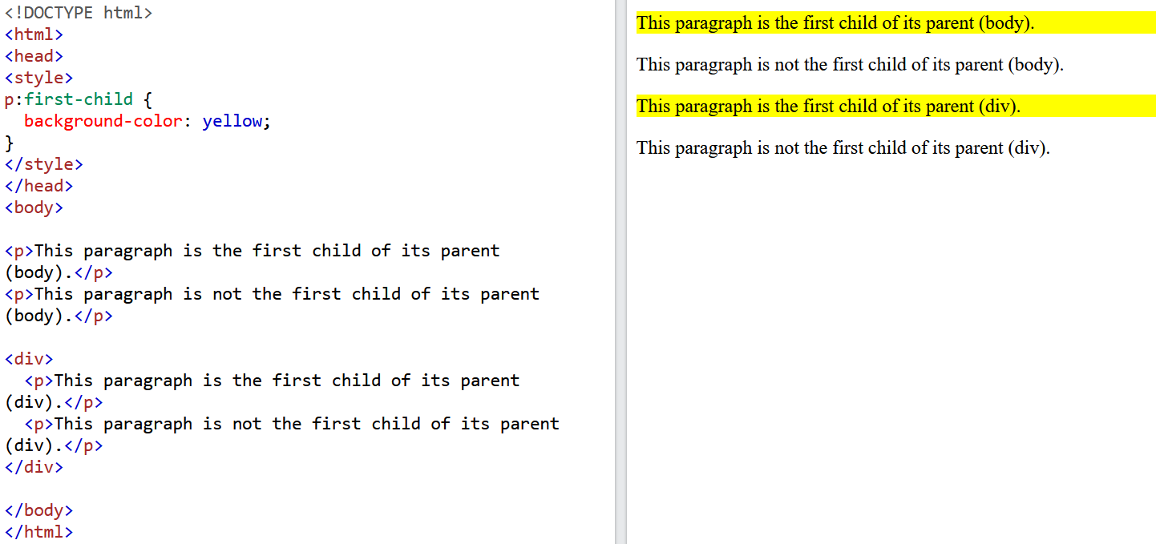
CSS | :first-child
Desc
Selector
PSEUDO CLASSES SELECTOR

Slide 31
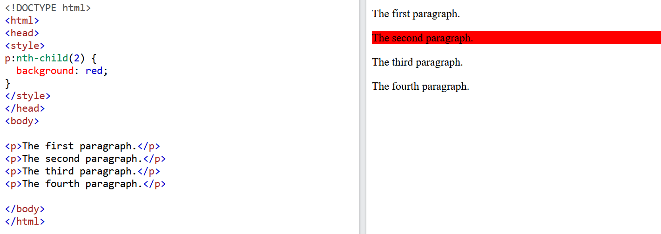
CSS | ::nth-child
Desc
Selector
PSEUDO CLASSES SELECTOR

Slide 32
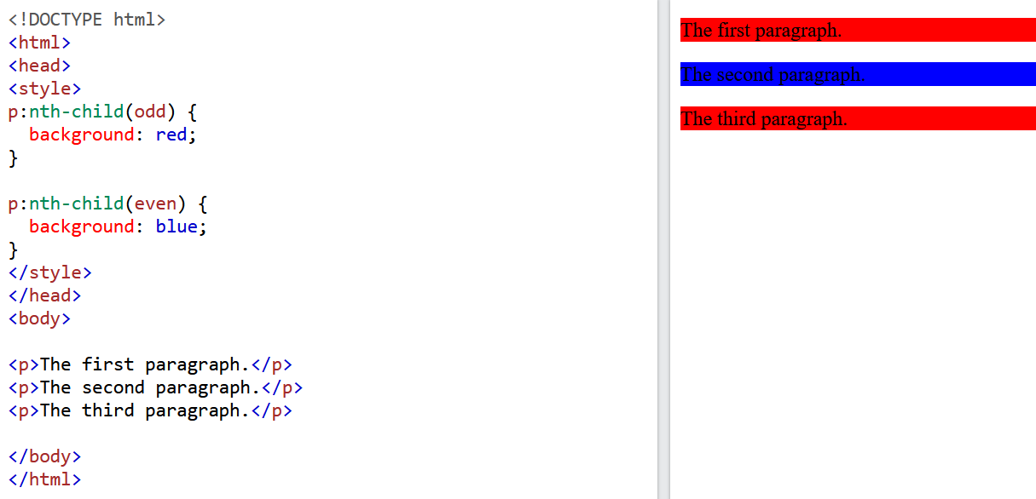
CSS | ::nth-child – odd & even
ODD
EVEN
Selector
ODD
Selector
PSEUDO CLASSES SELECTOR

Slide 33
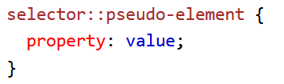
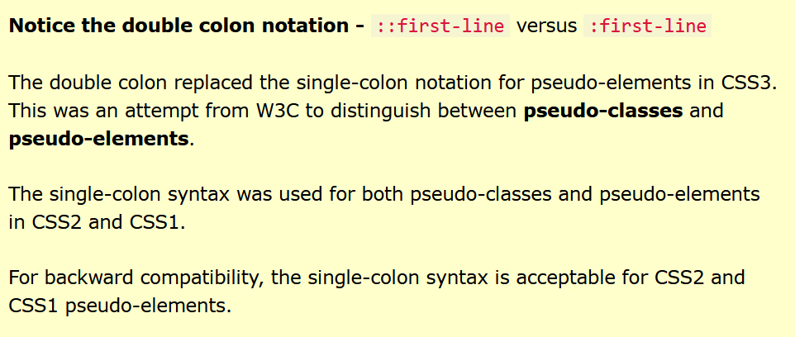
CSS | Pseudo Element Selector
PSEUDO ELEMENT SELECTOR
A CSS pseudo-element is used to style specified parts of an element.
For example, it can be used to:
Style the first letter, or line, of an element
Insert content before, or after, the content of an element
Syntax:

Slide 34
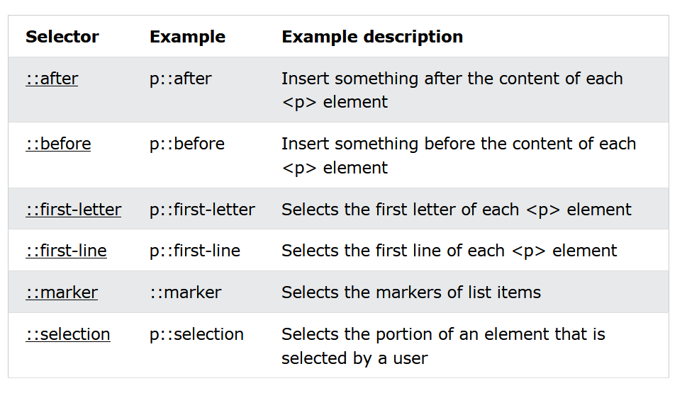
CSS | All Pseudo Elements
PSEUDO ELEMENT SELECTOR

Slide 35
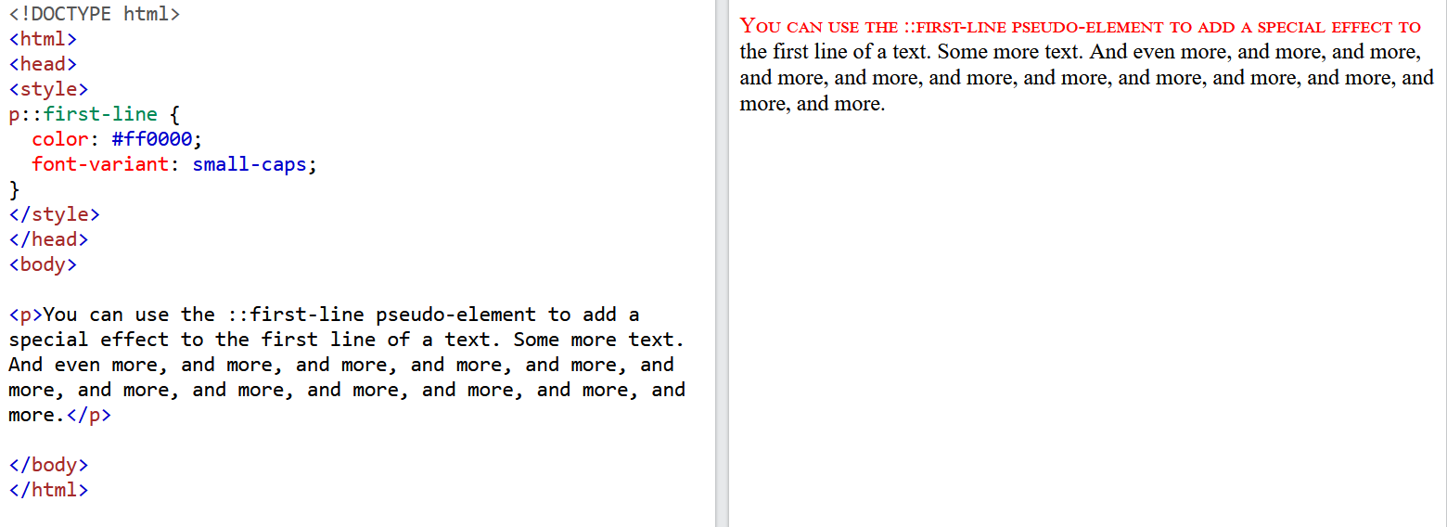
CSS | ::first-line
Desc
Selector
PSEUDO ELEMENT SELECTOR

Slide 36
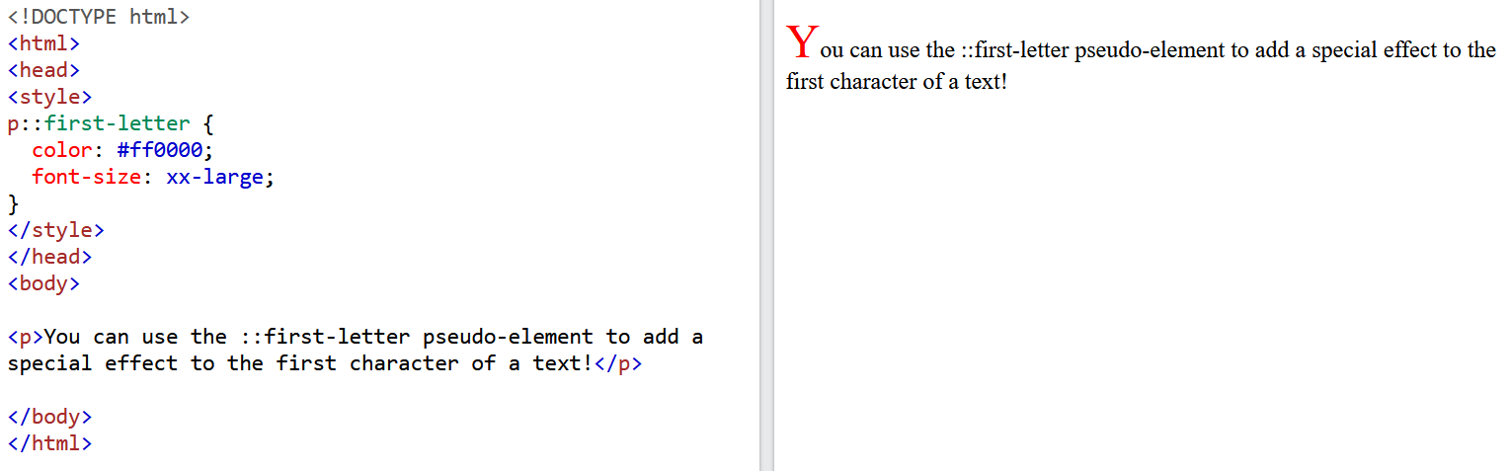
CSS | ::first-letter
Desc
Selector
PSEUDO ELEMENT SELECTOR

Slide 37
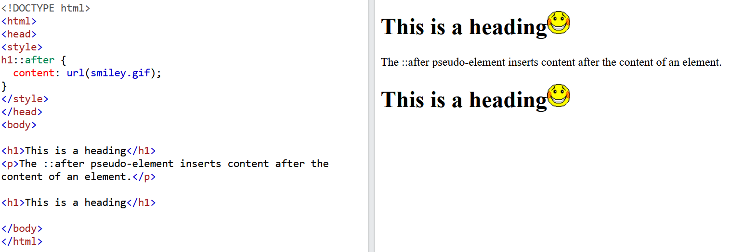
CSS | ::after
Desc
Selector
PSEUDO ELEMENT SELECTOR

Slide 38
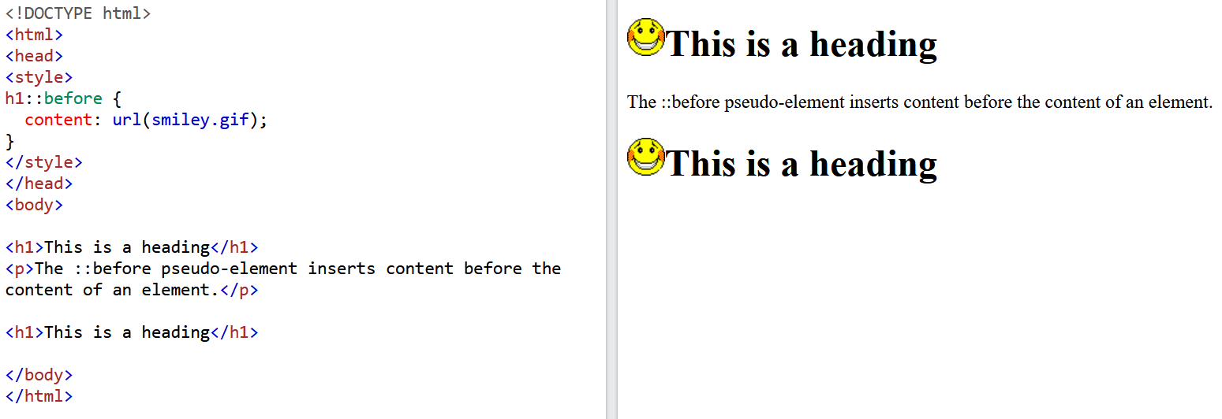
CSS | ::before
Desc
Selector
PSEUDO ELEMENT SELECTOR

Slide 39
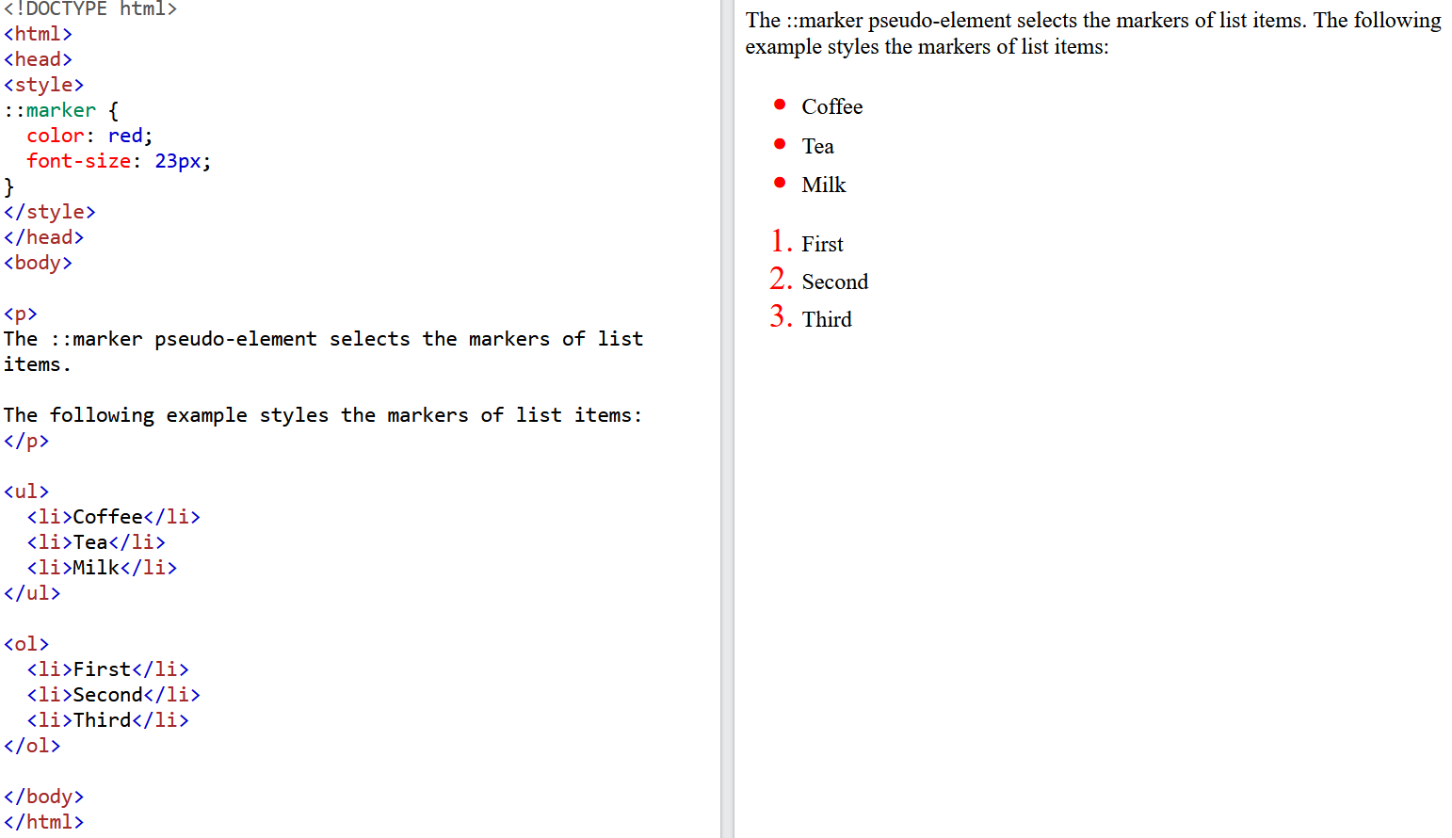
CSS | ::marker
Desc
Selector
PSEUDO ELEMENT SELECTOR

Slide 40
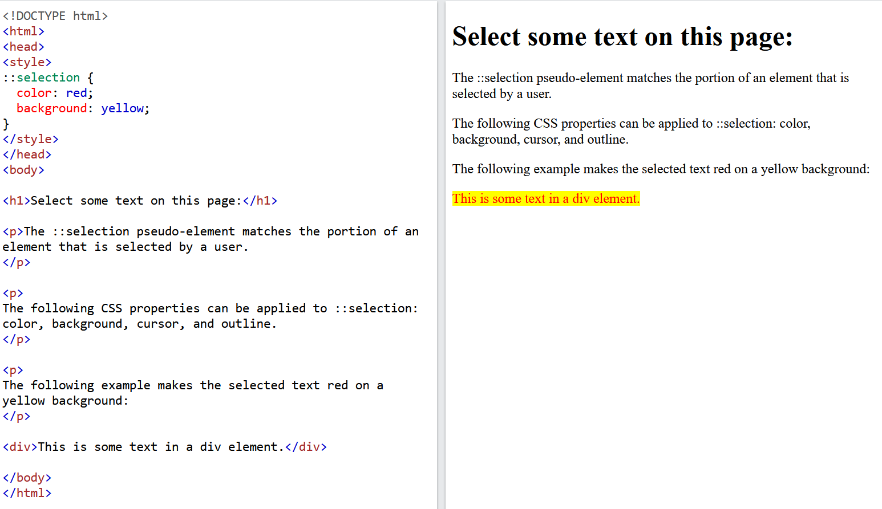
CSS | ::selection
Desc
Selector
PSEUDO ELEMENT SELECTOR

Slide 41
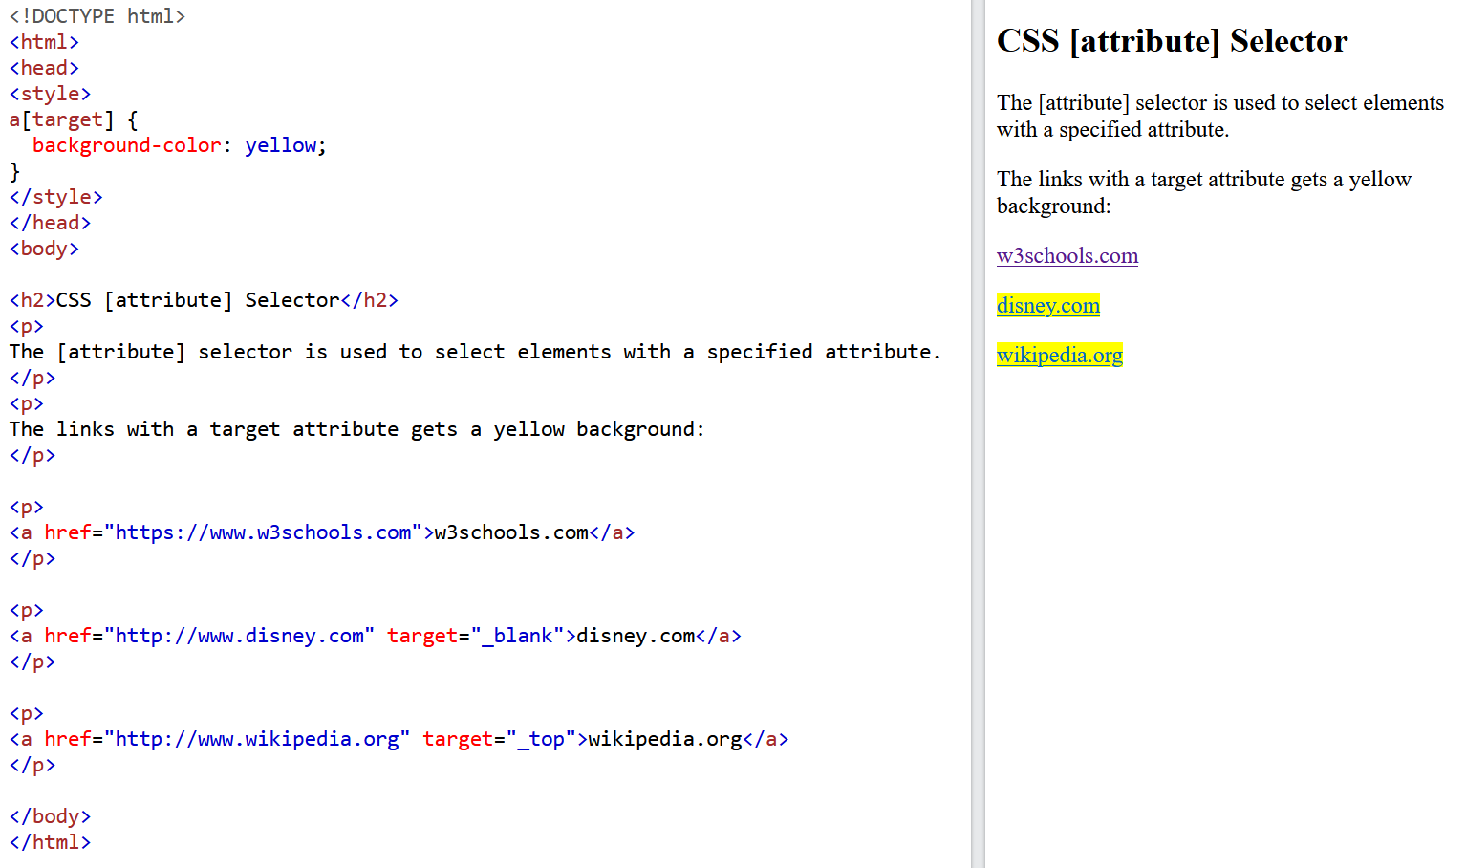
CSS | [Attribute] Selector
ATTRIBUTE SELECTOR

Slide 42
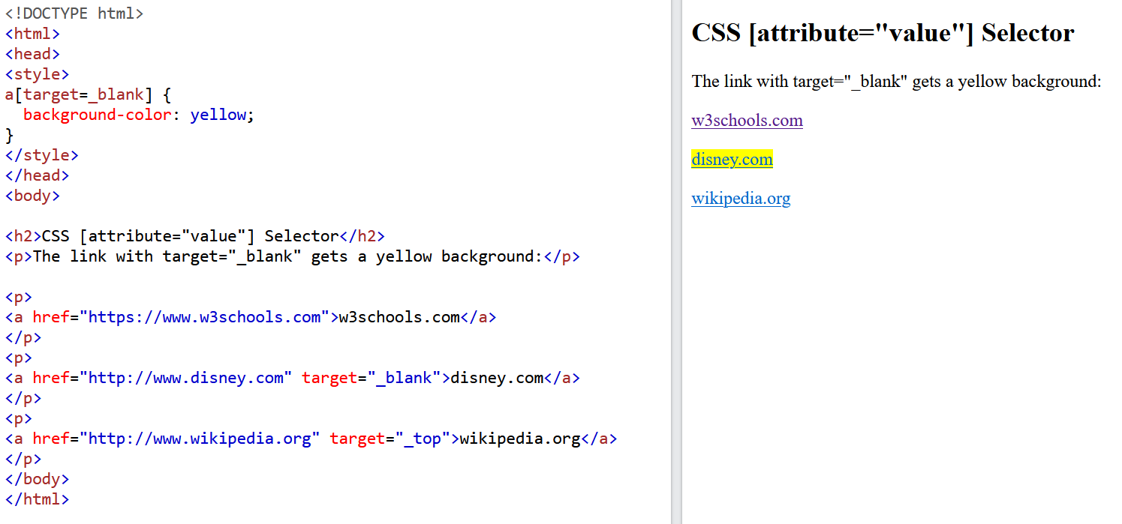
CSS | [Attribute=“value”] Selector
ATTRIBUTE SELECTOR

Slide 43
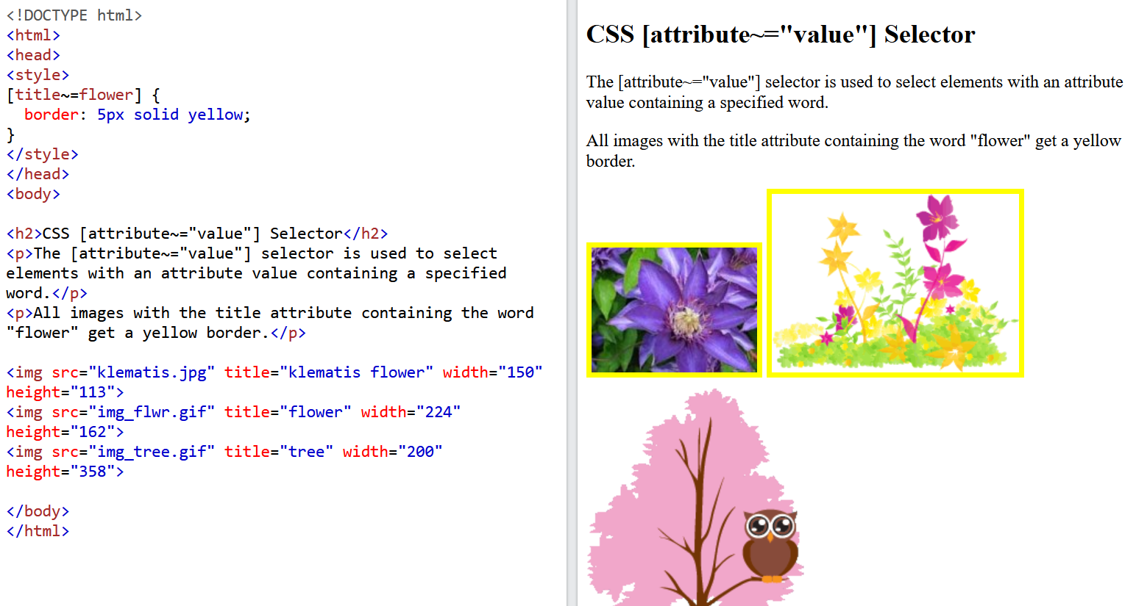
CSS | [Attribute~=“value”] Selector
ATTRIBUTE SELECTOR

Slide 44
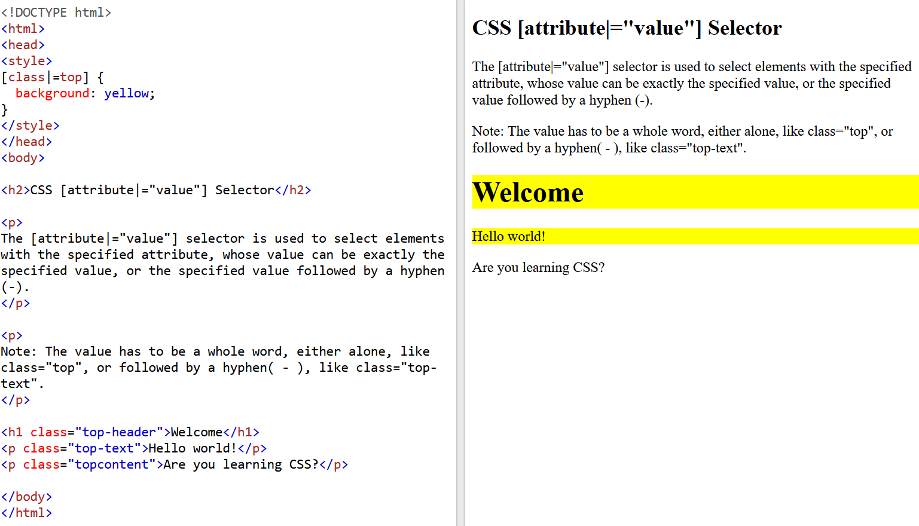
CSS | [Attribute|=“value”] Selector
ATTRIBUTE SELECTOR

Slide 45
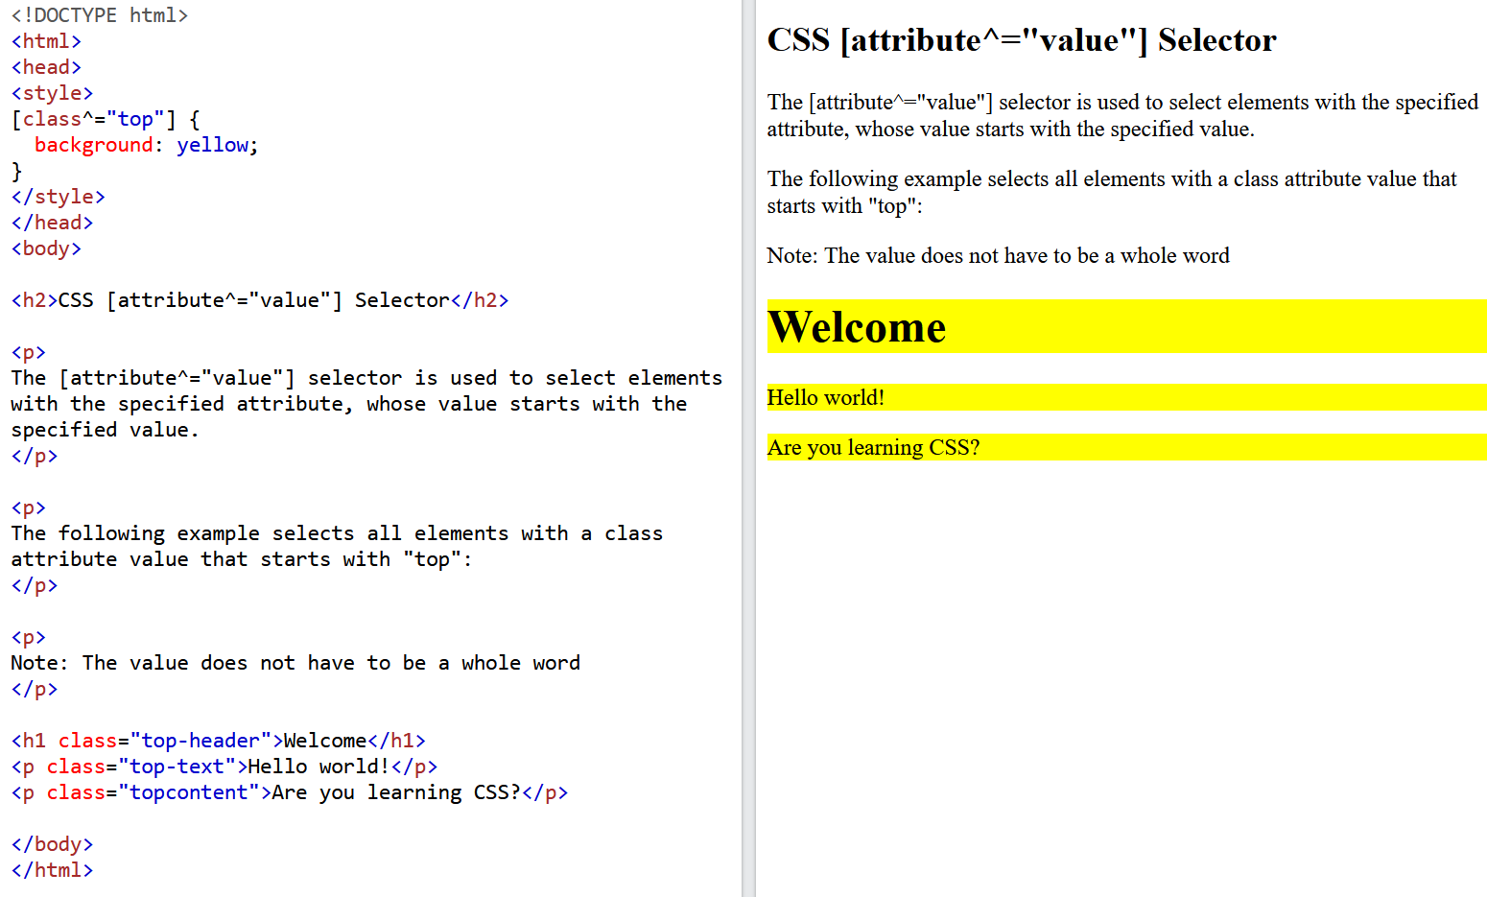
CSS | [Attribute^=“value”] Selector
ATTRIBUTE SELECTOR

Slide 46
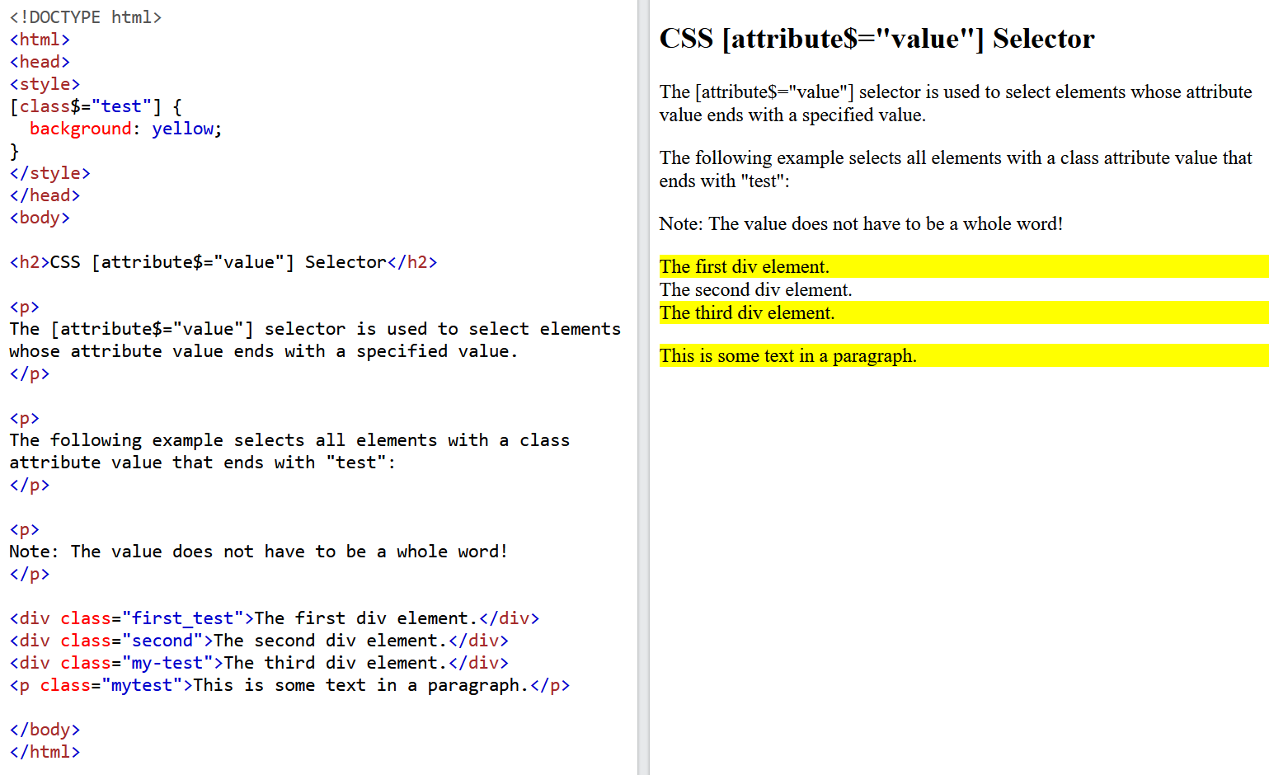
CSS | [Attribute$=“value”] Selector
ATTRIBUTE SELECTOR

Slide 47
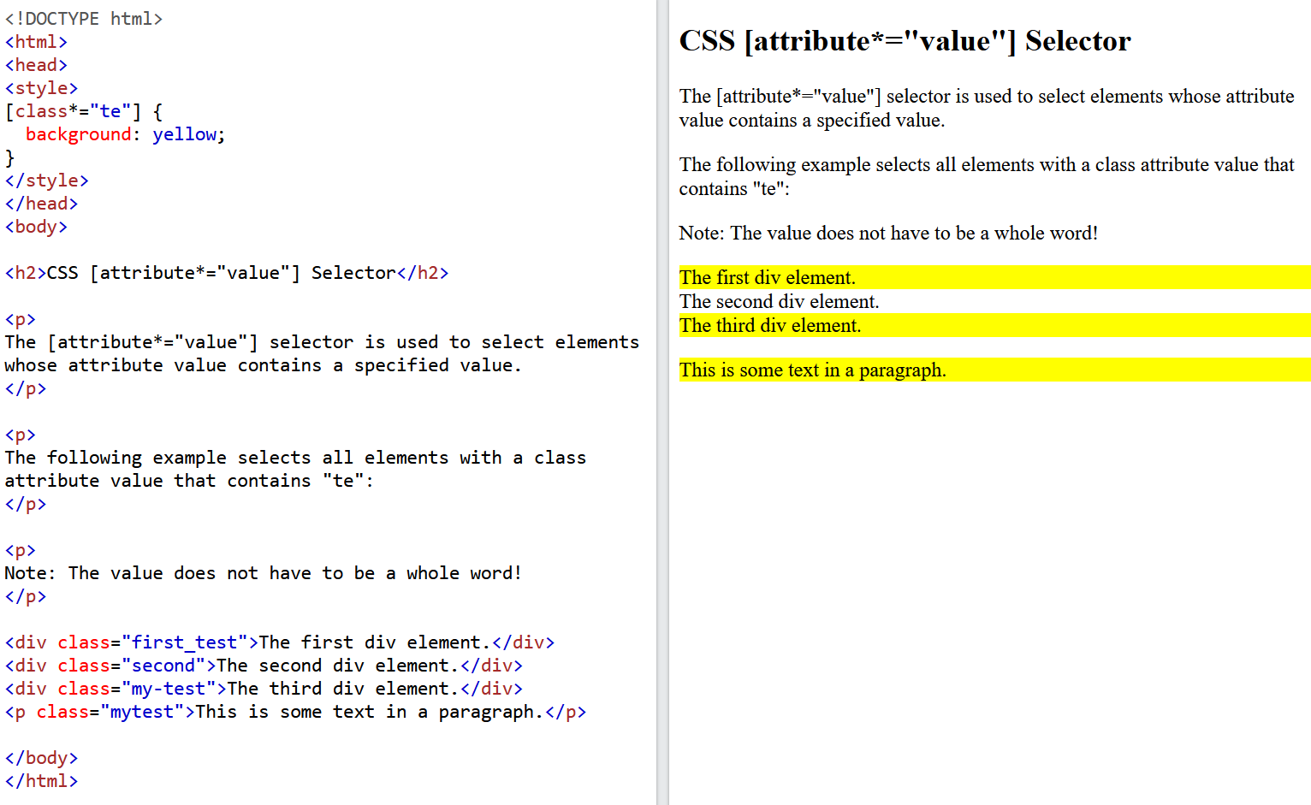
CSS | [Attribute*=“value”] Selector
ATTRIBUTE SELECTOR

Slide 48
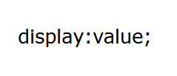
CSS | Display
To control the layout of an HTML element, the CSS Display is used.
On a web page, each element is a rectangular box.
The behavior of the rectangular box is specified by the CSS property.
Syntax:

Slide 49
CSS | Commonly display values
Commonly used CSS display values used are listed below:
display: inline;
display: inline-block;
display: block;
display: run-in;
display: none;
display:flex;
display:consents (MAGIC)

Slide 50
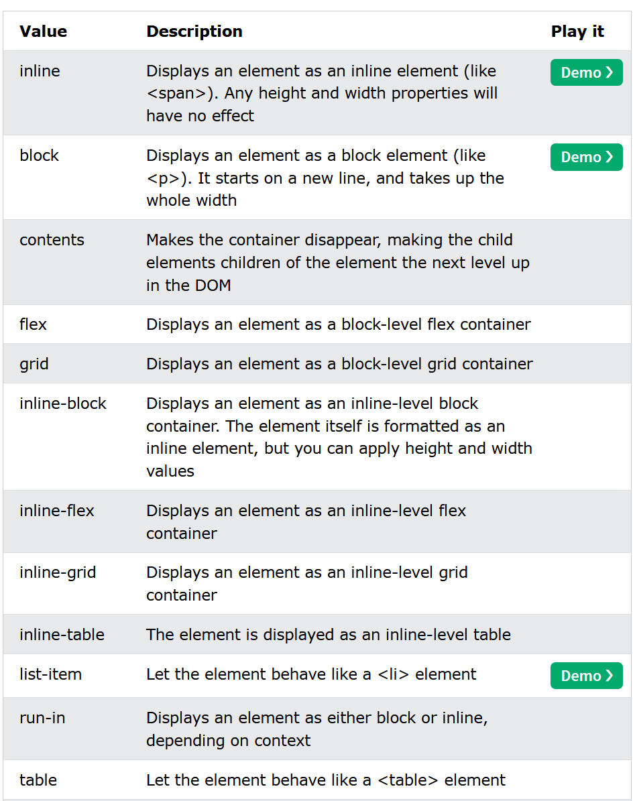
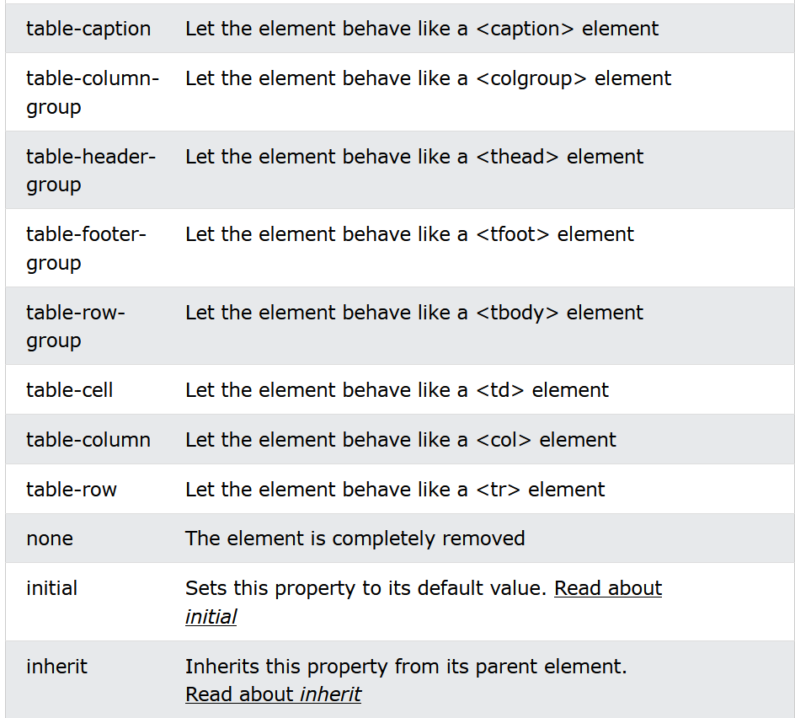
CSS | All display values

Slide 51
CSS | Flexbox
https://css-tricks.com/snippets/css/a-guide-to-flexbox/

