Slide 1
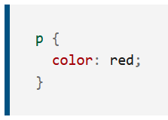
CCS
CSS (Cascading Style Sheets) is the code that styles web content. CSS basics walks through what you need to get started. We'll answer questions like: How do I make text red? How do I make content display at a certain location in the (webpage) layout? How do I decorate my webpage with background images and colors?
Like HTML, CSS is not a programming language. It's not a markup language either. CSS is a style sheet language. CSS is what you use to selectively style HTML elements. For example, this CSS selects paragraph text, setting the color to red:

Slide 2
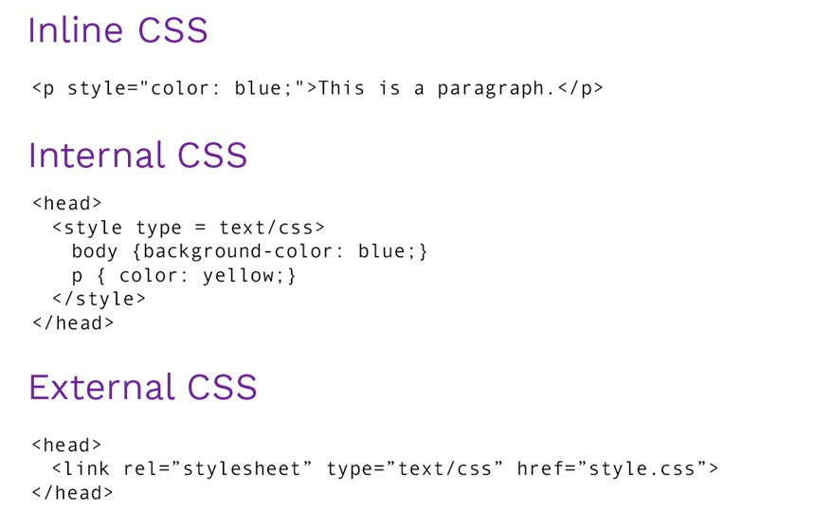
ADD CCS to HTML PAGE

Slide 3
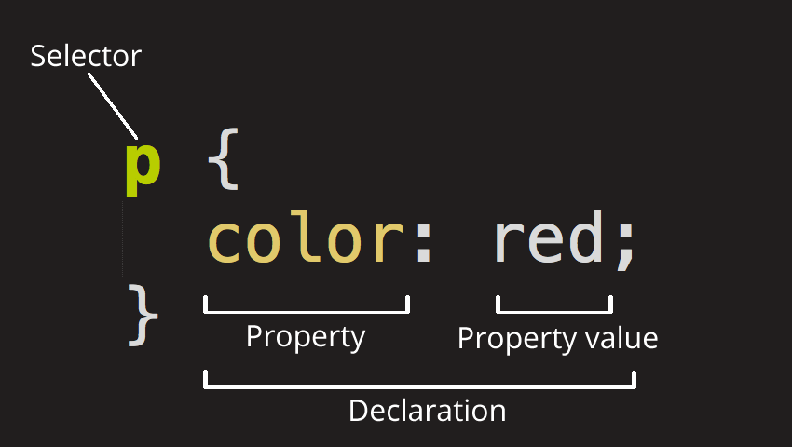
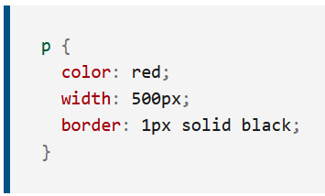
ANATOMY OF CSS RULESET
Selector
This is the HTML element name at the start of the ruleset. It defines the element(s) to be styled (in this example, <p> elements). To style a different element, change the selector.
Declaration
This is a single rule like color: red;. It specifies which of the element's properties you want to style.
Properties
These are ways in which you can style an HTML element. (In this example, color is a property of the <p> elements.) In CSS, you choose which properties you want to affect in the rule.
Property value
To the right of the property—after the colon—there is the property value. This chooses one out of many possible appearances for a given property. (For example, there are many color values in addition to red.)

Slide 4
DIFFERENT TYPE OF SELECTORS
There are many different types of selectors. The examples above use element selectors, which select all elements of a given type. But we can make more specific selections as well. Here are some of the more common types of selectors:
Selector name | What does it select | Example
Element selector (sometimes called a tag or type selector) | All HTML elements of the specified type. | p selects <p>
ID selector | The element on the page with the specified ID. On a given HTML page, each id value should be unique. | #my-id selects <p id="my-id"> or <a id="my-id">
Class selector | The element(s) on the page with the specified class. Multiple instances of the same class can appear on a page. | .my-class selects <p class="my-class"> and <a class="my-class">
Attribute selector | The element(s) on the page with the specified attribute. | img[src] selects <img src="myimage.png"> but not <img>
Pseudo-class selector | The specified element(s), but only when in the specified state. (For example, when a cursor hovers over a link.) | a:hover selects <a>, but only when the mouse pointer is hovering over the link.

Slide 5
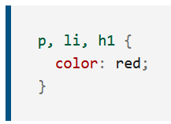
MULTIPLE SELECTOR
You can also select multiple elements and apply a single ruleset to all of them. Separate multiple selectors by commas. For example:

Slide 6
DISPLAY
Formally, the display property sets an element's inner and outer display types. The outer type sets an element's participation in flow layout; the inner type sets the layout of children. Some values of display are fully defined in their own individual specifications; for example the detail of what happens when display: flex is declared is defined in the CSS Flexible Box Model specification. See the table at the end of this document for all of the individual specifications.
Div block
Span inline

Slide 7
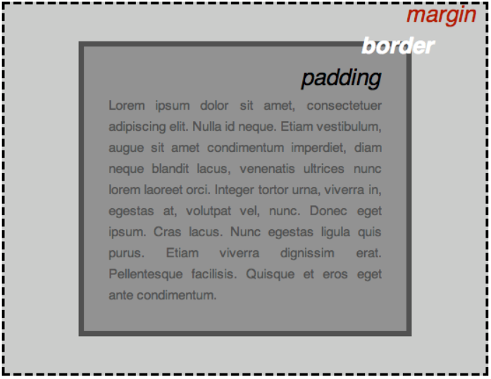
BOXES
Something you'll notice about writing CSS: a lot of it is about boxes. This includes setting size, color, and position. Most HTML elements on your page can be thought of as boxes sitting on top of other boxes.
padding, the space around the content. In the example below, it is the space around the paragraph text.
border, the solid line that is just outside the padding.
margin, the space around the outside of the border.

Slide 8
FLEXBOX
https://css-tricks.com/snippets/css/a-guide-to-flexbox/

