Slide 1
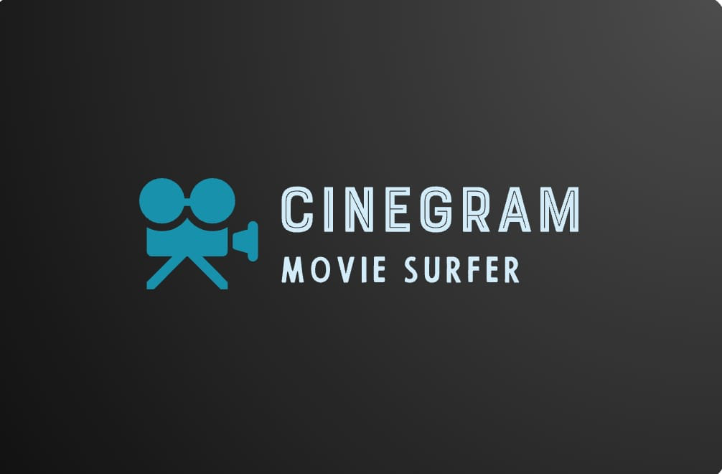
CINEGRAM Movie Surfer

Slide 2
TEAM MEMBERS
Parth Jagtap
Ojaswa Choudhary

Slide 3
ABSTRACT
CINEGRAM are meant to give suggestions to the users based on the features they love the most. A highly performing movie recommendation will suggest movies that match the similarities with the highest degree of performance. This study conducts a systematic literature review on cinegram. It highlights the filtering criteria in the recommender systems, algorithms implemented in movie recommender systems, the performance measurement criteria, the challenges in implementation, and recommendations for future research

Slide 4
INTRODUCTION
Recommender systems work by assessing the available information about the likely patterns of the users and making suggestions from the information available. The suggestions from the recommender systems help the system users find what is most suitable for them. Recommender systems are designed to ease product or service searches based on the least information available about the features. A combination of various factors is used to assess the correlations in patterns and user characteristics to determine the best product suggestions for the customers.

Slide 5
PROBLEM STATEMENT
With the vast array of movies available online, users often face decision fatigue and the challenge of discovering content aligned with their preferences. The existing recommendation systems may not be sufficiently personalized, leading to suboptimal user satisfaction. The cinegram addresses these challenges by developing a robust recommendation system.

Slide 6
ADVANTAGES
Personalization
Discovery of New Content
Increased User Engagement
Improved Customer Retention and Loyalty

Slide 7
Conclusion
The "Online Movie Recommendation System(CINEGRAM)" mini project aims to revolutionize the movie-watching experience by providing users with personalized and engaging recommendations. Through the use of advanced algorithms and a thoughtful user interface, the system seeks to address common challenges in recommendation systems and create a platform that evolves with user preferences and emerging trends

Slide 8
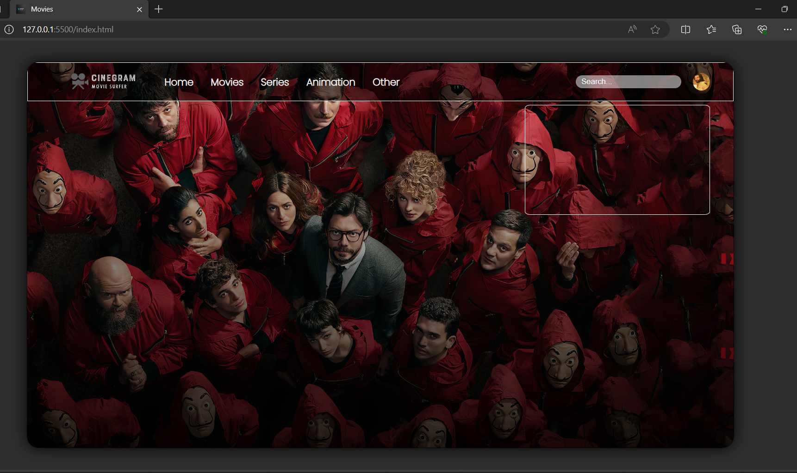
INTERFACE

Slide 9
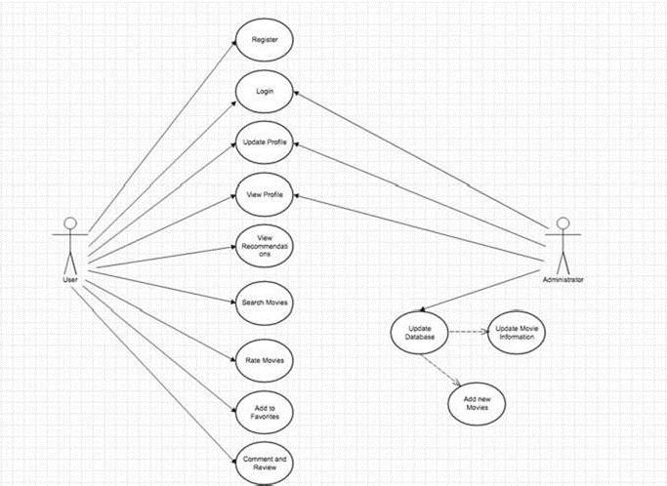
Use Case Diagram

Slide 10
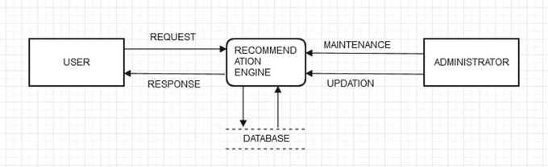
Data Flow Diagram level 0

Slide 11
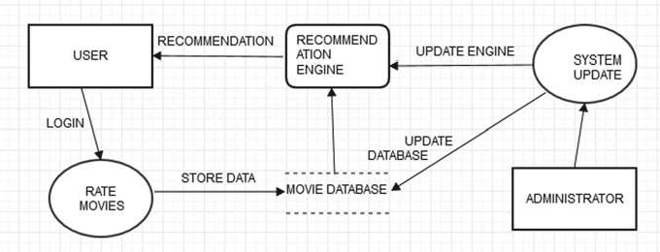
Data Flow Diagram level 1

Slide 12
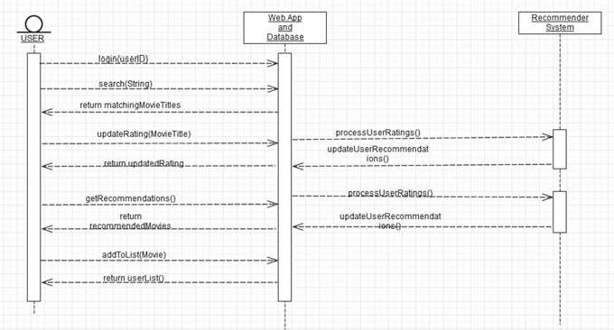
Sequence Diagram

Slide 13
Thank you

