Slide 1
My Portfolio
A Web Development Portfolio
[Your Name]
[Date]

Slide 2
Project Overview
This is my personal portfolio website where I showcase my skills, projects, and experience in web development. It includes sections such as Home, About Me, Skills, Projects, and Contact, with a fully responsive design for mobile and desktop views.
Key Features:
- Interactive design with smooth animations.
- Fully responsive for mobile and desktop views.
- Contact form with basic validation.

Slide 3
Technologies Used
Frontend: HTML, CSS, JavaScript
Libraries:
- Typed.js (for typing effect)
- Google Fonts (Poppins)
Features Implemented:
- Mobile navigation toggle
- Typing effect for dynamic text

Slide 4
Key Features
Mobile Navigation: Fixed sidebar with toggle functionality.
Typing Effect: Displays dynamic text like 'Front-End Developer', 'Back-End Developer', and 'Full Stack Developer'.
Contact Form: Validation to ensure that all fields are filled and email is valid.

Slide 5
Project Structure
Header: Contains profile image, social links, and navigation.
Main Section: Includes Home, About, Skills, Projects, and Contact.
Footer: Includes copyright and other links.

Slide 6
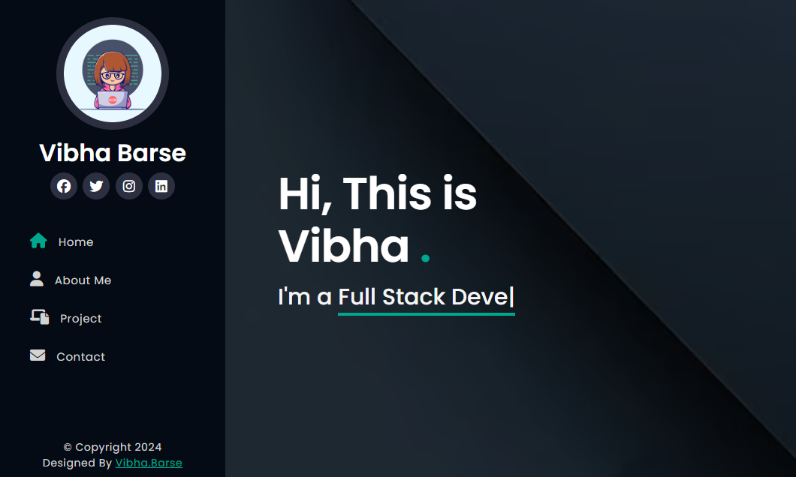
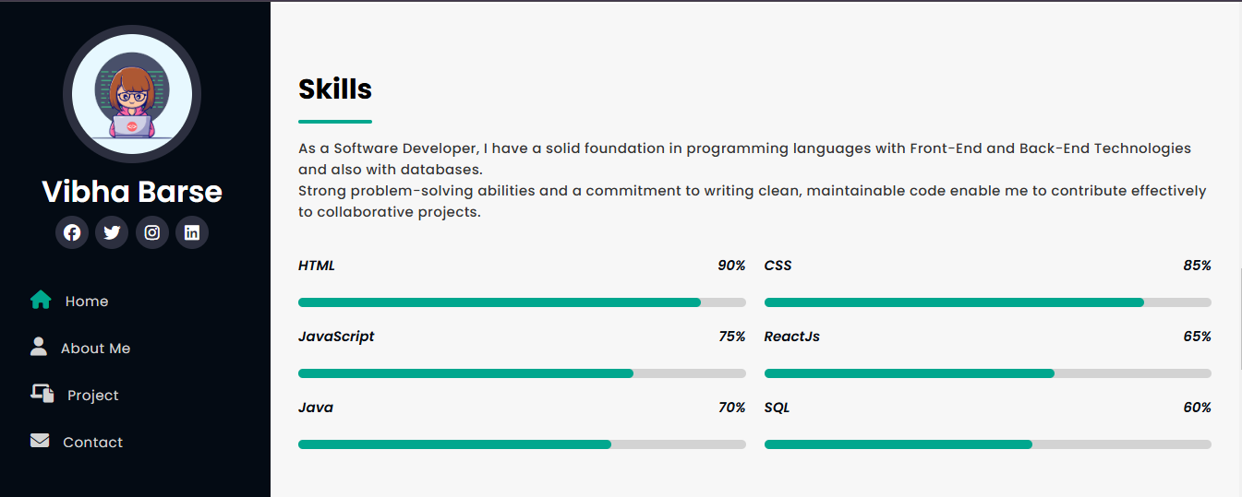
Portfolio - Interface Overview

Slide 7
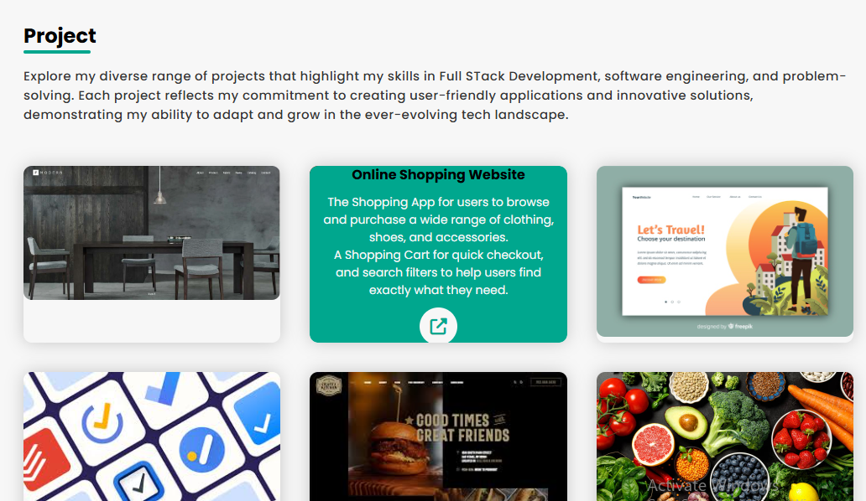
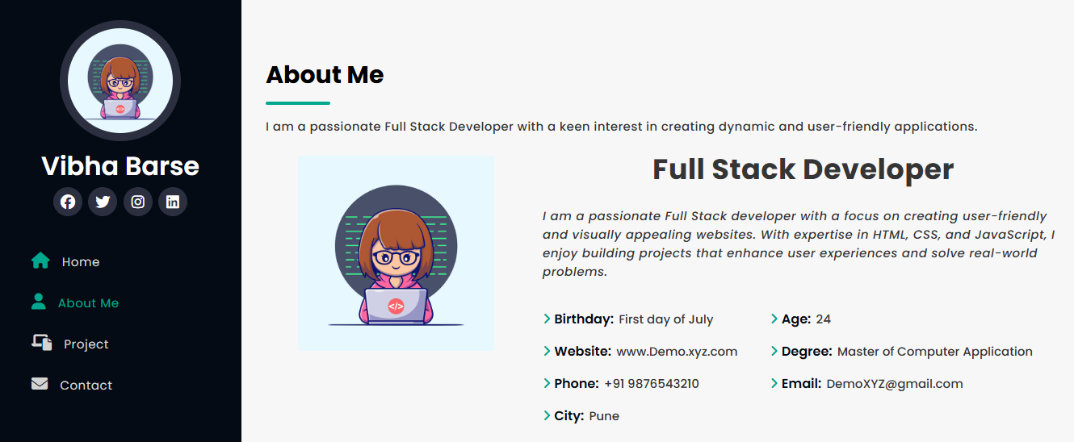

Slide 8
Challenges Faced
Challenge 1: Making the layout fully responsive.
Solution: Used media queries to adjust the layout for various screen sizes.
Challenge 2: Implementing smooth toggle for mobile navigation. Solution: JavaScript to toggle classes for visibility and transitions.

Slide 9
Learning Outcomes
Gained hands-on experience in responsive design using CSS.
Learned JavaScript fundamentals for DOM manipulation.
Improved understanding of form validation in client-side development.

Slide 10
Conclusion & Future Enhancements
Conclusion: This portfolio has helped me demonstrate my skills in web development and provided a platform to showcase my work.
Future Enhancements:
- Add a blog section for technical articles.
- Implement a database to manage projects dynamically.

Slide 11
Thank You!

