Slide 1
Expense Tracker Project
A Web Application to Manage Your Budget and Expenses

Slide 2
Project Overview
This project is a simple Expense Tracker web application that allows users to:
• Set a budget amount
• Track expenses with titles and costs
• See the remaining balance dynamically
• Get alerts when expenses exceed the budget

Slide 3
Features
• Real-time budget and expense tracking
• Alerts for expenses exceeding the budget
• Clear and user-friendly interface
• Dynamic balance updates with red color for negative balance

Slide 4
Technology Stack
• HTML5 for structure
• CSS3 for styling
• JavaScript for dynamic functionality

Slide 5
Code Structure
• index.html: Defines the layout and structure of the application
• style.css: Contains styles for all elements
• script.js: Implements the application's logic and functionality

Slide 6
How It Works
1. Set your total budget.
2. Add expenses with a title and amount.
3. See real-time updates of your balance and total expenses.
4. Get a warning if expenses exceed the budget.

Slide 7
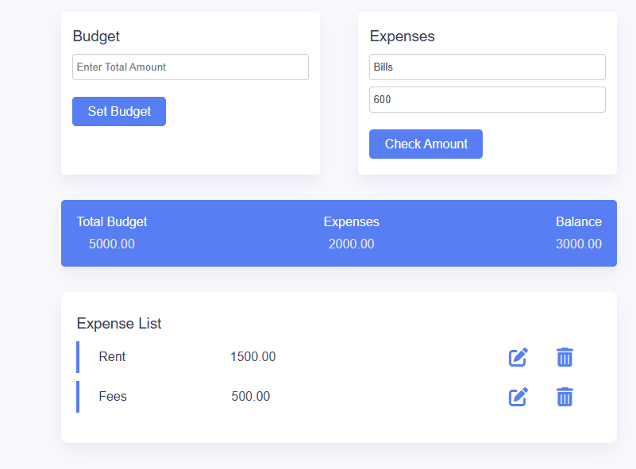
Expense Tracker: User Interface Overview

Slide 8
Future Enhancements
• Add user authentication for personalized expense tracking.
• Include categories for expenses.
• Generate detailed reports.
• Implement a mobile-friendly design.

