Slide 1
Customer Churn Analysis Using Python
Prepared by: Hudu Yusuf Ibrahim
Dataset: Telco Customer Churn Dataset
Tools: Python, Pandas, NumPy, Matplotlib, Seaborn, Jupyter Notebook

Slide 2
Business Background
• Customer retention is critical for subscription businesses.
• High churn reduces recurring revenue.
• Analyse churn drivers and recommend retention strategies.

Slide 3
Business Problem & Objectives
Business Problem:
Understand why customers leave.
Objectives:
• Identify high-risk customers
• Analyse contract, tenure, services and payment methods
• Recommend actions

Slide 4
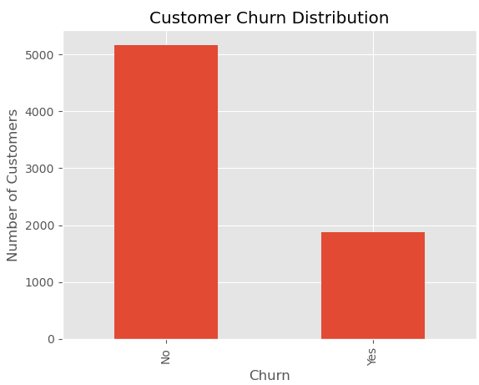
Dataset Overview
• 7,043 records
• 21 variables
• Target: Churn

Slide 5
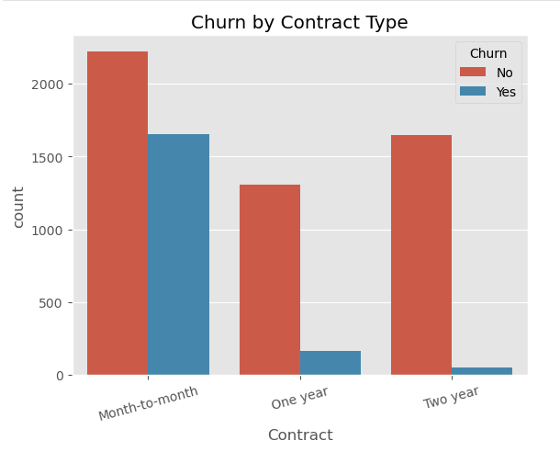
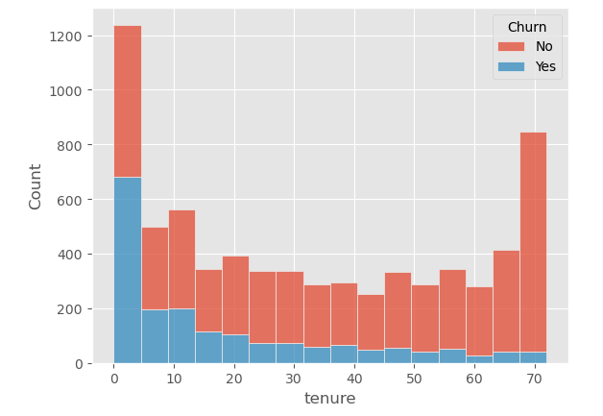
Contract & Tenure
Month-to-month churn: 42.7%, vs 11.3% (1-yr) and 2.8% (2-yr)
30.9% of customers have <12 months tenure — the highest-churn group

Slide 6
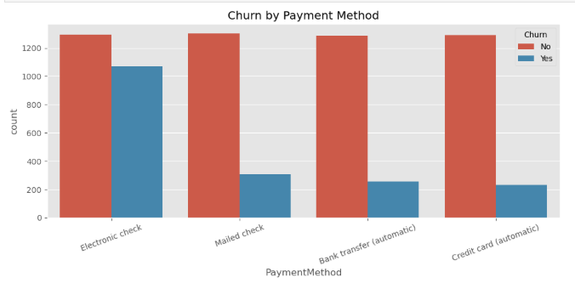
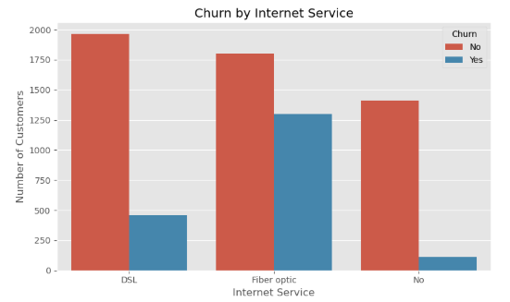
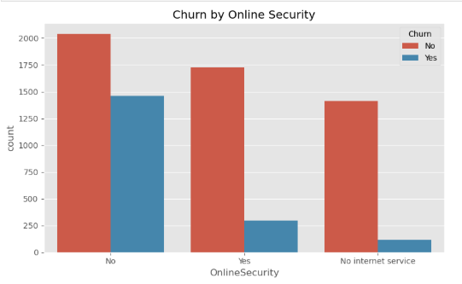
Service & Payment
Electronic Check, Fiber Optic, and no Online Security all link to higher churn.

Slide 7
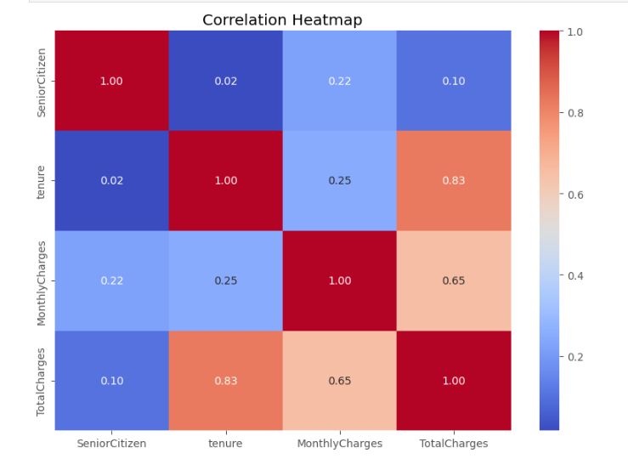
Correlation
• Tenure ↔ Total Charges: 0.83 (strong positive)
• Monthly Charges ↔ Total Charges: 0.65 (moderate)
• Tenure ↔ Monthly Charges: 0.25 (weak) — longer-tenured customers don’t necessarily pay more per month

Slide 8
Business Insights
• Longer contracts improve retention.
• Newer customers are at greater churn risk.
• Value-added services are associated with lower churn.
• Payment behaviour relates to churn — Electronic Check users churn most.
42.7% → 2.8%
churn: month-to-month vs two-year
30.9%
of customers have <12 months tenure
4 services
Security, Support, Backup, Protection — same pattern each time

Slide 9
Recommendations
1
Promote longer contracts (42.7% → 2.8% churn).
Improve onboarding in the first 12 months.
Bundle value-added services at signup.
Encourage automatic payments over Electronic Check.
Review pricing and value on Fiber Optic plans.
2
3
4
5

Slide 10
Conclusion
• Key churn drivers identified.
• Findings support data-driven retention strategies

