Slide 1
Uplyft E-Commerce Chatbot Assistant
Enhancing Customer Experience through AI-driven Product Discovery
Created by: Aditya Pratap Singh
Contact: +91 8858066219
Mail: adityapratap.job@gmail.com

Slide 2
🎯 Project Objective
- Build an intelligent, full-stack chatbot for e-commerce platforms
- Enable users to search, filter, and receive product recommendations
- Provide voice-enabled, mobile-responsive, and feedback-integrated experience
- Persist chat history and maintain session continuity

Slide 3
📐 Architecture Overview
Frontend (React + Tailwind)
↓ Axios API Calls
Backend (Flask + SQLAlchemy + JWT Auth)
↓ SQLite DB (120 products via Faker)
- Voice Input: Web Speech API
- RESTful, modular, deployment-ready

Slide 4
🧰 Tech Stack
Frontend: React, Tailwind CSS, Toastify, Day.js
Backend: Flask, Flask-CORS, SQLAlchemy, JWT
Database: SQLite (seeded with Faker)
Voice Input: Web Speech API
Tools: Postman, Railway, GitHub Pages

Slide 5
🚀 Features Implemented
✅ JWT Auth (Register/Login)
✅ Chat Interface with History & Timestamps
✅ Product Search + Smart Recommendations
✅ Voice Input (Web Speech API)
✅ Feedback & Auto-scroll System
✅ Responsive Design (Mobile/Desktop)

Slide 6
🧠 Key Learnings & Challenges
💡 Learnings:
- Full-stack integration with React & Flask
- Using JWT for secure auth flow
- Modular REST API design & deployment
⚠️ Challenges:
- CORS issues → Solved with Flask-CORS
- Speech API stability → Fallback logic
- Tailwind with CRA → Version downgrade fix

Slide 7
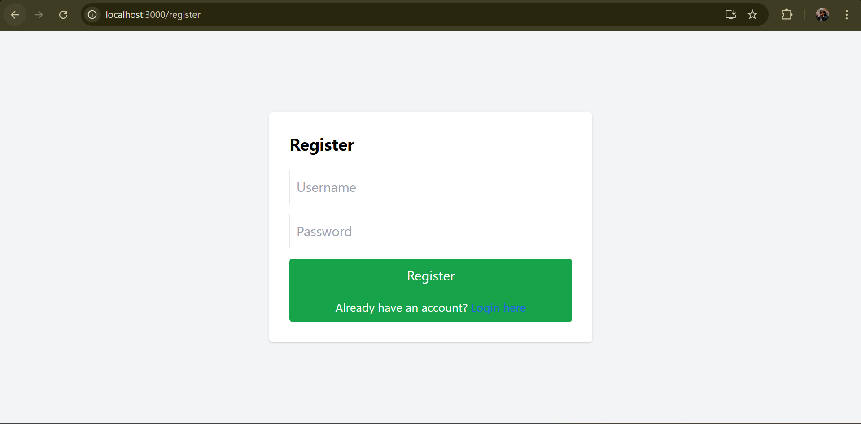
Register Page

Slide 8
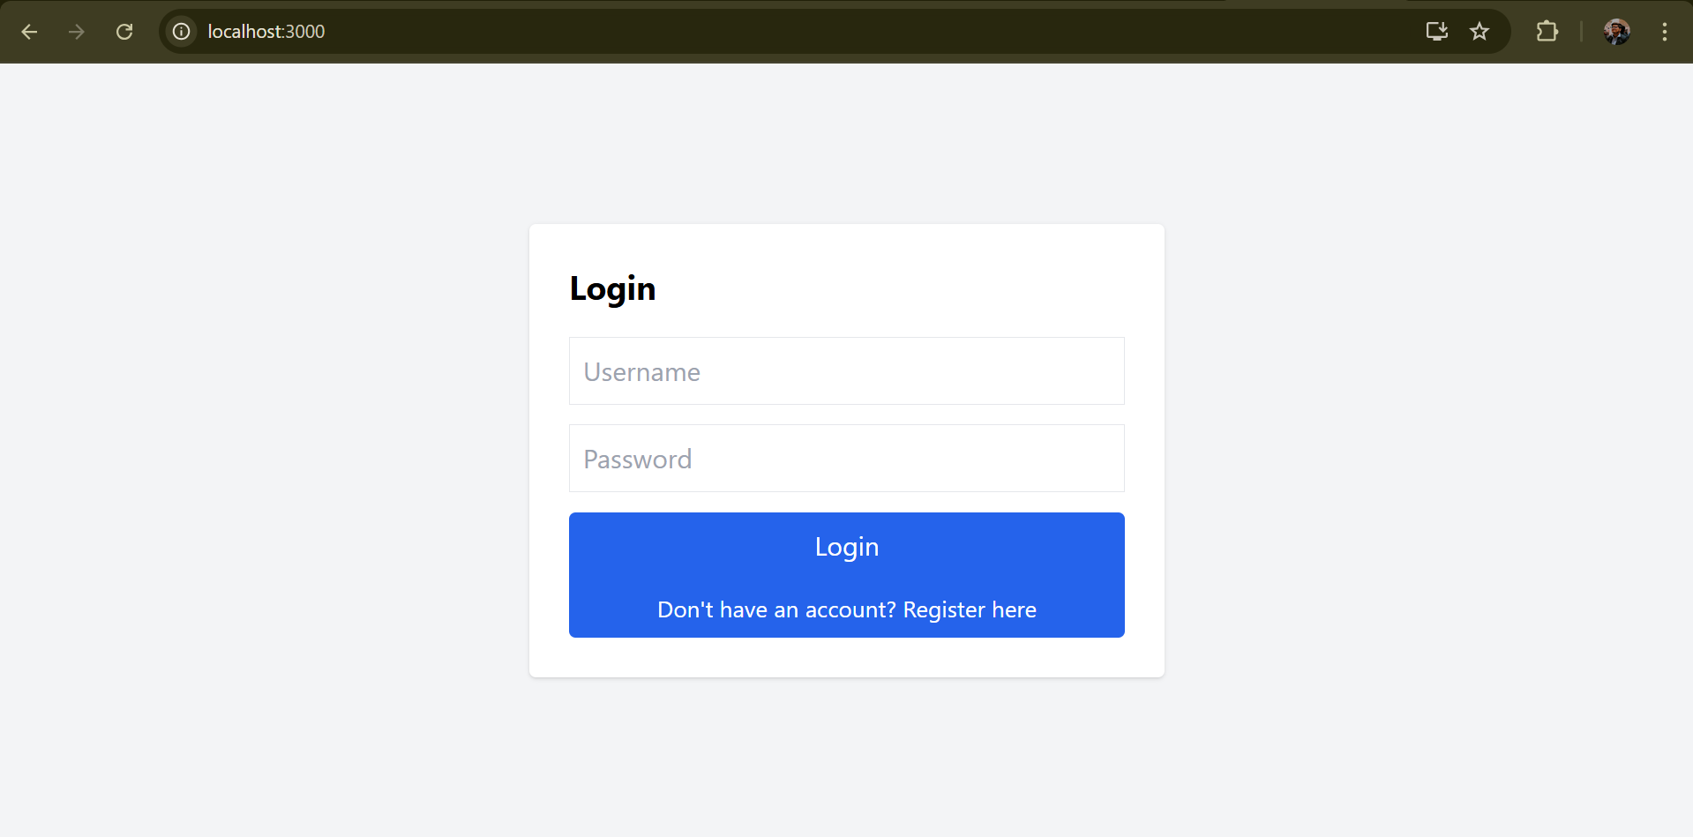
Login Page

Slide 9
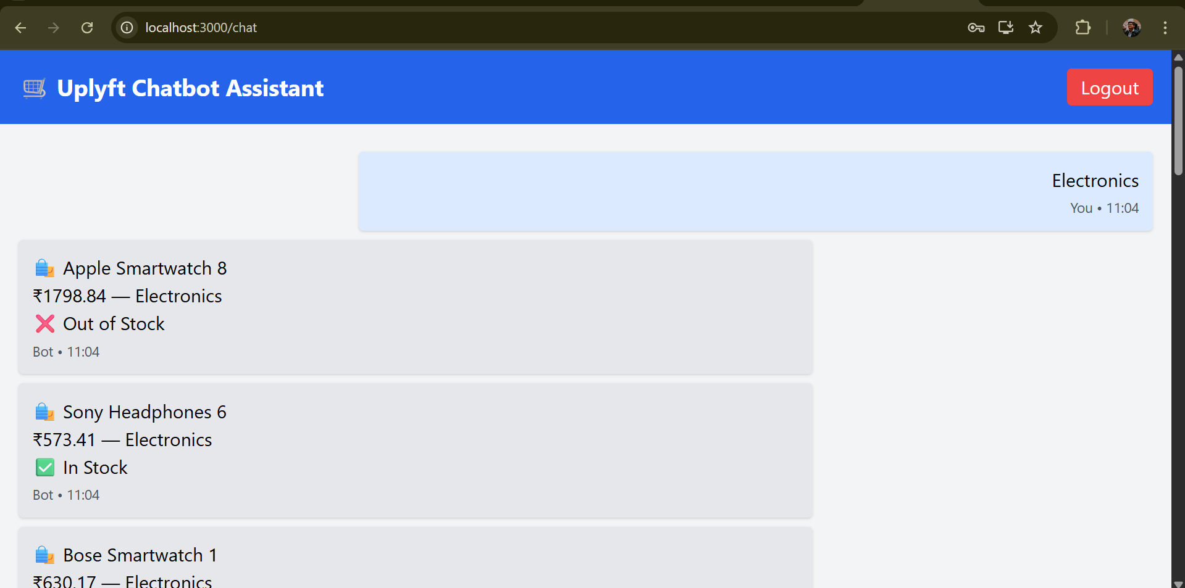

Slide 10
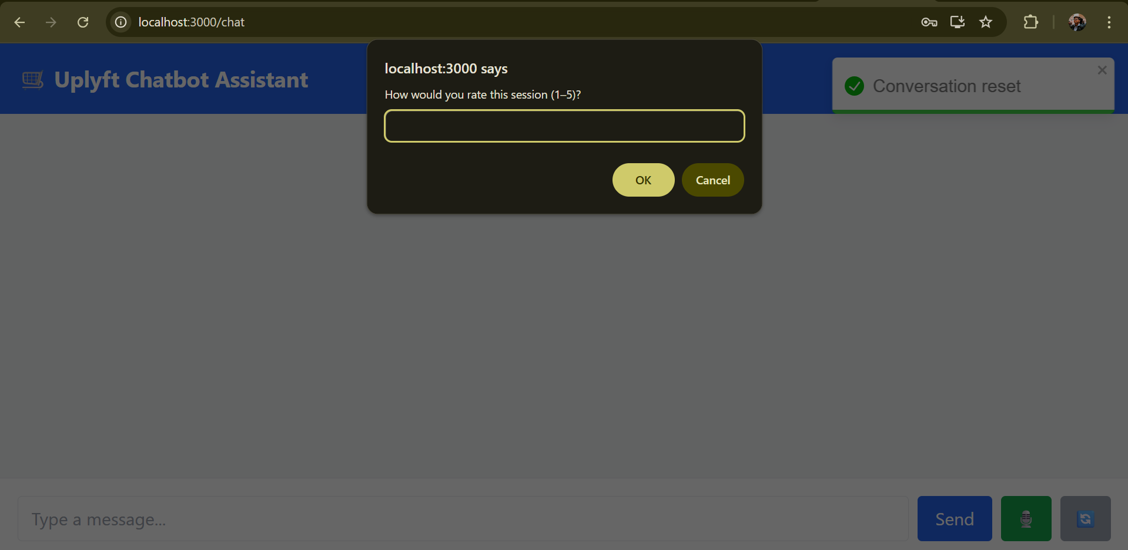
Feedback from the User

Slide 11
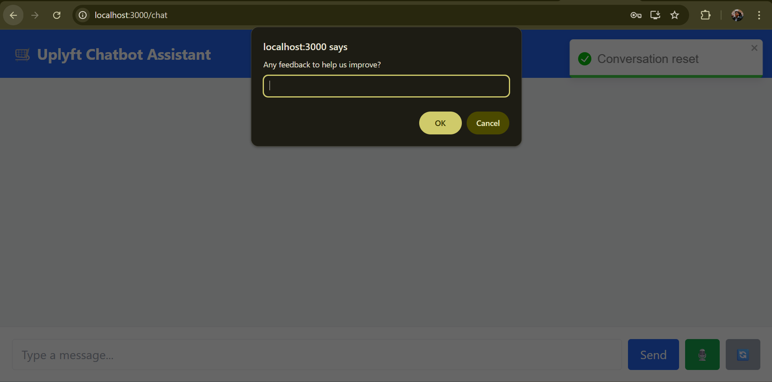
Recommendation/Suggestion from the user

