Slide 1
FOOD WastagesS MANAGEMENT SYSTEM

Slide 2
TEAM LEADER:
VIKAS KUMAR GUPTA
TEAM MEMBER:
TANUJ TAYAL
PROJECT SUPERVISOR:
ASSISTANT PROFESSOR
Dr. Ankit Verma

Slide 3
INTRODUCTION
1

Slide 4
In a world where excess often coexists with scarcity, “Food Wastages Management System” emerges as a beacon of hope, bridging the gap between surplus and need. Our web-based platform is dedicated to the noble cause of gathering details about leftover food from functions or events and distributing it to those in need.
In today's society, where countless events and gatherings are hosted daily, a significant amount of food often remains untouched, destined for Wastages. Yet, simultaneously, there are individuals and organizations facing hunger and food insecurity. At “Food Wastages Management System”, we believe in harnessing technology for social good, transforming surplus into sustenance.

Slide 5
Our mission is twofold: to combat food waste and alleviate hunger. Through our user-friendly platform, event organizers can effortlessly notify us about excess food, specifying type, quantity, and location. Meanwhile, individuals and organizations in need can easily access our database to find surplus food near them. By facilitating this connection, “Food Wastages Management System” fosters a community of compassion and sharing.
We are not merely a platform; we are a catalyst for change. Our vision extends beyond immediate relief, aiming to cultivate a culture of mindful consumption and generosity. By redirecting surplus food to those who need it most, we contribute to a more sustainable and equitable future.

Slide 6
Technologies / Software Requirements
2

Slide 7
Software Requirement for User -
OS :
Windows XP or above
Web Browser :
Microsoft Edge or above
Software Requirement for development –
System Software -
Operating System (Windows XP or Above)
Application Software -
Database (MongoDB)
Frameworks-
ReactJS
ExpressJS
Web Technologies –
JavaScript

Slide 8
Hardware Requirements
3

Slide 9
Hardware Requirement for development –
Input Devices - All basic input devices like keyboard, mouse, etc.
Output Devices - All basic output devices like printer, monitor, etc.
Secondary storage devices -
HDD - 60GB or above.
Back-up - Flash Drive, CD/DVD, cloud storage etc.
Internal components -
RAM - 512 MB (Minimum)
Processor - Intel Pentium 4 Processor or above
Hardware Requirement for User -
Input Devices - All basic input devices like keyboard, mouse, etc.
Output Devices - All basic output devices like printer, monitor, etc.
Stable and secure Internet connection.

Slide 10
Modules Description
4

Slide 11
Admin Module
In an admin module, the owner(admin) will be able to access the following feature :
Can Add/Edit/Read/Delete/Ban user’s accounts.
Can Add/Edit/Read/Delete/Hold Request.
Have the union of all the authorities present in any other module.
User Module
Customers can Add/Edit/Delete personal information about them.
Can search for categories.
An request for Wastages collection and further they can monitor their request.

Slide 12
Login and Registration Module
Registration : Ask for various required fields depending upon who’s registering(either Supervisor, user etc.) validates it from server-side script, and if successful registers the user and if not revert back to registration page for re-submission of the form.
Login : Will match the credential and login.

Slide 13
REPORTS
5

Slide 14
The system will generate reports for following modules separately -
Admin Module :
List of Registered Users.
List of Food available at real time.
An intuitive report regarding Food registered on the website.
List of connection, donator and receiver.
User Module :
List of Food available at real time.
Details of food donator.

Slide 15
Conclusion
6

Slide 16
In a world where excess and scarcity often collide, “Food Wastages Management System” stands as a beacon of hope, bridging the gap between surplus and need. Our web-based platform not only combats food waste but also alleviates hunger by connecting those with extra food to those in need. Through technology and empathy, we strive to create a more sustainable and equitable future. Join us in our mission to make a difference, one meal at a time, and together, let's build a world where no one goes hungry, and no food goes to waste.

Slide 17
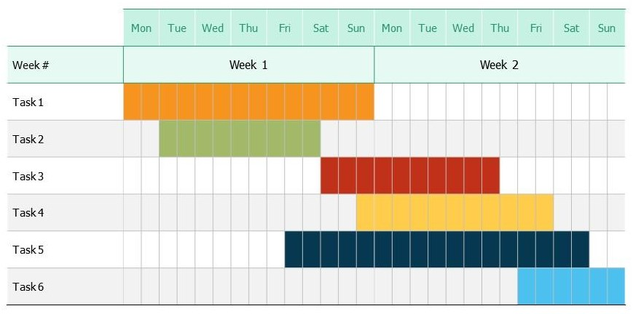
Gantt chart

