Slide 1
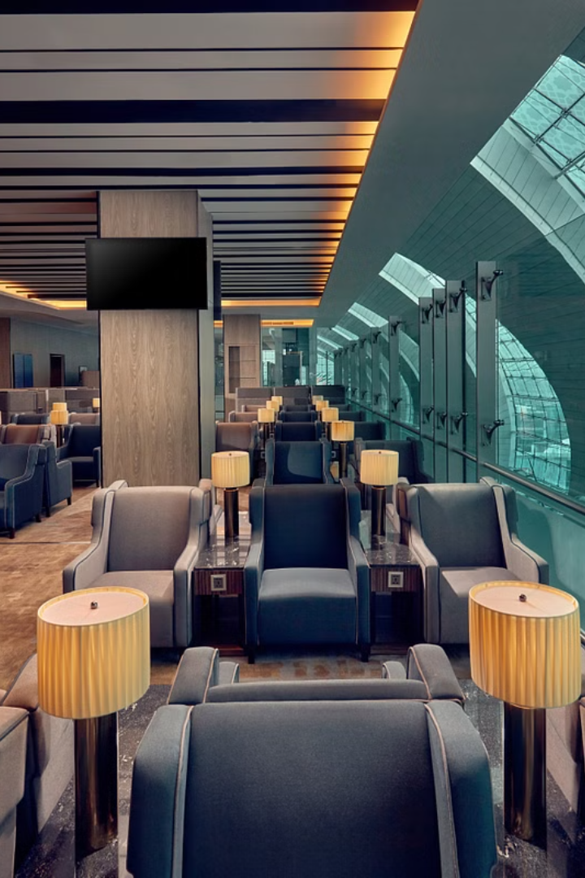
Flight Reservation System
The flight reservation system is the backbone of the modern travel industry, allowing users to seamlessly book, manage, and modify their airline tickets with just a few clicks. This comprehensive platform streamlines the entire booking process, from searching for flights to securing seats and completing payments.

Slide 2



User Registration and Login
User Profile
Login
Security
Create a secure user account with personal details and preferences.
Easily access your account and manage your bookings with a straightforward login process.
Enjoy peace of mind with robust security measures to protect your personal information.

Slide 3
Flight Search and Booking
Search Functionality
Booking Process
Flight Details
Easily find the perfect flight by filtering options like destination, dates, and class of travel.
Seamlessly complete your booking with a user-friendly interface and secure payment options.
Access comprehensive information about your flight, including departure/arrival times, airport details, and baggage allowance.

Slide 4
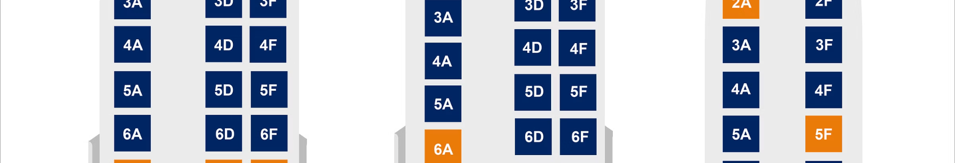
Seat Selection and Reservation
Seat Map
1
Visualize the available seats on your flight and select the perfect spot for your needs.
2
Seat Reservation
Secure your preferred seat quickly and conveniently, ensuring a comfortable journey.
Seat Upgrades
3
Enhance your experience by upgrading to premium seating options, if available.

Slide 5
Technologies / Software Requirements
Java
DBMS
Java's versatility, robustness, and ecosystem of libraries and frameworks make it a suitable choice for developing the backend components of a Flight Reservation System.
To store and manage flight schedules, passenger information, bookings, and other relevant data. Popular choices include MySQL.
HTML & CSS
Javascript
Create visually appealing and responsive web pages using HTML and CSS, ensuring an intuitive and enjoyable user experience.
JavaScript serves as a versatile programming language for creating dynamic and interactive user interfaces in a Flight Reservation System.

Slide 6
Payment Processing
Secure Payments
Multiple Options
Utilize industry-standard encryption and fraud prevention measures to protect your financial information.
Choose from a variety of payment methods, including credit/debit cards, digital wallets, and more.
Flexible Pricing
Instant Confirmation
Explore different fare classes and payment plans to find the option that best suits your budget.
Receive immediate confirmation of your successful payment and booking details.

Slide 7



Itinerary Management
View Itinerary
Modify Bookings
Receive Alerts
Access your complete travel plan, including flight details, arrival and departure times, and any additional bookings.
Easily make changes to your itinerary, such as rescheduling flights or updating passenger information.
Stay informed with real-time updates and notifications about any changes or disruptions to your travel plans.

Slide 8

Conclusion
The Flight Reservation System is a comprehensive and innovative solution that streamlines the airline industry's operations, enhancing the travel experience for both airlines and passengers. By integrating advanced features, such as user authentication, flight search and selection, booking management, and real-time updates, the system provides a seamless and efficient booking process. Additionally, the system's distributed architecture, centralized database, and robust security measures ensure data integrity and scalability, making it a valuable asset for the airline industry.

Slide 9
Customer Support and Assistance
1
Dedicated Hotline
2
Online Chat
Speak with knowledgeable agents who can help you with any questions or issues you may have.
Receive immediate assistance through a convenient chat interface for quick resolutions.
3
Self-Service Options
4
Multilingual Support
Explore comprehensive FAQs and tutorials to find answers to your questions on your own.
Communicate with representatives in your preferred language for a seamless customer experience.

