Slide 1

Instagram Clone
Gaurav Pandey
Anmol Dubey

Slide 2

Overview
Instagram: Transforming Visual Storytelling and Online Communication. admired throughout the world for its sharing capabilities, filters, and user-friendly UI.

Slide 3

What is a Clone of Instagram?
A duplicate of Instagram created by a different software company that has comparable features and user interfaces.
-Gives companies, proprietors, and developers a chance to take use of Instagram's widespread following.

Slide 4

Why Do People Like Instagram Clones?
- Growing popularity of social media sites targeted at particular populations or interests.
- Instagram's popularity demonstrates how community and interaction are facilitated by visual material.

Slide 5
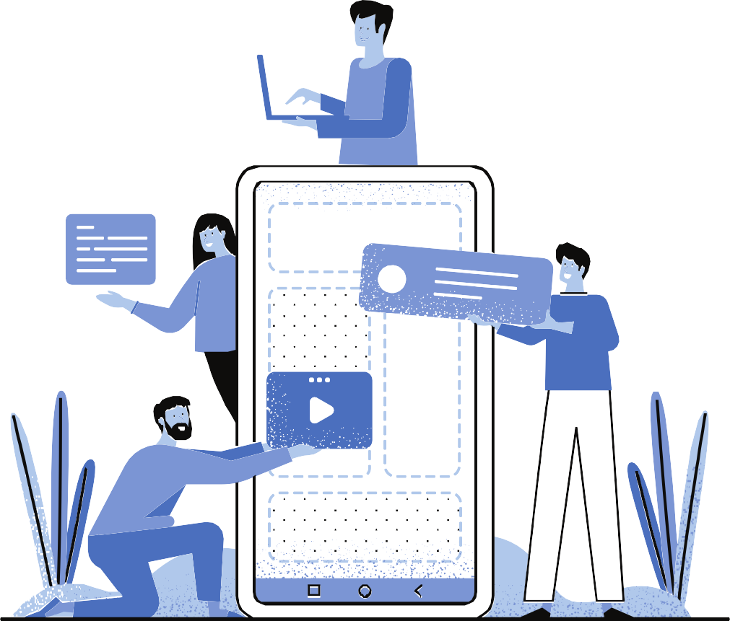
FEATURES OF INSTAGRAM CLONE
-ESSENTIAL FEATURES INCLUDE PHOTO/VIDEO SHARING, DIRECT MESSAGING, AND STORYTELLING.
-EXTRAS: COMMUNITY-BUILDING TOOLS, EDITING TOOLS, FILTERS, AND INTEGRATION WITH OTHER SOCIAL NETWORKS.

Slide 6
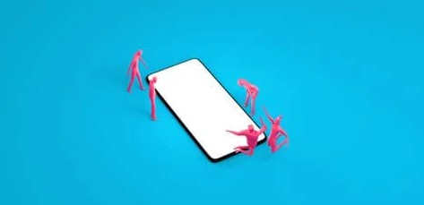
BUSINESSES GAINS FROM INSTAGRAM CLONES
-CUSTOMIZED OPTIONS TO FULFILL PARTICULAR OBJECTIVES.
-DEPENDABLE UPDATES AND STRONG SECURITY TO PROVIDE A FLAWLESS USER EXPERIENCE.

Slide 7

TAKING INTO ACCOUNT INSTAGRAM REPLICAS
-WORRIES OF USER TRUST, COPYRIGHT, AND DATA PRIVACY.
-STRESS THE IMPORTANCE OF ETHICS AND LAW.

Slide 8

ACCEPTING INSTAGRAM CLONES AS A CONCLUSION
- BUILDS A NEW PHASE IN THE EVOLUTION OF SOCIAL MEDIA.
-TAKE USE OF THE VISUAL NARRATIVE AND DIGITAL CONNECTIONS.

