Slide 1
Food Fusion Using MERN
Manmeet Chauhan (2200290140085)
Priyanshu Singh (2200290140118)
Parth Gupta (2200290140105)
Manan Sharma (2200290140084)

Slide 2
Introduction
Your go-to platform for culinary exploration and innovation.
Explore a wide range of recipes from around the world, curated to suit every taste and preference.
Provide feedback on your orders and share your dining experience through ratings and reviews.

Slide 3
Why Use FoodFusion?
Quick
Convenient
Delicious
We can Quickly placed order here
It is very Convenient
We can browse delicious Food in our menu

Slide 4
Modules

Slide 5
Authentication and Login
01
02
Restaurant Management

Slide 6
Menu and Ordering
03
04
Payment Processing

Slide 7
Delivery
05
06
Rating and Review

Slide 8
Admin Dashboard
07
08
User DashBoard

Slide 9
Hardware Requirements
Client Side Developer
Processor - Dual Core or above Processor -Quad Core or above
RAM - 1 GB RAM - 4GB OR above
Disk space - 120 GB Disk Space - 256 GB
Monitor - 14” or above/ tab/mobile Monitor - 14” or above
Others - Internet Connection Other - Internet Connection

Slide 10
Software Requirements
Tool
Vs Code
Web Browser
Technologies Used
NodeJs
MongoDB
Express Js
React js
API and External Server
Version Control

Slide 11
Output
1.Landing Page:
2. User Authentication:
3. Restaurant Listings:
4. Restaurant Details:
5. Menu and Ordering:
6. Checkout Process:
7. Order Tracking:
8. Profile Management:
9. Rating and Reviews:
10. Admin Dashboard (Backend Output):
11. Responsive Design:
12. Accessibility and Localization:

Slide 12
Conclusion
"In conclusion, our food delivery app offers convenience, variety, and satisfaction to users, revolutionizing the way people enjoy meals. With seamless ordering, prompt delivery, and delicious options, it's the ultimate solution for modern dining needs."

Slide 13
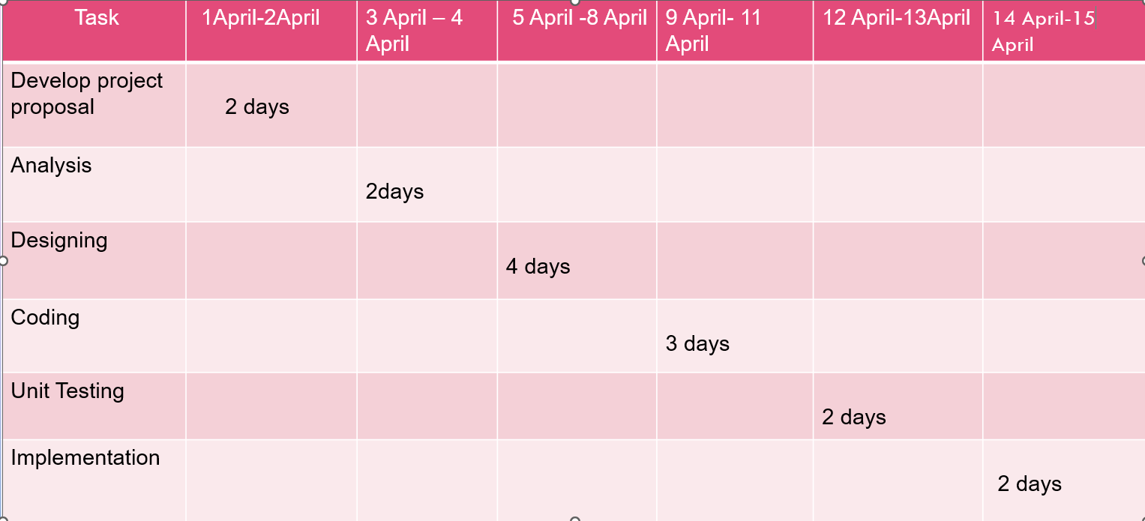
Gant Chart

