Slide 1
Human face recognition using eigenface analysis Report
ENGR 652 Image processing Final Exam: Fall 2014
Vy Bui

Slide 2
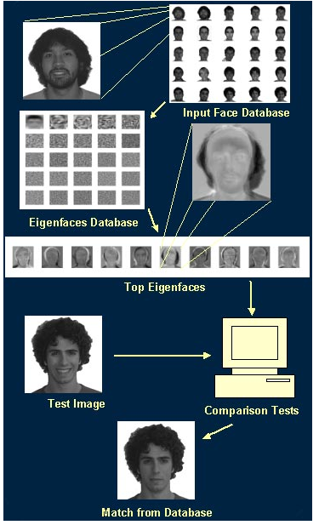
Eigenface System
The eigenface face recognition system can be divided into two core parts
The creation of the eigenface basis
The recognition of a new face.
The face recognition process follows the following general flow as in Figure 1.
The eigenface technique uses much more information by classifying faces based on general facial patterns. These patterns include the specific features of the face.
By using more information, eigenface analysis is naturally more effective than feature-based face recognition.
Figure 1. Face Recognition Process
Courtesy http://cnx.org/contents/9b410207-b30e-4baa-8687-5e2276a38b78@3/Obtaining_the_Eigenface_Basis

Slide 3
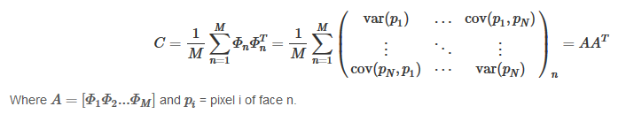
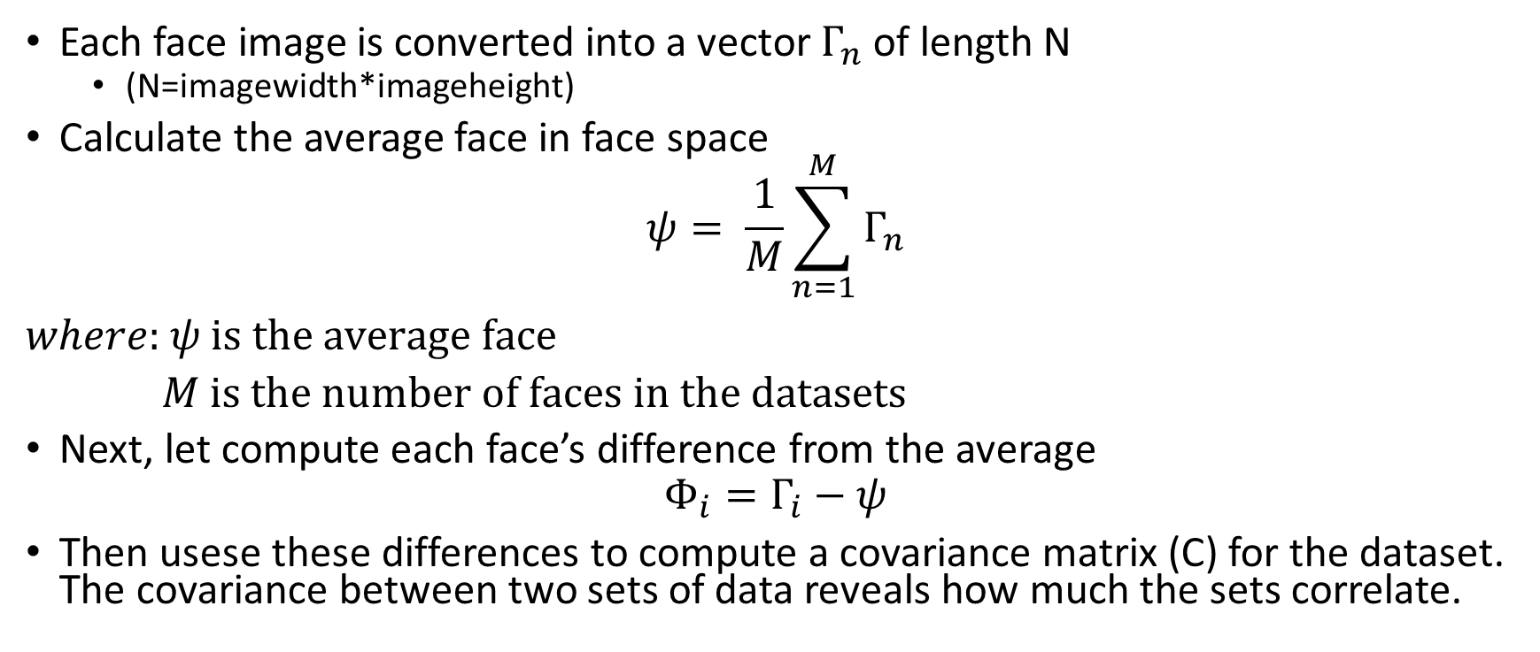
Eigenface Basis
Each face image is converted into a vector $Γ_{n}$ of length N
(N=imagewidth*imageheight)
Calculate the average face in face space
$$ψ= \frac{1}{M}\sum_{n=1}^{M}{Γ_{n}}$$ $where:$ $ψ is the average face$
$M is the number of faces in the datasets$
Next, let compute each face’s difference from the average
$$Φ_{i}=Γ_{i}−ψ$$
Then usese these differences to compute a covariance matrix (C) for the dataset. The covariance between two sets of data reveals how much the sets correlate.

Slide 4
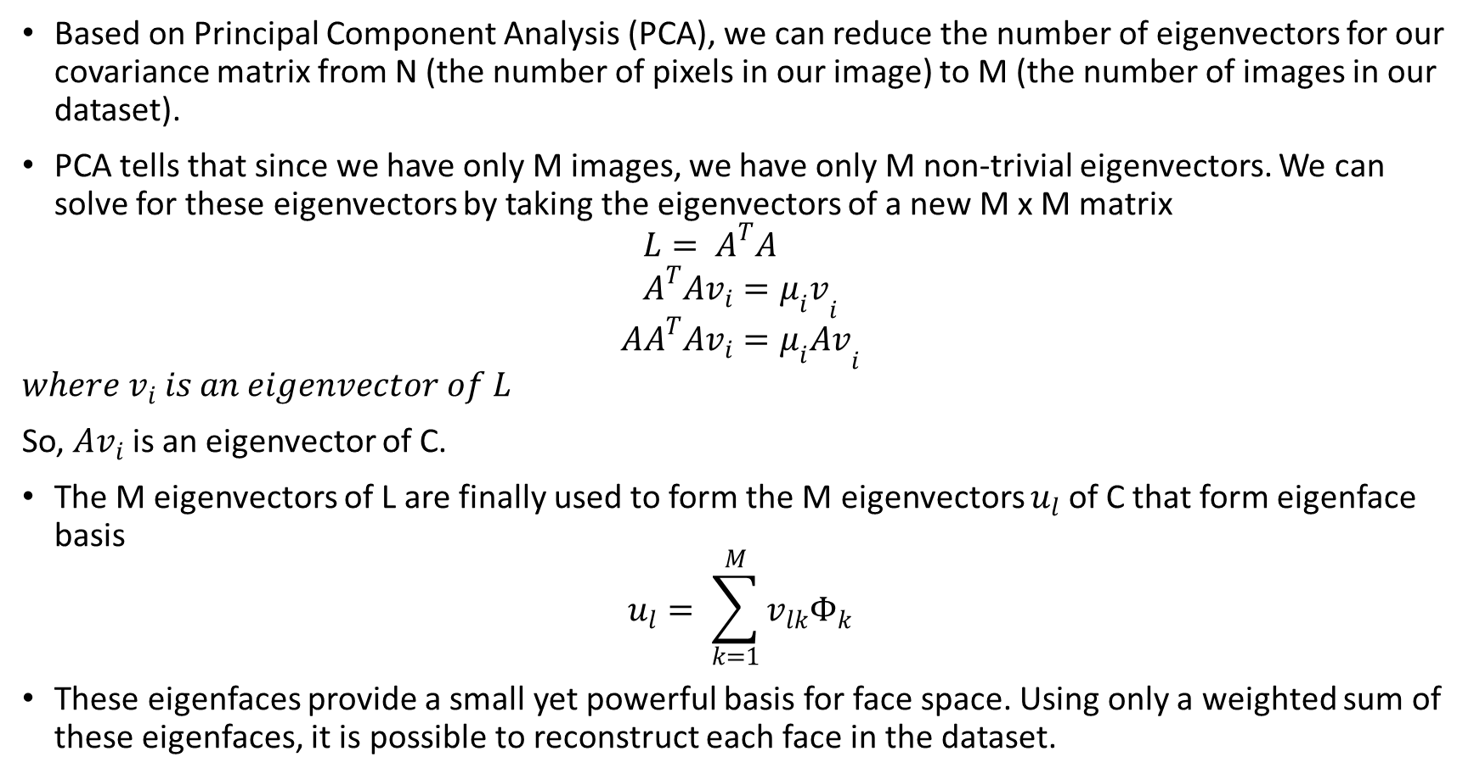
Simplifying the Initial Eigenface Basis
Based on Principal Component Analysis (PCA), we can reduce the number of eigenvectors for our covariance matrix from N (the number of pixels in our image) to M (the number of images in our dataset).
PCA tells that since we have only M images, we have only M non-trivial eigenvectors. We can solve for these eigenvectors by taking the eigenvectors of a new M x M matrix
$$L= A^{T}A \\ A^{T}Av_{i}={μ_{i}v}_{i}$$
$${AA}^{T}Av_{i}={μ_{i}Av}_{i}$$
$${where v}_{i} is an eigenvector of L$$
So, $Av_{i}$ is an eigenvector of C.
The M eigenvectors of L are finally used to form the M eigenvectors $u_{l}$ of C that form eigenface basis
$$u_{l}= \sum_{k=1}^{M}{v_{lk}Φ_{k}}$$
These eigenfaces provide a small yet powerful basis for face space. Using only a weighted sum of these eigenfaces, it is possible to reconstruct each face in the dataset.

Slide 5
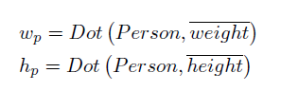
Face Detection using Eigenface
Suppose we had a set of vectors that represented a person's weight and height.
Projecting a given person onto these vectors would then yield that person's corresponding weight and height components.
Given a database of weight and height components, it would then be quite easy to find the closest matches between the tested person and the set of people in the database.

Slide 6
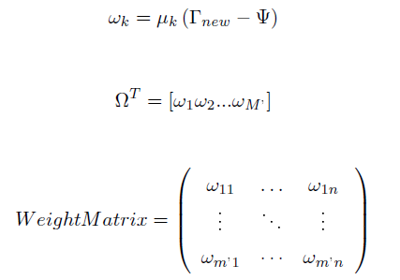
Face Detection using Eigenface
The face recognition using Eigenface is use the same process as discussed in previous slide.

Slide 7
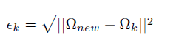
Face Detection using Eigenface
Recognition is simply a problem of finding the closest database image, or mathematically finding the minimum Euclidean distance between a test point and a database point.

Slide 8
Results

Slide 9
40 faces used for testing

Slide 10
Average face in face space

Slide 11
Top 20 eigenfaces from datasets

Slide 12
Performance Evaluation
CORRECT RECOGNITION | INCORRECT RECOGNITION
38 out of 40 | 2 out of 40
The two incorrect recognition faces are shown

Slide 13
Conclusion
This project involves human face recognition using eigenface analysis. The heart of the approach is the creation of a set of eigenfaces from a training dataset.
The accuracy is 95%. The mismatch faces might be explained that the acquired image sets do not include all the good features, for example, face angle, complexion, lighting are significant parts in the process of recognizing of a certain image.

Slide 14
References
[1] Face Recognition using Eigenface, http://cnx.org/contents/a2273736-3e2a-465d-a5cf-a67a0ce89acd@2.1/Face_Recognition_using_Eigenfa, accessed Dec 07, 2014
[2] Eigen basis, http://cnx.org/contents/9b410207-b30e-4baa-8687-5e2276a38b78@3/Obtaining_the_Eigenface_Basis, accessed Dec 07,2014.

