Slide 1
Hw2
Book problems:
3.1
3.2
3.6
3.18
3.23
3.25
3.27
3.28
Extra Problems 1,2, 3, and 4 in the slides

Slide 2
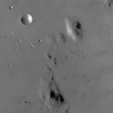
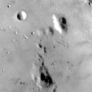
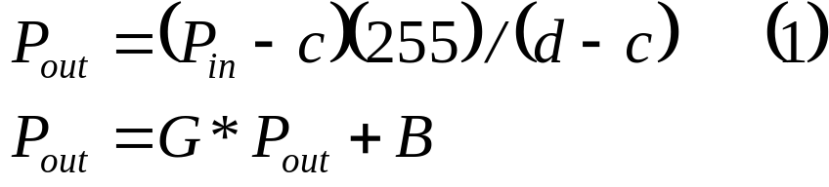
MATLAB Exercises 1 and 2
Ex1: out=imlin(in,G,B);
%G=gain, B= bias
Hw2-P1: It maps the highest value in 'in' to 255 and the lowest to 0. It maps in between values linearly. You can add gain and bias.
Ex2: function out=imlin2(in,a,b)
Hw2-P2: Write a function that do this linear
contrast stretching defined in Eq. (2).
Low=c, high =d
Low=a, high =b
Contrast stretching

Slide 3
MATLAB Exercise 3
function [out,F]=myhisteq(in,L);
%
% [out,F]=myhisteq(in,L);
%
% My histogram equalization function
% Takes an L level input image 'in' (must be integers)
% and maps it to an L Level output
% with an approximately flat histogram.
%
% out equalized image (L levels)
% F mapping function
% in input image (L levels, integer values)
% L # levels in input image
Hw2-P3: Run this code in Matlab after you write this function [out,F]=myhisteq(in,L);
Ca
load wva
test = wva(:,:,1);
hist(test(:),100); figure;
image(test); colormap(gray(256)); axis image
test2=myhisteq(test,256);
figure; hist(test2(:),100); figure;
image(test2); colormap(gray(256)); axis image

Slide 4
MATLAB Exercise 4
x=double(imread('cameraman.tif'));
Implement Gaussian smoothing filter as 2D and 1D (using separability). Compare run times for different size filters.
Use conv2 with row vector Gaussian array.
Use conv2 on the output of previous step using col vector Gaussian array.
Compare with conv2 using 2D Gaussian matrix

