Slide 1
Hw 6: affine_example
Consider rotation angle theta = pi/4;
1-Define Rotation matrix (column vector notation)
2-load pout.tif and display image of size (sy x sx)
3-define input pixel coordinates using meshgrid
4- Form new matrix IN similar to scalingtransformation.m
5-Perform coordinate transformation .
6- Extract the new X,Y coordinates by using clip function.
7-Use reshape function to create the new coordinates X and Y same size as input image
8- Use interp2 to find output
% What went wrong???
9-Define the center of rotation to be in the middle of the image
10- Define translation matrices as slide number 10 but (column notation)
11- repeat steps 5 to 8.

Slide 2
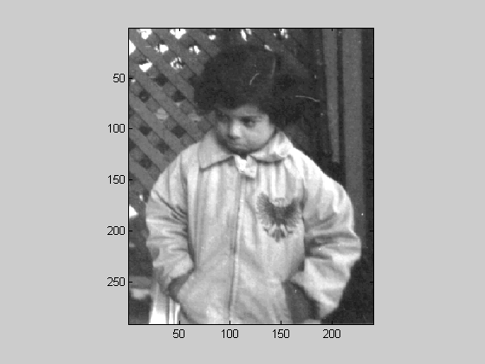
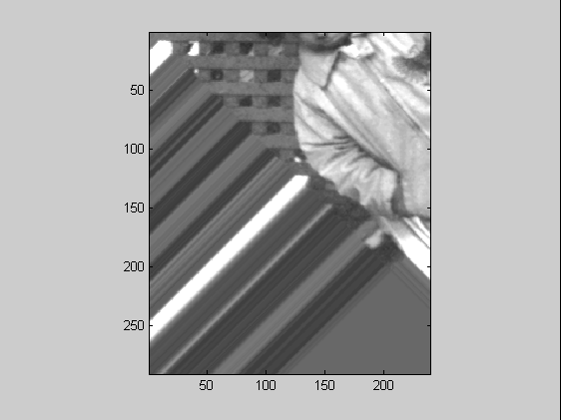
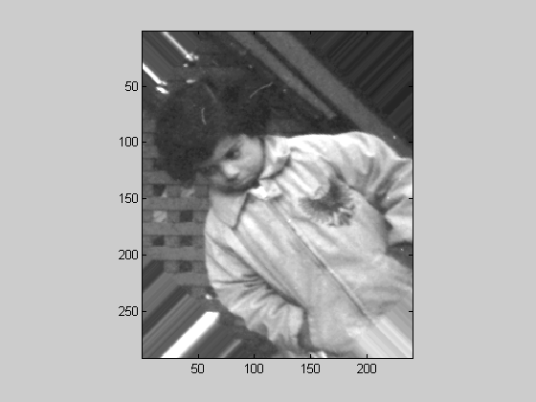
Output
Affine Transformations
COPYRIGHT © 2007 R. C. HARDIE. ALL RIGHTS RESERVED.

