Slide 1

Enhancing Credit Analysis & Assessment using Geospatial Techniques
By:
Deepak Kumar Gupta
Shruti Goyal
Supervisors: Prof. Peter Keenan, UCD
Selwyn Hearns, KPMG

Slide 2
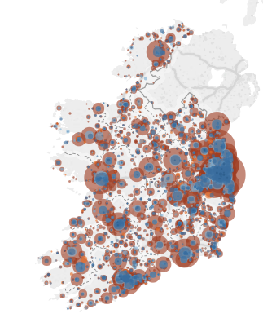









Business Problem
2007
2008
2009

Slide 3
Loan Process
Initial Application
Income, Asset Verification & Disclosure
Decision & Credit Scoring
Clear Approval Conditions
Closing

Slide 4
Previous Work

Slide 5
Previous Work
Method | Authors
Linear Regression | Lee and Chen (2005); Hand and Henley (1997)
Discriminant Analysis | Fisher (1936); Durand et al. (1941); Altman (1968); Eisenbeis (1978); Zhou et al. (2016); Liberati et al. (2017)
Logistic Regression | Hosmer et al. (1989); Altland (1999); Nie et al. (2011); Abdou et al. (2008); Bensic et al. (2005); Joanes (1993)
Decision trees | Kohavi and Quinlan (2002); Breiman et al. (1984); Zhang et al. (2010); Zekic-Susac et al. (2004); Zhou et al. (2008); Huang et al. (2007); Xia et al. (2017); Koh et al. (2015); Koutanaei et al. (2015)
Neural networks | Demuth et al. (2008); West (2000); Gately (1995); Presky et al. (1996); Ghosh and Reilly (1994); Desai et al. (1996)

Slide 6
Previous Work
Durand et al. (1941) used the Discriminant analysis for modelling a scoring system that gives a prediction about loan repayment.
Limitations:
Reduction in dimensionality
Improper estimation of classification error
Using linear functions instead of quadratic function

Slide 7
Previous Work
Huang et al. (2007) used decision tree along with support vector machines to build credit scoring model
Limitations of SVMs:
Long training time
Black box nature of model( similar to NNs)

Slide 8
Previous Work
Carling and Lundberg (2005) combined the geographical information with loan data to examine the credit rationing.
Finding:
Technological changes out weight needs of geographical proximity
Increasing distance between lender and borrower might be alarming

Slide 9
Methodology

Slide 10
Data
Data Sources:
Credit Rating and Loan portfolio from Bank
Property price register
Employment Rate(CSO)
Key Variables:
DefaultedLoans
CreditRating
PropertyValue
LoanBalance
LTV
InterestType
ProbationaryLoans
County
Town
AddressLatitude
AddressLongitude

Slide 11
Data Assumptions
Geospatial data such as address latitude and address longitude is assumed to depict geospatial location of a property correctly
Dimensions of house and size of the house(number of rooms, bathrooms, lawn, etc.) are not considered during model development
Factors such as neighbourhood, amenities etc. are not considered that affects the property price in the market

Slide 12
Algorithms Considered
Logistic Regression
Decision Tree(CART)

Slide 13
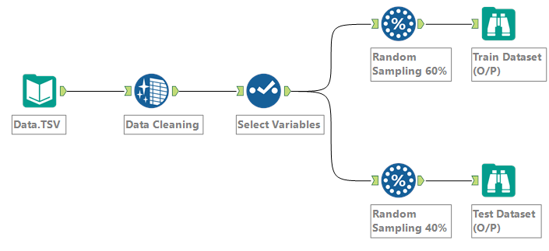
Data Processing

Slide 14

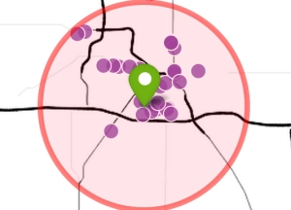



Our Approach
Select Origin City/Town
Select Radius (in KMs)
Aggregated data processed by predictive model in R Server
Send probability of default to Tableau
Visualize using dashboard

Slide 15
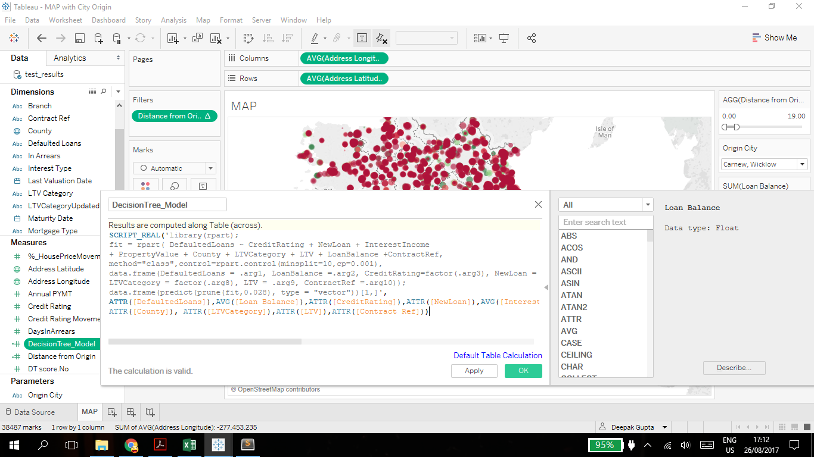
Connecting Tableau with R
Here you have a list of items

Slide 16
Observations

Slide 17
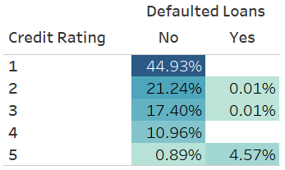
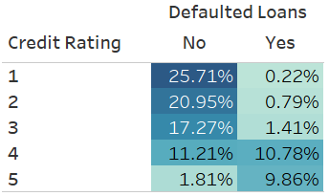
Distribution of Loan Accounts
Original Data
Normalized Data

Slide 18
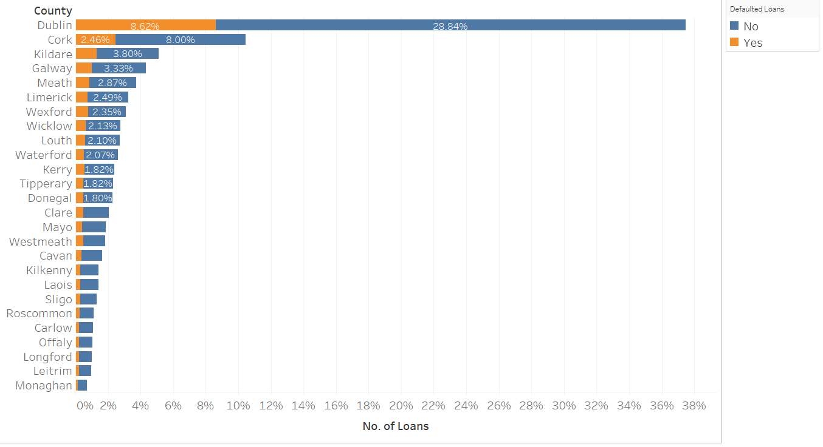
Distribution of Loan Accounts vs County

Slide 19
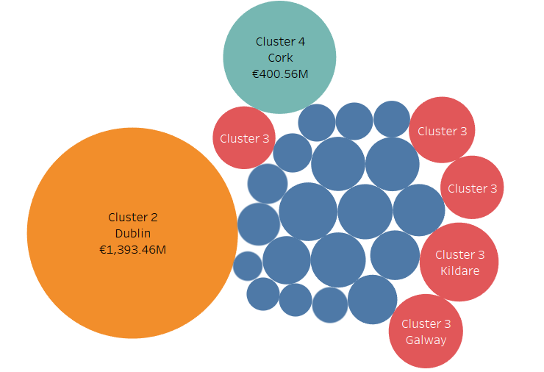
Clustering County based on Loan Balance

Slide 20
Results
Logistic Regression and Decision Tree

Slide 21
Model Performance Metrics
 | Logistic Regression |  |  | Decision Tree
Data/Measure | AUROC | KS | Gini | AUROC | KS | Gini
Original Data | 99.82 | 15 | 10 | 99.72 | 99.38 | 99.44
Normalized Data | 67.61 | 24 | 16 | 81.4 | 59.96 | 62.8

Slide 22
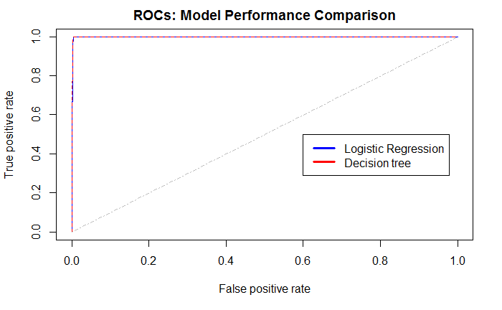
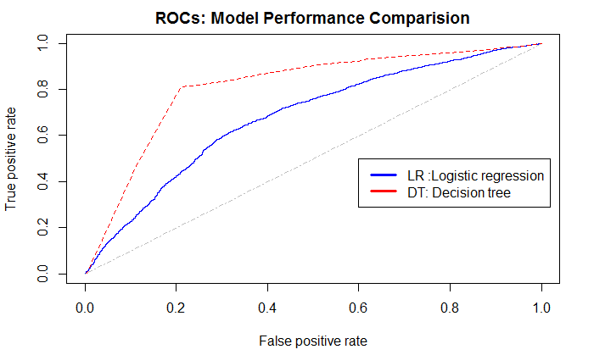
Model Performance Comparison
Original Data
Normalized Data

Slide 23
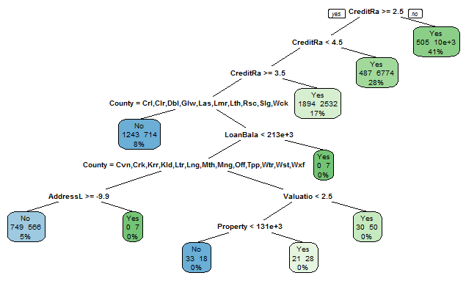
Decision Tree ⁺
⁺ Limited number of nodes in tree due to page size constraint

Slide 24
Dashboard Links
Overview
Portfolio Analysis
Predictive Model

Slide 25
Measure of Success
47%
70% users
60% users
Auditors feel this dashboard is extremely useful
Feel that geospatial techniques have enhanced credit assessment
Likely to recommend this dashboard to colleagues

Slide 26
End Users Profile⁺
Selwyn H
Head of IRM Audit at KPMG Ireland
James F
Auditor, KPMG
Simon M
Head of Data Science, Segmatic
John M
Software Developer, Kinesene Ltd
Ciaran F
Senior Product Consultant, Tableau
John L
Banking Director, SAS UKI
⁺ selective users profile out of 15

Slide 27
Business Contributions

Slide 28
Business Contributions
Interactive way to identify patterns in datasets to drill down into problem areas
Well timed potential issues indicators that adhere to provisions of audit processes and assessment of residential loans
Better and greater coverage of problem areas and increased focus on judgemental loan applications
Integration of useful and relevant market data and economic indicators for enhanced loan assessment

Slide 29
Recommendations

Slide 30
Recommendations
Dashboard
Real transactional data can improve the performance of Tableau dashboard which acts as decision support system
Geospatial Data
Credit assessment can be enhanced if it includes information such as house coordinates
External Factor
The model can perform better when trained with large number of external factors such as medical information, average salary in neighbourhood

Slide 31




Recommendations
Detailed system architecture for geospatial based credit assessment model
Transactional Data
External Data
CSO
Property Price Register
Real Time Data Loading
Production Data warehouse
QA Data warehouse
Alteryx Server (Bigdata Processing)
Business Reports
Tableau
Server
Microsoft R Server

Slide 32
Our Learning

Slide 33

Our Learning
Importance of Data Processing
Deployment of RServer
How performance of a model can vary with data
Human interaction is must in credit analysis

Slide 34
