Slide 1


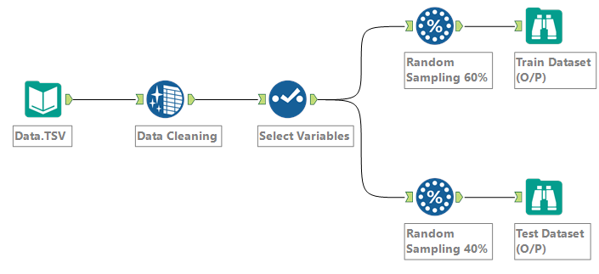
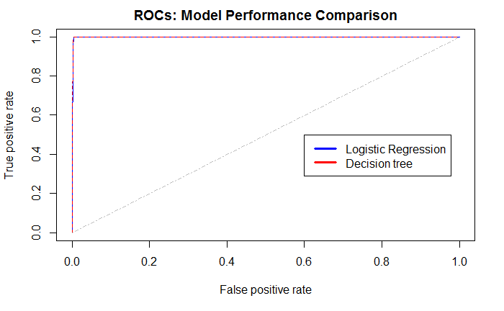
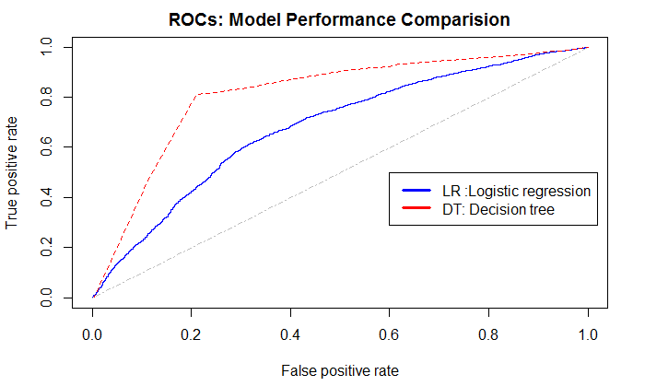
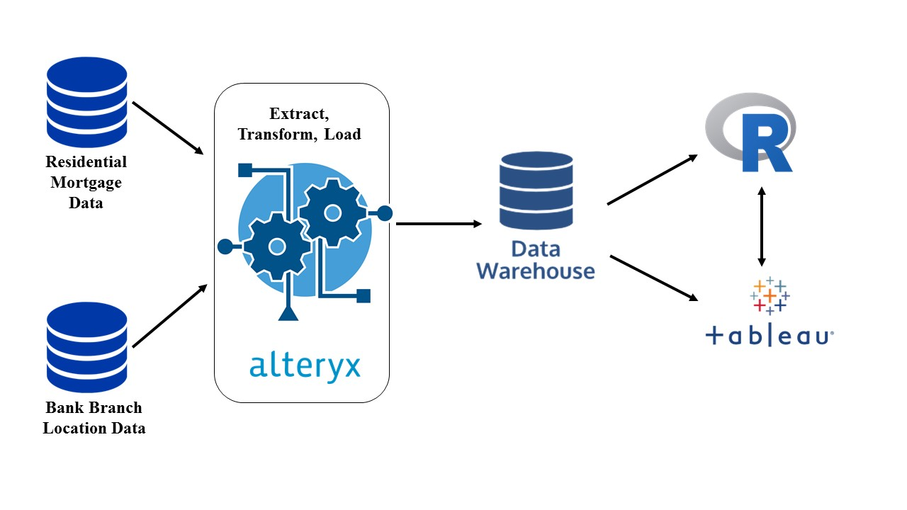
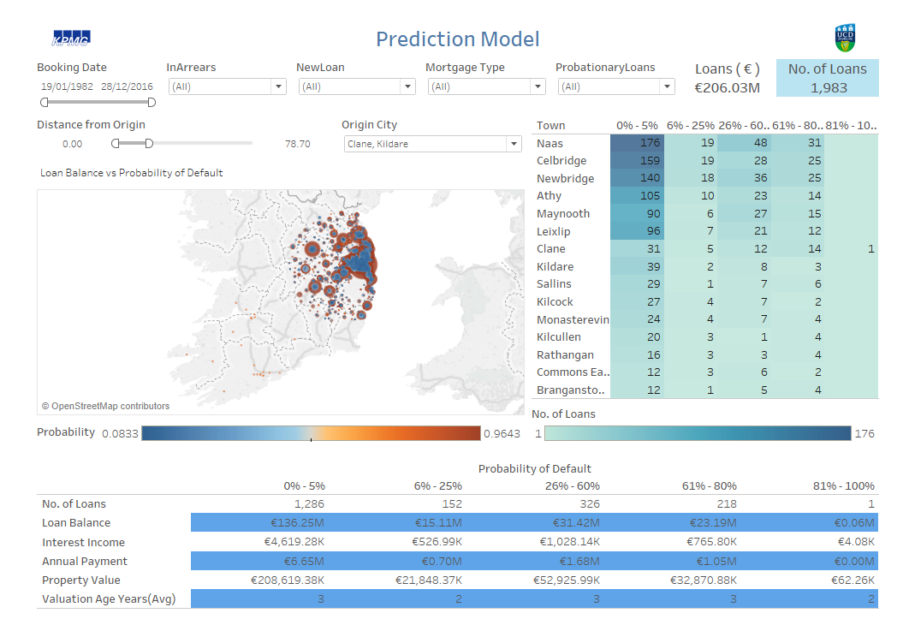
Enhancing Credit Analysis & Assessment Using Geo-Spatial Techniques Deepak Kumar Gupta, Shruti Goyal, Supervisor: Prof. Peter Keenan MSc Business Analytics ( Practicum)
Problem Statement: To improve information and underlying data with regard to loan performance, particularly in the property sector using Geo-spatial techniques with interactive dashboard.
Phase 1
Data Preprocessing
Results:
Model performance evaluated with original data and normalized data on Logistic regression and decision tree. Both model gave accuracy of 99.89% but with normalized dataset, decision tree outperformed logistics regression by 20% better accuracy.
Model | Logistic Regression |  |  | Decision Tree
Data/Measure | AUROC | KS | Gini | AUROC | KS | Gini
Original Data | 99.82 | 99.25 | 99.64 | 99.72 | 99.38 | 99.44
Normalized Data | 67.61 | 28.68 | 35.22 | 81.4 | 59.96 | 62.8
Phase 2
Data Model
A. Original Data
B. Normalized Data
Phase 3
Visualization & Dashboard
Business Contributions:
1. Auditors and credit analysts can use the dashboard to identify potential default loans
2. Financial institutions can develop new business strategies to offer loans targeted to particular areas
Conclusion:
47% user said this dashboard is extremely useful as auditing tool for loan portfolios.
Decision tree perform better over logistic regression model
Algorithm performance can be improved when real transactional data plugs in.

