Slide 1

Title : Printed Circuit Board Defect Detection Using YOLOv12-S
TEAM 10
SL.NO | NAME | ROLL.NO | USN
1. | Pooja R K | 259 | 01fe23bec080
2. | Shrushti Torgal | 212 | 01fe23bec017
3. | Brunda K | 214 | 01fe23bec019
Guide : Ramesh A Tabib
Department of Electronics and Communication

Slide 2
Outline
Problem Statement Objectives
Introduction
Litreature Survey
Block Diagram
Trend Analysis
Proposed Methodology
Contributions
Results
Future Work
References
Department of Electronics and Communication

Slide 3
Problem Statement
Design of an automated PCB defect detection system is required to accurately identify surface-level defects in high-density printed circuit boards. Manual inspection is slow, inconsistent, and unsuitable for high-speed industrial manufacturing lines. Existing deep learning-based methods struggle with microscopic, low-contrast, and overlapping defects in real-time conditions. Therefore, an efficient, accurate, and scalable automated inspection framework is essential for industrial PCB quality assurance.
Objectives
Design an automated PCB defect detection system
Accurately detect and classify critical PCB surface defects
Enhance detection of microscopic and low-contrast defects
Ensure high accuracy with ultra-low inference latency
Department of Electronics and Communication

Slide 4
Introduction
High-density and miniaturized PCBs contain microscopic surface defects that directly affect product reliability and safety.
Manual inspection and traditional AOI systems are slow and inconsistent, while existing deep learning models struggle
with small, low-contrast, and overlapping defects.
Current methods fail to balance accurate detection of microscopic defects with real-time performance required for
industrial production lines.
We design an efficient YOLOv12-s–based framework using attention-guided feature learning and clean dataset
preparation without increasing model complexity.
To develop a scalable, accurate, and real-time PCB defect inspection system suitable for high-speed industrial manufacturing.
Department of Electronics and Communication

Slide 5
Litrerature Survey
Author / Year | Method / Model | Key Strengths | Limitations / Gaps | Remarks
Redmon et al. (2016) | YOLO | End-to-end detection, fast inference | Poor performance on small objects | Not suitable for PCB micro-defects
Tang et al. (2019) | Traditional CNN + PCB Dataset | Introduced PCB defect dataset | Limited generalization, no real-time support | Dataset-focused work
Chen et al. (2022) | Transformer-YOLO | Improved global context modelling | High computational cost | Not practical for industrial deployment
Shen et al. (2024) | YOLOv5-based PCB Detection | Improved speed over CNN methods | Struggles with low-contrast and overlapping defects | Limited attention modeling
Mo et al. (2025) | Lightweight YOLO (SGT-YOLO) | Reduced model size | Accuracy drops for complex defects | Trade-off between speed and accuracy
Yuan et al. (2025) | YOLO-SSW | Enhanced feature extraction | Sensitive to dataset noise | Annotation consistency not addressed
Proposed Work | YOLOv12-s + Area Attention | High accuracy, real-time, attention-guided detection | — | Addresses accuracy, speed, and dataset issues simultaneously
Department of Electronics and Communication

Slide 6
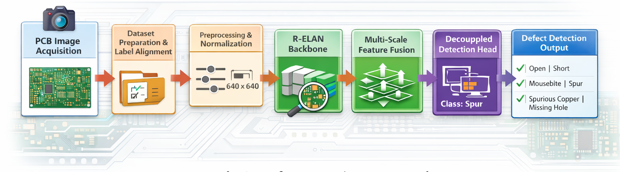
Block Diagram
Department of Electronics and Communication

Slide 7
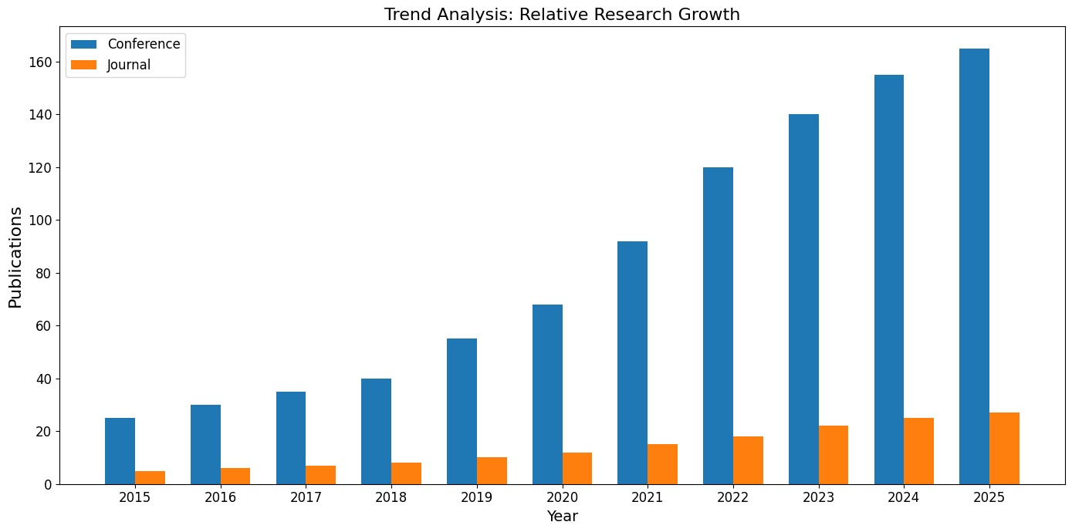
Trend Analysis
The trend analysis illustrates the growth of research activity in automated PCB defect detection from 2015 to 2025, based on conference and journal publications.
Conference publications show a sharp and continuous increase, indicating rapid innovation and early adoption of deep learning techniques in this domain.
Journal publications also grow steadily, reflecting the gradual maturation and validation of these methods for industrial use. A significant rise after 2019 highlights the impact of YOLO-based object detection frameworks and attention mechanisms in PCB inspection research.
This sustained growth demonstrates increasing industrial demand for real-time, accurate, and scalable PCB defect detection systems, thereby strongly motivating the proposed YOLOv12-s–based approach
Department of Electronics and Communication

Slide 8
Methodlogy
Input Acquisition: Capture high-resolution PCB images using AOI or industrial cameras.
Dataset Preparation: Apply label alignment, repair, and synchronization to ensure consistent annotations.
Preprocessing: Resize images to uniform size (640×640) and normalize pixel values for stable training.
Feature Extraction (R-ELAN Backbone): Extract multi-scale hierarchical features while preserving fine
PCB trace details.
Area Attention Mechanism: Highlight defect-prone regions to improve detection of microscopic, low-contrast
defects.
Multi-Scale Feature Fusion (FPN + PAN): Combine high-level semantic and low-level spatial features for
consistent detection across defect sizes.
Decoupled Detection Head: Separate bounding box regression and defect classification for accurate predictions.
Loss Function: Use combined CIoU + BCE + DFL to optimize localization and classification.
Inference Pipeline: Single-stage, forward-pass detection ensuring real-time performance with low latency
(~3 ms per image).
Result Output: Predict defect type and location for six classes – Open, Short, Mousebite, Spur,
Spurious Copper, Missing Hole.
Department of Electronics and Communication

Slide 9
Contributions
Attention-Guided Detection: Introduces an Area Attention ($A^2$) mechanism to focus on defect-prone regions.
Hierarchical Feature Extraction: Uses R-ELAN backbone for multi-scale feature representation while preserving
fine PCB traces.
Decoupled Detection Head: Separates bounding box regression and classification for improved accuracy.
Combined Loss Function: Integrates CIoU, BCE, and DFL for precise localization and defect classification.
Label Repair Protocol: Corrects dataset inconsistencies, ensuring reliable and reproducible training.
High Performance: Achieves real-time inference (~3 ms per image) with mAP@50 of 98.61% on DeepPCB dataset.
Department of Electronics and Communication

Slide 10
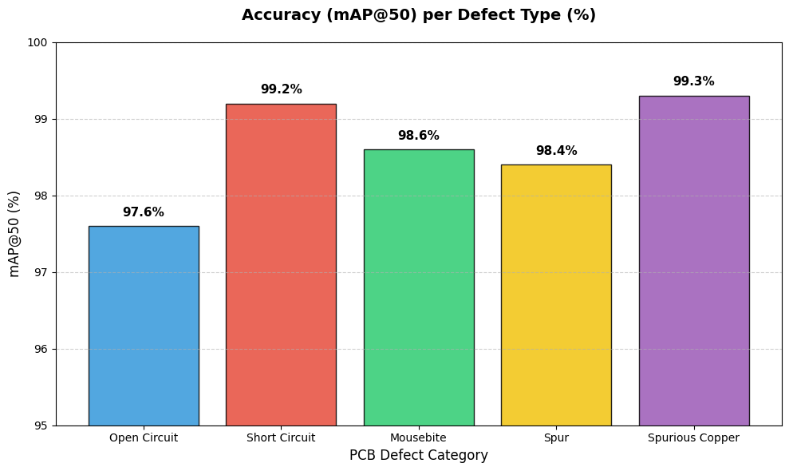
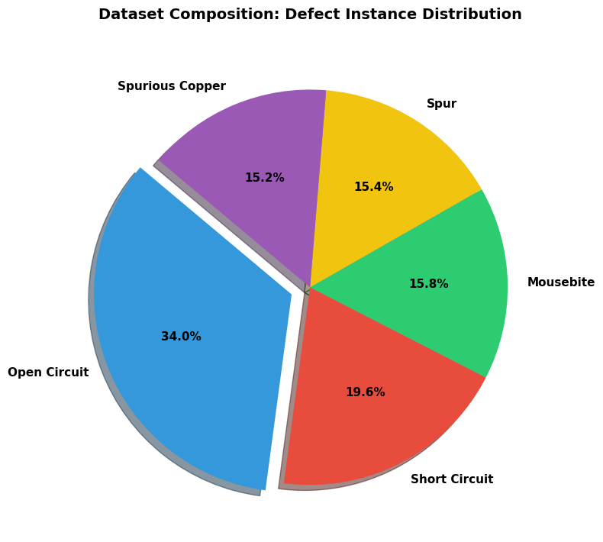
Results
The presented results summarize both the dataset characteristics and the class-wise detection performance of the proposed PCB defect detection framework.
The dataset shows a realistic distribution of defects, where open circuit defects dominate with 34.0%, followed by short circuits at 19.6%, while mousebite, spur, and spurious copper defects are nearly evenly distributed at around 15% each, indicating moderate class imbalance.
Despite this imbalance, the proposed YOLOv12-s model achieves consistently high detection accuracy across all defect categories. Spurious copper and short circuit defects achieve the highest mAP@50 values of 99.3% and 99.2%, respectively, while challenging micro-defects such as mousebite and spur reach 98.6% and 98.4%. Open circuit defects also maintain reliable performance at 97.6%. These results demonstrate that the proposed framework effectively handles both dominant and minority defect classes, confirming its suitability for accurate and real-time industrial PCB inspection.
Department of Electronics and Communication

Slide 11
Contributions
Attention-Guided Detection: Introduces an Area Attention ($A^2$) mechanism to focus on defect-prone regions.
Hierarchical Feature Extraction: Uses R-ELAN backbone for multi-scale feature representation while preserving
fine PCB traces.
Decoupled Detection Head: Separates bounding box regression and classification for improved accuracy.
Combined Loss Function: Integrates CIoU, BCE, and DFL for precise localization and defect classification.
Label Repair Protocol: Corrects dataset inconsistencies, ensuring reliable and reproducible training.
High Performance: Achieves real-time inference (~3 ms per image) with mAP@50 of 98.61% on DeepPCB dataset.
Department of Electronics and Communication

Slide 12
Contributions
Extend the framework to detect sub-surface and internal PCB defects by integrating X-ray or multimodal
inspection data.
Improve robustness under varying illumination and noise conditions using adaptive preprocessing and domain
adaptation techniques.
Optimize the model for edge and embedded deployment by applying pruning and quantization while maintaining
accuracy.
Expand evaluation to larger and more diverse industrial datasets to ensure generalization across different PCB
layouts and manufacturers.
Explore self-supervised and semi-supervised learning to reduce dependency on fully annotated PCB datasets.
Department of Electronics and Communication

Slide 13
References
J. Redmon, S. Divvala, R. Girshick, and A. Farhadi, “You Only Look Once: Unified, Real-Time Object Detection,”
Proceedings of the IEEE Conference on Computer Vision and Pattern Recognition (CVPR), pp. 779–788, 2016.
S. Tang, C. Luo, Y. Wang, and X. Zhang, “Online PCB Defect Detector on a New PCB Defect Dataset,” arXiv preprint
arXiv:1902.06197, 2019.
Ultralytics, “YOLOv12: Attention-Centric Real-Time Object Detectors,” GitHub Repository, 2025. Available online.
T. Yuan, X. Li, and H. Zhang, “YOLO-SSW: An Improved Detection Method for Printed Circuit Board Surface Defects,”
Mathematics, vol. 13, 2025.
M. Shen, Y. Liu, and K. Wang, “Defect Detection of Printed Circuit Board Assembly Based on YOLOv5,” Scientific Reports,
vol. 14, 2024.
G. Xiao, H. Zhang, and L. Chen, “PCB Defect Detection Algorithm Based on CDI-YOLO,” Scientific Reports, vol. 14, 2024.
X. Chen, L. Zhang, and K. Wang, “YOLO-PCBI: An Enhanced Object Detection Network for Microscopic PCB Defects,”
IEEE Robotics and Automation Letters, vol. 9, no. 3, pp. 2145–2152, 2024.
Y. Liu and K. Wang, “Optimizing Feature Pyramids for Small Object Detection in Printed Circuit Boards,”
IEEE Transactions on Instrumentation and Measurement, vol. 73, pp. 1–12, 2025.
Department of Electronics and Communication

Slide 14
THANK YOU
Department of Electronics and Communication

