Slide 1
ENERGY & UTILITIES
AI-Powered
Smart Grid
Digital Twin
Intelligent Operational Ecosystem for Energy & Utilities.
LIVE SIGNALS → SIMULATED DECISIONS → SAFER ACTION
Notes:
The concept joins live grid intelligence with a digital twin. AI recommends action; the twin tests it before it can affect physical infrastructure. This is a proposed operational ecosystem, not a claim of deployed performance.

Slide 2
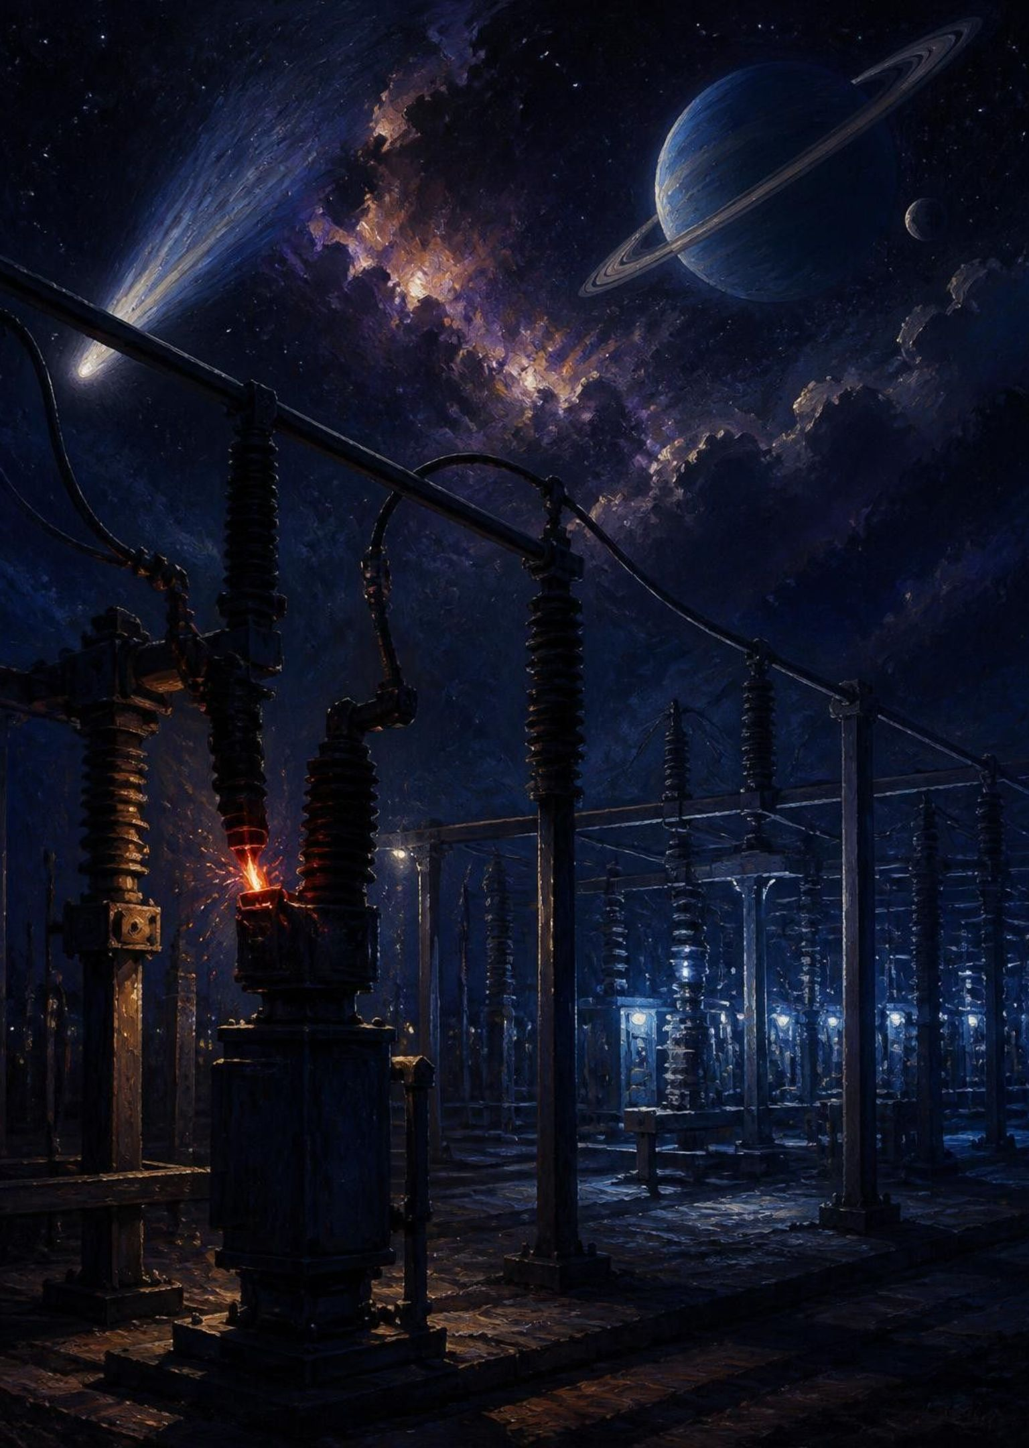

THE OPERATING GAP
The grid is data-rich but decision-poor
Unexpected outages
Renewable uncertainty
Equipment failures interrupt supply.
Solar and wind change the operating picture.
Slow fault detection
Fragmented grid data
Manual inspections delay response.
Energy losses stay hard to locate.
Signals arrive, decisions lag.
Notes:
The issue is the gap between sensing and deciding. Measurements live across systems, renewable output varies, and inspection workflows can be slow. The digital twin is intended to turn those disconnected signals into a shared operational decision.

Slide 3
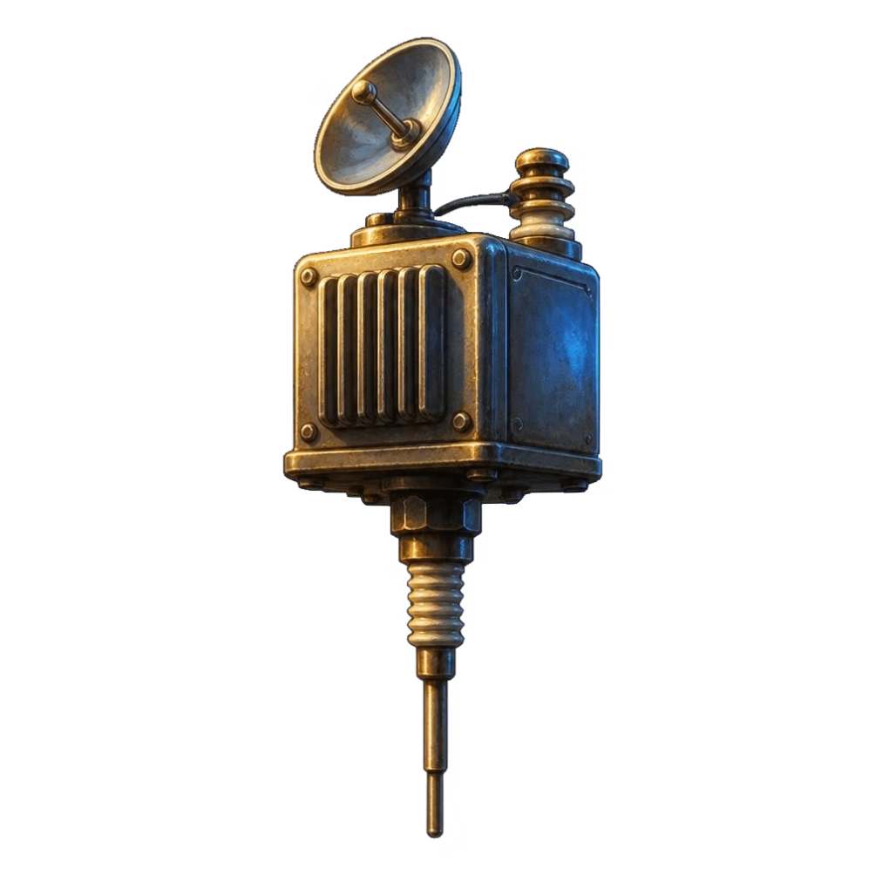
SIMULATE BEFORE YOU ACT
One digital twin predicts problems before they happen
01
02
03
04
05
06
Sensors
IoT/SCADA
AI Engine
Digital Twin
Prediction
Action
Capture
Connect
Analyze
Simulate
Anticipate
Respond
Every AI action is simulated in the twin first.
Failed simulations never reach the grid.
A safety gate between recommendation and execution.
Notes:
Read the pipeline from left to right. Live telemetry reaches the AI engine, then the twin evaluates the proposed intervention. Prediction becomes action only after simulation passes. The static sequence represents the requested animated flow and remains readable in exports.

Slide 4
CONNECTED ARCHITECTURE
From live data to action in five layers
Data sources | SCADA · AMI smart meters · PMU · Weather · Solar/wind · GIS · Drone/thermal
Data platform | IoT platform · Time-series database · OT historian
AI engine | Forecasting · Anomaly detection · Predictive maintenance · Outage prediction · Optimization · Computer vision
Digital twin | Real-time virtual replica of the grid
Applications | Control room · Field engineer app · Executive analytics
Notes:
The architecture flows downward through every layer. Sources feed the platform; the platform provides context to six AI modules. The twin validates proposed changes and exposes the resulting intelligence to operators, engineers and executives. The luminous offset plates express the requested layered 3D architecture without flattening it into a generated image.

Slide 5
Six AI modules, one ranked decision, tested in the twin
SIX MODULES
Load and renewable generation forecasting
Fault and anomaly detection
Predictive maintenance and outage prediction
Power flow and DER optimization
SIMULATED SCENARIO
Transformer health anomaly
Live grid state · Fault location flagged
Rank the intervention.
Test it in the twin.
Without AI
With AI
Fault → Failure → Outage → Long downtime
Anomaly → Prediction → Engineer alert → Preventive maintenance
Scenario outcome: no major outage
Notes:
This is the showcase scenario, not measured field performance. Forecasting covers load and renewable generation. Optimization covers power flow and distributed energy resources. The six modules surface a ranked intervention; the twin checks it before execution. In the transformer scenario, an anomaly triggers prediction, an engineer alert and preventive maintenance before failure. Status labels are editable overlays, not generated interface text.

Slide 6


HUMAN-GUIDED AUTONOMY
Reactive grid → Predictive grid → Autonomous grid
Respond after failure → intervene before failure → execute validated actions.
Control room and field engineer app share one live grid state.
TARGETS, NOT MEASURED RESULTS
Shorter outages, better prediction accuracy and faster field response
Lower maintenance cost and energy losses
Higher renewable utilization; more assets monitored at scale
AI · IoT · Digital Twin · Renewable Energy · Human Engineers
Predict. Prevent. Optimize. Power the Future.
Notes:
Autonomy is a progression with engineers in the loop, not a claim that the grid is already self-operating. Evaluate the concept against these targets without presenting them as measured results. Operators and field engineers work from the same live state, while twin validation remains the gate for action.

