Slide 1

Internet Of things
Lecturer: Reza Arjmandi
Summer 2016
Preface:
In this chapter, you will learn how your Raspberry Pi can participate in the Internet of Things in various ways.

Slide 2
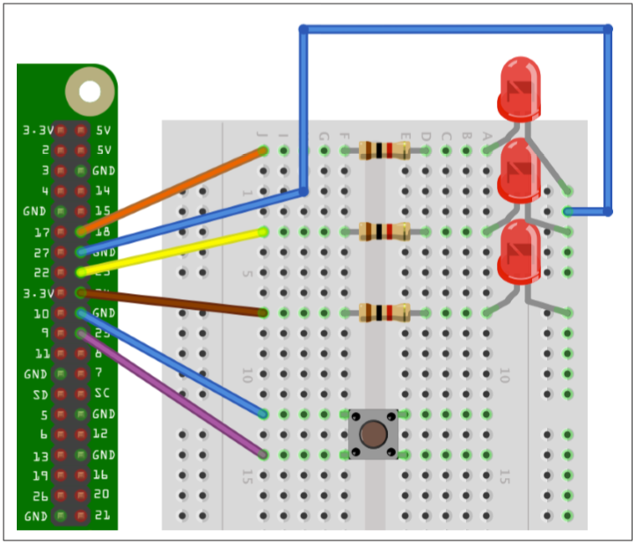
Web_Control project
Use the bottle Python web server library to create an HTML web interface to control the GPIO port.
install the bottle library

Slide 3
Web_Control project
from bottle import route, run
import RPi.GPIO as GPIO
GPIO.setmode(GPIO.BCM)
LedPins = [18, 23, 24]
LedStates = [0, 0, 0]
SwitchPin = 25
GPIO.setup(LedPins[0], GPIO.OUT)
GPIO.setup(LedPins[1], GPIO.OUT)
GPIO.setup(LedPins[2], GPIO.OUT)
GPIO.setup(SwitchPin, GPIO.IN, pull_up_down=GPIO.PUD_UP)

Slide 4
Web_Control project
def GetSwitchStatus():
state = GPIO.input(SwitchPin)
if state:
return 'Up'
else:
return 'Down'
def HtmlForLed(led):
l = str(led)
result = " <input type='button' onClick='changed(" + l + ")' value='LED " + l + "'/>"
return result
def UpdateLeds():
for i, value in enumerate(LedStates):
GPIO.output(LedPins[i], value)

Slide 5
Web_Control project
@route('/')
@route('/<led>')
def index(led="n"):
print(led)
if led != "n":
LedNum = int(led)
LedStates[LedNum] = not LedStates[LedNum]
UpdateLeds()
response = "<script>"
response += "function changed(led)"
response += "{"
response += " window.location.href='/' + led"
response += "}"
response += "</script>"
response += '<h1>GPIO Control</h1>'
response += '<h2>Button=' + GetSwitchStatus() + '</h2>'
response += '<h2>LEDs</h2>'
response += HtmlForLed(0)
response += HtmlForLed(1)
response += HtmlForLed(2)
return response

Slide 6
Web_Control project
try:
run(host='0.0.0.0', port=80)
finally:
print('\nCleaning up')
GPIO.cleanup()
You must run the program as superuser
Open a browser window from any machine on your network, even the Raspberry Pi itself, and navigate to the IP address of the Raspberry Pi. The web interface shown in following Figure should appear.
if you hold down the button as you reload the web page, you should see that the text next to Button says Down rather than Up.

Slide 7
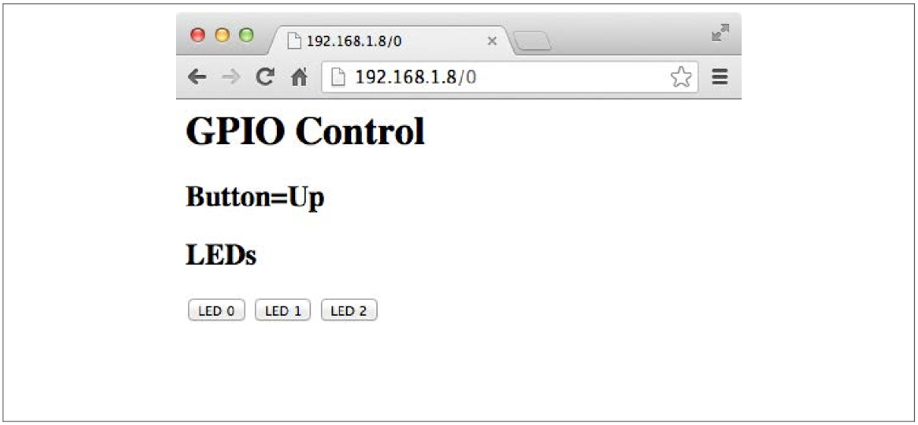
Web_Control project

Slide 8

dweet.io
dweet.io doesn't require any setup or sign-up— just publish and go. It's machine-to-machine (M2M) for the Internet Of Things (IOT) the way it was meant to be.
Dweeting

Slide 9
Dweeting
To dweet from your thing, simply call a URL like:
https://dweet.io/dweet/for/my-thing-name?hello=world
Just replace my-thing-name with a unique name. That's it!
Any query parameters you add to the request will be added as key-value pairs to the content of the dweet. For example:
https://dweet.io/dweet/for/my-thing-name?hello=world&foo=bar

Slide 10
Getting Dweets
To read the latest dweet for a thing, you can call...
https://dweet.io/get/latest/dweet/for/my-thing-name
Note that dweet.io only holds on to the last 5 dweets over a 24 hour period. If the thing hasn't dweeted in the last 24 hours, its history will be removed.
Or to read all the dweets for a dweeter, you can call...
https://dweet.io/get/dweets/for/my-thing-name

Slide 11
Real-time Streams
You can also create a real-time subscription to dweets using a "chunked" HTTP response.
Just make a call to
https://dweet.io/listen/for/dweets/from/my-thing-name
(Note, this won't work in a standard browser)
The server will keep the connection alive and send you dweets as they arrive, like:
{"thing":"my-thing-name","created":"2014-02-17T01:10:21.901Z","content":{"foo":"bar"}}
If you don't know what a chunked HTTP response is, it might be easier to use one of our client libraries below.

Slide 12
Client Libraries
You can also access dweet.io even quicker and easier with these pre-built client libraries.
To access Dweet from your Python program, the dweepy library needs to be installed, using the following commands:
git clone git://github.com/paddycarey/dweepy.git
cd dweepy
sudo python setup.py install

Slide 13
Internet_Control Project
We want chage the Web_Control project in a way that user can control the LED’s throghout the internet.
Use the dweet.io M2M service for messaging between Server-Side application and Client-Side interface.

Slide 14
Dweet.html (Client-Side)
<script src="http://ajax.googleapis.com/ajax/libs/jquery/1.7.2/jquery.min.js" type="text/javascript" charset="utf-8"></script>
<script>
function dweet(address){
$.get(address);
}
</script>
<h1>GPIO Control</h1>
<h2>LEDs</h2>
<input type='button' onClick='dweet("https://dweet.io/dweet/for/rpi_course_iot_projects?led0=1&led1=0&led2=0")' value='LED 1'/>
<input type='button' onClick='dweet("https://dweet.io/dweet/for/rpi_course_iot_projects?led0=0&led1=1&led2=0")' value='LED 2'/>
<input type='button' onClick='dweet("https://dweet.io/dweet/for/rpi_course_iot_projects?led0=0&led1=0&led2=1")' value='LED 3'/>

Slide 15
Dweet.py Project (Server-Side)
import time
import dweepy
import RPi.GPIO as GPIO
KEY = 'rpi_course_iot_projects'
led = [18, 23, 24]
led_states = [0, 0, 0]
GPIO.setmode(GPIO.BCM)
GPIO.setup(18, GPIO.OUT)
GPIO.setup(23, GPIO.OUT)
GPIO.setup(24, GPIO.OUT)
def UpdateLeds():
for i in range(len(led_states)):
GPIO.output(led[i], led_states[i])

Slide 16
Dweet.py Project (Server-Side)
while True:
try:
for dweet in dweepy.listen_for_dweets_from(KEY):
if(dweet['content']['led0'] == 1):
led_states[0] = not led_states[0]
elif(dweet['content']['led1'] == 1):
led_states[1] = not led_states[1]
elif(dweet['content']['led2'] == 1):
led_states[2] = not led_states[2]
UpdateLeds()
except Exception as e:
pass

Slide 17
poll(2) system call
One of the shortcomings of the input script is that it must poll the input pin’s value continuously, to see if the value has changed. In a multiprocessing environment like Linux, it is rude to burn the CPU like this (hence the compromise with the sleep command). A better design would have the program wait for a change on the input pin, allowing other processes to use the CPU while it waits.
The GPIO driver within the kernel is, in fact, able to do that, though not usable by shell commands. The C program evinput.c is an example program that takes advantage of this capability and is presented next. It uses the poll(2) system call to accomplish this. The basic procedure used is this:
1. The GPIO pin X is configured for input.
2. The value of /sys/class/gpio/gpioX/edge has been configured for the edge(s) to be reported
3. When querying the input pin, the open file descriptor for /sys/class/gpio/gpioX/value is provided to the poll(2) call (line 111).
4. The time-out is specified as –1 in argument 3, so poll(2) will wait forever, if necessary.
5. When there is new data for the GPIO input, poll(2) returns and rc will be greater than zero, breaking out of the loop.
6. The program must rewind to the beginning of the pseudo file with lseek(2) (line 118).
7. Finally, the text is read from the value file in line 119.

Slide 18
poll(2) system call
poll.h - definitions for the poll() function
The <poll.h> header shall define the pollfd structure that includes at least the following members:
int fd The following descriptor being polled.
short events The input event flags (see below).
short revents The output event flags (see below).

Slide 19
poll(2) system call
The following symbolic constants shall be defined, zero or more of which may be OR'ed together to form the events or revents members in the pollfd structure:
POLLIN Data other than high-priority data may be read without blocking.
POLLRDNORM Normal data may be read without blocking.
POLLRDBAND Priority data may be read without blocking.
POLLPRI High priority data may be read without blocking.
POLLOUT Normal data may be written without blocking.
POLLWRNORM Equivalent to POLLOUT.
POLLWRBAND Priority data may be written.
POLLERR An error has occurred ( revents only).
POLLHUP Device has been disconnected ( revents only).
POLLNVAL Invalid fd member ( revents only).

Slide 20
Compile Source Codes
For compile codes in gcc enter following command in terminal:
sudo gcc –Wall –c SourceCodeFile –o ObjectFileName
sudo gcc ObjectFileName –o ExecutableFileName

Slide 21
Test Run
A test was performed using a GPIO output pin (27) wired to the input pin (17). In one session, GPIO output pin 27 was changed from 0 to 1 and back. The events were captured in the other session, running ./evinput.
Input GPIO pin 17 was changed from this separate session, using output GPIO 27 (recall that it is wired to GPIO 17 for this test):
1 # cd /sys/class/gpio
2 # echo 27 >export
3 # ls
4 export gpio27 gpiochip0 unexport
5 # cd gpio27
6 # ls
7 active_low direction edge power subsystem uevent value
8 # echo out >direction
9 # echo 0 >value
10 # # s t a r t e d . / evinput 17 he r e . . .
11 # echo 1 >value
12 # echo 0 >value
13 # echo 1 >value

Slide 22
Test Run
Checking the system with the top command, you’ll see that ./evinput does not consume CPU. Yet the program is indeed responsive to the input change events. This leaves the CPU for all of your other processes that you may need to run
#include <fcntl.h>
#include <unistd.h>
#include <string.h>
#include <errno.h>
#include <signal.h>
#include <assert.h>
#include <sys/poll.h>
#include <string>
#include <iostream>
#include <fstream>
int GPIO_InPin = -1; /* GPIO input pin */
int is_signaled = 0; /* Exit program if signaled */

Slide 23
Test Run
typedef
enum { gp_export, gp_unexport, gp_direction, gp_edge, gp_value }
gpio_path_t;
std::string GPIO_GetPathAddress(int pin, gpio_path_t type)
{
std::string paths[] = {
"export",
"unexport",
"gpio" + std::to_string(pin) + "/direction" ,
"gpio" + std::to_string(pin) + "/edge",
"gpio" + std::to_string(pin) + "/value"
};
std::string result = "/sys/class/gpio/" + paths[type];
return result;
}

Slide 24
Test Run
int GPIO_OpenEdge(int pin, std::string edge)
{
std::string fileAddress;
std::ofstream file;
/* Export pin : /sys/class/gpio/export */
fileAddress = GPIO_GetPathAddress(pin, gp_export);
file.open(fileAddress);
file << pin << std::endl;
file.close();
/* Direction : /sys/class/gpio%d/direction */
fileAddress = GPIO_GetPathAddress(pin, gp_direction);
file.open(fileAddress);
file << "in" << std::endl;
file.close();

Slide 25
Test Run
/* Edge : /sys/class/gpio%d/edge */
fileAddress = GPIO_GetPathAddress(pin, gp_edge);
file.open(fileAddress);
file << edge << std::endl;
file.close();
/* Value : /sys/class/gpio%d/value */
FILE *f;
int fd;
fileAddress = GPIO_GetPathAddress(pin, gp_value);
fd = open(fileAddress.c_str(), O_RDWR);
return fd;
}

Slide 26
Test Run
void GPIO_Close(int pin)
{
std::string fileAddress;
std::ofstream file;
/* Unexport : /sys/class/gpio/unexport */
fileAddress = GPIO_GetPathAddress(pin, gp_unexport);
file.open(fileAddress);
file << pin << std::endl;
file.close();
}

Slide 27
Test Run
int GPIO_Poll(int fd)
{
struct pollfd polls;
polls.fd = fd; /* /sys/class/gpio17/value */
polls.events = POLLPRI; /* Exceptions */
int rc;
do
{
rc = poll(&polls, 1, -1); /* Block */
if (is_signaled)
return -1; /* Exit if ^C received */
} while (rc < 0 && errno == EINTR);
assert(rc > 0);
char buf[32];
int n;
lseek(fd, 0, SEEK_SET);
n = read(fd, buf, sizeof buf);/* Read value */
assert(n>0);
buf[n] = 0;
n = std::stoi(buf);
return n; /* Return value */
}

Slide 28
Test Run
void SigIntHandler(int signo)
{
is_signaled = 1; /* Signal to exit program */
}
int main(int argc, char **argv)
{
if (argc != 2)
{
std::cout << "Usage: " << argv[0] << "<gpio_in_pin>\n";
return 1;
}
GPIO_InPin = std::stoi(argv[1]);
if (GPIO_InPin < 0 || GPIO_InPin >= 32)
{
std::cout << "Usage: " << argv[0] << "<gpio_in_pin>\n";
return 1;
}
signal(SIGINT, SigIntHandler); /* Trap on SIGINT */

Slide 29
Test Run
int fd, v;
fd = GPIO_OpenEdge(GPIO_InPin, "both"); /* GPIO input */
std::cout << "Monitoring for GPIO input changes:\n";
while ((v = GPIO_Poll(fd)) >= 0)
std::cout << "GPIO " << GPIO_InPin << " changed: " << v << std::endl;
while (!is_signaled); /* Quit if ^C'd */
close(fd); /* Close gpio%d/value */
GPIO_Close(GPIO_InPin); /* Unexport gpio */
return 0;
}

Slide 30


Contact us
www.e-system.ir
Info@e-system.ir

