Slide 1

Raspberry pi Networking
Lecturer: Reza Arjmandi
Summer 2016
Preface:
This chapter gives you recipes for connecting your Raspberry Pi to the Internet and controlling it remotely over a network

Slide 2
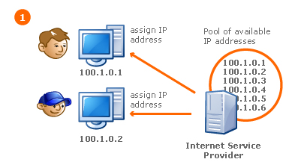
Network And IP
IP configuration:
Static
dynamic

Slide 3
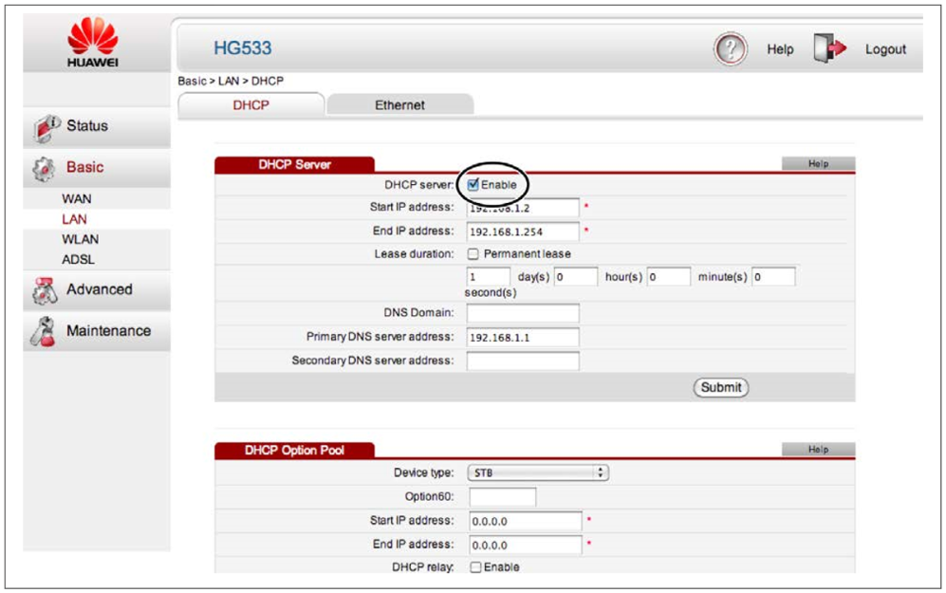
Connecting to a Wired Network
Raspbian distributions (in fact, pretty much all distributions for the Pi) are preconfigured to connect to any network using DHCP (Dynamic Host Configuration Protocol). They will automatically be assigned an IP address as long as DHCP is enabled on your network.

Slide 4
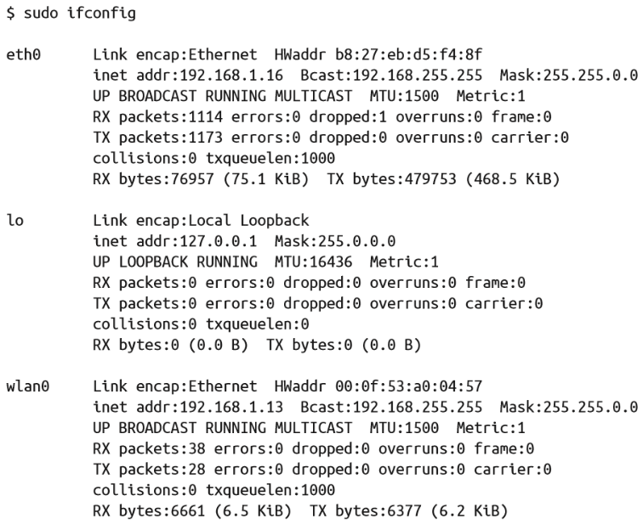
Finding Out Your IP Address
You want to know the IP address of your Raspberry Pi so that you can communicate with it, whether connecting to it as a web server, exchanging files, or controlling it remotely with SSH (future Recipe) or VNC (future Recipe) or XRDP (future Recipe).
An IP address is a four-part number uniquely identifying a computer’s network interface within a network. Each part is separated by a dot.

Slide 5
Setting a Static IP Address
1 - Enter following command in terminal (not save this configuration and change after reboot)
sudo ifconfig wlan0 192.168.43.132 netmask 255.255.255.0
set default gateway:
sudo route add default gw 192.168.43.1

Slide 6
Setting a Static IP Address
To set the IP address of your Raspberry Pi, whether using a wired or wireless network, you need to edit the configuration file /etc/network/interfaces.
To edit this file, type the following command:
$ sudo nano /etc/network/interfaces
If you are using a wired network, change the section for the adapter eth0; for a wireless network, change the section for wlan0.
Then comment(with write #) all block that start with wlan0 or eth0

Slide 7
Setting a Static IP Address
Then you need to edit the configuration file /etc/dhcpcd.conf .
To edit this file, type the following command:
$ sudo nano /etc/dhcpcd.conf
First, decide on an IP address to use. You need to pick one that is both unused by any other machine on the network and within the allowed range of IP addresses for your home hub.
adding the following lines at the end of file:
interface wlan0
static ip_address=X.Y.Z.50/24

Slide 8
Setting the Network Name of a Raspberry Pi
Changing the name of your Pi is pretty straightforward. There are just two files that need to be changed.
First, edit the file /etc/hostname.
You can do this by opening a Terminal window and typing the command:
$ sudo nano /etc/hostname
Replace “raspberrypi” with a name of your choice. This should remain one word, without any punctuation or unusual characters. This includes the _ character.

Slide 9
Setting the Network Name of a Raspberry Pi
Second, open the file /etc/hosts in an editor using the command:
$ sudo nano /etc/hosts
The file will look something like this:
127.0.0.1
localhost ::1
localhost ip6-localhost ip6-loopback
fe00::0
ip6-localnet ff00::0
ip6-mcastprefix ff02::1
ip6-allnodes ff02::2
ip6-allrouters
127.0.1.1 raspberrypi
Change the text at the end that uses the old name (“raspberrypi”) to the new name.

Slide 10
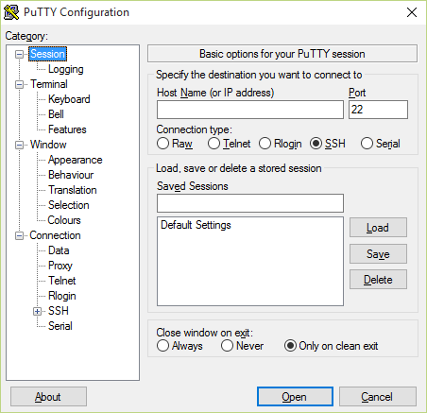
Controlling the Pi Remotely with SSH
The easiest way to set up SSH on the Raspberry Pi is to use the raspi_config application.
You can start this at any time by entering the following command in Terminal:
$ sudo raspi-config
Scroll down to the SSH option and enable it.
On newer versions of Raspbian, SSH is automatically enabled and there is no setting to change.

Slide 11
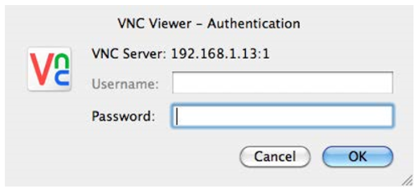
Controlling the Pi Remotely with VNC
If you need access to the full Raspberry Pi desktop environment remotely, then you need to use VNC
1-Install a VNC (Virtual Network Connection) server.
Open a Terminal session (or SSH session) on the Pi and run the following commands:
$ sudo apt-get update
$ sudo apt-get install tightvncserver
Having installed the VNC server, run it using the command:
$ vncserver :1
The first time you run this, you will be prompted to create a new password, so anyone connecting remotely has to enter the password before being granted access to the Pi.
To connect to the Pi from a remote computer, you will need to install a VNC client. RealVNC is a popular choice and connects well with tightvnc.
Enter “:1” after the IP address to indicate that you
wish to connect to display number 1.

Slide 12
Controlling the Pi Remotely with VNC
If you want the VNC server to automatically start whenever you restart your Raspberry Pi, follow these steps:
$ cd /home/pi
$ cd .config
$ mkdir autostart
$ cd autostart
$ nano tightvnc.desktop
Paste the following into the editor window:
[Desktop Entry]
Type=Application
Name=TightVNC
Exec=vncserver :1
StartupNotify=false

Slide 13
Controlling the Pi Remotely with RDP
You want access to the full Raspbian graphical desktop of your Pi from a PC or Mac OS X using RDP.
Install the XRDP software on your Raspberry Pi by entering the following commands:
$ sudo apt-get update
$ sudo apt-get install xrdp
Once the software is installed, it will automatically start the xrdp service, which means the service will automatically start when the Raspberry Pi is rebooted.
If you have Windows 7 or later, then it already includes an RPD client for connecting to your Raspberry Pi. You will find it on your Start menu under All Programs/Accessories/Remote Desktop Connection.
RDP does the same job as VNC but works more efficiently and therefore refreshes the contents of the screen more smoothly. The only downside is that for Mac OS X users, it does not integrate with the Share Screen feature of OS X.

Slide 14
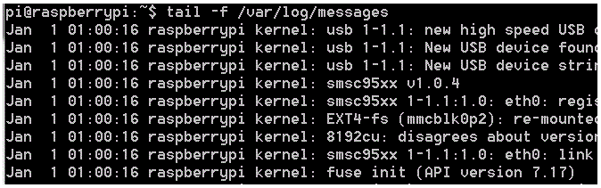
Using a Raspberry Pi for Network Attached Storage
Mount a USB Hard Disk Drive on Raspberry Pi:
First we need to find out where our system locates the device. Before you plug the USB device in, type…
tail -f /var/log/messages
You should then see something like this…

Slide 15
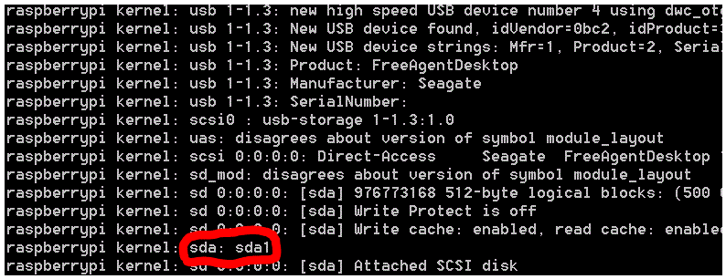
Using a Raspberry Pi for Network Attached Storage
Now plug your USB hard drive into the USB port (if externally powered) or USB hub (if USB powered) and watch for new messages. This is what came up when I plugged mine in…
As you can see it gives you all sorts of info about the disk drive. The main part which interests us is the id that the computer gave it. In this case, sda1 (circled in red).
At this point, the tail command has served its purpose so we can kill it with
CTRL-C

Slide 16
Using a Raspberry Pi for Network Attached Storage
First, install ntfs-3g file system driver:
sudo apt-get install ntfs-3g
Before we can mount the drive, we need to make a directory (folder) for it. You only have to do this the first time – you can use the same directory next time as it will still be there.
sudo mkdir /home/pi/USBHDD
If you are logged on as the default Raspberry Pi Debian user, pi, you will need to use this command to mount the drive with read/write permission.
sudo mount -t ntfs-3g -o uid=pi,gid=pi /dev/sda1 /home/pi/USBHDD
If that doesn’t work, it will give you an error message, then instead of ntfs-3g try vfat. Once you have it mounted, it’s time to explore

Slide 17
Using a Raspberry Pi for Network Attached Storage
You want to use your Raspberry Pi as Network Attached Storage (NAS) by accessing a large USB drive attached to your Raspberry Pi from computers on your network.
The solution to this problem is to install and configure Samba. To do this, issue the commands:
$ sudo apt-get install samba
$ sudo apt-get install samba-common-bin
Now, attach the USB hard drive to the Raspberry Pi. It will automatically mount in your /media folder. To check that it’s there, use the command:
You now need to configure Samba so the drive can be shared on the network. To do this, you first need to add a Samba user (pi). Enter the following command and type in a password:
$ sudo smbpasswd -a pi
New SMB password:
Retype new SMB password:
Added user pi.

Slide 18
Using a Raspberry Pi for Network Attached Storage
You now need to make some changes to the file /etc/samba/smb.conf, so enter the command:
$ sudo nano /etc/samba/smb.conf
The first line you’re looking for is near the top of the file:
workgroup = WORKGROUP
You only need to change this if you plan to connect from a Windows machine. This should be the name of your Windows workgroup. For Windows XP, the default is MSHOME; for newer versions of Windows, it is HOME. (But check on your Windows network.)
The next change to be made is further down the file in the Authentication section. Find the line:
# security = user
Remove the # from the front to turn security on.

Slide 19
Using a Raspberry Pi for Network Attached Storage
Finally, scroll right to the end of the file and add the following lines:
[USB]
path = /home/pi/USBHDD
comment = NAS Drive valid
users = pi
writeable = yes
browseable = yes
create mask = 0777
public = yes
Save the file and then restart Samba by entering the command:
$ sudo /etc/init.d/samba restart

Slide 20
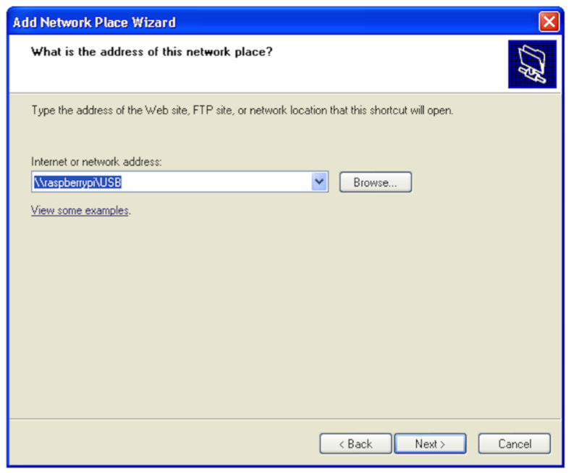
Using a Raspberry Pi for Network Attached Storage
If you are connecting to the NAS from a Windows machine, the exact procedure will vary depending on your version of Windows. However, the basic principle is that at some point you will need to enter the network address, which should be \\raspberrypi\USB

Slide 21
Using a Raspberry Pi for Network Attached Storage
If you are connecting to the NAS from a Windows machine, the exact procedure will vary depending on your version of Windows. However, the basic principle is that at some point you will need to enter the network address, which should be \\raspberrypi\USB
You will then be prompted for the username
and password before you can use the NAS disk

Slide 22


Contact us
www.e-system.ir
Info@e-system.ir

