Slide 1

Internet Of things
Lecturer: Reza Arjmandi
Summer 2016
Preface:
In this chapter, you will learn how your Raspberry Pi can participate in the Internet of Things in various ways.

Slide 2
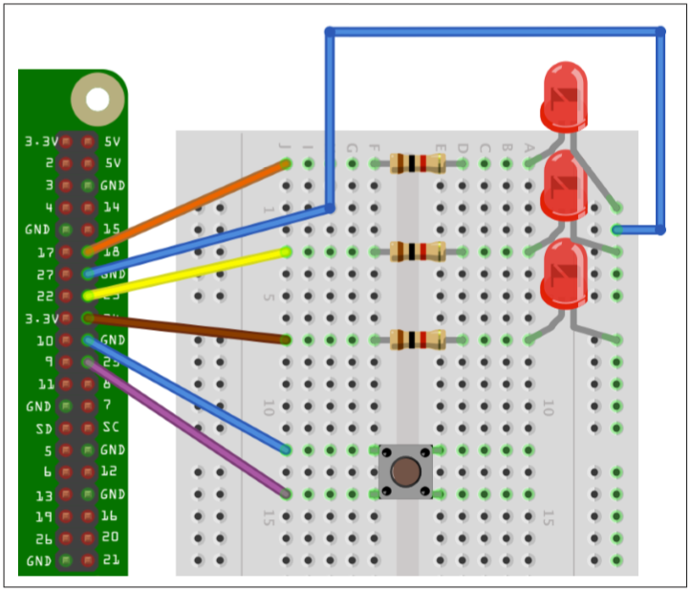
Controlling GPIO Outputs Using a Web Interface
Use the bottle Python web server library to create an HTML web interface to control the GPIO port.
install the bottle library

Slide 3
Controlling GPIO Outputs Using a Web Interface
from bottle import route, run
import RPi.GPIO as GPIO
host = '192.168.1.8'
GPIO.setmode(GPIO.BCM)
led_pins = [18, 23, 24]
led_states = [0, 0, 0]
switch_pin = 25
GPIO.setup(led_pins[0], GPIO.OUT)
GPIO.setup(led_pins[1], GPIO.OUT)
GPIO.setup(led_pins[2], GPIO.OUT)
GPIO.setup(switch_pin, GPIO.IN, pull_up_down=GPIO.PUD_UP)

Slide 4
Controlling GPIO Outputs Using a Web Interface
def switch_status():
state = GPIO.input(switch_pin)
if state:
return 'Up'
else:
return 'Down'
def html_for_led(led):
l = str(led)
result = " <input type='button' onClick='changed(" + l + ")' value='LED " + l + "'/>"
return result
def update_leds():
for i, value in enumerate(led_states):
GPIO.output(led_pins[i], value)

Slide 5
Controlling GPIO Outputs Using a Web Interface
@route('/')
@route('/<led>')
def index(led="n"):
print(led)
if led != "n":
led_num = int(led)
led_states[led_num] = not led_states[led_num]
update_leds()
response = "<script>"
response += "function changed(led)"
response += "{"
response += " window.location.href='/' + led"
response += "}"
response += "</script>"
response += '<h1>GPIO Control</h1>'
response += '<h2>Button=' + switch_status() + '</h2>'
response += '<h2>LEDs</h2>'
response += html_for_led(0)
response += html_for_led(1)
response += html_for_led(2)
return response

Slide 6
Controlling GPIO Outputs Using a Web Interface
try:
run(host='0.0.0.0', port=80)
finally:
print('\nCleaning up')
GPIO.cleanup()
You must run the program as superuser
Open a browser window from any machine on your network, even the Raspberry Pi itself, and navigate to the IP address of the Raspberry Pi. The web interface shown in following Figure should appear.
if you hold down the button as you reload the web page, you should see that the text next to Button says Down rather than Up.

Slide 7
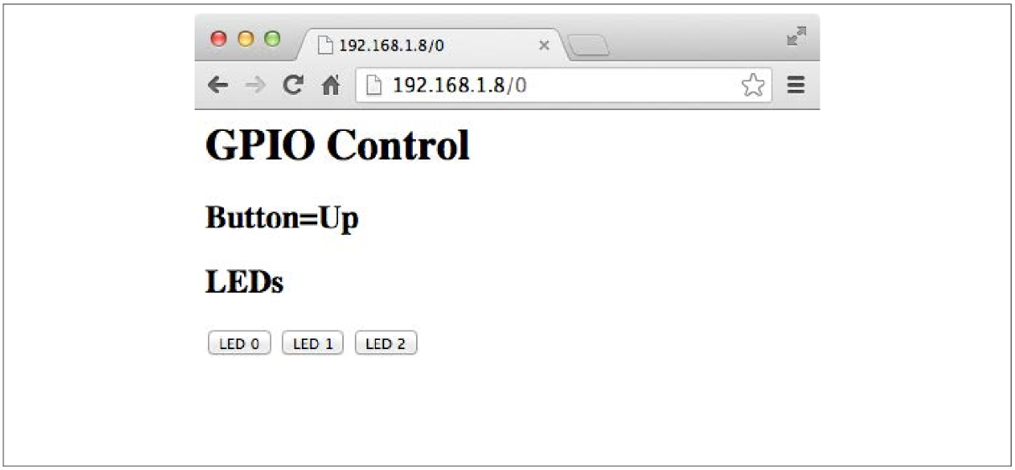
Controlling GPIO Outputs Using a Web Interface

Slide 8
poll(2) system call
One of the shortcomings of the input script is that it must poll the input pin’s value continuously, to see if the value has changed. In a multiprocessing environment like Linux, it is rude to burn the CPU like this (hence the compromise with the sleep command). A better design would have the program wait for a change on the input pin, allowing other processes to use the CPU while it waits.
The GPIO driver within the kernel is, in fact, able to do that, though not usable by shell commands. The C program evinput.c is an example program that takes advantage of this capability and is presented next. It uses the poll(2) system call to accomplish this. The basic procedure used is this:
1. The GPIO pin X is configured for input.
2. The value of /sys/class/gpio/gpioX/edge has been configured for the edge(s) to be reported
3. When querying the input pin, the open file descriptor for /sys/class/gpio/gpioX/value is provided to the poll(2) call (line 111).
4. The time-out is specified as –1 in argument 3, so poll(2) will wait forever, if necessary.
5. When there is new data for the GPIO input, poll(2) returns and rc will be greater than zero, breaking out of the loop.
6. The program must rewind to the beginning of the pseudo file with lseek(2) (line 118).
7. Finally, the text is read from the value file in line 119.

Slide 9
poll(2) system call
poll.h - definitions for the poll() function
The <poll.h> header shall define the pollfd structure that includes at least the following members:
int fd The following descriptor being polled.
short events The input event flags (see below).
short revents The output event flags (see below).

Slide 10
poll(2) system call
The following symbolic constants shall be defined, zero or more of which may be OR'ed together to form the events or revents members in the pollfd structure:
POLLIN Data other than high-priority data may be read without blocking.
POLLRDNORM Normal data may be read without blocking.
POLLRDBAND Priority data may be read without blocking.
POLLPRI High priority data may be read without blocking.
POLLOUT Normal data may be written without blocking.
POLLWRNORM Equivalent to POLLOUT.
POLLWRBAND Priority data may be written.
POLLERR An error has occurred ( revents only).
POLLHUP Device has been disconnected ( revents only).
POLLNVAL Invalid fd member ( revents only).

Slide 11
Compile Source Codes
For compile codes in gcc enter following command in terminal:
sudo gcc –Wall –c SourceCodeFile –o ObjectFileName
sudo gcc ObjectFileName –o ExecutableFileName

Slide 12
Test Run
A test was performed using a GPIO output pin (27) wired to the input pin (17). In one session, GPIO output pin 27 was changed from 0 to 1 and back. The events were captured in the other session, running ./evinput.
Input GPIO pin 17 was changed from this separate session, using output GPIO 27 (recall that it is wired to GPIO 17 for this test):
1 # cd /sys/class/gpio
2 # echo 27 >export
3 # ls
4 export gpio27 gpiochip0 unexport
5 # cd gpio27
6 # ls
7 active_low direction edge power subsystem uevent value
8 # echo out >direction
9 # echo 0 >value
10 # # s t a r t e d . / evinput 17 he r e . . .
11 # echo 1 >value
12 # echo 0 >value
13 # echo 1 >value

Slide 13
Test Run
Checking the system with the top command, you’ll see that ./evinput does not consume CPU. Yet the program is indeed responsive to the input change events. This leaves the CPU for all of your other processes that you may need to run
#include <fcntl.h>
#include <unistd.h>
#include <string.h>
#include <errno.h>
#include <signal.h>
#include <assert.h>
#include <sys/poll.h>
#include <string>
#include <iostream>
#include <fstream>
int GPIO_InPin = -1; /* GPIO input pin */
int is_signaled = 0; /* Exit program if signaled */

Slide 14
Test Run
typedef
enum { gp_export, gp_unexport, gp_direction, gp_edge, gp_value }
gpio_path_t;
std::string GPIO_GetPathAddress(int pin, gpio_path_t type)
{
std::string paths[] = {
"export",
"unexport",
"gpio" + std::to_string(pin) + "/direction" ,
"gpio" + std::to_string(pin) + "/edge",
"gpio" + std::to_string(pin) + "/value"
};
std::string result = "/sys/class/gpio/" + paths[type];
return result;
}

Slide 15
Test Run
int GPIO_OpenEdge(int pin, std::string edge)
{
std::string fileAddress;
std::ofstream file;
/* Export pin : /sys/class/gpio/export */
fileAddress = GPIO_GetPathAddress(pin, gp_export);
file.open(fileAddress);
file << pin << std::endl;
file.close();
/* Direction : /sys/class/gpio%d/direction */
fileAddress = GPIO_GetPathAddress(pin, gp_direction);
file.open(fileAddress);
file << "in" << std::endl;
file.close();

Slide 16
Test Run
/* Edge : /sys/class/gpio%d/edge */
fileAddress = GPIO_GetPathAddress(pin, gp_edge);
file.open(fileAddress);
file << edge << std::endl;
file.close();
/* Value : /sys/class/gpio%d/value */
FILE *f;
int fd;
fileAddress = GPIO_GetPathAddress(pin, gp_value);
fd = open(fileAddress.c_str(), O_RDWR);
return fd;
}

Slide 17
Test Run
void GPIO_Close(int pin)
{
std::string fileAddress;
std::ofstream file;
/* Unexport : /sys/class/gpio/unexport */
fileAddress = GPIO_GetPathAddress(pin, gp_unexport);
file.open(fileAddress);
file << pin << std::endl;
file.close();
}

Slide 18
Test Run
int GPIO_Poll(int fd)
{
struct pollfd polls;
polls.fd = fd; /* /sys/class/gpio17/value */
polls.events = POLLPRI; /* Exceptions */
int rc;
do
{
rc = poll(&polls, 1, -1); /* Block */
if (is_signaled)
return -1; /* Exit if ^C received */
} while (rc < 0 && errno == EINTR);
assert(rc > 0);
char buf[32];
int n;
lseek(fd, 0, SEEK_SET);
n = read(fd, buf, sizeof buf);/* Read value */
assert(n>0);
buf[n] = 0;
n = std::stoi(buf);
return n; /* Return value */
}

Slide 19
Test Run
void SigIntHandler(int signo)
{
is_signaled = 1; /* Signal to exit program */
}
int main(int argc, char **argv)
{
if (argc != 2)
{
std::cout << "Usage: " << argv[0] << "<gpio_in_pin>\n";
return 1;
}
GPIO_InPin = std::stoi(argv[1]);
if (GPIO_InPin < 0 || GPIO_InPin >= 32)
{
std::cout << "Usage: " << argv[0] << "<gpio_in_pin>\n";
return 1;
}
signal(SIGINT, SigIntHandler); /* Trap on SIGINT */

Slide 20
Test Run
int fd, v;
fd = GPIO_OpenEdge(GPIO_InPin, "both"); /* GPIO input */
std::cout << "Monitoring for GPIO input changes:\n";
while ((v = GPIO_Poll(fd)) >= 0)
std::cout << "GPIO " << GPIO_InPin << " changed: " << v << std::endl;
while (!is_signaled); /* Quit if ^C'd */
close(fd); /* Close gpio%d/value */
GPIO_Close(GPIO_InPin); /* Unexport gpio */
return 0;
}

Slide 21


Contact us
www.e-system.ir
Info@e-system.ir

