Slide 1

Raspberry pi Python Advanced
Lecturer: Reza Arjmandi
Summer 2016
Preface:
In this chapter, we will explore some of the more advanced concepts in the Python language—in particular, object-oriented Python, reading and writing files, handling exceptions, using modules, and Internet programming.

Slide 2
Help In Python
You can use help to access the docstrings of the different modules you have imported, e.g., try the following:
>>> import math
>>> help(math)
………
>>>help(math.sin)
………
For open help center of python:
>>> help(help)
…
Help for modules:
>>> help(“modules”)
…
Help for one module(not required to import):
>>> help(“modules time”)
…

Slide 3
Formatting Numbers
Apply a format string to the number. For example:
>>> x = 1.2345678
>>> "number={:.2f}".format(x)
'number=1.23'
>>>
The formatting string can contain a mixture of regular text and markers delimited by { and }. The parameters to the format function (there can be as many as you like) will be substituted in place of the marker, according to the format specifier.
In the preceding example, the format specifier is :.2f, which means that the number will be specified with two digits after the decimal place and is a float f.

Slide 4
Formatting Numbers
If you wanted the number to be formatted so the total length of the number is always seven digits (or padding spaces), then you would add another number before the decimal place like this:
>>> “number={:7.2f}".format(x)
‘number= 1.23'
>>>
In this case, since the number is only three digits long, there are four spaces of padding before the 1.
Example2:
>>> c = 20.5
>>> "Temperature {:5.2f} deg C, {:5.2f} deg F.".format(c, c * 9 / 5 + 32)
'Temperature 20.50 deg C, 68.90 deg F.'
>>>

Slide 5
Formatting Dates
You want to convert a date into a string and format it in a certain way.
Apply format string to the date object.
Example:
>>> from datetime import datetime
>>> d = datetime.now()
>>> "{:%Y-%m-%d %H:%M:%S}".format(d)
'2013-05-02 16:00:45'
>>>
The Python formatting language includes some special symbols for formatting date. %Y, %m, and %d correspond to year, month, and day numbers, respectively.

Slide 6
Returning More Than One Value
You need to write a function that returns more than one value.
Return a Python tuple and use the multiple variable assignment syntax.
Example:
>>> def calculate_temperatures(kelvin):
... celsius = kelvin - 273
... fahrenheit = celsius * 9 / 5 + 32
... return celsius, fahrenheit
...
>>> c, f = calculate_temperatures(340)
>>>
>>> print(c)
67
>>> print(f)
152.6
A tuple is a Python data structure that’s a little like a list, except that tuples are enclosed in parentheses rather than brackets. They are also of fixed size.

Slide 7
Defining a Class
You need to group together related data and functionality into a class.
Example:
class Person:
'''This class represents a person object'''
def __init__(self, name, tel):
self.name = name
self.tel = tel
The first line inside the class definition uses the triple, single, or double quotes to denote a documentation string. This should explain the purpose of the class. Although entirely optional, adding a documentation string to a class allows others to see what the class does. This is particularly useful if the class is made available for others to use.
Doc strings are not like normal comments because, although they are not active lines of code, they do get associated with the class, so, at any time, you can read the doc string for a class using the following command:
Person.__doc__

Slide 8
Defining a Class
Inside the class definition is the constructor method, which will be called automatically whenever you create a new instance of the class.
def __init__(self, name, tel):
self.name = name
self.tel = tel
The constructor method must be named as shown with double underscores on either side of the word init.
One way in which Python differs from most object-oriented languages is that you have to include the special variable self as a parameter to all the methods that you define within the class. This is a reference to, in this case, the newly created instance. The variable self is the same concept as the special variable this that you find in Java and some other languages.

Slide 9
Defining a Class
The code in this method transfers parameters that were supplied to it into member variables. The member variables do not need to be declared in advance, but do need to be prefixed by self..
So the following line:
self.name = name
creates a variable called name that’s accessible to every member of the class Person and initializes it with the value passed into the call to create an instance, which looks like this:
p = Person("Simon", "1234567")
We can then check that our new Person object, p, has a name of “Simon” by typing the following:
>>> p.name
Simon
In a complex program, it is good practice to put each class in its own file with a filename that matches the class name. This also makes it easy to convert the class into a module

Slide 10
Defining a Method
You need to add a method to a class.
Example:
class Person:
'''This class represents a person object'''
def __init__(self, first_name, surname, tel):
self.first_name = first_name
self.surname = surname
self.tel = tel
def full_name(self):
return self.first_name + " " + self.surname
If one method calls another within the same class, the call to the method has to be prefixed with self

Slide 11
Inheritance
Use inheritance to create a subclass of an existing class and add new member variables and methods.
By default, all new classes that you create are subclasses of object. You can change this by specifying the class you want to use as a superclass in parentheses after the class name in a class definition. The following example defines a class (Employee) as a subclass (Person) and adds a new member variable (salary) and an extra method (give_raise):
class Employee(Person):
def __init__(self, first_name, surname, tel, salary): super().__init__(first_name, surname, tel)
self.salary = salary
def give_raise(self, amount):
self.salary = self.salary + amount

Slide 12
Inheritance
Note that the preceding example is for Python 3. For Python 2, you can’t use super the same way. Instead, you must write:
class Employee(Person):
def __init__(self, first_name, surname, tel, salary): Person.__init__(self, first_name, surname, tel)
self.salary = salary
def give_raise(self, amount):
self.salary = self.salary + amount
In both these examples, the initializer method for the subclass first uses the initializer method of the parent class (superclass) and then adds the member variable. This has the advantage that you do not need to repeat the initialization code in the new subclass.
The Python inheritance mechanism is actually very powerful and supports multiple inheritance—where a subclass inherits from more than one superclass. For more on inheritance, see the official documentation for Python.

Slide 13
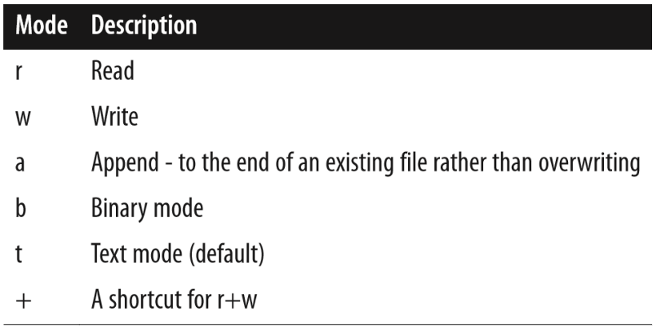
Writing to a File
Use the open, write, and close functions to open a file, write some data, and then close the file, respectively:
>>> f = open('test.txt', 'w')
>>> f.write('This file is not empty')
>>> f.close()
The open method takes two parameters. The first is the path to the file to be written. This can be relative to the current working directory, or if it starts with a /, an absolute path.
The second parameter is the mode in which the file should be opened. To overwrite an existing file, or create the file with the name specified if it doesn’t exist, just use w.
>>> f = open('test.txt', 'r+b')
Binary mode allows you to read or write binary streams of data, such as images, rather than text.

Slide 14
Reading from a File
To read a file’s contents, you need to use the file methods open, read, and close. The following example reads the entire contents of the file into the variable s:
f = open('test.txt')
s = f.read()
f.close()
You can also read text files one line at a time using the method readline.
The preceding example will throw an exception if the file does not exist or is not readable for some other reason. You can handle this by enclosing the code in a try/except construction like this:
try:
f = open('test.txt')
s = f.read()
f.close()
except IOError:
print("Cannot open the file")

Slide 15
Pickling
Use the Python pickling feature to dump the data structure to file in a format that can be automatically read back into memory as an equivalent data structure later on.
Example:
>>> import pickle
>>> mylist = ['some text', 123, [4, 5, True]]
>>> f = open('mylist.pickle', 'w')
>>> pickle.dump(mylist, f)
>>> f.close()
To unpickle the contents of the file into a new list, use the following:
>>> f = open('mylist.pickle')
>>> other_array = pickle.load(f)
>>> f.close()
>>> other_array
['some text', 123, [4, 5, True]]

Slide 16
Pickling
Pickling will work on pretty much any data structure you can throw at it. It does not need to be a list.
The file is saved in a text format that is sort of human-readable, but you will not normally need to look at or edit the text file.

Slide 17
Handling Exceptions
If something goes wrong while a program is running, you want to catch the error or exception and display a more user-friendly error message.
Use Python’s try/except construct.
try:
f = open('test.txt')
s = f.read()
f.close()
except IOError:
print("Cannot open the file")
A common situation where runtime exceptions can occur—in addition to during file access—is when you are accessing a list and the index you are using is outside the bounds of the list. For example, this happens if you try to access the fourth element of a three element list:
>>> list = [1, 2, 3]
>>> list[4]
Traceback (most recent call last):
File "<stdin>", line 1, in <module>
IndexError: list index out of range

Slide 18
Handling Exceptions
Exception is pretty near the top of that tree and will catch almost any exception. You can also have separate except sections for catching different types of exception and handling each in a different way. If you do not specify any exception class, all exceptions will be caught.
Python also allows you to have else and finally clauses in your error handling:
list = [1, 2, 3]
try:
list[8]
except:
print("out of range")
else:
print("in range")
finally:
print("always do this")
The else clause will be run if there is no exception, and the finally clause will be run whether there is an exception or not.

Slide 19
Handling Exceptions
Whenever an exception occurs, you can get more information about it using the exception object, which is available only if you use the as keyword, as shown in the following example:
>>> list = [1, 2, 3]
>>> try:
... list[8]
... except Exception as e:
... print("out of range")
... print(e)
...
out of range list index out of range
>>>

Slide 20
Using Modules
Use the import command:
import random
Standard Python libraries include modules for random numbers, database access, various Internet protocols, object serialization, and many more.
One consequence of having so many modules is that there is the potential for conflict —for example, if two modules have a function of the same name. To avoid such conflicts, when importing a module, you can specify how much of the module is accessible.
For example, if you just use a command like this:
import random
there is no possibility of any conflicts because you will only be able to access any functions or variables in the module by prefixing them with random..

Slide 21
Using Modules
If, on the other hand, you use the following command, everything in the module will be accessible without your having to put anything in front of it.
from random import *
In between these two extremes, you can explicitly specify those components of a module that you need within a program so that they can be conveniently used without any prefix.
Example:
>>> from random import randint
>>> print(randint(1,6))
2
>>>
A third option is to use the as keyword to provide a more convenient or meaningful name for the module when referencing it.
>>> import random as R
>>> R.randint(1, 6)

Slide 22
Random Numbers
You need to generate a random number between a range of numbers.
Use the random library:
>>> import random
>>> random.randint(1, 6)
2
>>> random.randint(1, 6)
6
>>> random.randint(1, 6)
5
A common use of random numbers is to select something at random from a list. You can do this by generating an index position and using that, but there is also a command in the random module specifically for this. Try out the following example:
>>> import random
>>> random.choice(['a', 'b', 'c'])
'a'

Slide 23
Making Web Requests from Python
You need to read the contents of a web page into a string using Python 2
Python has an extensive library for making HTTP requests.
The following example reads the contents of the Google home page into the string contents:
import urllib2
contents = urllib2.urlopen("https://www.google.com/").read()
print(contents)

Slide 24
Command-Line Arguments in Python
You want to run a Python program from the command line and pass it parameters.
Import sys and use its argv property, as shown in the following example. This returns an array, the first element of which is the name of the program. The other elements are any parameters (separated by spaces) that were typed on the command line after the program name.
Example:
import sys
for (i, value) in enumerate(sys.argv):
print("arg: %d %s " % (i, value))
Running the program from the command line, with some parameters after it, results in the following output:
$ python cmd_line.py a b c
arg: 0 cmd_line.py
arg: 1 a
arg: 2 b
arg: 3 c

Slide 25
Sending Email from Python
You want to send an email message from a Python program.
Python has a library for the Simple Mail Transfer Protocol (SMTP) that you can use to send emails:
Attach library to your code: import smtplib
Create SMTP Session Client Object: smtpserver = smtplib.SMTP(SMTP_SERVER, SMTP_PORT)
Start Security connection: SSL or TLS: smtpserver.starttls()
Login to smtp server: smtpserver.login(GMAIL_USER, GMAIL_PASS)
Send email to your recipient: smtpserver.sendmail(GMAIL_USER, recipient, msg)
Close Connection: smtpserver.quit()

Slide 26
Sending Email with push button
Example:
import smtplib
import RPi.GPIO as GPIO
GMAIL_USER = ‘YOUR_RASPBERY_PI_GMAIL'
GMAIL_PASS = ‘YOUR_GMAIL_PASSWORD'
SMTP_SERVER = 'smtp.gmail.com'
SMTP_PORT = 587
GPIO.setmode(GPIO.BCM)
GPIO.setup(18,GPIO.IN,pull_up_down=GPIO.PUD_UP)

Slide 27
Sending Email with push button
def send_email(recipient, subject, text):
smtpserver = smtplib.SMTP(SMTP_SERVER, SMTP_PORT)
smtpserver.starttls()
smtpserver.login(GMAIL_USER, GMAIL_PASS)
header = 'To:' + recipient + '\n' + 'From: ' + GMAIL_USER
header = header + '\n' + 'Subject:' + subject + '\n'
msg = header + '\n' + text + ' \n\n'
smtpserver.sendmail(GMAIL_USER, recipient, msg)
smtpserver.quit()
counter=0
while(1):
if(GPIO.input(18)==0):
print("Danger!!!!!!")
print("sending email...")
send_email('arjmandi.re@gmail.com', 'Danger: home security!', 'Button Pressed-number: ' + str(counter))
print("send complete")
counter = counter + 1

Slide 28
Sending Email with push button
If you are not using Gmail, then you will also need to change the values of the SMTP_SERVER and possibly SMTP_PORT.
The send_email message simplifies the use of the smtplib library into a single function that you can reuse in your projects.

Slide 29
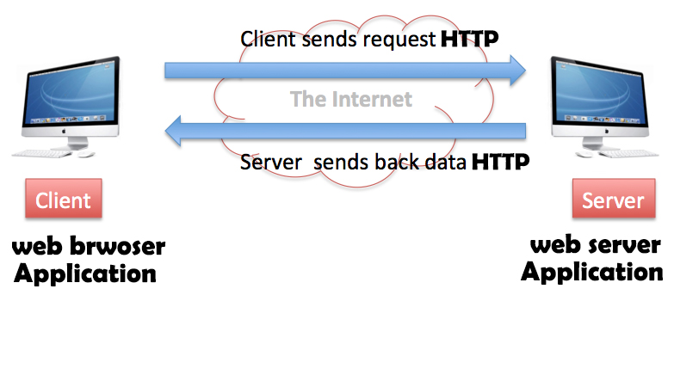
Web Service

Slide 30

Writing a Simple Web Server in Python
You need to create a simple Python web server, but don’t want to have to run a full web server stack.
Use the bottle Python library to run a pure Python web server that will respond to HTTP requests.
To install bottle, use the following command:
sudo apt-get install python-bottle
Following Figure shows the page you see if you connect to the Raspberry Pi from a browser anywhere on your network:

Slide 31
Writing a Simple Web Server in Python
from bottle import route, run,template
from datetime import datetime
@route('/')
def index():
dt = datetime.now()
time = "{:%Y-%m-%d %H:%M:%S}".format(dt)
return template('<b>Pi thinks the date/time is: {{t}}</b>', t=time)
run(host='192.168.1.16', port=80)
To start the program, you need to run it with superuser privileges:
$ sudo python bottle_test.py

Slide 32
Writing a Simple Web Server in Python
After the import commands, the @route command links the URL path / with the handler function that follows it.
That handler function formats the date and time and then returns a string of the HTML to be rendered by the browser. In this case, it uses a template into which values can be substituted.
The final run line actually starts the web serving process. Note that you need to specify the hostname and port. Port 80 is the default port for web serving, so if you wish to use a different port, then you need to add the port number with a : after the server address.
You can define as many routes and handlers as you like within the program.

Slide 33


Contact us
www.e-system.ir
Info@e-system.ir

