Slide 1

Raspberry pi Sensors
Lecturer: Reza Arjmandi
Summer 2016
Preface:
In this chapter, you will look at recipes for using sensors of various types that will allow the Raspberry Pi to measure temperature, light, and more.

Slide 2
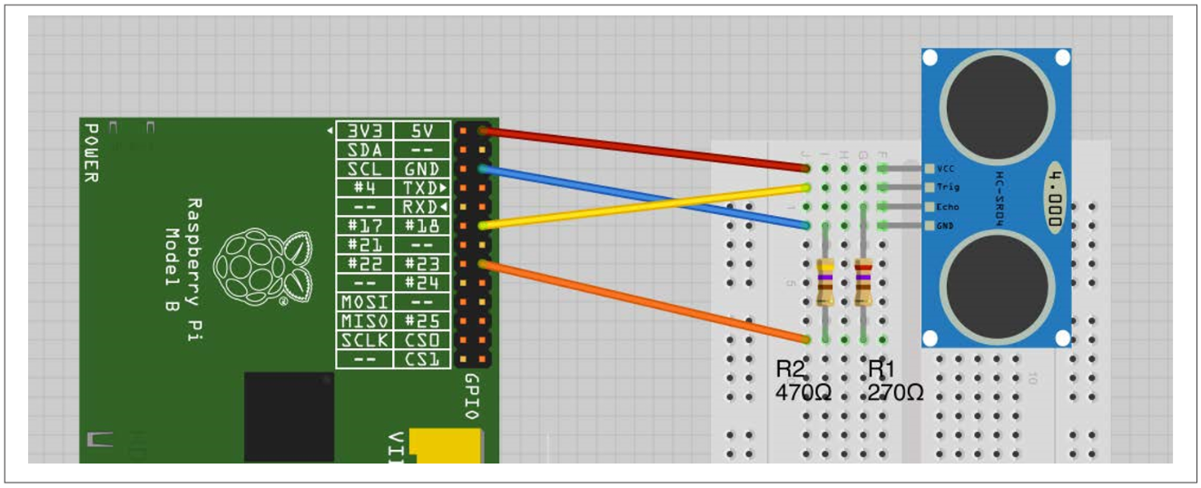
Measuring Distance
The resistors are necessary to reduce the echo output of the rangefinder from 5V to 3.3V

Slide 3
Measuring Distance
import RPi.GPIO as GPIO
import time
trigger_pin = 18
echo_pin = 23
GPIO.setmode(GPIO.BCM)
GPIO.setup(trigger_pin, GPIO.OUT)
GPIO.setup(echo_pin, GPIO.IN)
def send_trigger_pulse():
GPIO.output(trigger_pin, True)
time.sleep(0.0001)
GPIO.output(trigger_pin, False)
def wait_for_echo(value, timeout):
count = timeout
while GPIO.input(echo_pin) != value and count > 0:
count = count - 1

Slide 4
Measuring Distance
def get_distance():
send_trigger_pulse()
wait_for_echo(True, 10000)
start = time.time()
wait_for_echo(False, 10000)
finish = time.time()
pulse_len = finish – start
distance_cm = pulse_len / 0.000058
distance_in = distance_cm / 2.5
return (distance_cm, distance_in)
while True:
print("cm={} \t inches={}“.format(get_distance()))
time.sleep(1)

Slide 5
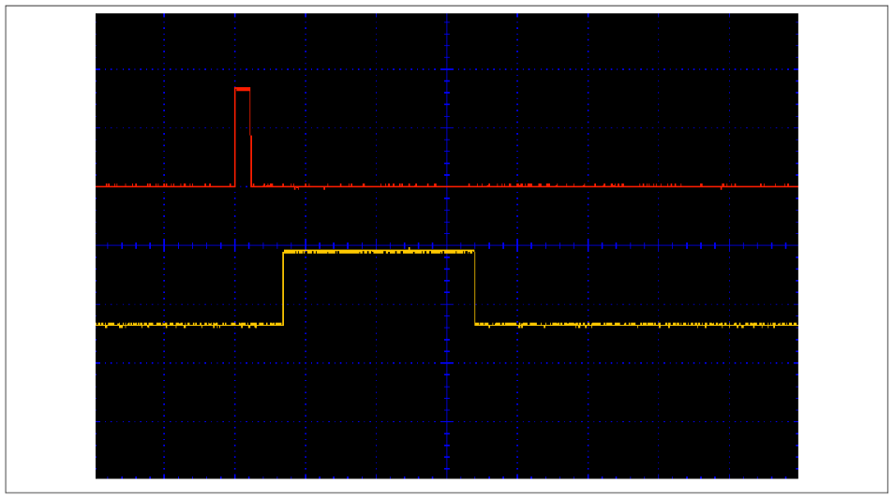
Measuring Distance
Following Figure shows an oscilloscope trace of the sensor in action. The top (red) trace is connected to trig and the bottom (yellow) trace is connected to echo. You can see that first the trig pin is taken high for a short pulse. There is then a short delay before the echo pin goes high. This then stays high for a period that is proportional to the distance from the sensor.

Slide 6
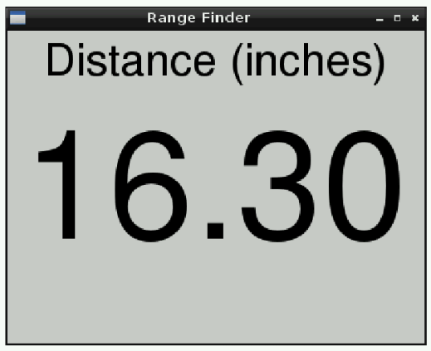
Displaying Sensor Values
Use the Tkinter library to open a window and write the reading on it as a label with a large font
This example uses data from the ultrasonic rangefinder of previous Recipe, complete that recipe first if you want to try out this example.

Slide 7
Displaying Sensor Values
class App:
def __init__(self, master):
self.master = master
frame = Frame(master)
frame.pack()
label = Label(frame, text='Distance (inches)', font=("Helvetica", 32))
label.grid(row=0)
self.reading_label = Label(frame, text='12.34', font=("Helvetica", 110))
self.reading_label.grid(row=1)
self.update_reading()
def update_reading(self):
cm, inch = get_distance()
reading_str = "{:.2f}".format(inch)
self.reading_label.configure(text=reading_str)
self.master.after(500, self.update_reading)
root = Tk()
root.wm_title('Range Finder')
app = App(root)
root.geometry("400x300+0+0")
root.mainloop()

Slide 8
Using a Keypad
Keypads are arranged in rows and columns, with a push switch on the intersection of each row or column. To find out which key is pressed, you first connect all the row and column connections to Raspberry Pi GPIO pins. So, for a 4 × 3 keypad, you will need four + three pins. By scanning each column in turn (setting it to output high) and reading the value of each of the row inputs, you can determine which (if any) key is pressed.
All the real action takes place in the get_key function. This enables each column in turn, by setting it to high. An inner loop then tests each of the rows in turn. If one of the rows is high, then the key name corresponding to that row and column is looked up in the keys array. If no keypress is detected, then the default value of key (0) is returned.

Slide 9
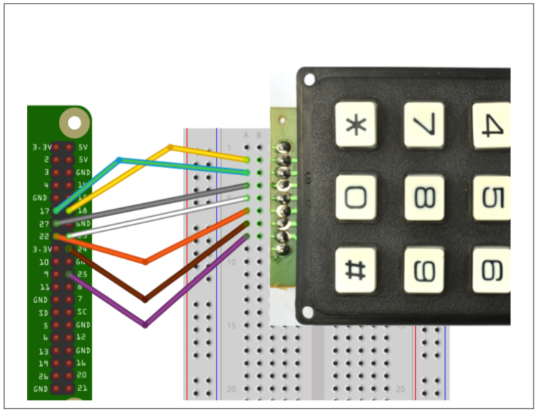
Using a Keypad

Slide 10
Using a Keypad
import RPi.GPIO as GPIO
import time
GPIO.setmode(GPIO.BCM)
rows = [17, 25, 24, 23]
cols = [27, 18, 22]
keys = [ ['1', '2', '3'], ['4', '5', '6'], ['7', '8', '9'], ['*', '0', '#']]
for row_pin in rows:
GPIO.setup(row_pin, GPIO.IN, pull_up_down=GPIO.PUD_DOWN)
for col_pin in cols:
GPIO.setup(col_pin, GPIO.OUT)

Slide 11
Using a Keypad
def get_key():
key = 0
for col_num, col_pin in enumerate(cols):
GPIO.output(col_pin, 1)
for row_num, row_pin in enumerate(rows):
if GPIO.input(row_pin):
key = keys[row_num][col_num] GPIO.output(col_pin, 0)
return key
while True:
key = get_key()
if key :
print(key)
time.sleep(0.3)

Slide 12
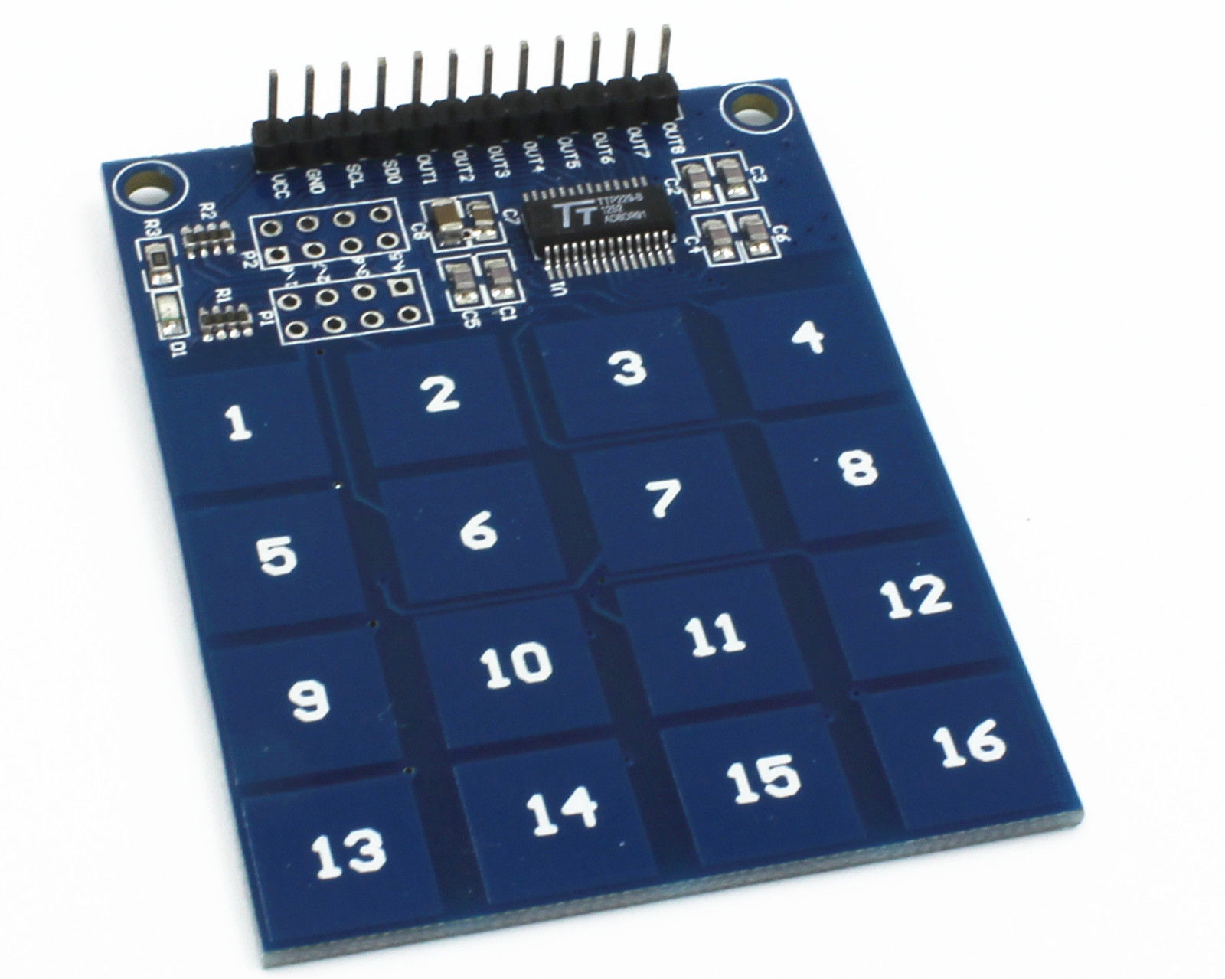
Using a Capacitive Touch Keypad

Slide 13
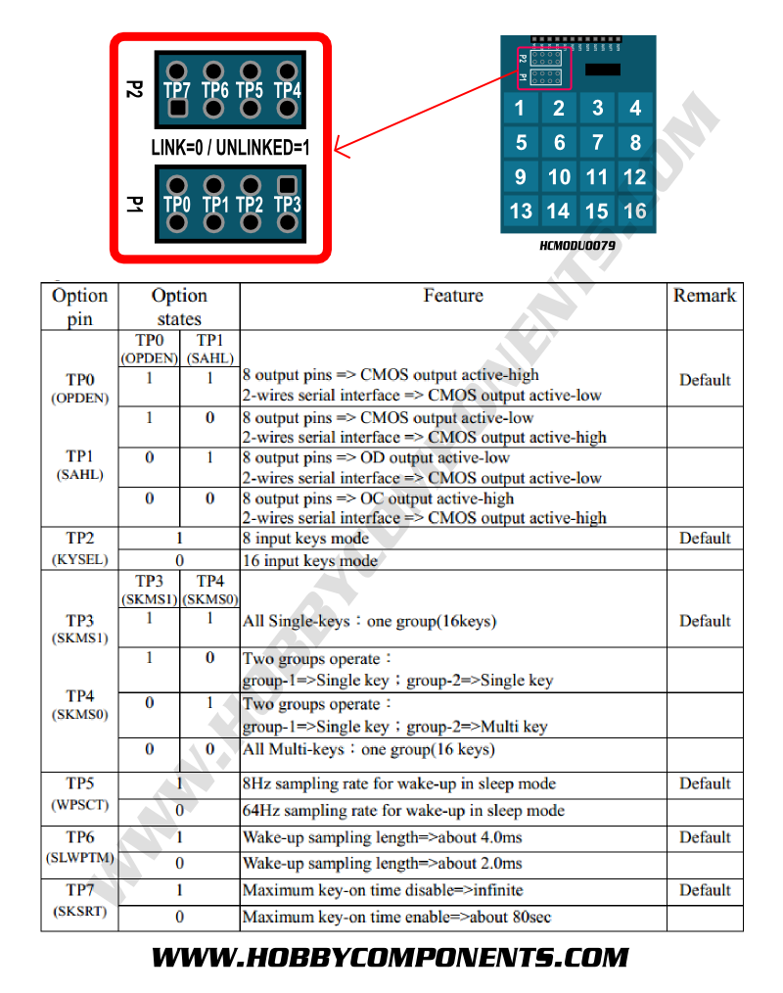
Using a Capacitive Touch Keypad

Slide 14
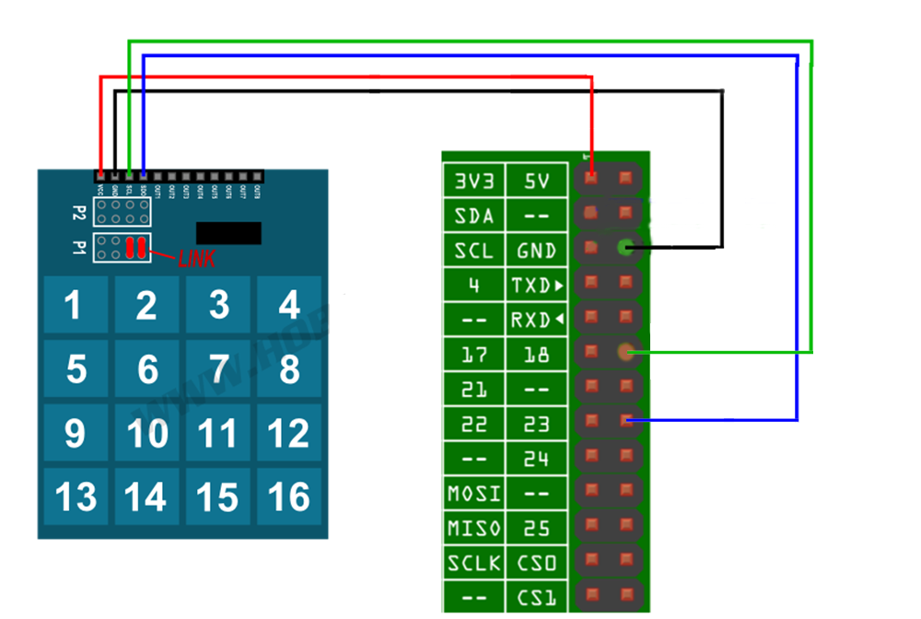
Using a Capacitive Touch Keypad

Slide 15
Using a Capacitive Touch Keypad
import RPi.GPIO as GPIO
import time
GPIO.setmode(GPIO.BCM)
GPIO.setup(18, GPIO.OUT)
GPIO.setup(23, GPIO.IN, pull_up_down = GPIO.PUD_UP)
def ReadKeyPad():
keyState = 0
for i in range(1, 17):
GPIO.output(18, 0)
if(GPIO.input(23) == 0):
keyState=i
GPIO.output(18, 1)
return keyState

Slide 16
Using a Capacitive Touch Keypad
LastKey = -1
while 1:
key = ReadKeyPad()
if(key != LastKey and key > 0):
print(key)
LastKey = key
time.sleep(0.1)

Slide 17
Using a Unipolar Stepper Motor
You want to drive a five-lead unipolar stepper motor using a Raspberry Pi.
Use a ULN2803 Darlington driver chip.
Stepper motors fit somewhere between DC motors and servo motors in the world of motor technologies. Like a regular DC motor, they can rotate continuously, but you can also very accurately position them by moving them a step at a time in either direction.
If you’re using Python 3, change the command raw_input to just input

Slide 18
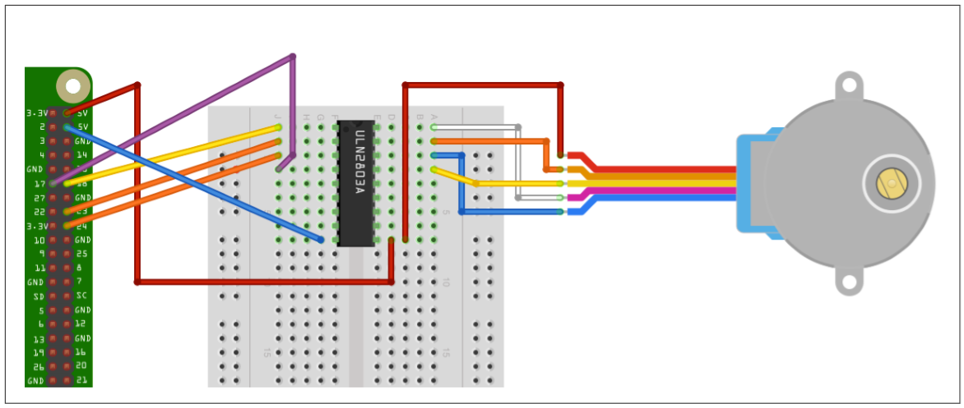
Using a Unipolar Stepper Motor

Slide 19
Using a Unipolar Stepper Motor
import RPi.GPIO as GPIO
import time
GPIO.setmode(GPIO.BCM)
coil_A_1_pin = 18
coil_A_2_pin = 23
coil_B_1_pin = 24
coil_B_2_pin = 17
GPIO.setup(coil_A_1_pin, GPIO.OUT)
GPIO.setup(coil_A_2_pin, GPIO.OUT)
GPIO.setup(coil_B_1_pin, GPIO.OUT)
GPIO.setup(coil_B_2_pin, GPIO.OUT)
forward_seq = ['1010', '0110', '0101', '1001']
reverse_seq = list(forward_seq) # to copy the list
reverse_seq.reverse()

Slide 20
Using a Unipolar Stepper Motor
def forward(delay, steps):
for i in range(steps):
for step in forward_seq:
set_step(step)
time.sleep(delay)
def backwards(delay, steps):
for i in range(steps):
for step in reverse_seq:
set_step(step)
time.sleep(delay)
def set_step(step):
GPIO.output(coil_A_1_pin, step[0] == '1')
GPIO.output(coil_A_2_pin, step[1] == '1')
GPIO.output(coil_B_1_pin, step[2] == '1')
GPIO.output(coil_B_2_pin, step[3] == '1')

Slide 21
Using a Unipolar Stepper Motor
while True:
set_step('0000')
delay = raw_input("Delay between steps (milliseconds)?")
steps = raw_input("How many steps forward? ")
forward(int(delay) / 1000.0, int(steps))
set_step('0000')
steps = raw_input("How many steps backwards? ")
backwards(int(delay) / 1000.0, int(steps))
When you run the program, you will be prompted for a delay between steps. This should be two or more. You will then be prompted for the number of steps in each direction

Slide 22
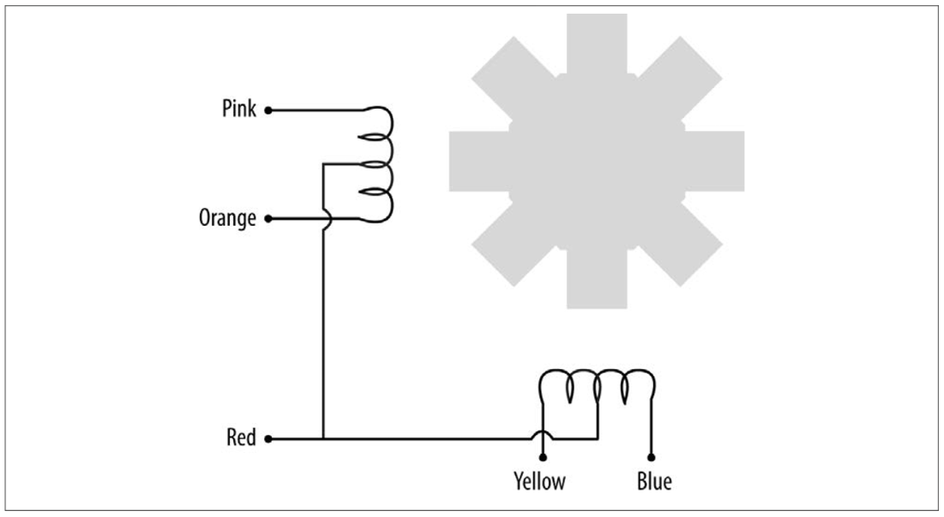
Using a Unipolar Stepper Motor
Stepper motors use a cogged rotor and electromagnets to nudge the wheel around a step at a time (following Figure). Note that the colors of the leads will vary.
Energizing the coils in a certain order drives the motor around. The number of steps that the stepper motor has in a 360-degree rotation is actually the number of teeth on the rotor.

Slide 23
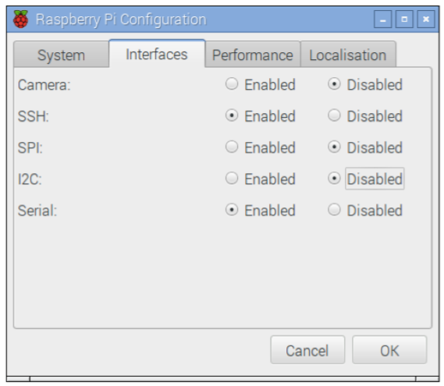
Setting Up I2C
For this recipe to work, you will also need to set up your Raspberry Pi for I2C, so follow recipe:
In the latest versions of Raspbian, enabling I2C is simply a matter of using the Raspberry Pi Configuration tool that you will find on the main menu under Preferences . Just check the box for I2C and click OK. You will be prompted to restart.

Slide 24
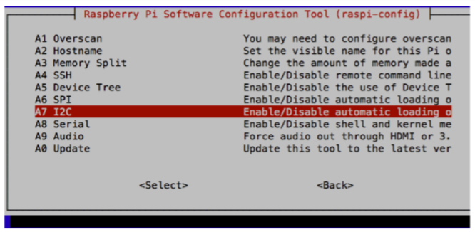
Setting Up I2C
On older versions of Raspbian, the raspi-config tool does the same job
$ sudo raspi-config
Then select Advanced from the menu and scroll down to I2C

Slide 25
Setting Up I2C
At this point, you will probably also want to install the Python I2C library by using the command:
$ sudo apt-get install python-smbus
You will then need to reboot the Raspberry Pi for the changes to take effect.

Slide 26
Using I2C Tools
You have an I2C device attached to your Raspberry Pi, and you want to check that it’s attached and find its I2C address.
From a Terminal window on your Pi, type the following commands to fetch and install the i2c-tools:
$ sudo apt-get install i2c-tools

Slide 27
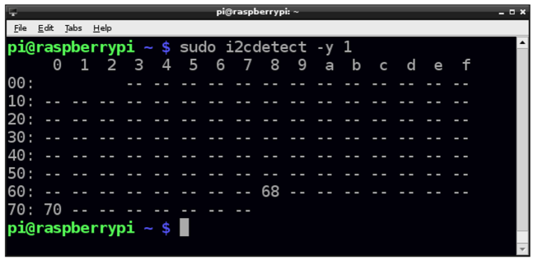
Using I2C Tools
Attach your I2C device to the Pi and run the command:
$ sudo i2cdetect -y 1
Note that if you are using a very old Raspberry Pi revision 1 board, you need to change 1 to 0 in the preceding line of code.
If I2C is available, you will see some output like that shown. This shows that two I2C addresses are in use—0x68 and 0x70.

Slide 28
Using an OLED Graphical Display
Some of these displays have just four pins, whereas others have eight pins. The 8-pin varieties (including Adafruit’s displays) have more pins because they have both an I2C and SPI interfaces. The 4-pin displays just have an I2C.
The I2C interface is better suited for use with the Raspberry Pi because the display operates at 5V, and both interface pins for I2C (SDA and SCL) are 3.3V outputs from the Raspberry Pi, whereas the SPI interface’s MISO pin is a 3.3V input that requires level conversion before connecting to the Raspberry Pi.
The connections between the Raspberry Pi and the module are as follows:
• VCC on the display to 5V on the Raspberry Pi GPIO connector
• GND on the display to GND on the Raspberry Pi GPIO connector
• SDA on the display to GPIO 2 (SDA) on the Raspberry Pi GPIO connector
• SCL on the display to GPIO 3 (SCL) on the Raspberry Pi GPIO connector s

Slide 29
Using an OLED Graphical Display
Adafruit has a library for these displays. Install it by using these commands:
$ git clone https://github.com/adafruit/Adafruit_Python_SSD1306.git
$ cd Adafruit_Python_SSD1306
$ sudo python setup.py install
This library uses the Python Image Library (PIL), which can be installed by using the command:
$ sudo pip install pillow

Slide 30
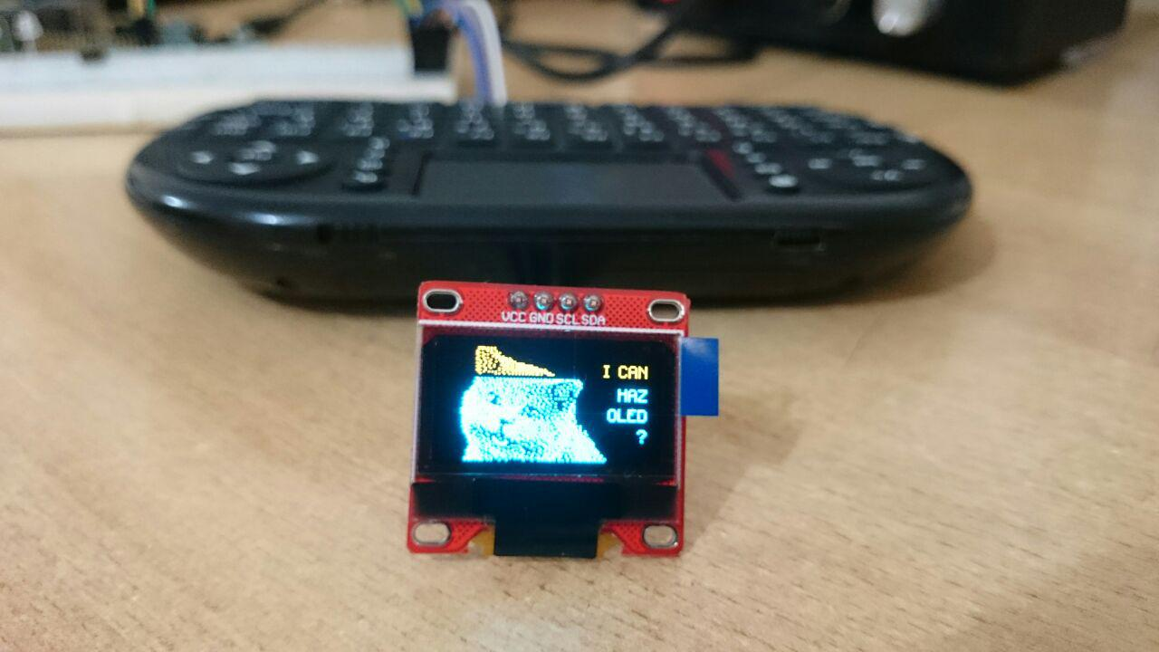
OLED Example2 Load Image

Slide 31
OLED Example2 Load Image
import time import Adafruit_SSD1306 from PIL import Image
# Raspberry Pi pin configuration: RST = 24
# 128x32 display with hardware I2C: disp = Adafruit_SSD1306.SSD1306_128_32(rst=RST)
image = Image.open('happycat_oled_64.ppm').convert('1')
disp.image(image)
disp.display()

Slide 32
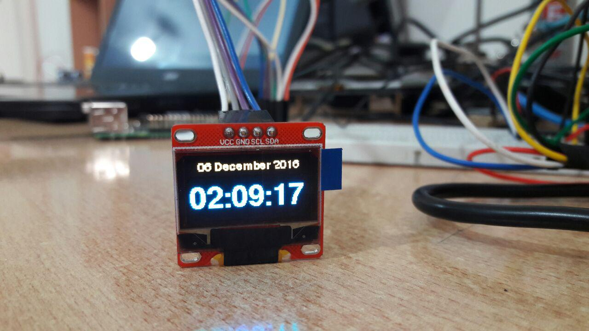
Using an OLED Graphical Display

Slide 33
Using an OLED Graphical Display
import Adafruit_SSD1306
from datetime import datetime
import time
from PIL import Image
from PIL import ImageDraw
from PIL import ImageFont
# Setup Display
RST=24
device = Adafruit_SSD1306.SSD1306_128_64(rst=RST)
device.begin()
device.clear()
device.display()
width = device.width
height = device.height
font_file = '/usr/share/fonts/truetype/freefont/FreeSansBold.ttf‘
small_font = ImageFont.truetype('FreeSans.ttf', 12, filename=font_file)
large_font = ImageFont.truetype('FreeSans.ttf', 33, filename=font_file)

Slide 34
Using an OLED Graphical Display
# Display a message on 3 lines, first line big font
def display_message(top_line, line_2):
global device
image = Image.new('1', (width, height))
draw = ImageDraw.Draw(image)
draw.text((10, 0), top_line, font=small_font, fill=255)
draw.text((0, 20), line_2, font=large_font, fill=255)
device.image(image)
device.display()
while True:
now = datetime.now()
date_message = '{:%d %B %Y}'.format(now)
time_message = '{:%H:%M:%S}'.format(now)
display_message(date_message,time_message)
time.sleep(0.1)

Slide 35
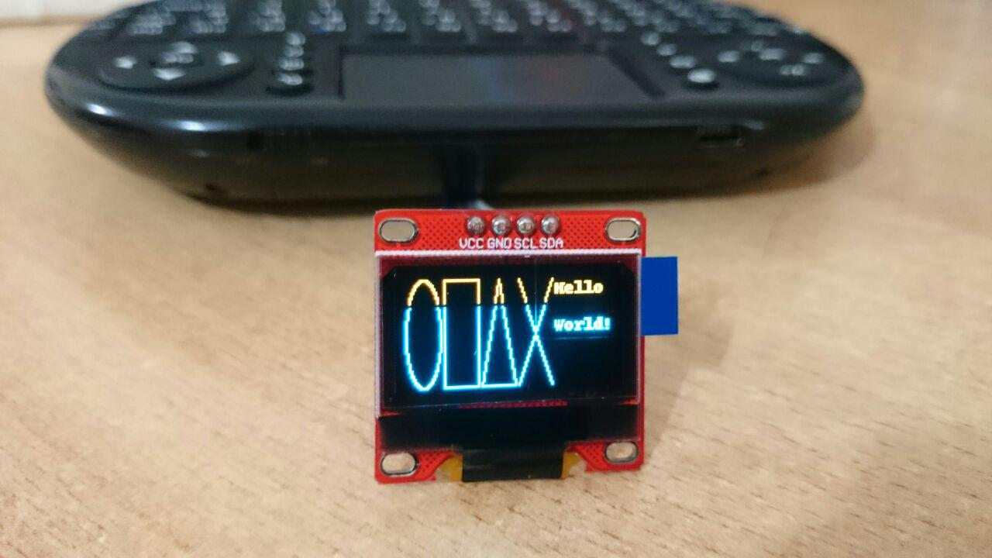
OLED Example3 Draw Shapes

Slide 36
OLED Example3 Draw Shapes
import time
import Adafruit_SSD1306
from PIL import Image
from PIL import ImageDraw
from PIL import ImageFont
# Raspberry Pi pin configuration:
RST = 24
disp = Adafruit_SSD1306.SSD1306_128_64(rst=RST)
disp.begin()
# Clear display.
disp.clear()
disp.display()

Slide 37
OLED Example3 Draw Shapes
# Create blank image for drawing.
# Make sure to create image with mode '1' for 1-bit color.
width = disp.width
height = disp.height
image = Image.new('1', (width, height))
# Get drawing object to draw on image.
draw = ImageDraw.Draw(image)
# Draw a black filled box to clear the image.
draw.rectangle((0,0,width,height), outline=0, fill=0)
# Draw some shapes.
# First define some constants to allow easy resizing of shapes.
padding = 2
shape_width = 20
top = padding
bottom = height-padding

Slide 38
OLED Example3 Draw Shapes
# Move left to right keeping track of the current x position for drawing shapes.
x = padding
# Draw an ellipse.
draw.ellipse((x, top , x+shape_width, bottom), outline=255, fill=0)
x += shape_width+padding
# Draw a rectangle.
draw.rectangle((x, top, x+shape_width, bottom), outline=255, fill=0)
x += shape_width+padding
# Draw a triangle.
draw.polygon([(x, bottom), (x+shape_width/2, top), (x+shape_width, bottom)], outline=255, fill=0)
x += shape_width+padding

Slide 39
OLED Example3 Draw Shapes
# Draw an X.
draw.line((x, bottom, x+shape_width, top), fill=255)
draw.line((x, top, x+shape_width, bottom), fill=255)
x += shape_width+padding
# Load default font.
font = ImageFont.load_default()
# Write two lines of text.
draw.text((x, top), 'Hello', font=font, fill=255)
draw.text((x, top+20), 'World!', font=font, fill=255)
# Display image.
disp.image(image)
disp.display()

Slide 40
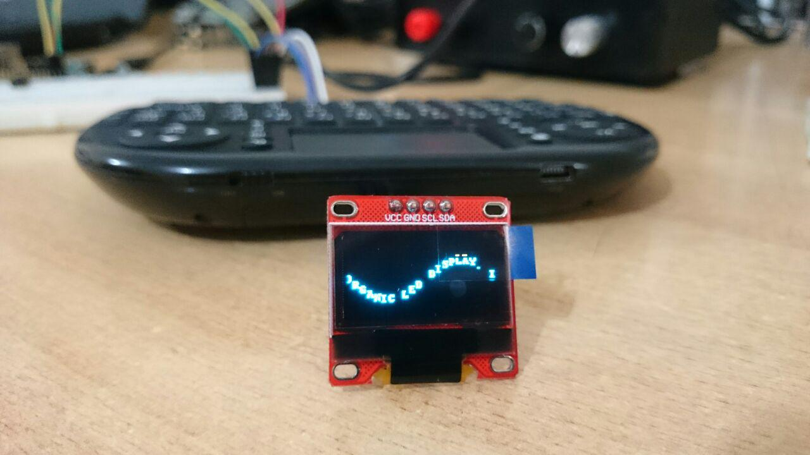
OLED Example4 wave animation

Slide 41
OLED Example4 wave animation
import math
import time
import Adafruit_SSD1306
from PIL import Image
from PIL import ImageFont
from PIL import ImageDraw
# Raspberry Pi pin configuration:
RST = 24
# 128x32 display with hardware I2C:
disp = Adafruit_SSD1306.SSD1306_128_64(rst=RST)
# Initialize library.
disp.begin()

Slide 42
OLED Example4 wave animation
# Get display width and height.
width = disp.width
height = disp.height
# Clear display.
disp.clear()
disp.display()
# Create image buffer.
# Make sure to create image with mode '1' for 1-bit color.
image = Image.new('1', (width, height))
# Load default font.
font = ImageFont.load_default()
# Create drawing object.
draw = ImageDraw.Draw(image)

Slide 43
OLED Example4 wave animation
# Define text and get total width.
text = 'SSD1306 ORGANIC LED DISPLAY. THIS IS AN OLD SCHOOL DEMO SCROLLER!! GREETZ TO: LADYADA & THE ADAFRUIT CREW, TRIXTER, FUTURE CREW, AND FARBRAUSCH‘
maxwidth, unused = draw.textsize(text, font=font)
# Set animation and sine wave parameters.
amplitude = height/4
offset = height/2 – 4
velocity = -2
startpos = width
# Animate text moving in sine wave.
print('Press Ctrl-C to quit.')
pos = startpos

Slide 44
OLED Example4 wave animation
while True:
# Clear image buffer by drawing a black filled box. draw.rectangle((0,0,width,height), outline=0, fill=0)
# Enumerate characters and draw them offset vertically based on a sine wave.
x = pos
for i, c in enumerate(text):
# Stop drawing if off the right side of screen.
if x > width:
break
# Calculate width but skip drawing if off the left side of screen.
if x < -10:
char_width, char_height = draw.textsize(c, font=font)
x += char_width
continue
# Calculate offset from sine wave.
y = offset+math.floor(amplitude*math.sin(x/float(width)*2.0*math.pi))

Slide 45
OLED Example4 wave animation
# Draw text.
draw.text((x, y), c, font=font, fill=255)
# Increment x position based on chacacter width.
char_width, char_height = draw.textsize(c, font=font)
x += char_width
# Draw the image buffer.
disp.image(image)
disp.display()
# Move position for next frame.
pos += velocity
# Start over if text has scrolled completely off left side of screen.
if pos < -maxwidth:
pos = startpos
# Pause briefly before drawing next frame.
time.sleep(0.1)

Slide 46


Contact us
www.e-system.ir
Info@e-system.ir

