Slide 1
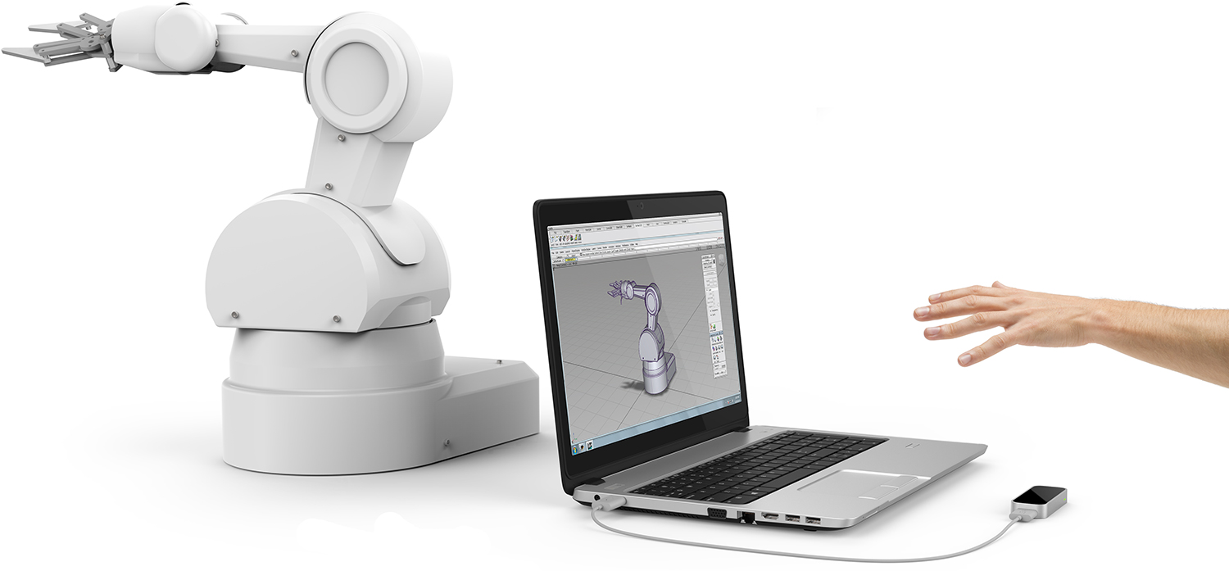
Leap Motion
workshop
Lecturer : Reza Arjmandi

Slide 2
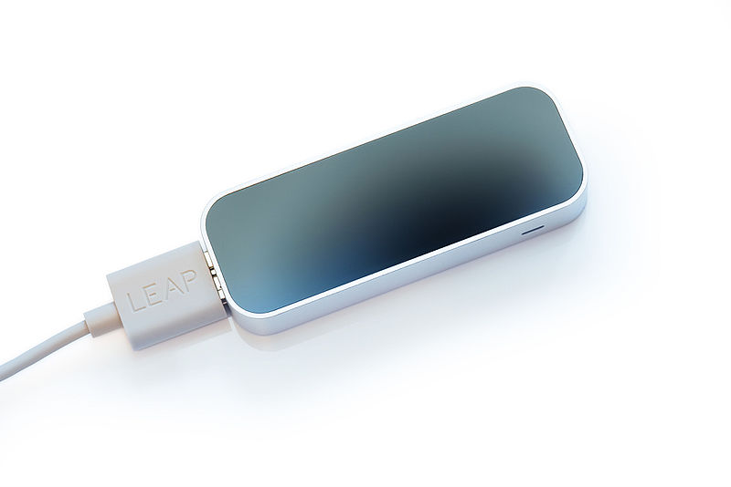
Introduction
Leap Motion, Inc. is an American company that manufactures and markets a computer hardware sensor device that supports hand and finger motions as input, analogous to a mouse, but requires no hand contact or touching.
In 2016, the company released new software designed for hand tracking in virtual reality.

Slide 3

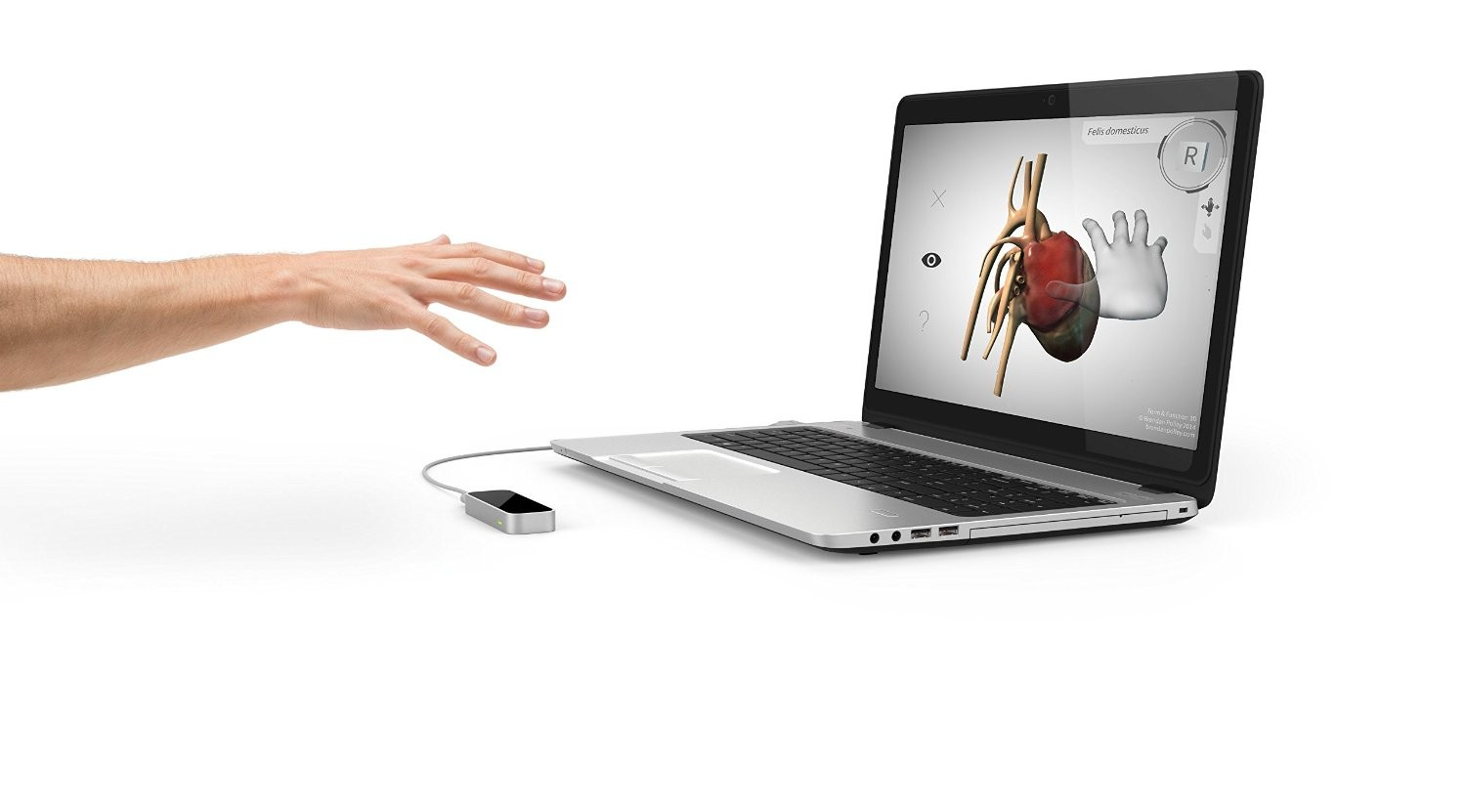
Application
The Leap Motion controller is a small USB peripheral device which is designed to be placed on a physical desktop, facing upward. It can also be mounted onto a virtual reality headset.

Slide 4
Technology
Using two monochromatic IR cameras and three infrared LEDs, the device observes a roughly hemispherical area, to a distance of about 1 meter.
The LEDs generate pattern-less IR light and the cameras generate almost 200 frames per second of reflected data.
This is then sent through a USB cable to the host computer, where it is analyzed by the Leap Motion software using "complex maths" in a way that has not been disclosed by the company, in some way synthesizing 3D position data by comparing the 2D frames generated by the two cameras.
The smaller observation area and higher resolution of the device differentiates the product from the Kinect, which is more suitable for whole-body tracking in a space the size of a living room.
In a demonstration to CNET, the controller was shown to perform tasks such as navigating a website, using pinch-to-zoom gestures on maps, high-precision drawing, and manipulating complex 3D data visualizations.

Slide 5

Software SDK
V2 Tracking
Orion
Unity Assetes

Slide 6
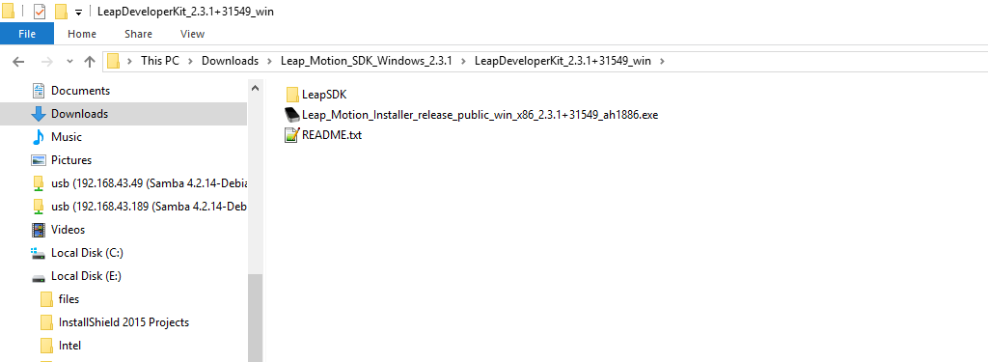
V2 Tracking

Slide 7
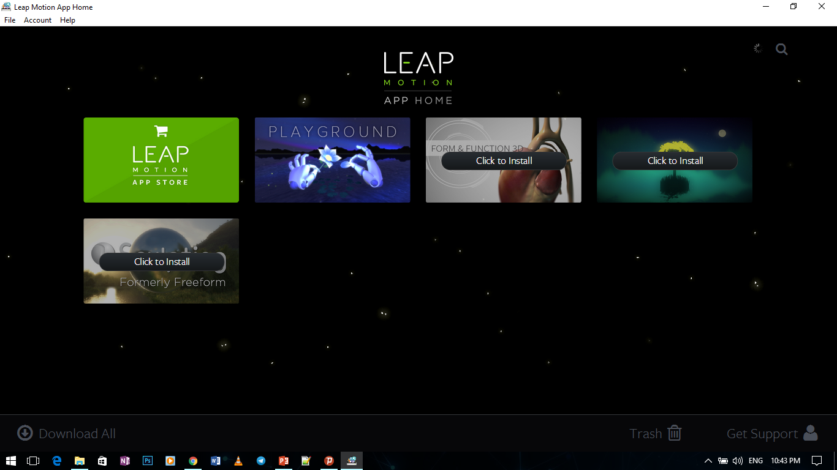
Leap Motion App Home

Slide 8
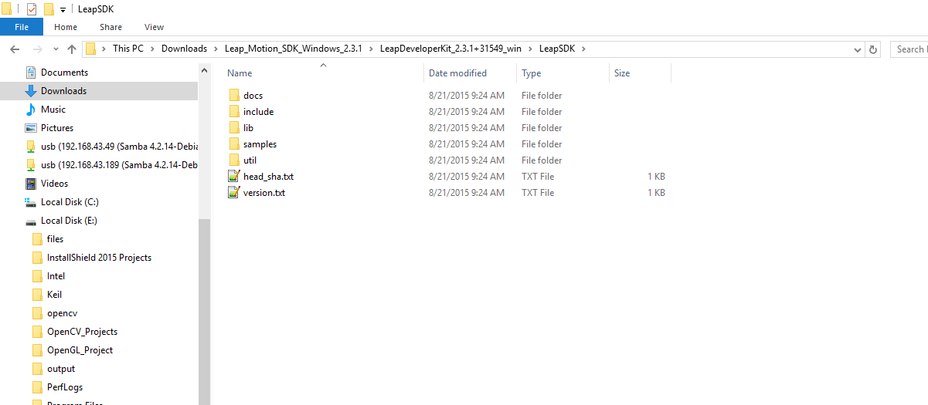
LeapSDK

Slide 9
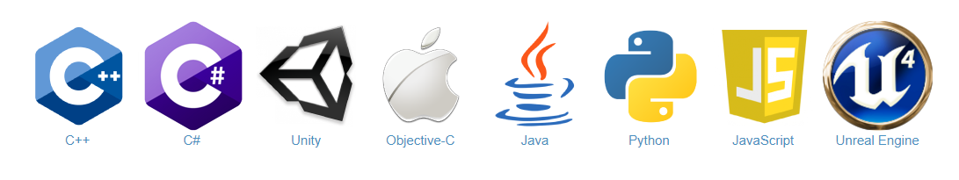
Leap Motion SDK

Slide 10
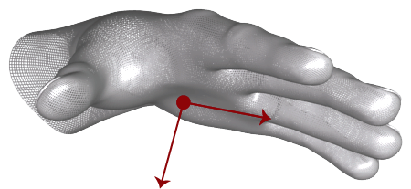
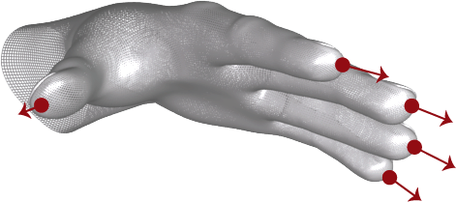
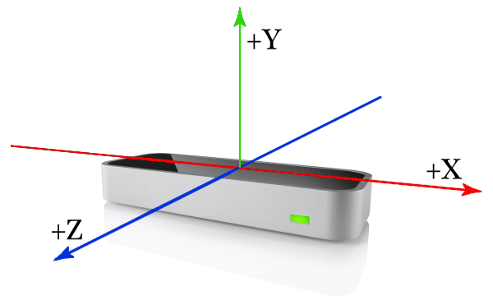
Coordinate System

Slide 11
Leap Motion Simple Example

Slide 12
C++ SDK
Example 1
#include "Leap.h“
#include <iostream>
using namespace Leap;
class SampleListener : public Listener
{
public:
virtual void onInit(const Controller&);
virtual void onConnect(const Controller&);
virtual void onDisconnect(const Controller&);
virtual void onExit(const Controller&);
virtual void onFrame(const Controller&);
virtual void onFocusGained(const Controller&);
virtual void onFocusLost(const Controller&);
virtual void onDeviceChange(const Controller&);
virtual void onServiceConnect(const Controller&);
virtual void onServiceDisconnect(const Controller&);
};

Slide 13
C++ SDK
Example 1
void main(int argc, char** argv)
{
SampleListener listener;
Controller controller
controller.addListener(listener);
std::cout << "Press Enter to quit..." << std::endl;
std::cin.get();
controller.removeListener(listener);
}

Slide 14
C++ SDK
Example 1
void SampleListener::onInit(const Controller& controller)
{
std::cout << "Initialized" << std::endl;
}
void SampleListener::onConnect(const Controller& controller)
{
std::cout << "Connected" << std::endl;
controller.enableGesture(Gesture::TYPE_CIRCLE);
controller.enableGesture(Gesture::TYPE_KEY_TAP);
controller.enableGesture(Gesture::TYPE_SCREEN_TAP);
controller.enableGesture(Gesture::TYPE_SWIPE);
}
void SampleListener::onDisconnect(const Controller& controller)
{
std::cout << "Disconnected" << std::endl;
}

Slide 15
C++ SDK
Example 1
void SampleListener::onExit(const Controller& controller)
{
std::cout << "Exited" << std::endl;
}
void SampleListener::onFrame(const Controller& controller)
{
auto frame = controller.frame();
std::cout << "Frame id: " << frame.id()
<< ", timestamp: " << frame.timestamp()
<< ", hands: " << frame.hands().count()
<< ", extended fingers: " <<
frame.fingers().extended().count()
<< ", tools: " << frame.tools().count()
<< ", gestures: " << frame.gestures().count() << std::endl;
}

Slide 16
C++ SDK
Example 1
void SampleListener::onFocusGained(const Controller& controller)
{
std::cout << "Focus Gained" << std::endl;
}
void SampleListener::onFocusLost(const Controller& controller)
{
std::cout << "Focus Lost" << std::endl;
}
void SampleListener::onServiceConnect(const Controller& controller)
{
std::cout << "Service Connected" << std::endl;
}
void SampleListener::onServiceDisconnect(const Controller& controller)
{
std::cout << "Service Disconnected" << std::endl;
}

Slide 17
C++ SDK
Example 1
void SampleListener::onDeviceChange(const Controller& controller)
{
std::cout << "Device Changed" << std::endl;
auto devices = controller.devices();
for (const auto& device : devices)
{
std::cout << "id: " << devices[i].toString() << std::endl;
std::cout << " isStreaming: " << (devices[i].isStreaming() ? "true" : "false") << std::endl;
}
}

Slide 18
Introduction ZMQ Library

Slide 19
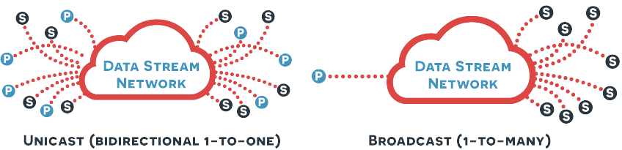
Data Stream Network

Slide 20
C++ SDK
ZMQ - Publisher
auto context = zmq_ctx_new();
auto publisher = zmq_socket(context, ZMQ_PUB);
zmq_bind(publisher, "tcp://*:9999");
zmq_send(publisher, BroadcastMSG.c_str(), BroadcastMSG.length(), 0);

Slide 21
C++ SDK
ZMQ - Subscriber
auto context = zmq_ctx_new();
auto console = zmq_socket(context, ZMQ_SUB);
zmq_connect(console, service_sensor_sub.c_str());
zmq_setsockopt(console, ZMQ_SUBSCRIBE, "HL:", 3);
char buf[256];
zmq_recv(console, buf, sizeof buf - 1, 0);

Slide 22
Controling DC Motor Project

Slide 23

Windows Side Project

Slide 24
C++ SDK
Controling DC Motor Project
#include "Leap.h"
#include <string>
#include <iostream>
#include <zmq.h>
using namespace Leap;
std::string BroadcastMSG = "None";

Slide 25
C++ SDK
Controling DC Motor Project
class SampleListener : public Listener
{
public:
virtual void onFrame(const Controller& controller)
{
const auto frame = controller.frame();
auto hands = frame.hands();
auto normPalmPos = hands[0].palmNormal();
auto palmPos = hands[0].palmPosition();
if (hands[0].isValid())
{
int pwm = palmPos.y / 6.5;
if (pwm >= 100)
pwm = 99;
BroadcastMSG = normPalmPos.x > 0 ? "CW:" + std::to_string(pwm) : "CC:" + std::to_string(pwm);
}
}
};

Slide 26
C++ SDK
Controling DC Motor Project
void main()
{
SampleListener listener;
Controller controller;
controller.addListener(listener);
auto context = zmq_ctx_new(); auto publisher = zmq_socket(context, ZMQ_PUB);
zmq_bind(publisher, "tcp://*:9999");
long long int counter = 0;
while (true)
{
if (BroadcastMSG != "None")
{
zmq_send(publisher, BroadcastMSG.c_str(), 5, 0);
std::cout << "Broadcast Message " << counter++ << " : " << BroadcastMSG << std::endl;
BroadcastMSG = "None";
}
}
controller.removeListener(listener);
}

Slide 27
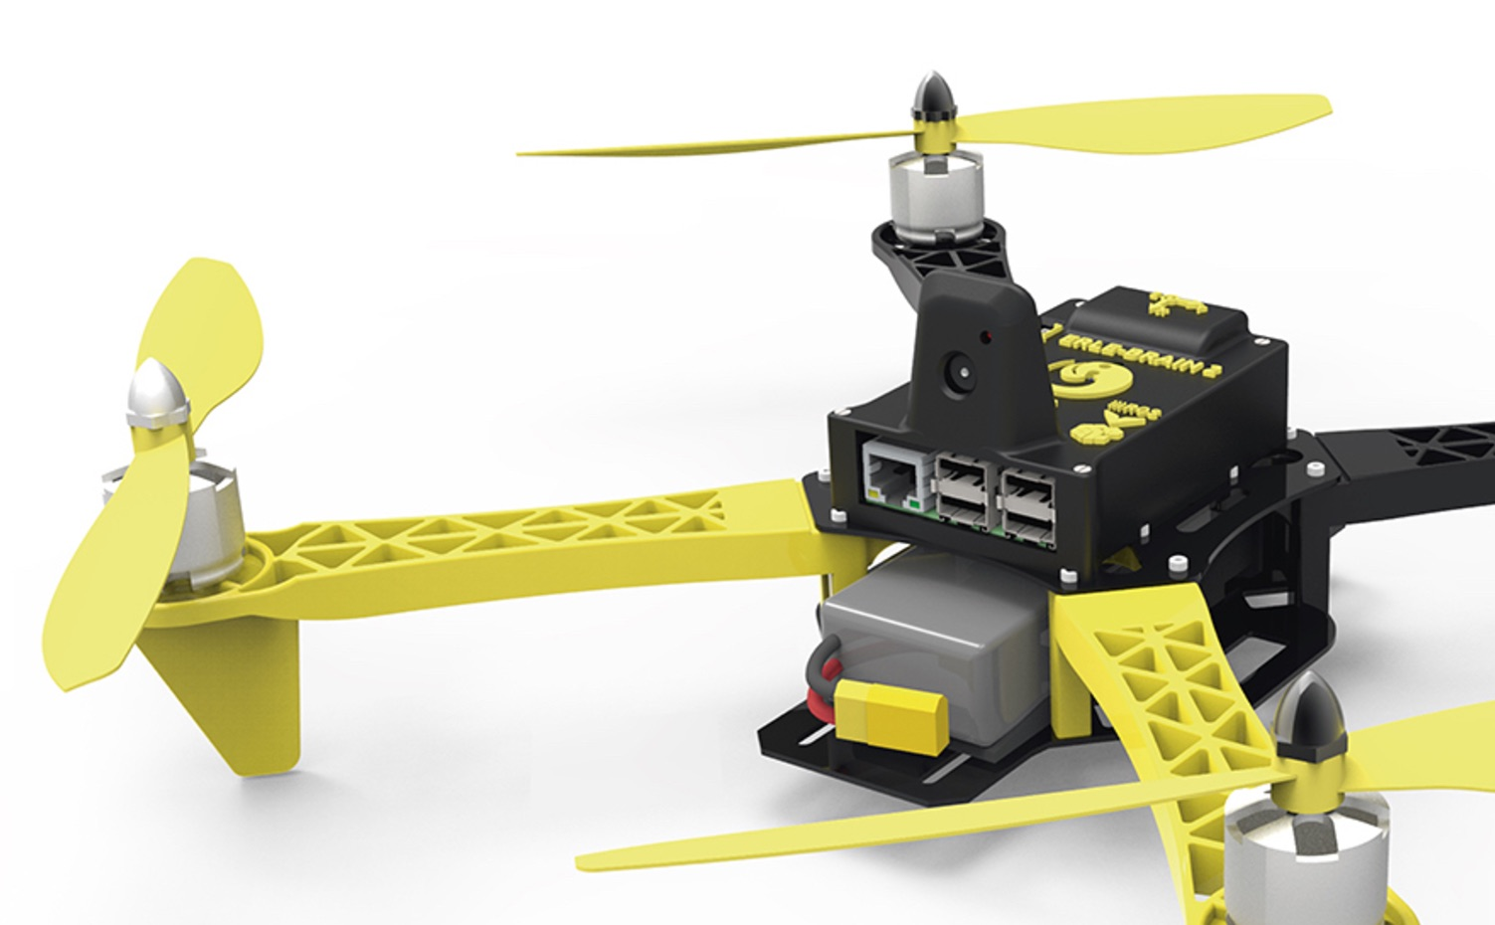
Raspberry Pi Side Project

Slide 28
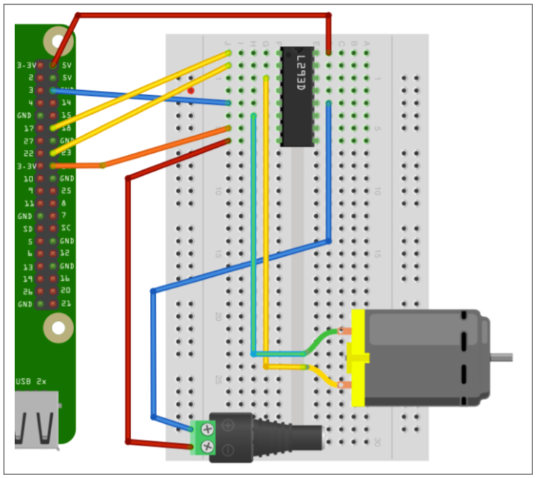
Project Schematic

Slide 29
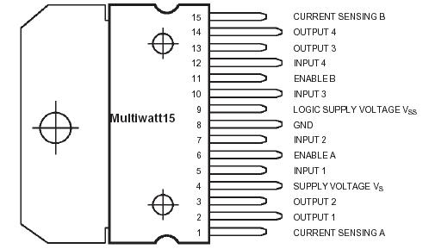
L298 Schematic

Slide 30
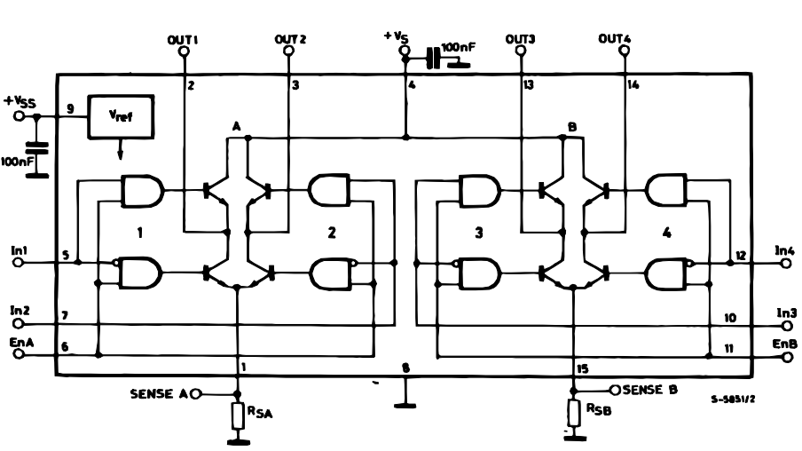
L298 Schematic

Slide 31
C++ SDK
Controling DC Motor Project
#include <wiringPi.h>
#include <softPwm.h>
#include <string>
#include <assert.h>
#include <thread>
#include <zmq.h>
#include <iostream>
enum {CW = 1, CCW = 2} Direction;
int Speed = 0;
int EnablePin = 18;
int In1Pin = 23;
int In2Pin = 24;

Slide 32
C++ SDK
Controling DC Motor Project
void CW_Rotate()
{
digitalWrite(In1Pin, LOW);
digitalWrite(In2Pin, HIGH);
}
void CCW_Rotate()
{
digitalWrite(In1Pin, HIGH);
digitalWrite(In2Pin, LOW);
}

Slide 33
C++ SDK
Controling DC Motor Project
void MotorAction()
{
softPwmCreate(EnablePin, 0, 100);
pinMode(In1Pin, OUTPUT);
pinMode(In2Pin, OUTPUT);
CW_Rotate();
while (1)
{
if (Direction == CW)
CW_Rotate();
else
CCW_Rotate();
softPwmWrite(EnablePin, Speed);
}
}

Slide 34
C++ SDK
Controling DC Motor Project
int main(void)
{
wiringPiSetupSys();
std::thread t(MotorAction);
auto context = zmq_ctx_new();
assert(context);
auto console = zmq_socket(context, ZMQ_SUB);
assert(console);
std::string service_sensor_sub = "tcp://192.168.43.87:9999";
auto rc = zmq_connect(console, service_sensor_sub.c_str());
assert(rc != -1);
zmq_setsockopt(console, ZMQ_SUBSCRIBE, "CW:", 3);
zmq_setsockopt(console, ZMQ_SUBSCRIBE, "CC:", 3);

Slide 35
C++ SDK
Controling DC Motor Project
while (true)
{
char buf[256];
rc = zmq_recv(console, buf, sizeof buf - 1, 0);
if (rc > 0)
{
buf[rc] = 0;
std::string getCmd = buf;
Direction = getCmd.substr(0, 3) == "CW:" ? CW : CCW;
auto getPwm = std::stoi(getCmd.substr(3, 5));
getPwm *= 2;
getPwm = getPwm > 99 ? 99 : getPwm;
Speed = getPwm;
std::cout << getCmd <<std::endl;
}
}
return 0;
}

Slide 36
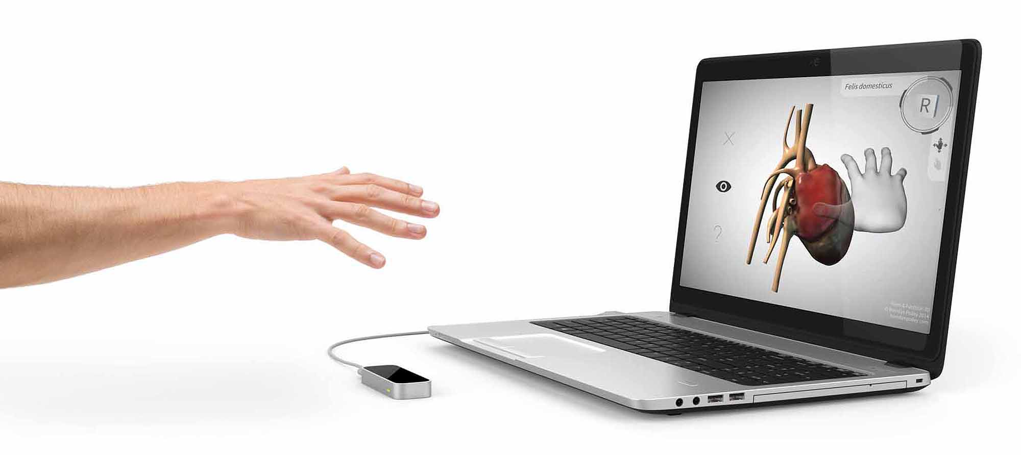
Controlling 3D Volume Project

Slide 37
C++ SDK
Controlling 3D Volume Project
#include <vtkCubeSource.h>
#include <vtkSmartPointer.h>
#include <vtkPolyDataMapper.h>
#include <vtkActor.h>
#include <vtkRenderWindow.h>
#include <vtkRenderer.h>
#include <vtkRenderWindowInteractor.h>
#include <vtkCamera.h>
#include "Leap.h"
using namespace Leap;
Vector origin;
Vector move;
Vector center;
Vector originVector;
Vector rotateVec;
bool freez = false;

Slide 38
C++ SDK
Controlling 3D Volume Project
vtkSmartPointer<vtkRenderWindowInteractor> renderWindowInteractor;
vtkSmartPointer<vtkCamera> camera;
vtkSmartPointer<vtkActor> actor;
class SampleListener : public Listener
{
public:
virtual void onFrame(const Controller& controller)
{
const auto frame = controller.frame();
const auto hand1 = frame.hands()[0];
const auto hand2 = frame.hands()[1];

Slide 39
C++ SDK
Controlling 3D Volume Project
if (hand1.isValid())
{
if (hand2.isValid())
freez = true;
else
freez = false;
rotateVec = hand1.palmNormal();
center = hand1.palmPosition();
}
}
};

Slide 40
C++ SDK
Controlling 3D Volume Project
class vtkTimerCallback : public vtkCommand
{
public:
static vtkTimerCallback *New()
{
auto cb = new vtkTimerCallback;
return cb;
}
virtual void Execute(vtkObject * caller, unsigned long eventId, void *vtkNotUsed(callData))
{
auto interactor = vtkRenderWindowInteractor::SafeDownCast(caller);
if (!freez)
{
actor->RotateX((rotateVec.x - originVector.x) * 200);
actor->RotateY((rotateVec.y - originVector.y) * 200);
actor->RotateX((rotateVec.z - originVector.z) * 200);

Slide 41
C++ SDK
Controlling 3D Volume Project
double x, y, z;
camera->GetPosition(x, y, z);
camera->SetPosition(x, y, center.y * 2);
}
interactor->Render();
}
};

Slide 42
C++ SDK
Controlling 3D Volume Project
void main(int argc, char *argv[])
{
originVector.x = 0.0;
originVector.y = 0.0;
originVector.z = -1.0;
rotateVec.x = 0.0;
rotateVec.y = 0.0;
rotateVec.z = -1.0;
SampleListener listener;
Controller controller;
controller.addListener(listener);
auto cubeSource = vtkSmartPointer<vtkCubeSource>::New();
cubeSource->SetCenter(0.0, 0.0, 0.0);
cubeSource->SetXLength(100.0);
cubeSource->SetYLength(100.0);
cubeSource->SetZLength(100.0);

Slide 43
C++ SDK
Controlling 3D Volume Project
auto mapper = vtkSmartPointer<vtkPolyDataMapper>::New();
mapper->SetInputConnection(cubeSource->GetOutputPort());
actor = vtkSmartPointer<vtkActor>::New();
actor->SetMapper(mapper);
auto renderer = vtkSmartPointer<vtkRenderer>::New();
renderer->AddActor(actor);
renderer->SetBackground(.1, .3, .2); // Background color dark green
camera = vtkSmartPointer<vtkCamera>::New();
renderer->SetActiveCamera(camera);
renderer->ResetCamera();
camera->SetClippingRange(1, 5000);
auto renderWindow = vtkSmartPointer<vtkRenderWindow>::New();
renderWindow->AddRenderer(renderer);
renderWindow->SetWindowName(argv[0]);
renderWindow->SetSize(1000, 1000);

Slide 44
C++ SDK
Controlling 3D Volume Project
renderWindowInteractor = vtkSmartPointer<vtkRenderWindowInteractor>::New();
renderWindowInteractor->SetRenderWindow(renderWindow);
renderWindowInteractor->SetInteractorStyle(nullptr);
renderWindowInteractor->Initialize();
auto callback = vtkSmartPointer<vtkTimerCallback>::New();
renderWindowInteractor->AddObserver(vtkCommand::TimerEvent, callback);
renderWindowInteractor->CreateRepeatingTimer(10);
renderWindow->Render();
renderWindowInteractor->Start();
controller.removeListener(listener);
}

Slide 45
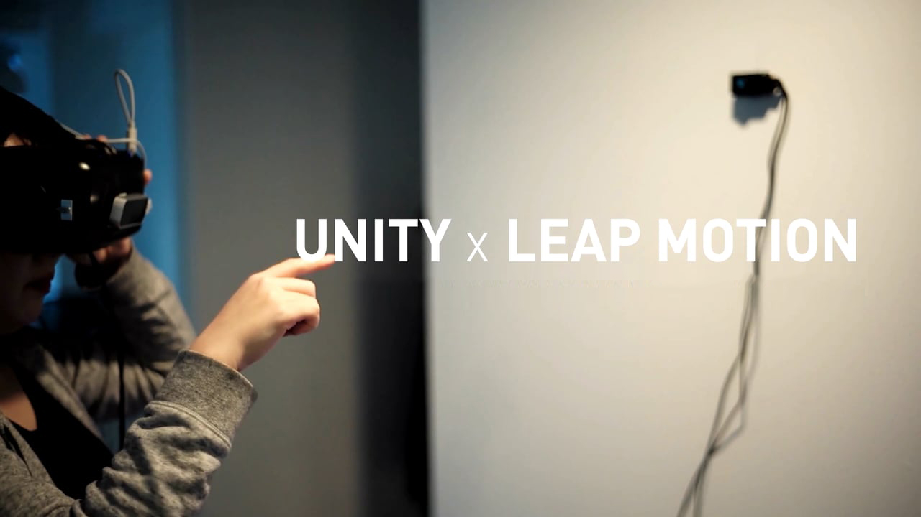

Slide 46

Unity 3D Game Engine

Slide 47

Vuforia Augmented Reality Platform

Slide 48
Controlling LED Array Project

Slide 49
Windows Side Project

Slide 50
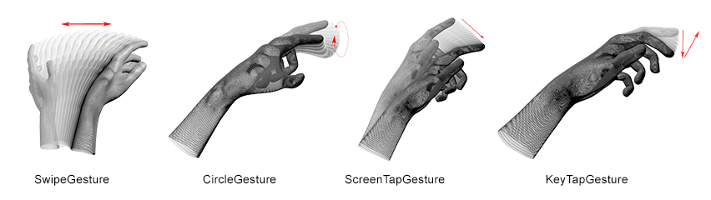
Leap Motion Gestures

Slide 51
C++ SDK
Controling LED Array Project
#include "Leap.h"
#include <string>
#include <iostream>
#include <zmq.h>
using namespace Leap;
std::string BroadcastMSG = "None";

Slide 52
C++ SDK
Controling LED Array Project
class SampleListener : public Listener
{
public:
virtual void onFrame(const Controller& controller)
{
const auto frame = controller.frame();
auto hands = frame.hands();
if (hands[0].isValid() && hands[1].isValid())
{
BroadcastMSG = "HR:HL";
return;
}

Slide 53
C++ SDK
Controling LED Array Project
auto gestures = frame.gestures();
for (const auto &gesture : gestures)
{
if (gesture.isValid())
{
switch (gesture.type())
{
case Gesture::Type::TYPE_SWIPE:
SetBroadcastMsg(frame.hands(), "HR:TYPE_SWIPE", "HL:TYPE_SWIPE");
break;
case Gesture::Type::TYPE_KEY_TAP:
SetBroadcastMsg(frame.hands(), "HR:TYPE_KEY_TAP", "HL:TYPE_KEY_TAP");
break;
case Gesture::Type::TYPE_SCREEN_TAP:
SetBroadcastMsg(frame.hands(), "HR:TYPE_SCREEN_TAP", "HL:TYPE_SCREEN_TAP");
break;

Slide 54
C++ SDK
Controling LED Array Project
case Gesture::Type::TYPE_CIRCLE:
SetBroadcastMsg(frame.hands(), "HR:TYPE_CIRCLE", "HL:TYPE_CIRCLE");
break;
}
}
}
}

Slide 55
C++ SDK
Controling LED Array Project
private:
void SetBroadcastMsg(const Leap::HandList& hands ,const std::string& msgR, const std::string& msgL)
{
if (hands[0].isValid())
{
if (hands[0].isRight())
{
BroadcastMSG = msgR;
return;
}
else
{
BroadcastMSG = msgL;
return;
}
}

Slide 56
C++ SDK
Controling LED Array Project
if (hands[1].isValid())
{
if (hands[1].isRight())
{
BroadcastMSG = msgR;
return;
}
else
{
BroadcastMSG = msgL;
return;
}
}
}
};

Slide 57
C++ SDK
Controling LED Array Project
int main()
{
SampleListener listener;
Controller controller;
controller.enableGesture(Leap::Gesture::TYPE_KEY_TAP, true);
controller.enableGesture(Leap::Gesture::TYPE_CIRCLE, true);
controller.enableGesture(Leap::Gesture::TYPE_SCREEN_TAP, true);
controller.enableGesture(Leap::Gesture::TYPE_SWIPE, true);
controller.addListener(listener);
auto context = zmq_ctx_new();
auto publisher = zmq_socket(context, ZMQ_PUB);
zmq_bind(publisher, "tcp://*:9999");

Slide 58
C++ SDK
Controling LED Array Project
long long int counter = 0;
while (true)
{
if (BroadcastMSG != "None")
{
zmq_send(publisher, BroadcastMSG.c_str(), BroadcastMSG.length(), 0);
std::cout << "Broadcast Message " << counter++ << " : " << BroadcastMSG << std::endl;
Sleep(500);
BroadcastMSG = "None";
}
}
controller.removeListener(listener);
return 0;
}

Slide 59
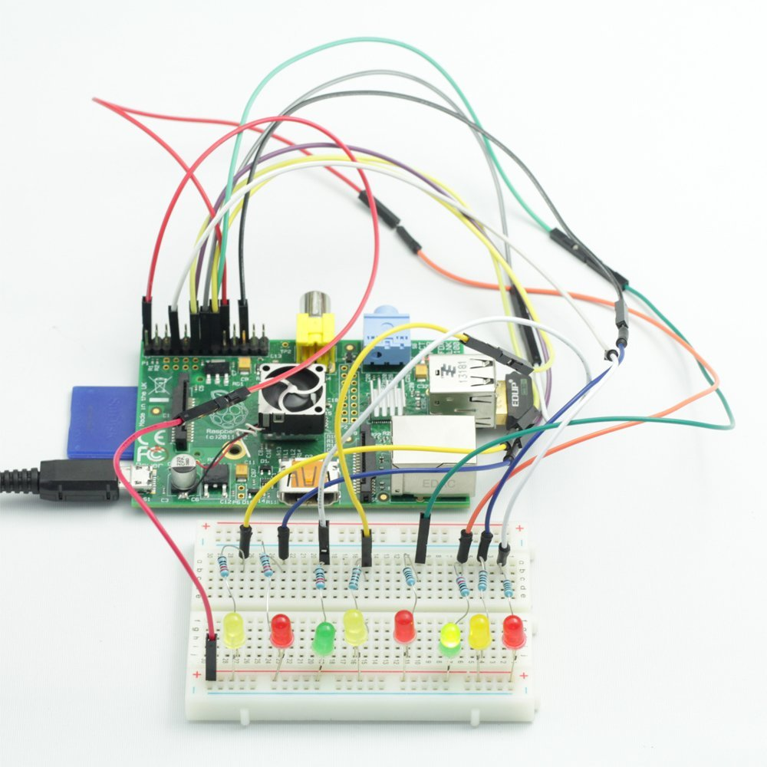
Raspberry Pi Side Project

Slide 60
C++ SDK
Controling LED Array Project
#include <wiringPi.h>
#include <string>
#include <assert.h>
#include <thread>
#include <zmq.h>
#include <iostream>
enum Hand {Right = 1, Left = 2};
enum {Static = 1, Blink = 2, CircleR = 3, CircleL = 4, BlinkAll = 5 } Mode;
int LEDList[9] = { 2, 3, 4, 17, 27, 22, 23, 24, 8 };
int LEDPos;

Slide 61
C++ SDK
Controling LED Array Project
void NextLEDL()
{
LEDPos++;
if (LEDPos > 8)
LEDPos = 0;
}
void NextLEDR()
{
LEDPos--;
if (LEDPos < 0)
LEDPos = 8;
}

Slide 62
C++ SDK
Controling LED Array Project
void ResetGPIO()
{
for (const auto &led : LEDList)
{
pinMode(led, OUTPUT);
digitalWrite(led, LOW);
}
}
void LEDAction()
{
int blinkValue = 1;
while (1)
{
ResetGPIO();
switch (Mode)
{

Slide 63
C++ SDK
Controling LED Array Project
case Static:
{
pinMode(LEDList[LEDPos], OUTPUT);
digitalWrite(LEDList[LEDPos], HIGH);
break;
}
case Blink:
{
pinMode(LEDList[LEDPos], OUTPUT);
digitalWrite(LEDList[LEDPos], blinkValue);
blinkValue = !blinkValue;
delay(500);
break;
}

Slide 64
C++ SDK
Controling LED Array Project
case CircleR:
{
pinMode(LEDList[LEDPos], OUTPUT);
digitalWrite(LEDList[LEDPos], HIGH);
NextLEDR();
delay(200);
break;
}
case CircleL:
{
pinMode(LEDList[LEDPos], OUTPUT);
digitalWrite(LEDList[LEDPos], HIGH);
NextLEDL();
delay(200);
break;
}

Slide 65
C++ SDK
Controling LED Array Project
case BlinkAll:
{
for (const auto & led : LEDList)
{
pinMode(led, OUTPUT);
digitalWrite(led, blinkValue);
}
blinkValue = !blinkValue;
delay(500);
break;
}
}
}
}

Slide 66
C++ SDK
Controling LED Array Project
int main(void)
{
wiringPiSetupSys();
Mode = Static;
LEDPos = 0;
std::thread t(LEDAction);
auto context = zmq_ctx_new();
assert(context);
auto console = zmq_socket(context, ZMQ_SUB);
assert(console);
std::string service_sensor_sub = "tcp://192.168.43.87:9999";

Slide 67
C++ SDK
Controling LED Array Project
auto rc = zmq_connect(console, service_sensor_sub.c_str());
assert(rc != -1);
zmq_setsockopt(console, ZMQ_SUBSCRIBE, "HL:", 3);
zmq_setsockopt(console, ZMQ_SUBSCRIBE, "HR:", 3);
while (true)
{
char buf[256];
rc = zmq_recv(console, buf, sizeof buf - 1, 0);
if (rc > 0)
{
buf[rc] = 0;
std::string getCmd = buf;
auto hand = getCmd.substr(0, 3) == "HR:" ? Right : Left;
if (getCmd.substr(3, 5) == "HL")
{
Mode = BlinkAll;
std::cout << getCmd << std::endl;
}

Slide 68
C++ SDK
Controling LED Array Project
if (getCmd.substr(3, 13) == "TYPE_SWIPE")
{
hand == Right ? NextLEDL() : NextLEDR();
std::cout << getCmd << std::endl;
}
else if (getCmd.substr(3, 14) == "TYPE_CIRCLE") {
Mode = hand == Right ? CircleR :CircleL;
std::cout << getCmd << std::endl;
}
else if (getCmd.substr(3, 15) == "TYPE_KEY_TAP")
{
Mode = Blink;
std::cout << getCmd << std::endl;
}
else if (getCmd.substr(3, 18) == "TYPE_SCREEN_TAP")
{
Mode = Static;
std::cout << getCmd << std::endl;
}}}
return 0;
}

