Slide 1

Raspberry pi Controlling Hardware
Lecturer: Reza Arjmandi
Summer 2016
Preface:
In this chapter, you come to grips with the control of electronics through the Raspberry Pi’s GPIO connector.

Slide 2
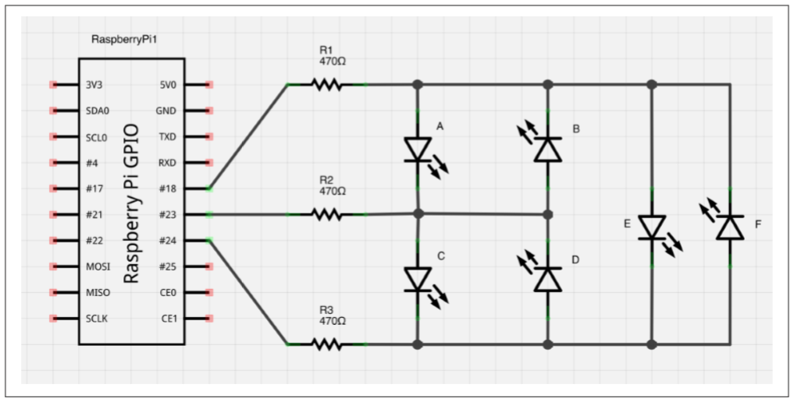
Using Lots of LEDs (Charlieplexing)

Slide 3
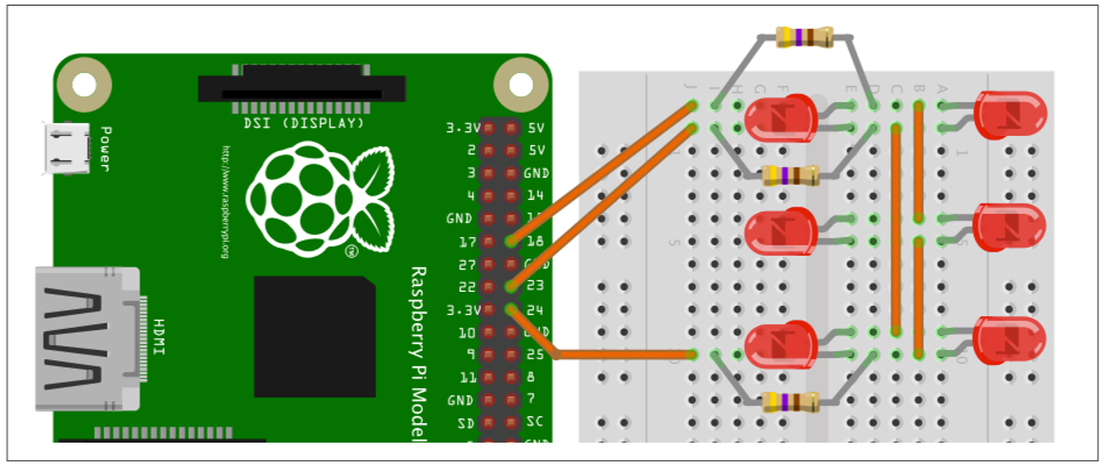
Using Lots of LEDs (Charlieplexing)

Slide 4
Using Lots of LEDs (Charlieplexing)
import RPi.GPIO as GPIO
pins = [18,23,24]
pinLedStates = [[1,0,-1],
[0,1,-1],
[-1,1,0],
[-1,0,1],
[1,-1,0],
[0,-1,1]]
GPIO.setmode(GPIO.BCM)
def SetPin(pinIndex, pinState):
if (pinState == -1):
GPIO.setup(pins[pinIndex], GPIO.IN)
else:
GPIO.setup(pins[pinIndex], GPIO.OUT)
GPIO.output(pins[pinIndex], pinState)

Slide 5
Using Lots of LEDs (Charlieplexing)
def LightLed(ledNumber):
for (pinIndex, pinState) in enumerate(pinLedStates[ledNumber]):
SetPin(pinIndex, pinState)
SetPin(0, -1)
SetPin(1, -1)
SetPin(2, -1)
while(True):
x = int(input("Pin 0 to 5: "))
LightLed(x)

Slide 6
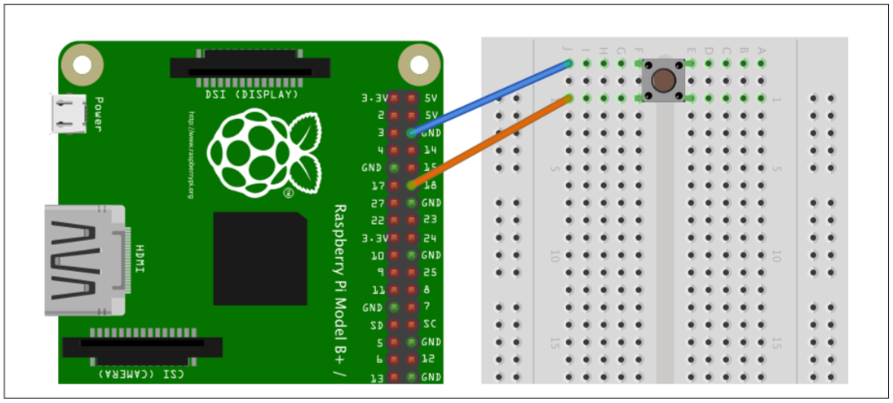
Programming with Interrupts

Slide 7
Programming with Interrupts
You could detect when a button has been pressed, or a GPIO input has changed, by simply checking repeatedly in a loop; for example:
while True:
if GPIO.input(18) == False:
print('You pressed the button‘)
time.sleep(0.1)
The disadvantage here is that you can’t do much else while you are checking for button presses. A second disadvantage is that if the button press is very quick, it could come and go before you can register it with the GPIO.input. This approach is called polling.
Interrupts work differently. They allow you to associate a function with one of the pins so that when the voltage at the input changes either from low to high or vice versa, you can trigger the function to be run.
You can see how this works in the following example program. First, define a function called my_callback that takes a single argument. This argument specifies the input that triggered the interrupt, allowing you to use the same handler function for a number of interrupts.

Slide 8
Programming with Interrupts
You want to respond to some event, such as a button push, without having to continually poll the input pin to see if its state has changed.
Use the add_event_detect function of the RPi.GPIO library.
The upcoming example shows how you can attach an interrupt service routine to be triggered when a button is pressed.
Try running the program with superuser privileges

Slide 9
Programming with Interrupts
The line of code that does the actual linking is:
GPIO.add_event_detect(18, GPIO.FALLING, callback=my_callback)
The first parameter specifies the pin (18). The second can be GPIO.FALLING or GPIO.RISING. If this is set to FALLING, the function will only be called if the GPIO pin goes from high to low. If, on the other hand, the second argument is set to RISING, the function will only be called when the input goes from low to high
The event handler function does not stop the main counting loop while it runs; it actually runs in its own separate thread of execution.

Slide 10
Programming with Interrupts
import RPi.GPIO as GPIO
import time
def myCallback(channel):
print("You pressed button")
GPIO.setmode(GPIO.BCM)
GPIO.setup(18, GPIO.IN, pull_up_down=GPIO.PUD_UP)
GPIO.add_event_detect(18, GPIO.FALLING, callback=myCallback, bouncetime=200)
i = 0
while(True):
i = i + 1
print(i)
time.sleep(0.2)

Slide 11
Programming with Interrupts
Switches often bounce when pressed. This means they don’t always transition cleanly from open to closed, but bounce between the two, possibly several times, making it appear that the button was pressed multiple times, in very rapid succession, when actually it was pressed only once.
If you keep pressing the button, you’ll probably see this reflected in the output as the message appearing more than once for one button press.
The library actually has an option to stop bounce from being a problem, by preventing the interrupt from being triggered again within a certain amount of time. To make use of this feature, just add the extra optional parameter bouncetime to the add_event_detect call. The value of bouncetime is in milliseconds.
GPIO.add_event_detect(18, GPIO.FALLING, callback=my_callback, bouncetime=100)

Slide 12
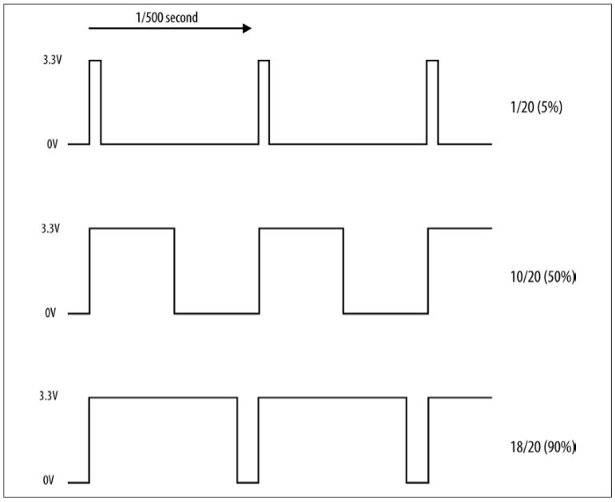
Pulse Width Modulation

Slide 13
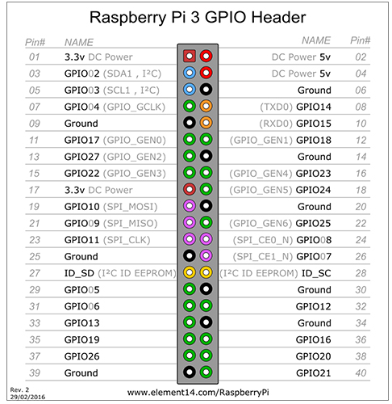
Generate PWM with GPIO
How to Generate PWM:
1-Configure Pin as Output:
GPIO.setup(pin, GPIO.OUT)
2-Create PWM Module:
Pwm_var = GPIO.PWM(pin, Pulse_freq)
3-Start PWM:
Pwm_var.start(initial_value)
3-you can change duty_cycle:
Pwm_var.ChangeDutyCycle(duty_percent)

Slide 14
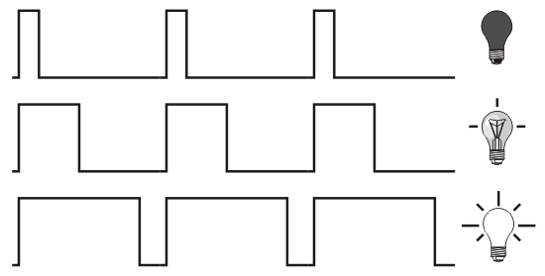
Controlling the Brightness of an LED
PWM is a clever technique where you vary the length of pulses while keeping the overall number of pulses per second (the frequency in Hz) constant. following Figure illustrates the basic principle of PWM.

Slide 15
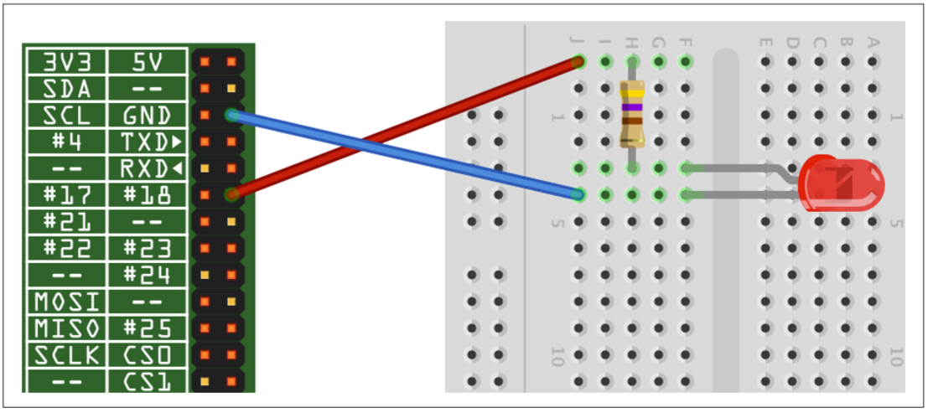
Controlling the Brightness of an LED
Connect an LED to one of the GPIO pins using a 470Ω or 1kΩ series resistor to limit the current.

Slide 16
Controlling the Brightness of an LED
The RPi.GPIO library has a pulse-width modulation (PWM) feature that allows you to control the power to an LED and its brightness.
import RPi.GPIO as GPIO
ledPin = 18
GPIO.setmode(GPIO.BCM)
GPIO.setup(ledPin, GPIO.OUT)
pwmLed = GPIO.PWM(ledPin, 100)
pwmLed.start(100)
while(True):
dutyStr = input("Please Enter Brightness(0 to 100): ")
duty = int(dutyStr)
pwmLed.ChangeDutyCycle(duty)

Slide 17
Controlling the Brightness of an LED
If you are using Python 3 rather than Python 2, change the command input to just raw_input.
Run the Python program, and you will be able to change the brightness by entering a number between 0 and 100

Slide 18
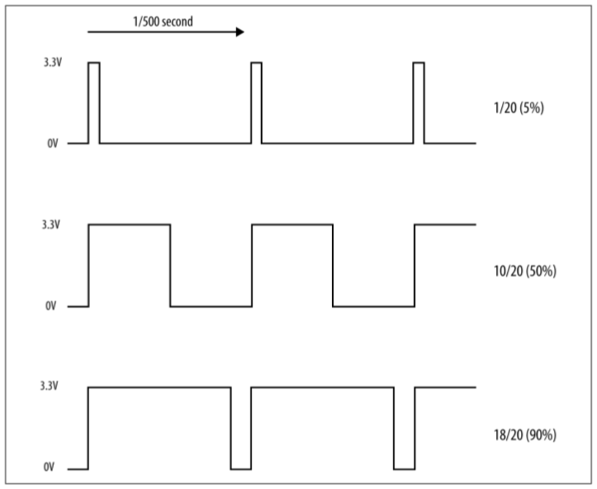
Controlling the Brightness of an LED

Slide 19
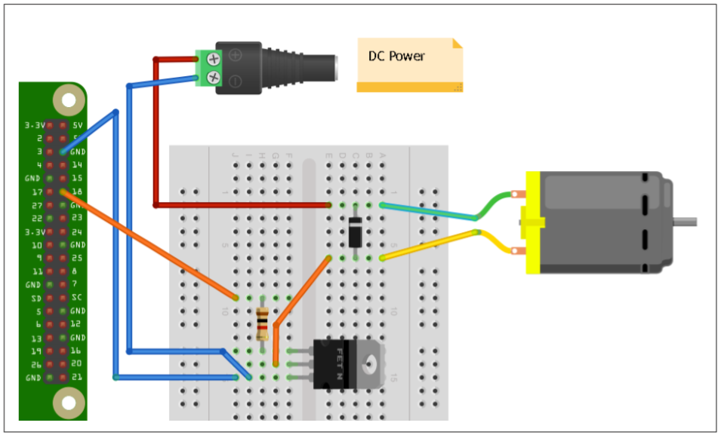
Controlling the Speed of a DC Motor

Slide 20
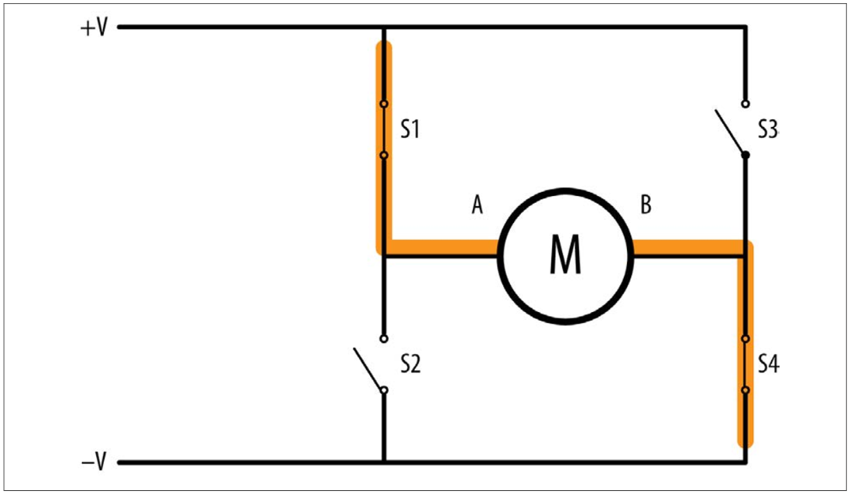
Controlling the Direction of a DC Motor
you can use individual transistors to make an H-Bridge, it is simpler to use an H-Bridge IC such as the L293D. This chip actually has two H-Bridges in it, so you can use it to control two motors.
The L293 has three control pins for each of the two motor control channels. The Enable pin just enables or disables the channel as a whole. In the example program, this is connected to a PWM output to control the speed of the motor. The other two pins (IN1 and IN2) control the direction in which the motor will be driven.
If IN1 is high and IN2 is low, the motor will turn in one direction. If those two pins are reversed, the motor will turn in the opposite direction.

Slide 21
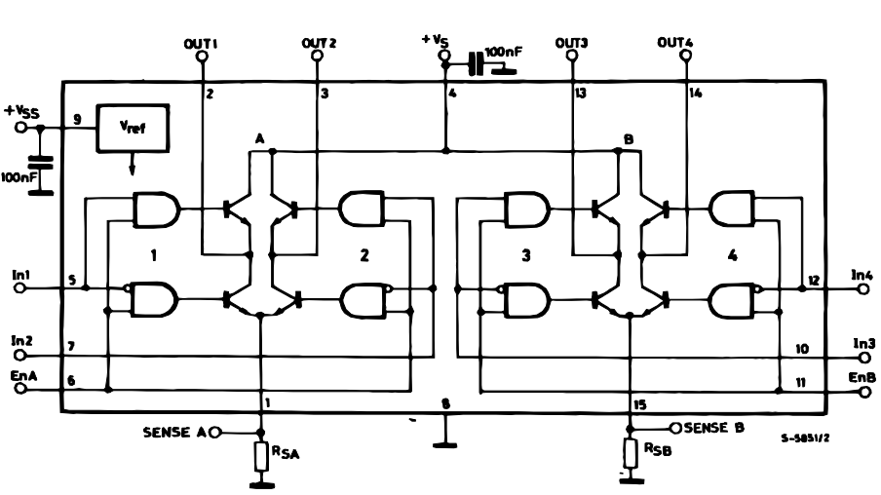
Controlling the Direction of a DC Motor

Slide 22
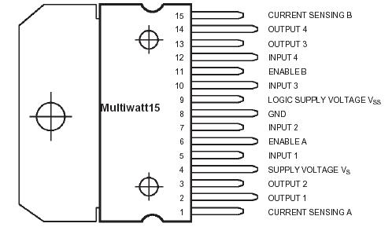
Controlling the Direction of a DC Motor

Slide 23
Controlling the Direction of a DC Motor
You want to control both the speed and direction of a small DC motor.
Use an H-Bridge chip or module.
You have two recipes to choose from for controlling a motor. The first, the “DIY approach,” uses solderless breadboard and a L293D chip. The second design uses a readymade H-Bridge module from SparkFun, connecting it directly to the Raspberry Pi with jumper leads.
Both the L293D and the SparkFun module are capable of driving two motors without any extra hardware.
If the project is driving wheels, then you will typically use a gearmotor, which combines a motor and gearbox to reduce the RPM and increase the torque.
Whichever hardware option you decided upon, you can use the same program to try out the motor. This allows you to enter a letter f or r and then a single digit between 0 and 9. The motor will then either go forward or backward, at a speed specified by the digit—0 for stopped, 9 for full speed.

Slide 24
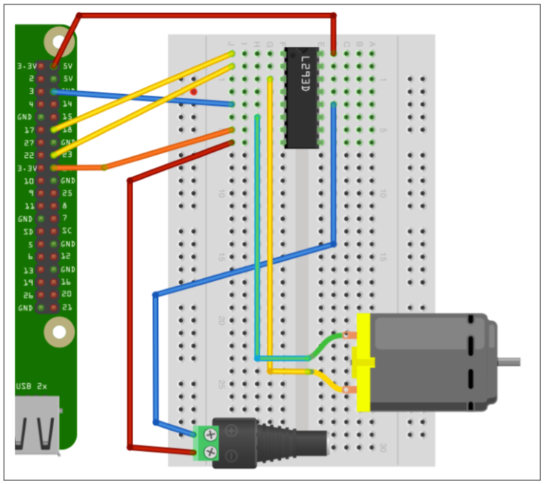
Controlling the Direction of a DC Motor

Slide 25
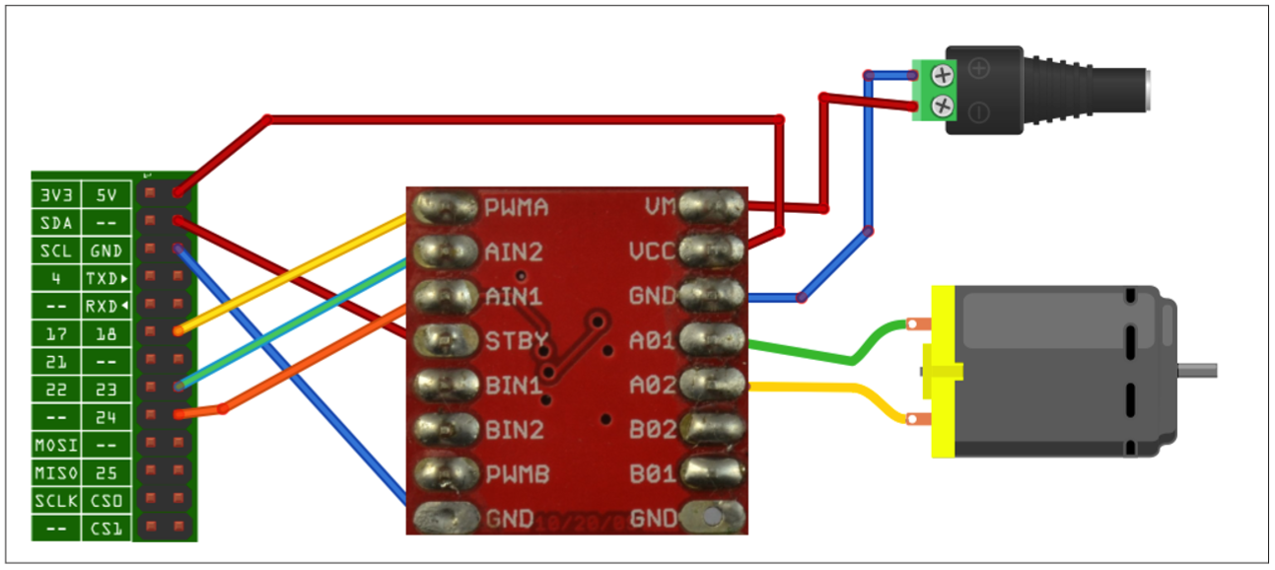
Controlling the Direction of a DC Motor

Slide 26
Controlling the Direction of a DC Motor
import RPi.GPIO as GPIO
import time
enablePin = 18
inPin1 = 23
inPin2 = 24
GPIO.setmode(GPIO.BCM)
GPIO.setup(enablePin, GPIO.OUT)
GPIO.setup(inPin1, GPIO.OUT)
GPIO.setup(inPin2, GPIO.OUT)
pwm = GPIO.PWM(enablePin, 500)
pwm.start(0)
def Clockwise():
GPIO.output(inPin1, True)
GPIO.output(inPin2, False)
def CounterClockwise():
GPIO.output(inPin1, False)
GPIO.output(inPin2, True)

Slide 27
Controlling the Direction of a DC Motor
while True:
cmd = input("command f/r 0..9 e.g. f5: ")
direction = cmd[0]
if (direction == "f"):
Clockwise()
else:
CounterClockwise()
speed = int(cmd[1]) * 10
pwm.ChangeDutyCycle(speed)

Slide 28


Contact us
www.e-system.ir
Info@e-system.ir

