Slide 1
KEYLOGGER project
CAPSTONE PROJECT
Presented By:
1.NAME- Keerthi M
COLLEGE NAME- Priyadarshini engineering college
DEPARTMENT- Computer science and engineering

Slide 2
OUTLINE
Problem Statement
Proposed System/Solution
System Development Approach
Algorithm & Deployment
Result (Output Image)
Conclusion
Future Scope
References

Slide 3
Problem Statement
In today's digital age, where cybersecurity threats loom large, one of the significant concerns is the proliferation of keyloggers, stealthy software tools designed to monitor and record keystrokes on a user's computer without their knowledge. Keyloggers pose a severe threat to individuals and organizations as they can capture sensitive information such as passwords, credit card details, and other personal data, leading to identity theft, financial loss, and privacy breaches.

Slide 4
Proposed Solution
Implement Keystroke Logging:
Write code to capture keystrokes. You can achieve this using platform-specific libraries or APIs. In Windows, you might use the Windows API or libraries like pyhook for Python. For macOS, you can use Objective-C libraries or the NSEvent class in Objective-C or Swift. On Linux, you might use X11 or other system-level libraries.
Store or Send Logs:
Decide how you want to store or transmit the captured keystrokes. You might log them to a text file, store them in a database, or send them over a network connection to a remote server.
Handle Permissions and Security:
Ensure that your keylogger operates within legal and ethical boundaries. Inform users if keystrokes are being captured, and obtain necessary permissions if required by law. Implement security measures to protect the captured data, such as encryption for transmission or storage.
Stealth Mode (Optional):
If you want your keylogger to run stealthily, without the user's knowledge, you'll need to implement techniques to hide its presence. This might involve hiding the process from task managers, using rootkit-like techniques, or running the keylogger as a hidden service.
Testing:
Thoroughly test your keylogger to ensure it captures keystrokes accurately and behaves as expected. Test it on different operating systems and environments to verify compatibility.

Slide 5
System Approach
Hardware Keylogger are easy to use as they are placed in the internal hardware of the computer itself or it can be secretly inserted in between the CPU and the keyboard wire. But to plant the hardware Keylogger, the cybercriminal has to have physical access to the computer system while no one is watching.

Slide 6
Algorithm & Deployment
Capture Keystrokes:
Implement a mechanism to capture keystrokes made by the user. You can achieve this by utilizing platform-specific libraries or modules.
Record Keystrokes:
Store the captured keystrokes in a secure and persistent manner. You might choose to log them into a file, a database, or transmit them to a remote server, depending on your project requirements.
Documentation: Document the keylogger's functionality, usage instructions, and any other relevant information for future reference.

Slide 7

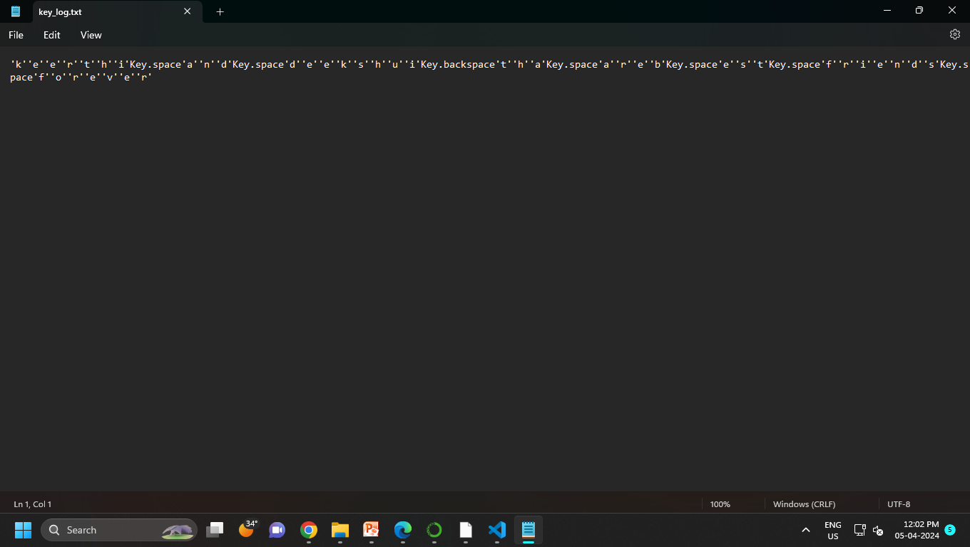
Result

Slide 8
Conclusion
In this paper, the article attempts to insight the keylogger workings, different types of password attacks and prevention & detection measures to reduce and avoid the keylogging attacks. This paper had discussed a cryptography encryption decryption method to reduce the keylogging attacks. To reduce the keylogging attacks user has to keep their software up-to-date and it is advisable to maintain the strong password policy for their systems. It is advisable to disable the self-running files that are externally connected devices like USBs and restrict to copy the files to and from external computers by doing this attacks may get reduce. In literature review, this paper discussed the various measures and methods to reduce keylogging attacks and it also used for parents to monitoring the children’s activity.

Slide 9
Future scope
Improved Stealth and Security: Implement advanced techniques to make the Keylogger more discreet and resistant to detection by antivirus software and anti-keylogging tools. Enhanced Logging: Add features to capture additional types of data, such as screenshots, clipboard contents, and web camera footage, to provide a more comprehensive overview of user activity. Remote Monitoring: Develop the ability to remotely access and monitor the logged data, possibly through a web-based interface or mobile application, allowing users to view activity from anywhere. Encryption and Data Protection: Integrate encryption algorithms to secure the logged data and implement secure methods for transmitting it to a designated server or storage location. User Authentication: Incorporate user authentication mechanisms to ensure that only authorized individuals can access the logged data and configure the Keylogger settings. Behavioral Analysis: Implement algorithms to analyze user behavior and detect suspicious or potentially malicious activity, providing alerts or notifications to the administrator. Compliance and Legal Considerations: Ensure compliance with relevant laws and regulations regarding privacy and data protection, and provide features to facilitate adherence to these requirements. Integration with Security Solutions: Enable integration with other security software and systems, such as intrusion detection/prevention systems or Security Information and Event Management (SIEM) platforms, to enhance overall security posture. Overall, the future scope for a Keylogger project lies in continually adapting to evolving security threats and user needs, while prioritizing privacy, security, and legal compliance.

Slide 10
References
https://www.ntiva.com/cyber-security-services/
geeksforgeeks.org/cryptography-introduction/
https://sec.okta.com/articles/2020/12/password-spraying-attacks-and-how-prevent-them
https://info-savvy.com/password-attacks/
https://www.linkedin.com/pulse/common-security-attacks-cyber-mobile-atms-wifi-iot-niteen-lall
https://searchsecurity.techtarget.com/definition/keylogger
https://www.veracode.com/security/keylogger
Antioch Shield against the Software Key loggers. Aslam at el. (2004)
Analysis and Implementation of Decipherments of Keylogger, Parth Mananbhai Patel, Prof. Vivek K.ShahParth (2015).
Bait Your Hook: A Novel Detection Technique for Keyloggers,Stefano Ortolani, Cristiano Giuffrida, Bruno Crispo (2010).

Slide 11
THANK YOU

