Slide 1
How Inport Works
Hope Internals Series
Tianyou Li

Slide 2
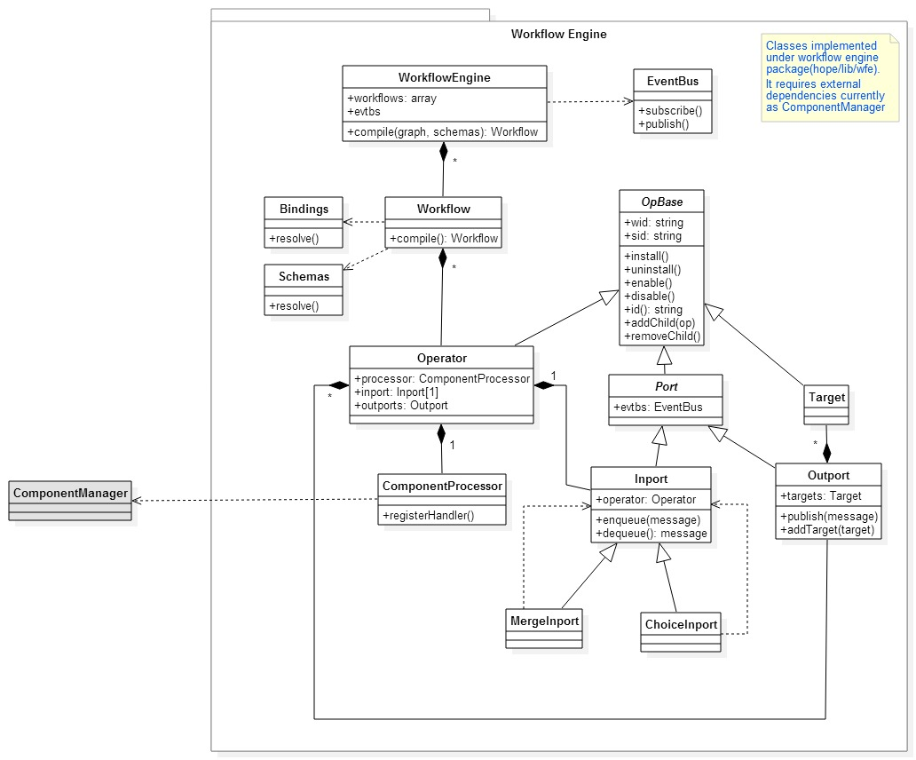
Inport Class Diagram

Slide 3
Inport Compile Time Representation
Inport
#Children: Inport
MergeInport
#operator: Operator
#Children: Inport
#operator: Operator
ChoiceInport
#Children: Inport
#operator: Operator
Operator
ChoiceInport
#operate: ComponentProcessor
Inport
#Children: Inport
#Children: Inport
#inport: Inport
#operator: Operator
MergeInport
#operator: Operator
#Children: Inport
#operator: Operator
Inport
All descendant inport will share the same root operator
Inport
#Children: Inport
#Children: Inport
#operator: Operator
#operator: Operator

Slide 4
Inport Install Time Representation
Inport
#Children: Inport
MergeInport
#operator: Operator
Inport
#Children: Inport
#operator: Operator
#Children: Inport
ChoiceInport
#operator: Operator
#Children: Inport
Wrapped
Operator
#operator: Operator
Operator
ChoiceInport
#operate: ComponentProcessor
#operate: ComponentProcessor
Inport
#Children: Inport
#Children: Inport
#inport: Inport
#operator: Operator
MergeInport
#operator: Operator
#Children: Inport
#operator: Operator
Inport
Inport
ChoiceInport will pass through its operator to next level;
MergeInport will create a wrapped operator, which reference to its original operator, then pass the wrapped operator to next level
Inport should always be the the leaf node, and hold the operator which its component processor will be installed to handle input message
#Children: Inport
#Children: Inport
#operator: Operator
#operator: Operator
Wrapped
Operator
#operate: ComponentProcessor

Slide 5
Inport Run Time Representation
Inport
#Children: Inport
MergeInport
#operator: Operator
Inport
#Children: Inport
#operator: Operator
#Children: Inport
ChoiceInport
#operator: Operator
#Children: Inport
Wrapped
Operator
#operator: Operator
Operator
ChoiceInport
#operate: ComponentProcessor
#operate: ComponentProcessor
Inport
#Children: Inport
#Children: Inport
#inport: Inport
#operator: Operator
MergeInport
#operator: Operator
#Children: Inport
#operator: Operator
Inport
Inport
Message processing started from the leaf node as bottom-up, with the processor handler generated from top-down
#Children: Inport
#Children: Inport
#operator: Operator
#operator: Operator
Wrapped
Operator
#operate: ComponentProcessor

