Slide 1


World Quant IQC’ 24 Team Oblivion INDIAN INSTITUTE OF TECHNOLOGY PATNA
ADITYA PRAKASH | YAGYESH ANSHUL | AARAV SHYAM
1
Here is where your presentation begins

Slide 2

Slide Line
Alpha 01
Alpha 02
Alpha 03
Page – 3-4
Page – 5-6
Page – 7-8
Based on pre-tax income and capital efficiency
Region : CHN
Universe : TOP3000
Overview of the alpha 02
Region : USA
Universe : TOP3000
Overview of the alpha 03
Region : USA
Universe : TOP3000
2

Slide 3

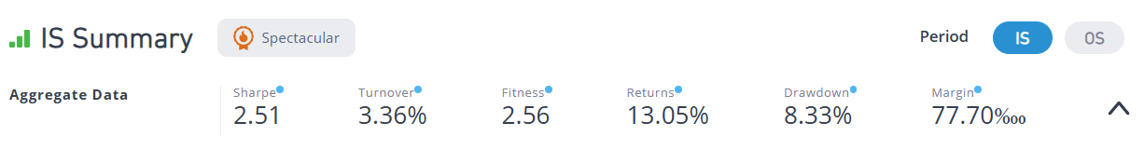
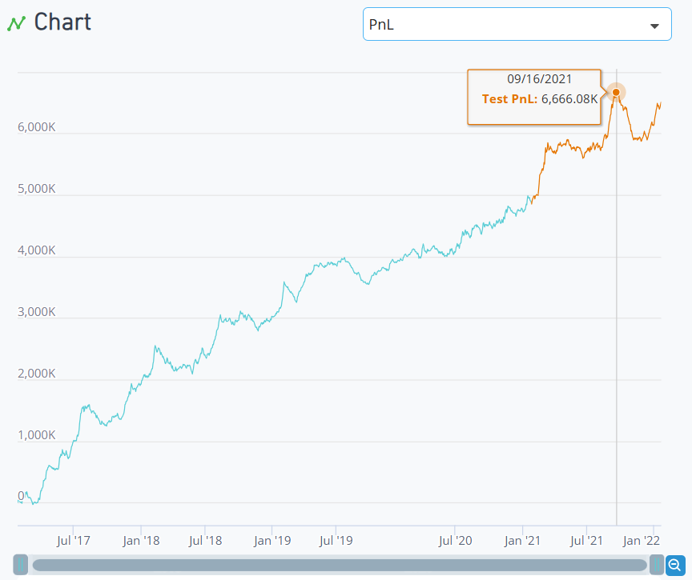
Alpha 01
Source of Idea
Ranking firms based on their pretax income seemed intuitive as it directly reflects a company's profitability. Further investigation into the efficiency ratio, revealed effective utilization of capital to generate revenue.
Hypothesis
Companies that rank high in both pre-tax income over time and capital efficiency within their industry are likely to be stronger performers and potentially better investment opportunities.
3

Slide 4
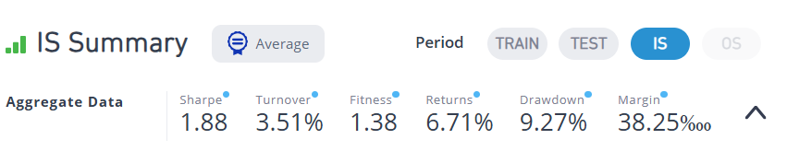
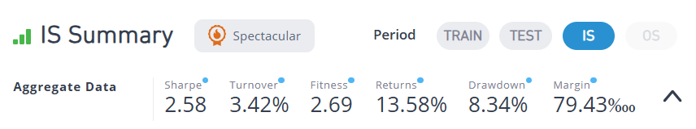
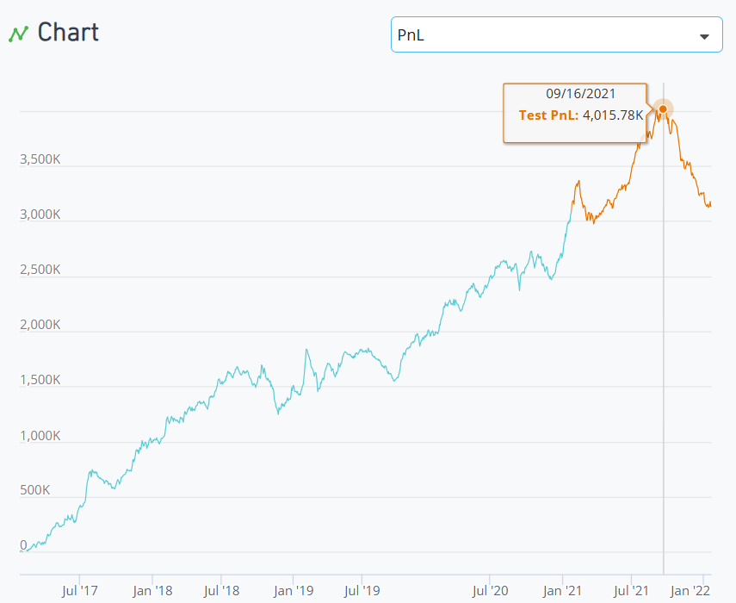
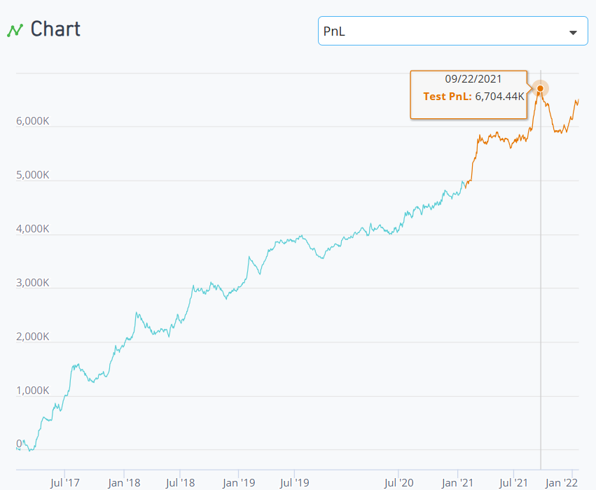
First Implementation :
Scope of Improvement :
Operators | Datasets :
The first implementation was to rank companies with higher pre-tax income over an extended period, suggesting better performance persistently.
This revised model aims to identify companies that not only generate high revenues but also effectively manage their tax liabilities, leading to better overall performance.
group_rank , ts_rank , quantile | pretax_income , income_tax , sales , cap
4

Slide 5
Alpha 02
Source of Idea
The idea behind is that companies with higher pretax income over an extended period of time, along with being efficient with their capital usage, are more likely to perform better within same type of companies.
Hypothesis
Companies that rank high in both pre-tax income over time and capital efficiency within their industry are likely to be stronger performers and potentially better investment opportunities.
5

Slide 6
First Implementation :
Scope of Improvement :
Operators | Datasets :
The first implementation was to rank companies with higher pre-tax income over an extended period, suggesting better performance persistently.
This revised model aims to identify companies that not only generate high revenues but also effectively manage their tax liabilities, leading to better overall performance.
group_rank , ts_rank , quantile | pretax_income , income_tax , sales , cap
6

Slide 7
Alpha 03
Source of Idea
The idea behind is that companies with higher pretax income over an extended period of time, along with being efficient with their capital usage, are more likely to perform better within same type of companies.
Hypothesis
Companies that rank high in both pre-tax income over time and capital efficiency within their industry are likely to be stronger performers and potentially better investment opportunities.
7

Slide 8
First Implementation :
Scope of Improvement :
Operators | Datasets :
The first implementation was to rank companies with higher pre-tax income over an extended period, suggesting better performance persistently.
This revised model aims to identify companies that not only generate high revenues but also effectively manage their tax liabilities, leading to better overall performance.
group_rank , ts_rank , quantile | pretax_income , income_tax , sales , cap
8

Slide 9
References
Earnings Before Tax (EBT) vs Pretax Income - Overview, How To Calculate (corporatefinanceinstitute.com)
Pretax Profit Margin: Definition, Uses, Calculation, Example (investopedia.com)
Alpha 01
Alpha 02
Links here
Alpha 03
Links here
9

Slide 10



Thanks
Aditya Prakash
Yagyesh Anshul
Aarav Shyam
10

