Slide 1
Noodles Crypto Analytics Platform
End-to-End Data Pipeline with Python & Power BI
Rakesh Tripathy | 2026

Slide 2
Executive Summary
What: Automated analytics pipeline
Why: Data-driven decisions
How: Python ETL + SQL DW + Power BI
Impact: 1M+ rows, <5 min refresh

Slide 3
Business Problem
Manual analysis is slow
Need automation & scalability
Users: Executives, Traders, Analysts
Goal: Daily actionable insights

Slide 4
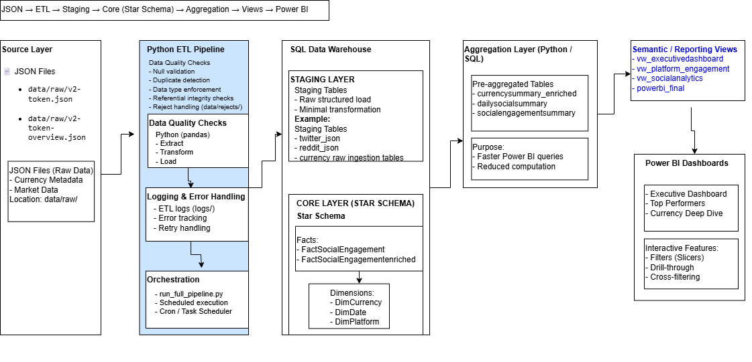
Technical Architecture
JSON → ETL → Staging → Star Schema → Aggregations → Power BI
Tools: Python, SQL Server, Power BI
Automated daily pipeline
Python 🐍pandas 🐼Database 🗄️Power BI 📊

Slide 5
Data Model
Star Schema
Dimensions: Currency, Date, Platform
Facts: Social Engagement
Grain: 1 row per currency per day

Slide 6
Python ETL Pipeline
Extract → Transform → Load
Logging + Error Handling
100K rows/min
~5 min runtime

Slide 7
Data Quality & Validation
Checks: Nulls, duplicates, integrity
Reject handling
99.8% quality score

Slide 8
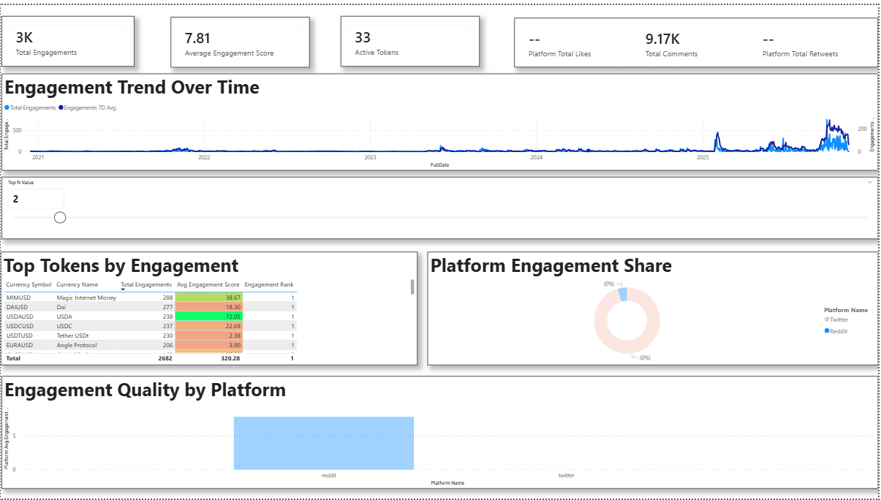
Power BI Executive Dashboard
KPIs: Market Cap, Volume
Interactive filters
Drill-through enabled

Slide 9
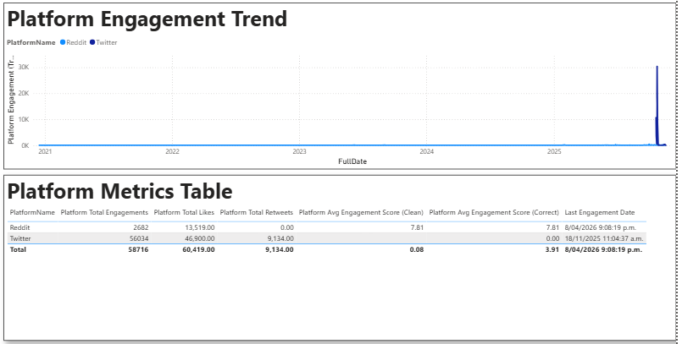
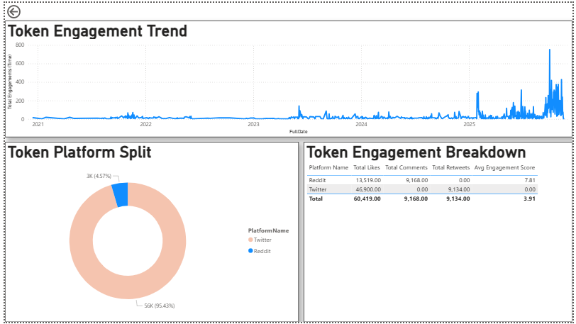
Top Performers Report
Top Gainers/Losers
Dynamic Top N
Insight: +25% weekly gains

Slide 10
Key Insights
BTC dominance: 45%
Engagement predicts price
Volume precedes price
Top 20 = 90% volume

Slide 11
Technical Highlights
Python: 1500+ lines
SQL: 10+ tables/views
Power BI: 20+ DAX
<5 min refresh
99.8% accuracy

Slide 12
Thank You
Questions?
GitHub: your repo
Demo video link

