Slide 1

Foodoo.com
Good food, good health!!

Slide 2
Introduction
Foodoo.com is a meal sharing platform with aim to connect friends and guests over quality meals prepared by home chefs and standard restaurants.

Slide 3
Some statistics
According to wfp 790 million people do not have enough food to eat. About 1/9 persons in the world.
Developing countries leading with 12.9% of their population being undernourished.
In sub saharan Africa, 1/4 % persons are undernourished. Go to sleep without eating to satisfaction. 1/6 children are underweight.

Slide 4
How does Foodoo.com operate?
Users of foodoo are classified into two: chefs and guests.
Chefs are divided into home chefs (individuals who make their own meals and advertise for guests) and restaurant chefs (usually restaurant that advertises its meals for customers).
Guests are users interested and seeking for new recipes to eat.

Slide 5
How does Foodoo.com operate?
Foodoo is intended to be hosted as a Facebook application, allowing guests to follow chefs and invite friends to newly discovered foodoo joints.
The guests logins with his Facebook profile details and indicates interest in eating at a joint by clicking a hand at the bottom of menu. This sends and instant message to chef notifying him/her of a guests interest to eat at his joint.
The chef logins with Facebook to update new menus/create accounts. Payment is done at the joint.

Slide 6
Advantages of Foodoo.com
It allows for balanced diet and better living , especially for students because of its low tariffs on quality meals.
Share our culinary traditions with other people, especially tourists that will be coming for 2016 and 2018 cup of nations in Cameroon.(Sell our traditional cuisine).
Help us discover ourselves and unite many. (Reviving the spirit of togetherness).

Slide 7
Advantages of Foodoo.com
Taste new meals which we did not know any existence. E.g kwacoco bible.
Because not all your friend’s friends are your friends, it will help us make new friends over meals.
Help many discover their talent especially home chefs and hobby chefs.

Slide 8
Security concerns solved.
Guests and chefs are verified through SMS confirmation with the registered number.
Signup with Facebook allows us trace who visits which foodoo joint.
The platform allows users to review and rate chefs to maintain quality of meals.

Slide 9
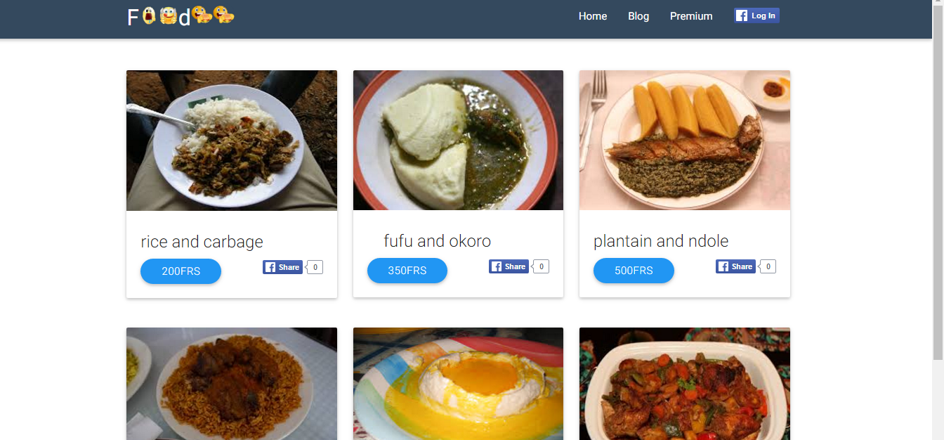

Slide 10
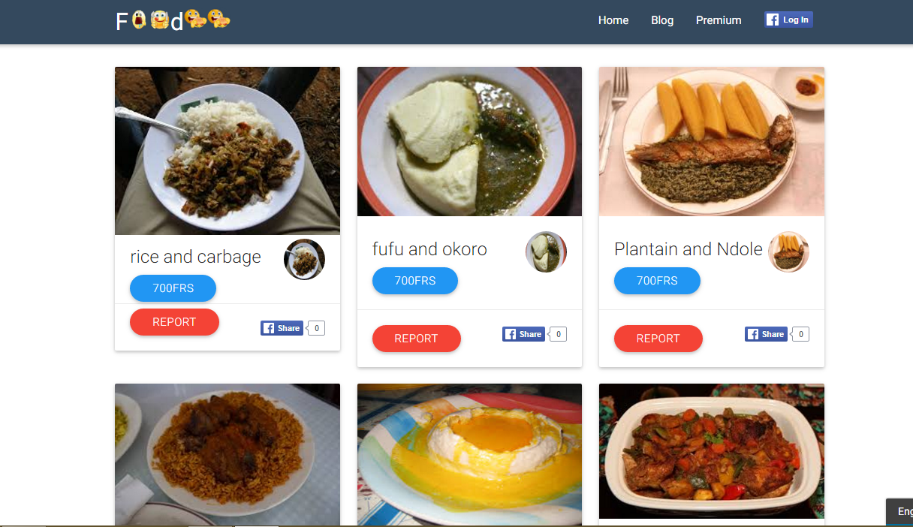

Slide 11
Appreciation goes to:
Mr. Ayuk Etta (CEO of SkyLabase)
Daniel Carlson(#dinesh) (Software engineer at SkyLabase)
Ivange Larry (#debugger, #openmrs)
Joseph Ndango (Software engineer at SkyLabase)
Egoko Elvine (#Ubuntu)

Slide 12
Disclaimer!!
All of this work has been and will continue to be carried out individually and should in no way be attributed to my work at Skylabase.
All queries should be addressed directly to me.

Slide 13
THANKS FOR YOUR KIND ATTENTION !
Presented By : Obia Remmy B. N.
Computer Engineering Student
FET.

