Slide 1
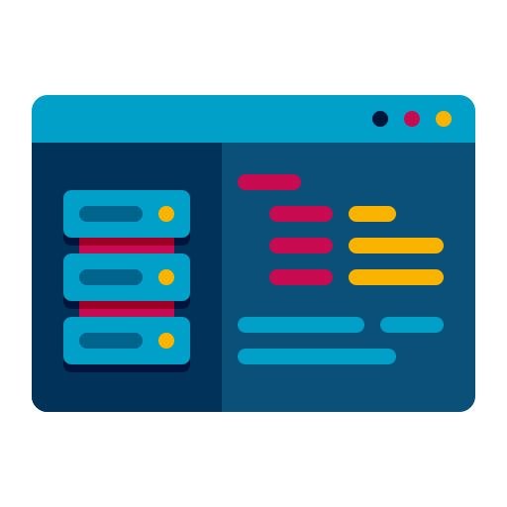


Chat Application
1. A chat application or any type of social media application consists of three major sections
1. Front end or UI/UX
2. Backend
3. Database

Slide 2
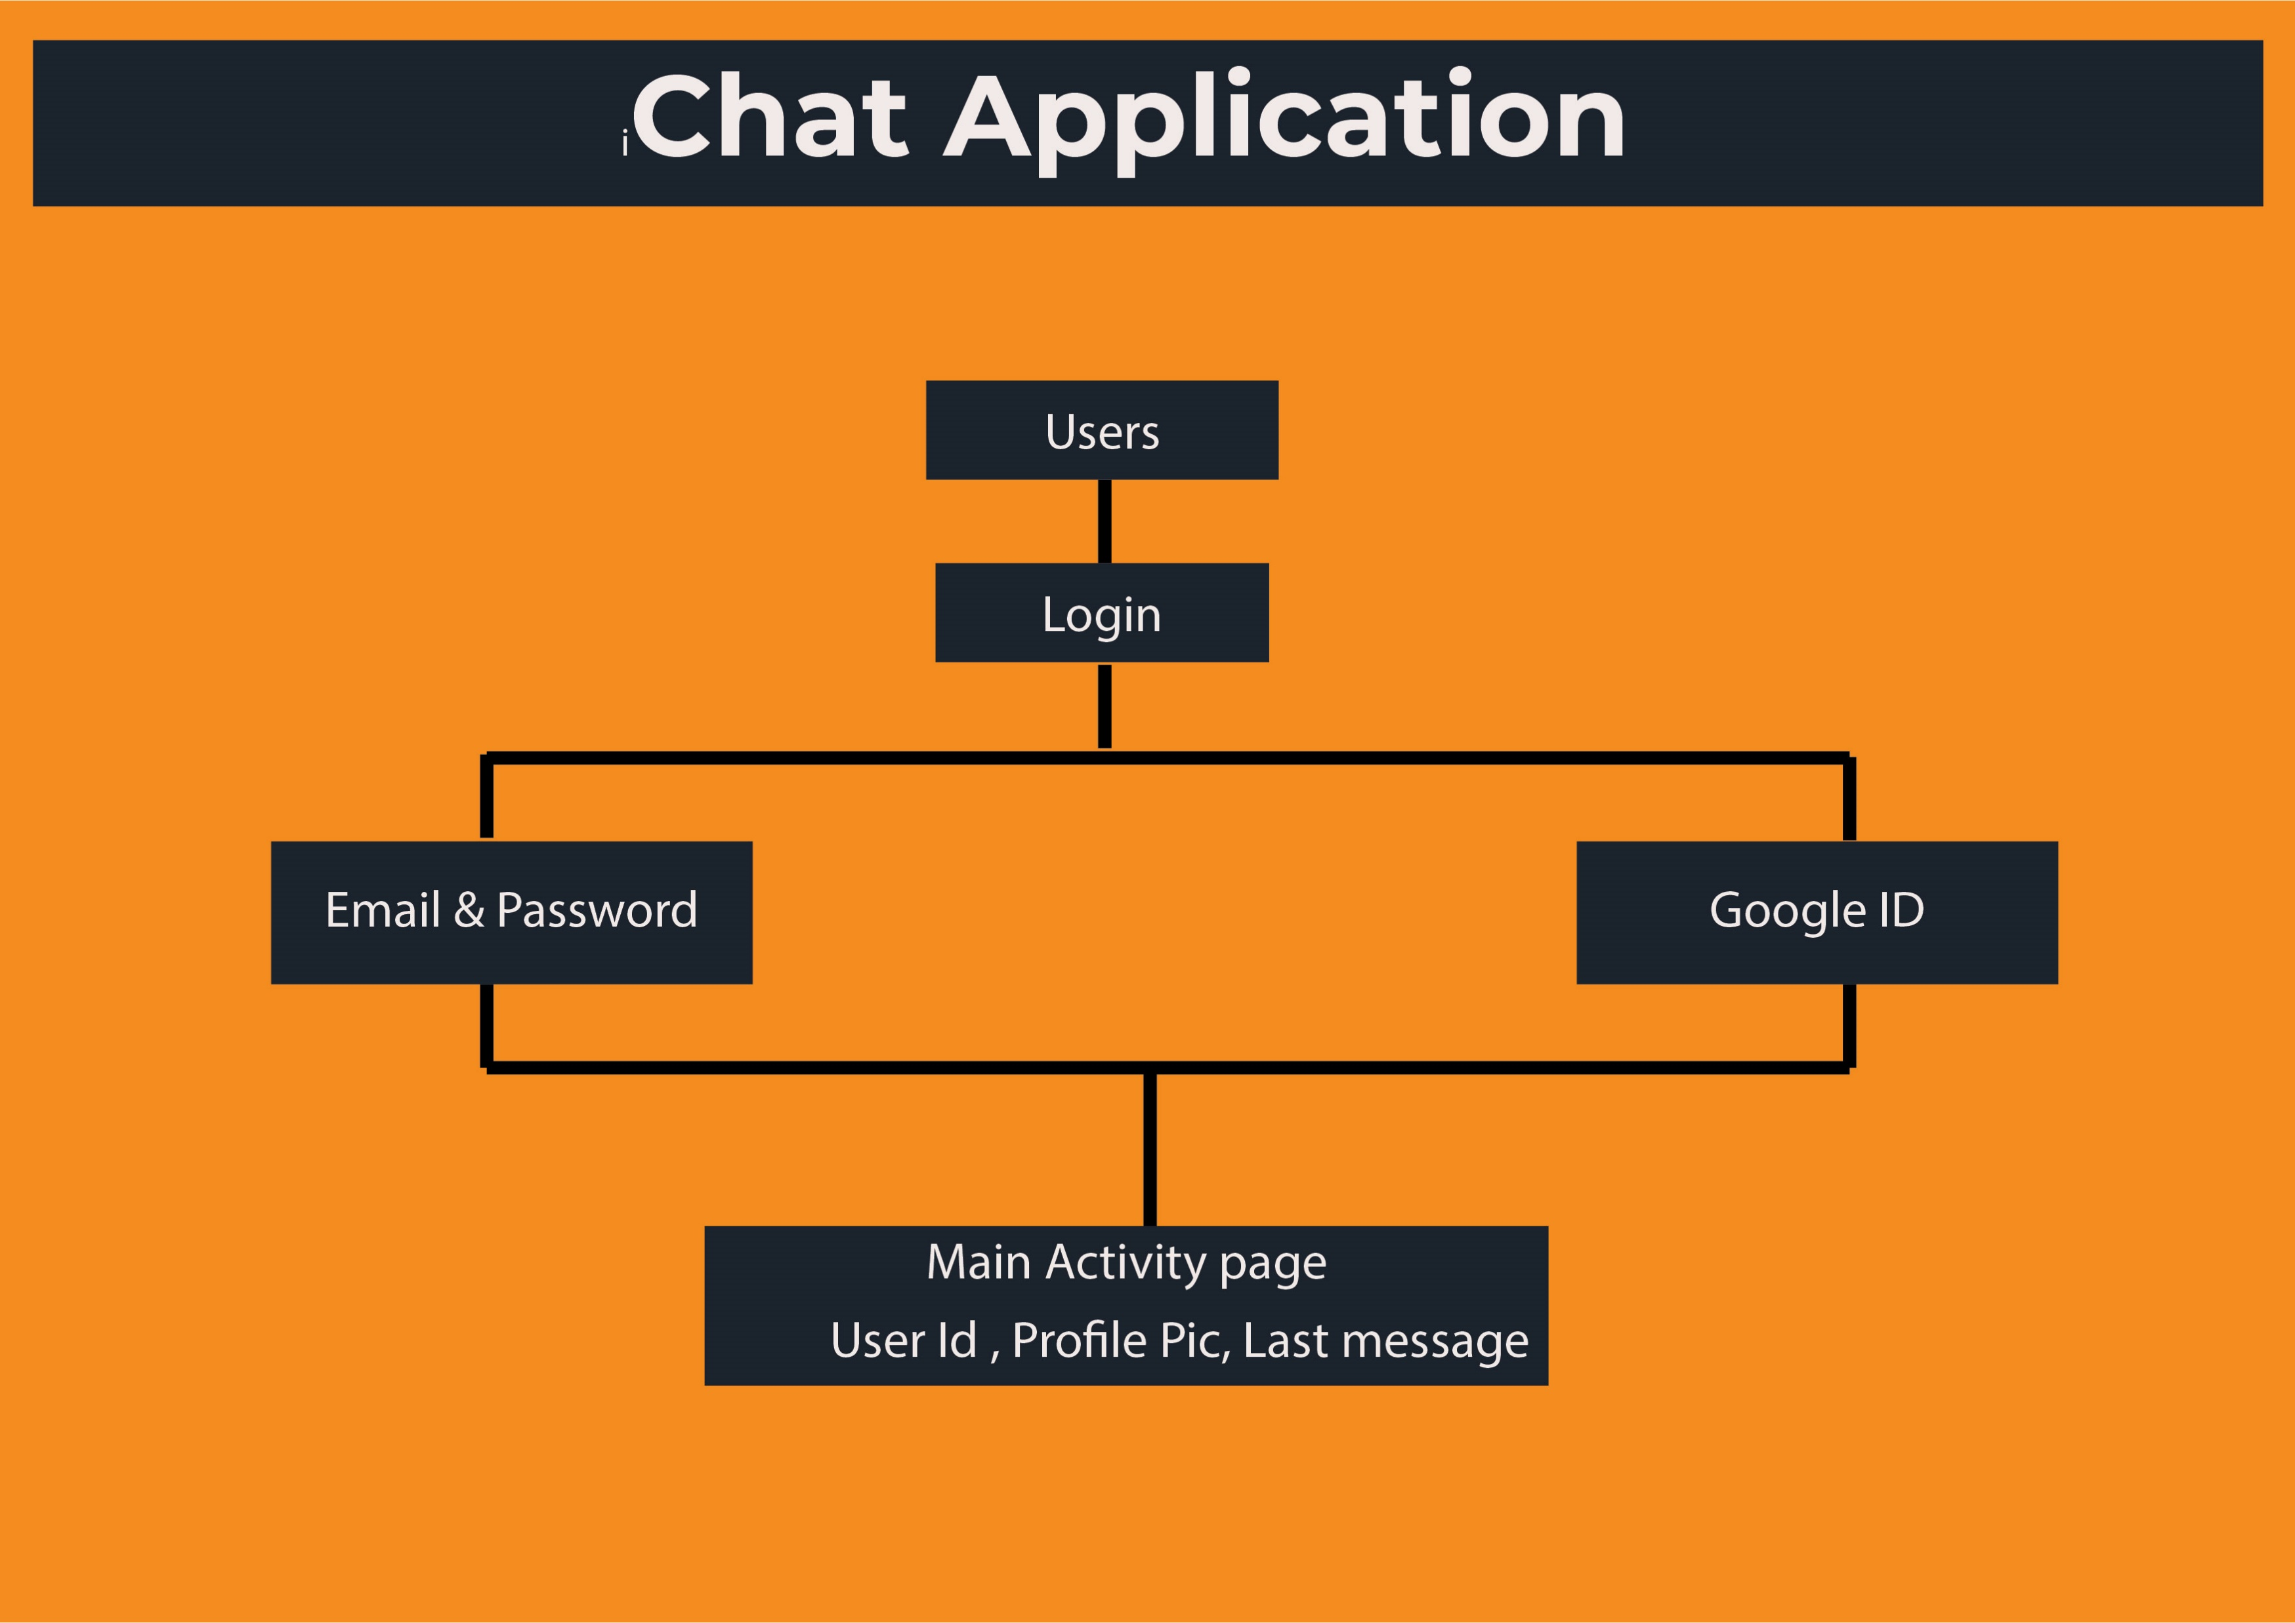

Slide 3
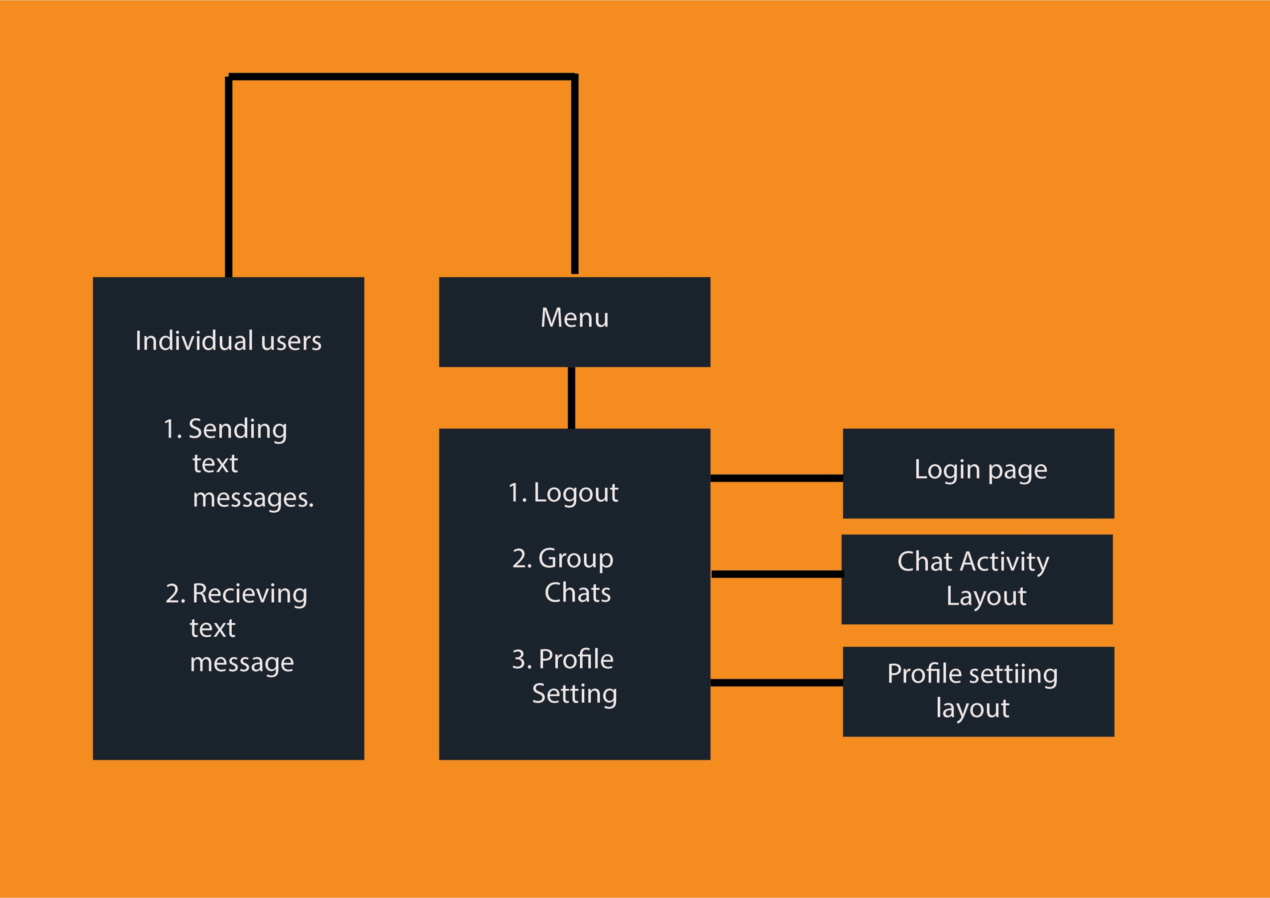

Slide 4
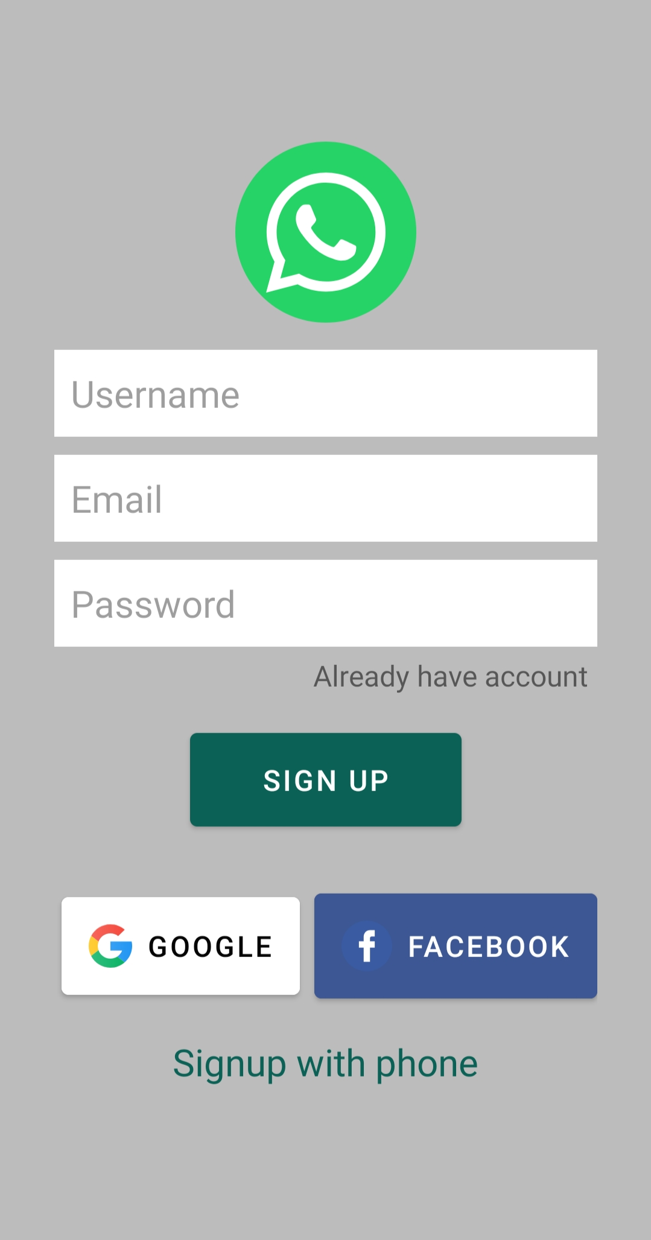
Front End
Front end consists of different layouts and different views edit text and the layout we used in this projects are as follow as
Layout
Components of this layout are
Linear Layout
Image View
Edit text
Buttons
Text views

Slide 5
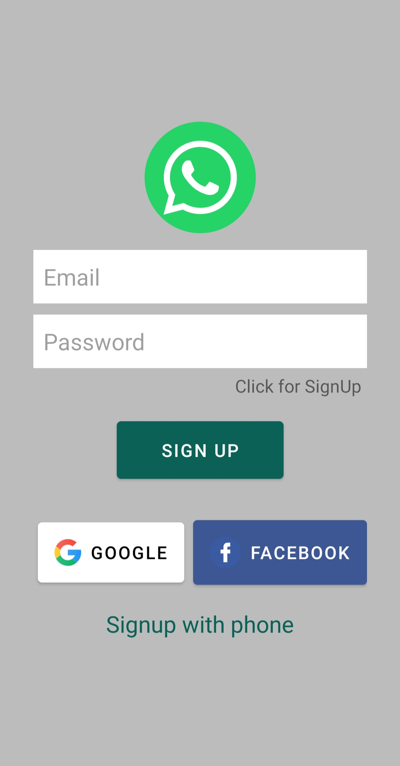
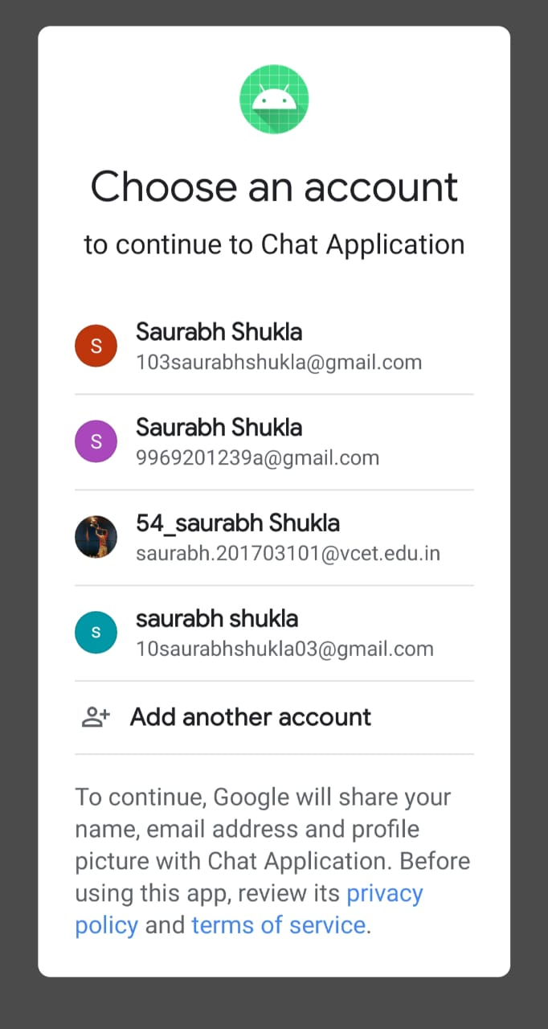
2. SignIn Layout
3. Google
Authoriza
-tion
Components of this layout are
Linear Layout
Image View
Edit text
Buttons
Text views

Slide 6
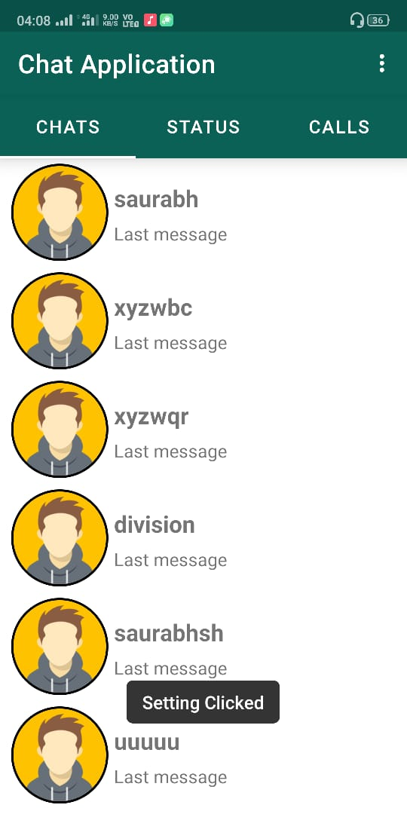
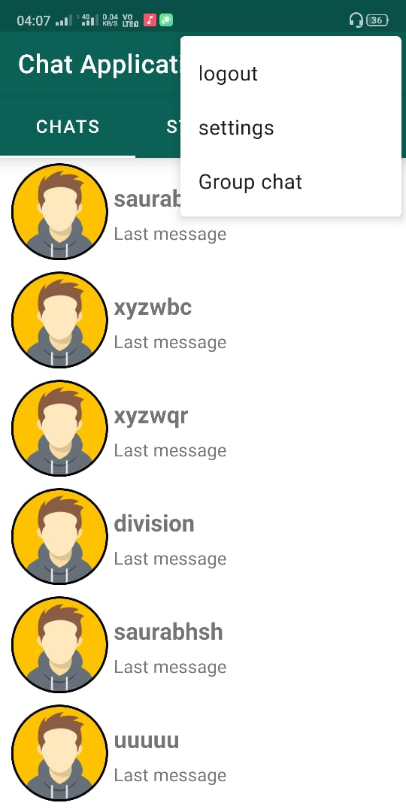
4. MainActivity
5. Menu
Components of this layout are
Components of
this layout are
Users
Menu
Action bar
Logout
Settings
Group chat

Slide 7
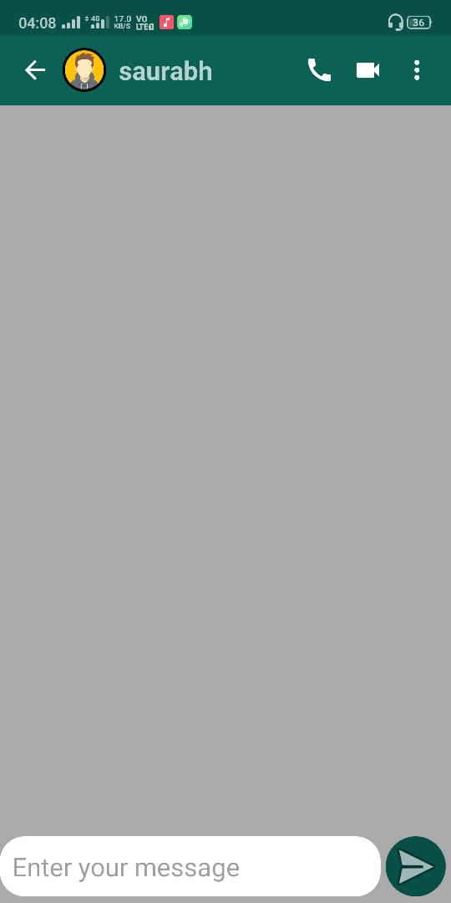
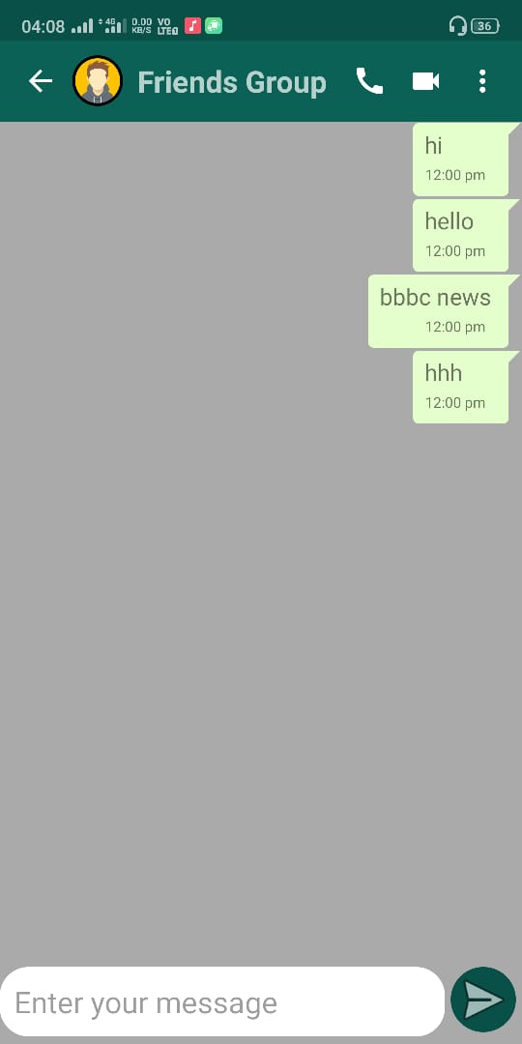
7. Group
Chat
Layout
6. Chat Layout
Components of
this layout are
Components of
this layout are
Sending text
Receiving text
Receiving text
Sending text

Slide 8
Database
Firebase
Google Firebase is a Google-backed application development software that enables developers to develop iOS, Android and Web apps. Firebase provides tools for tracking analytics, reporting and fixing app crashes, creating marketing and product experiment.

Slide 9
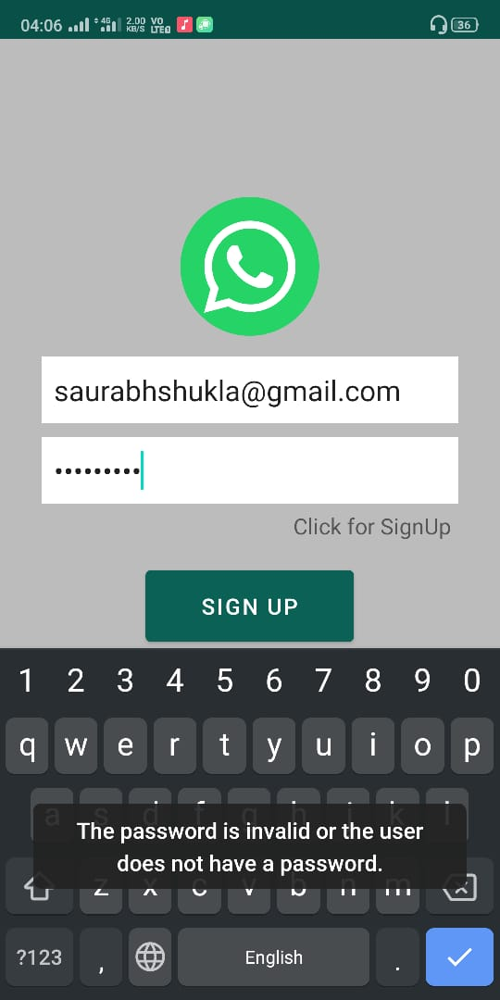

Different exception or
Wrong password
Issues are taken care
By firebase itself.
Programmer don’t need to develop code for
These errors
Firebase

Slide 10
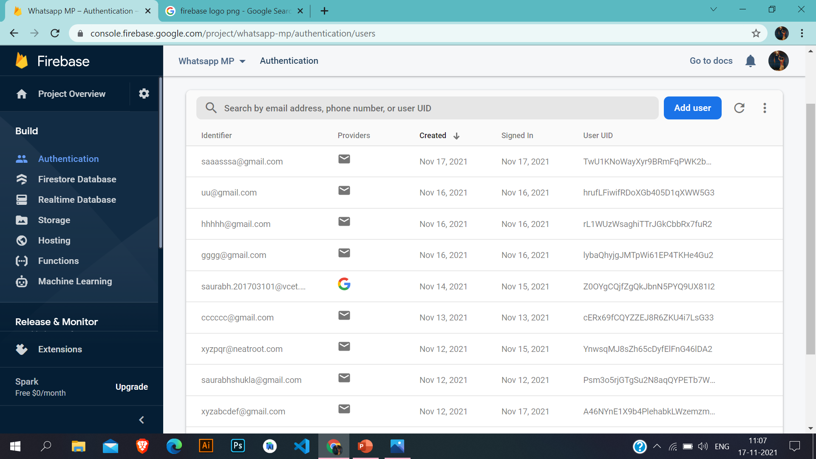
Firebase Users panel
1. Users connect through
their google id
2. Users connected
through Email
and password

Slide 11
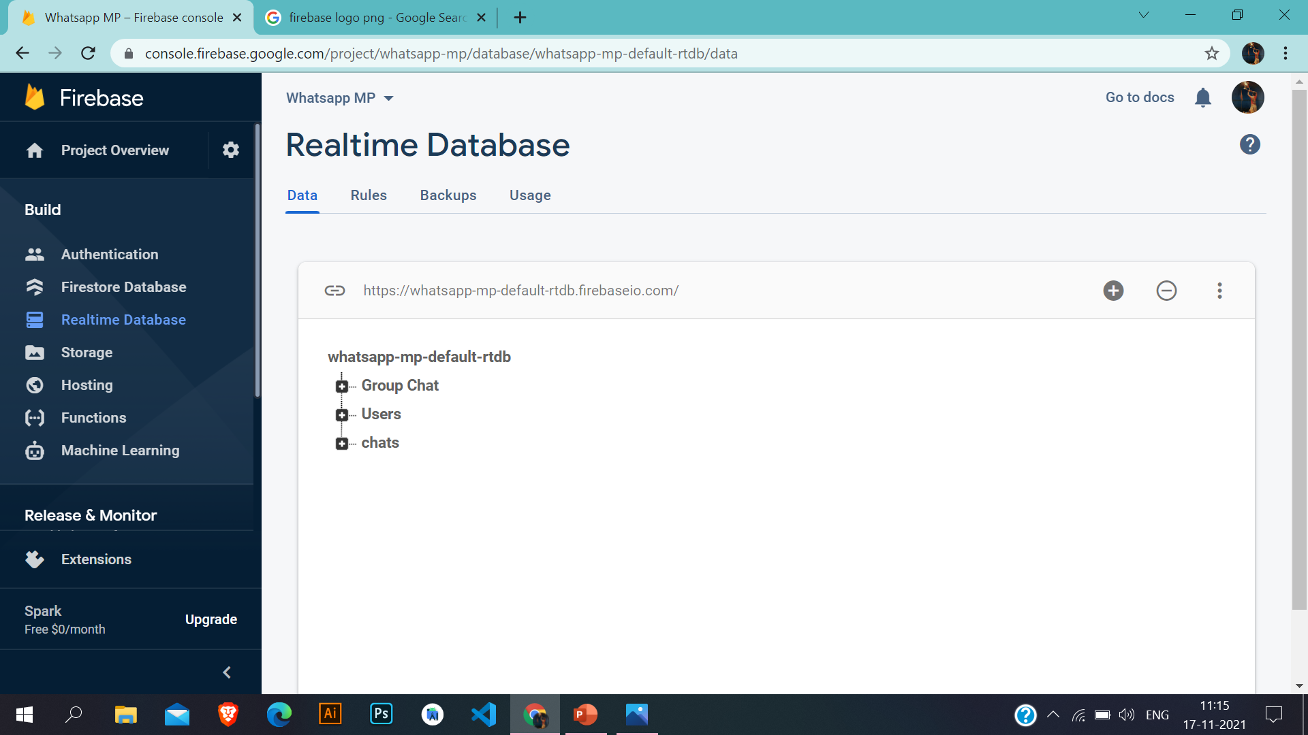
Firebase Real time
Database Feature
1. Different nodes
are connected
2. Nodes will
recognize user through
their ID provided by
firebase.
3. Every node have
its own sub nodes

Slide 12
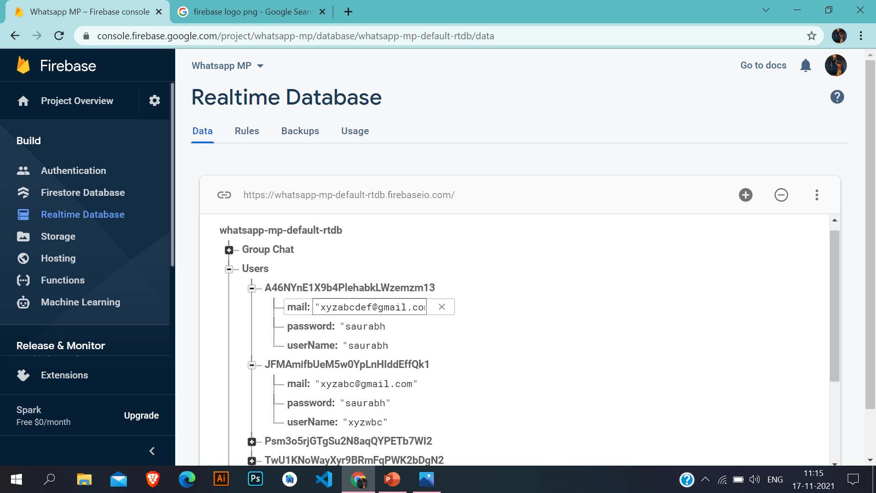
Users Node
Firebase Real time
Database Feature
1. Nodes will
recognize user through
their ID provided by
firebase.
2. Every node have
its own sub nodes
3. Here users node
is holding
Mail address,
Password,
UserName.

Slide 13

Group chats
Firebase Real time
Database Feature
1. Nodes will
recognize user through
their ID provided by
firebase.
2. Every node have
its own sub nodes
3. Here users node
is holding
Message,
timelstamps,
Uid.

Slide 14

Chats Node
Firebase Real time
Database Feature
1. Nodes will
recognize user through
their ID provided by
firebase.
2. Every node have
its own sub nodes
3. Here users node
is holding
Mail address,
Password,
UserName.

