Slide 1
Cyfrowe Formaty Danych Data Notations
DATA-NOTATIONS
Course Introduction

Slide 2
Communication with Teacher
Course forum on Microsoft Teams
Microsoft Teams chat
Email (details on teacher’s e-card)
Office Hours (details on teacher’s e-card)
Teacher’s e-card
https://e-uczelnia.uek.krakow.pl/course/view.php?id=218

Slide 3
Course Details

Slide 4
Course Content
Main Class Topics
Version Control System
Text document formats (TXT, CSV, XML, JSON)
Basics of document formatting (, Markdown, HTML, CSS)

Slide 5
Checking Knowledge
TESTS | POINTS
Test 1 | 0-10
Test 2 | 0-10
TOTAL | 0-20
Bonus point for high attendance | 0-2

Slide 6
Test Score Improvement
Impossible

Slide 7
Test For Absent Students
At the end of the semester (~January)
Absence has to be confirmed by a sick leave (within 7 days)

Slide 8
Final Grade
Total Points | Final Grade
>= 18 | 5.0
>= 16 | 4.5
>= 14 | 4.0
>= 12 | 3.5
>= 10 | 3.0
< 10 | 2.0

Slide 9
Services Necessary for Course
Log in to Teams, Moodle, and Github

Slide 10
Sign up for Course on Teams
Run Microsoft Teams
Log in to your account
Display team list
Select „join a team”
Use a team code 2626hb7

Slide 11
Sign up for Course on Moodle
Log in to Moodle https://moodle.uek.krakow.pl
Find the course Formaty Danych Cyfrowych / Data Notations
Sign up for the course As the access key, use your full group number (from University Schedule)

Slide 12
Create Account on Github
Go to the Github service https://github.com
Create an account or use the one you have
Important!! In Github Settings, enter your real full name (first and last name)

Slide 13
Make Copy of Class Materials
Log in to Github
Find the course materials (github repository) stalj/data-notations
Fork (copy) the repository
Make sure you have your own private copy of the course materials on your account on Github

Slide 14
Homework
Tools Installation

Slide 15
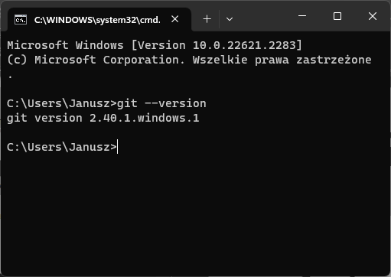

Install Git
Install Git Control Version System https://git-scm.com
Check Git on your computer
Open command prompt window
Enter command git --version

Slide 16

Install Visual Studio Code
Install Microsoft Visual Studio Code (VSCode) https://code.visualstudio.com
Install VSCode extensions
XML Red Hat
Rainbow CSV
Markdown Preview Github Styling
Live Server

Slide 17
Clone Your Course Repository
Find out on how to use Git command git clone
Open command prompt window
Clone (copy) your own copy of the course repository (materials) from github to your personal computer

Slide 18
Read the Course Syllabus
In your local repository, open a folder 01-CourseIntroduction
Familiarise yourself with the course syllabus Syllabus.docx

