Slide 1
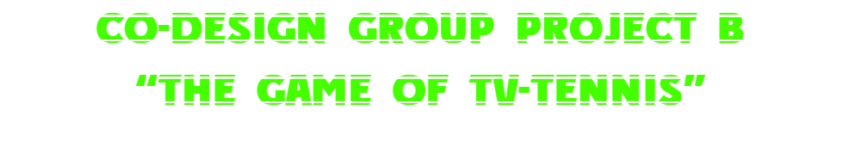
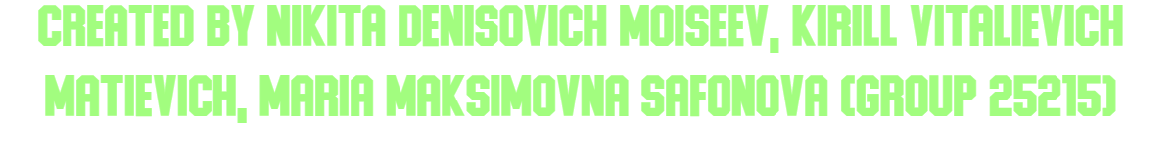

Slide 2
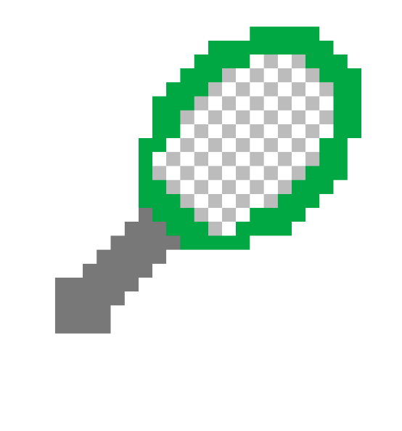

0. Project Description

Slide 3
Project Description
Our project is TV-Tennis. The history of this game began with Tennis for Two, introduced by William Higinbotham on October 18, 1958. The first version used an analog computer for calculations and an oscilloscope as a display.
Over time, the mechanics of the game have constantly changed and evolved. The idea of two rackets fixed in the outermost columns of the field and controlled by joysticks was proposed by Ralph Baer in his prototype "Brown Box" (1967). In 1975, the Japanese company Epoch developed this concept in the TV Tennis Electrotennis system, where the rackets could only move up and down.

Slide 4
1. Video system

Slide 5
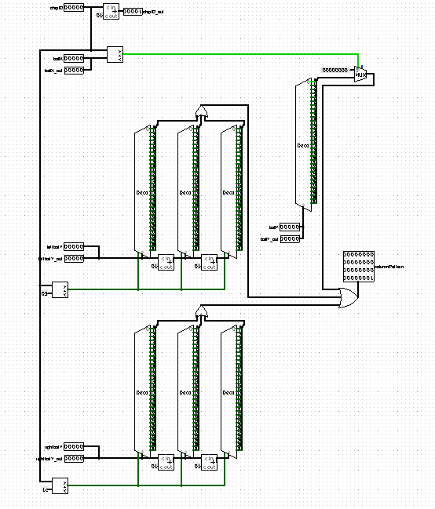
Videochip1
Generate 32-bit pattern for one display column

Slide 6
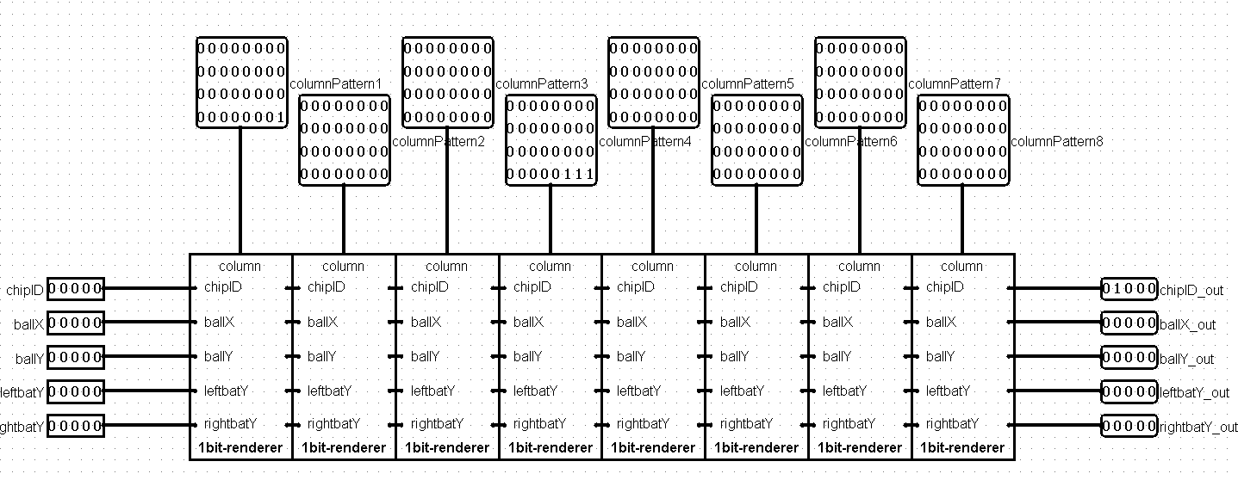
videochip8

Slide 7
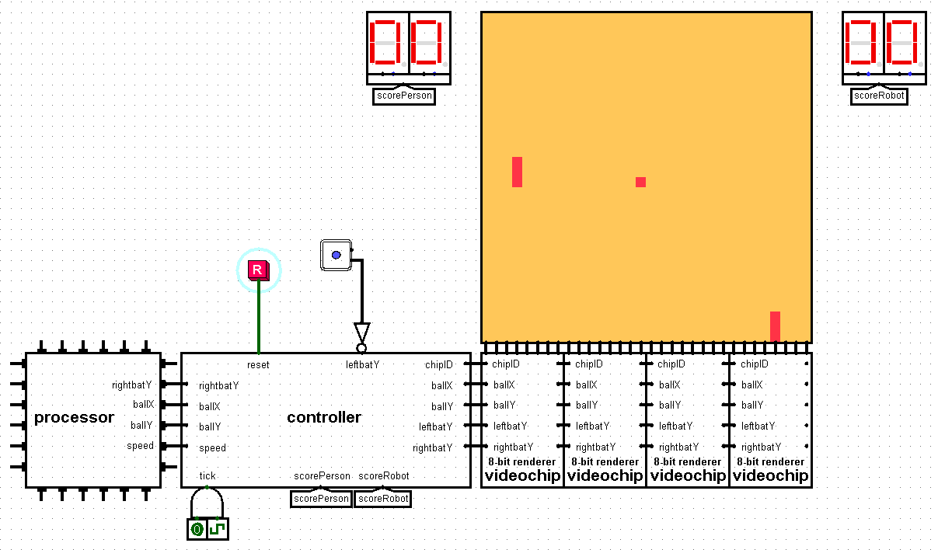

Slide 8
2. Controller

Slide 9
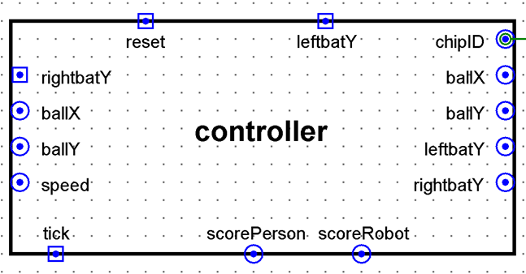
Inputs and outputs of the circuit

Slide 10
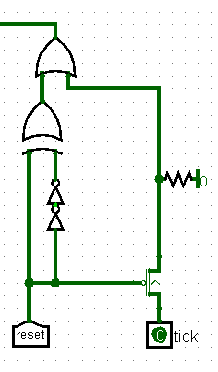
The reset part

Slide 11
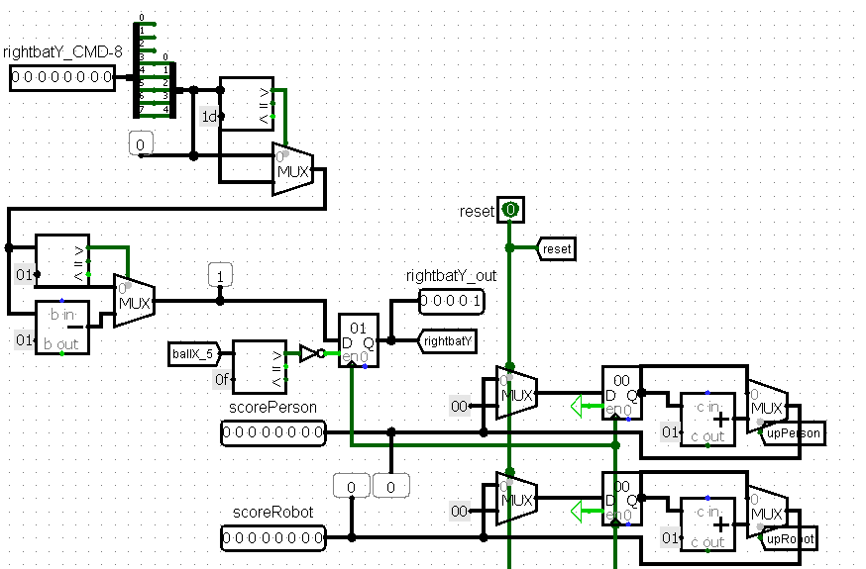
The part with Registers

Slide 12
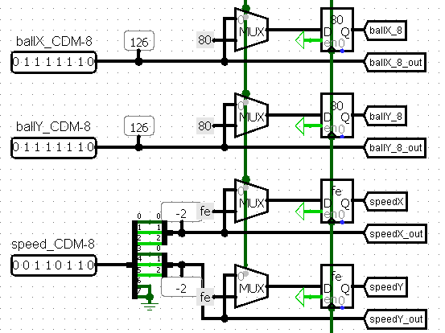
The part with Registers

Slide 13
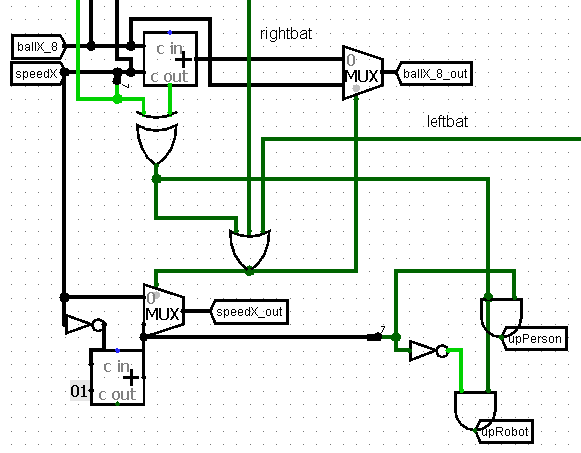
The part for X-coordinate
control and keeping score of the game

Slide 14
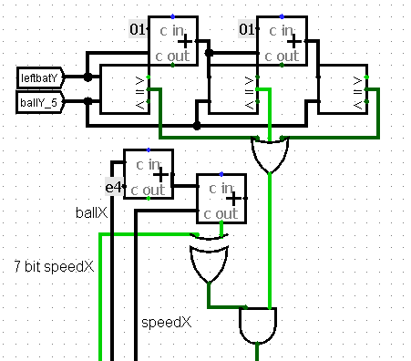
Pushing the ball away from the right racket

Slide 15
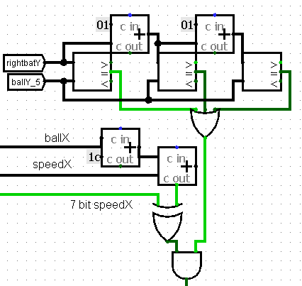
Pushing the ball away from the left racket

Slide 16
3. Processor

Slide 17
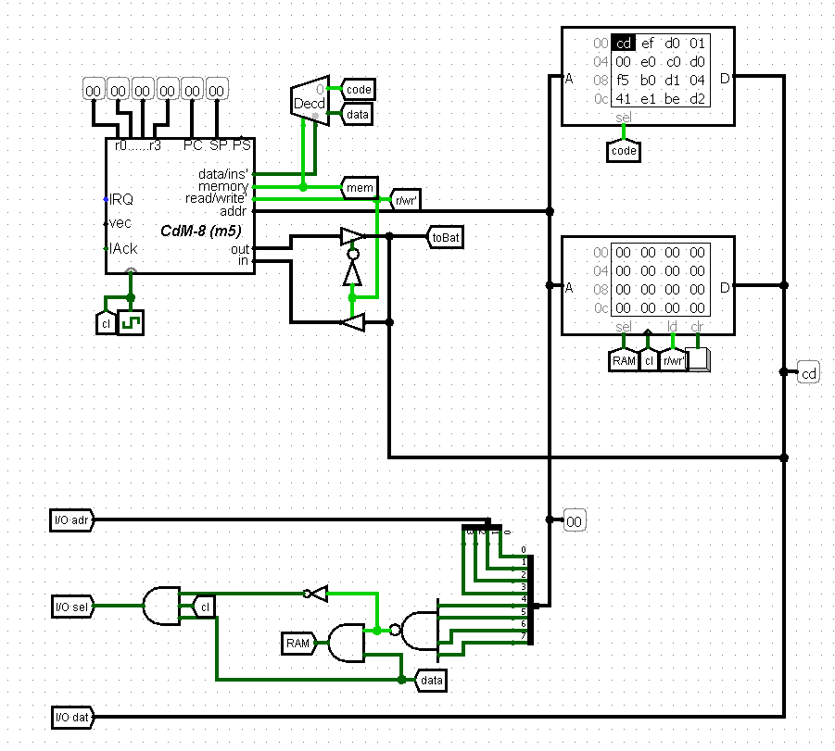
Realization of the Harvard setup with CdM-8

Slide 18
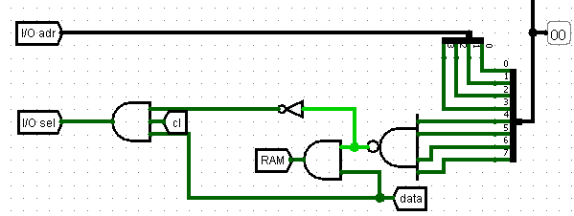
The part for recognizing access to memory or I/O devices

Slide 19
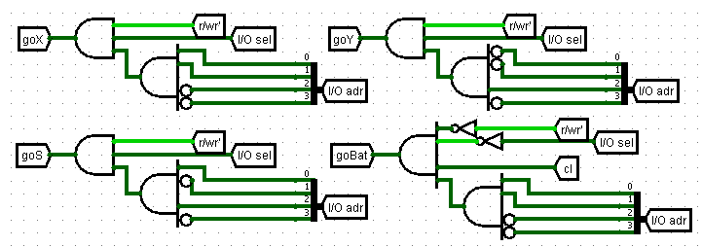
«Turnstiles»
Elements for determining the required I/O device and providing data exchange access

Slide 20
4. Robot Algorithm

Slide 21
carry_counter = 0
while True:
speed = read(0xf5)
speedX = speed & 0b00000111
speedY = (speed >> 3) & 0b00000111
if (speedX < 0):
continue
if (coordinateX > 120):
continue
result = read(0xf3)
result = 224 - result
result = result / speedX
result = abs(result * speedY)
if (carry_bit == 1):
carry_counter = carry_counter + 1
result = result * sign(speedY)
coordinateY = read(0xf4)
result = result + coordinateY
if (carry_bit == 1):
carry_counter = carry_counter + 1
if (carry_counter % 2 == 1):
result = not(result)
if (coordinateX < 112):
if (speedX > 0):
write(0xf3, result)
carry_counter = 0

Slide 22
4. Hardware (Architectural Differences)

Slide 23
Right paddle handling
Reference: simple 5‑bit latch when ball in left half
Ours: receives 8‑bit value → upper 5 bits → clamp to max 29 → shift down by 1 pixel
Reason: algorithm outputs bottom pixel; correction improves reliability
Video subsystem
Reference: chain of 32 individual video chips
Ours: 8‑chip sections (videochip8), 4 sections in series – simpler wiring, fewer errors
Advanced features (diffusion, spin)
Reference: described as possible extensions
Ours: not included – kept design focused and stable

Slide 24
5. Software Differences (Robot Algorithm)

Slide 25
Skipping iterations & balance
Reference: mentions processor may be too slow
Ours: explicit check if ballX > 120 → skip
Clock ratio tuned (CPU 15× faster) → robot misses ~50% of balls

Slide 27
Thank you
for your attention.
Your questions?

