Slide 1


Conditional Execution
Chapter 3
Python for Everybody
www.py4e.com
Notes:
Note from Chuck. If you are using these materials, you can remove the UM logo and replace it with your own, but please retain the CC-BY logo on the first page as well as retain the acknowledgement page(s).

Slide 2
Conditional Steps
x = 5
x < 10 ?
Yes
Program:
x = 5
if x < 10:
print('Smaller')
if x > 20:
print('Bigger')
print('Finis')
print('Smaller')
Output:
Smaller
Finis
x > 20 ?
No
print('Bigger')
print('Finis')

Slide 3
Comparison Operators
Boolean expressions ask a question and produce a Yes or No result which we use to control program flow
Boolean expressions using comparison operators evaluate to True / False or Yes / No
Comparison operators look at variables but do not change the variables
Python | Meaning
< | Less than
<= | Less than or Equal to
== | Equal to
>= | Greater than or Equal to
> | Greater than
!= | Not equal
Remember: “=” is used for assignment.
http://en.wikipedia.org/wiki/George_Boole

Slide 4
Comparison Operators
x = 5
if x == 5 :
print('Equals 5')
if x > 4 :
print('Greater than 4')
if x >= 5 :
print('Greater than or Equals 5')
if x < 6 : print('Less than 6')
if x <= 5 :
print('Less than or Equals 5')
if x != 6 :
print('Not equal 6')
Equals 5
Greater than 4
Greater than or Equals 5
Less than 6
Less than or Equals 5
Not equal 6

Slide 5
One-Way Decisions
x = 5
print('Before 5')
if x == 5 :
print('Is 5')
print('Is Still 5')
print('Third 5')
print('Afterwards 5')
print('Before 6')
if x == 6 :
print('Is 6')
print('Is Still 6')
print('Third 6')
print('Afterwards 6')
Yes
x == 5 ?
Before 5
Is 5
Is Still 5
Third 5
Afterwards 5
Before 6
Is 6
Is Still 6
Third 6
Afterwards 6
No
print('Is 5’)
print('Still 5')
print('Third 5')

Slide 6
Indentation
Increase indent indent after an if statement or for statement (after : )
Maintain indent to indicate the scope of the block (which lines are affected by the if/for)
Reduce indent back to the level of the if statement or for statement to indicate the end of the block
Blank lines are ignored - they do not affect indentation
Comments on a line by themselves are ignored with regard to indentation

Slide 7
Warning: Turn Off Tabs!!
Atom only used spaces for files with ".py" extension (nice!)
Most text editors can turn tabs into spaces - make sure to enable this feature
NotePad++: Settings -> Preferences -> Language Menu/Tab Settings
TextWrangler: TextWrangler -> Preferences -> Editor Defaults
Python cares a *lot* about how far a line is indented. If you mix tabs and spaces, you may get “indentation errors” even if everything looks fine

Slide 8
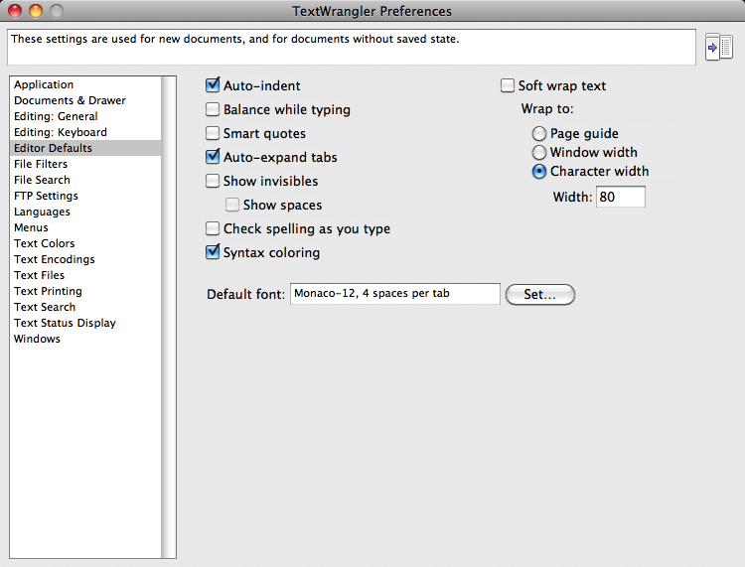

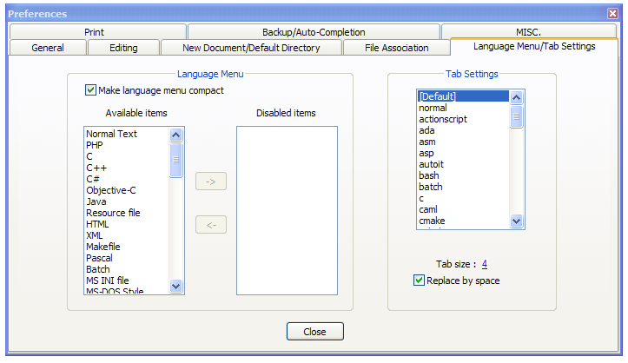
This will save you much unnecessary pain.

Slide 9
increase / maintain after if or for
decrease to indicate end of block
x = 5
if x > 2 :
print('Bigger than 2')
print('Still bigger')
print('Done with 2')
for i in range(5) :
print(i)
if i > 2 :
print('Bigger than 2')
print('Done with i', i)
print('All Done')

Slide 10
Think about begin/end blocks
x = 5
if x > 2 :
print('Bigger than 2')
print('Still bigger')
print('Done with 2’)
for i in range(5) :
print(i)
if i > 2 :
print('Bigger than 2')
print('Done with i', i)
print('All Done')

Slide 11
Nested Decisions
x > 1
yes
no
print('More than one’)
x = 42
if x > 1 :
print('More than one')
if x < 100 :
print('Less than 100')
print('All done')
x < 100
yes
no
print('Less than 100')
print 'All Done'

Slide 12
Two-way Decisions
X = 4
Sometimes we want to do one thing if a logical expression is true and something else if the expression is false
It is like a fork in the road - we must choose one or the other path but not both
no
x > 2
yes
print('Not bigger')
print('Bigger')
print 'All Done'

Slide 13
Two-way Decisions with else:
X = 4
no
x > 2
yes
x = 4
if x > 2 :
print('Bigger')
else :
print('Smaller')
print 'All done'
print('Not bigger')
print('Bigger')
print 'All Done'

Slide 14
Visualize Blocks
X = 4
no
x > 2
yes
x = 4
if x > 2 :
print('Bigger')
else :
print('Smaller')
print 'All done'
print('Not bigger')
print('Bigger')
print 'All Done'

Slide 15
Multi-way
yes
x < 2
print('small')
if x < 2 :
print('small')
elif x < 10 :
print('Medium')
else :
print('LARGE')
print('All done')
no
yes
x < 10
print('Medium')
no
print('LARGE')
print('All Done')

Slide 16
Multi-way
x = 0
yes
x < 2
print('small')
x = 0
if x < 2 :
print('small')
elif x < 10 :
print('Medium')
else :
print('LARGE')
print('All done')
no
yes
x < 10
print('Medium')
no
print('LARGE')
print('All Done')

Slide 17
Multi-way
x = 5
yes
x < 2
print('small')
x = 5
if x < 2 :
print('small')
elif x < 10 :
print('Medium')
else :
print('LARGE')
print('All done')
no
yes
x < 10
print('Medium')
no
print('LARGE')
print('All Done')

Slide 18
Multi-way
x = 20
yes
x < 2
print('small')
x = 20
if x < 2 :
print('small')
elif x < 10 :
print('Medium')
else :
print('LARGE')
print('All done')
no
yes
x < 10
print('Medium')
no
print('LARGE')
print('All Done')

Slide 19
Multi-way
if x < 2 :
print('Small')
elif x < 10 :
print('Medium')
elif x < 20 :
print('Big')
elif x < 40 :
print('Large')
elif x < 100:
print('Huge')
else :
print('Ginormous')
# No Else
x = 5
if x < 2 :
print('Small')
elif x < 10 :
print('Medium')
print 'All done'

Slide 20
Multi-way Puzzles
Which will never print regardless of the value for x?
if x < 2 :
print('Below 2')
elif x < 20 :
print('Below 20')
elif x < 10 :
print('Below 10')
else :
print('Something else')
if x < 2 :
print('Below 2')
elif x >= 2 :
print('Two or more')
else :
print('Something else')

Slide 21
The try / except Structure
You surround a dangerous section of code with try and except
If the code in the try works - the except is skipped
If the code in the try fails - it jumps to the except section

Slide 22
$ python3 notry.py
Traceback (most recent call last): File "notry.py", line 2, in <module> istr = int(astr)ValueError: invalid literal for int() with base 10: 'Hello Bob'
$ cat notry.py
astr = 'Hello Bob'
istr = int(astr)
print('First', istr)
astr = '123'
istr = int(astr)
print('Second', istr)
All
Done

Slide 23
$ python3 notry.py
Traceback (most recent call last): File "notry.py", line 2, in <module> istr = int(astr)ValueError: invalid literal for int() with base 10: 'Hello Bob'
The program stops here
$ cat notry.py
astr = 'Hello Bob'
istr = int(astr)
print('First', istr)
astr = '123'
istr = int(astr)
print('Second', istr)
All
Done

Slide 24
Generic
Computer
Software
Input
Devices
Central
Processing
Unit
Secondary
Memory
Output
Devices
Main
Memory
Notes:
Who has see a traceback in CTools?

Slide 25
Generic
Computer
Software
Input
Devices
Central
Processing
Unit
Secondary
Memory
Output
Devices
Main
Memory
Notes:
Who has see a traceback in CTools?

Slide 26
astr = 'Hello Bob'
try:
istr = int(astr)
except:
istr = -1
print('First', istr)
astr = '123'
try:
istr = int(astr)
except:
istr = -1
print('Second', istr)
When the first conversion fails - it just drops into the except: clause and the program continues.
$ python tryexcept.py
First -1
Second 123
When the second conversion succeeds - it just skips the except: clause and the program continues.

Slide 27
try / except
astr = 'Bob'
print('Hello')
astr = 'Bob'
try:
print('Hello')
istr = int(astr)
print('There')
except:
istr = -1
print('Done', istr)
istr = int(astr)
print('There')
istr = -1
print('Done', istr)
Safety net

Slide 28
Sample try / except
rawstr = input('Enter a number:')
try:
ival = int(rawstr)
except:
ival = -1
if ival > 0 :
print('Nice work')
else:
print('Not a number')
$ python3 trynum.py
Enter a number:42
Nice work
$ python3 trynum.py
Enter a number:forty-two
Not a number
$

Slide 29
Exercise
Rewrite your pay computation to give the employee 1.5 times the hourly rate for hours worked above 40 hours.
Enter Hours: 45
Enter Rate: 10
Pay: 475.0
475 = 40 * 10 + 5 * 15

Slide 30
Exercise
Rewrite your pay program using try and except so that your program handles non-numeric input gracefully.
Enter Hours: 20
Enter Rate: nine
Error, please enter numeric input
Enter Hours: forty
Error, please enter numeric input

Slide 31
Summary
Nested Decisions
Multi-way decisions using elif
try / except to compensate for errors
Short circuit evaluations
Comparison operators == <= >= > < ! =
Logical operators: and or not
Indentation
One-way Decisions
Two-way decisions: if: and else:

Slide 32
Acknowledgements / Contributions
These slides are Copyright 2010- Charles R. Severance (www.dr-chuck.com) of the University of Michigan School of Information and made available under a Creative Commons Attribution 4.0 License. Please maintain this last slide in all copies of the document to comply with the attribution requirements of the license. If you make a change, feel free to add your name and organization to the list of contributors on this page as you republish the materials.
Initial Development: Charles Severance, University of Michigan School of Information
… Insert new Contributors and Translators here
...

