Slide 1


Networked Programs
Chapter 12
Python for Informatics: Exploring Information
www.pythonlearn.com
Notes:
Note from Chuck. If you are using these materials, you can remove the UM logo and replace it with your own, but please retain the CC-BY logo on the first page as well as retain the entire last page.

Slide 2
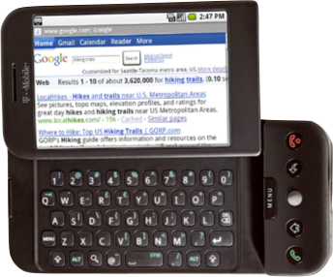

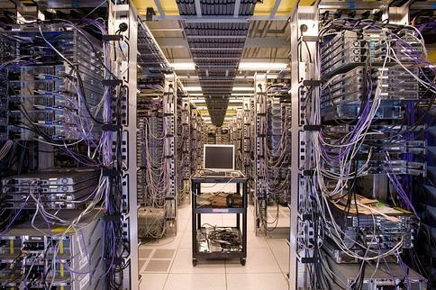
Client
Server
Internet

Slide 3
Internet
HTTP
Request
Python
HTML
JavaScript
Response
GET
Data Store
AJAX
Templates
memcache
CSS
socket
POST

Slide 4
Network Architecture....

Slide 5
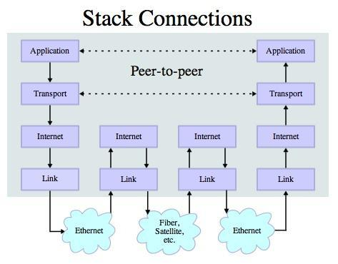
Transport Control Protocol (TCP)
Built on top of IP (Internet Protocol)
Assumes IP might lose some data - stores and retransmits data if it seems to be lost
Handles “flow control” using a transmit window
Provides a nice reliable pipe
Source: http://en.wikipedia.org/wiki/Internet_Protocol_Suite

Slide 6
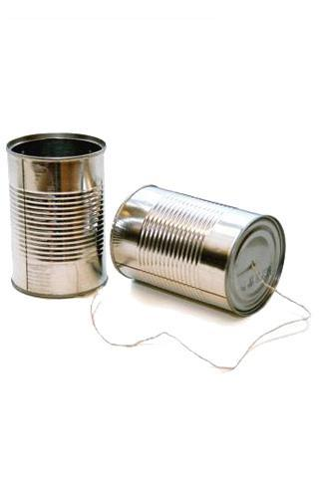
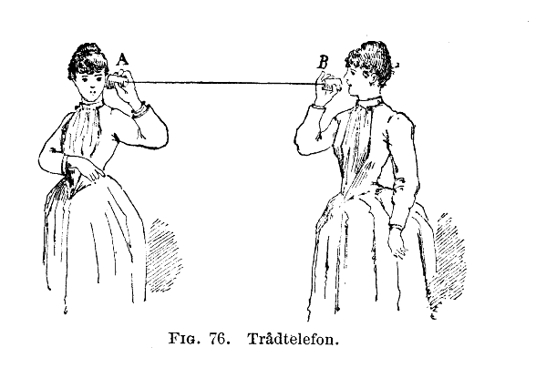
http://en.wikipedia.org/wiki/Tin_can_telephone
http://www.flickr.com/photos/kitcowan/2103850699/

Slide 7

TCP Connections / Sockets
“In computer networking, an Internet socket or network socket is an endpoint of a bidirectional inter-process communication flow across an Internet Protocol-based computer network, such as the Internet.”
Process
Process
Internet
Socket
http://en.wikipedia.org/wiki/Internet_socket

Slide 8
TCP Port Numbers
A port is an application-specific or process-specific software communications endpoint
It allows multiple networked applications to coexist on the same server.
There is a list of well-known TCP port numbers
http://en.wikipedia.org/wiki/TCP_and_UDP_port

Slide 9


www.umich.edu
Incoming
E-Mail
25
Login
23
blah blah blah blah
80
74.208.28.177
Web Server
443
Personal
Mail Box
109
Please connect me to the web server (port 80) on http://www.dr-chuck.com
110
Clipart: http://www.clker.com/search/networksym/1

Slide 10
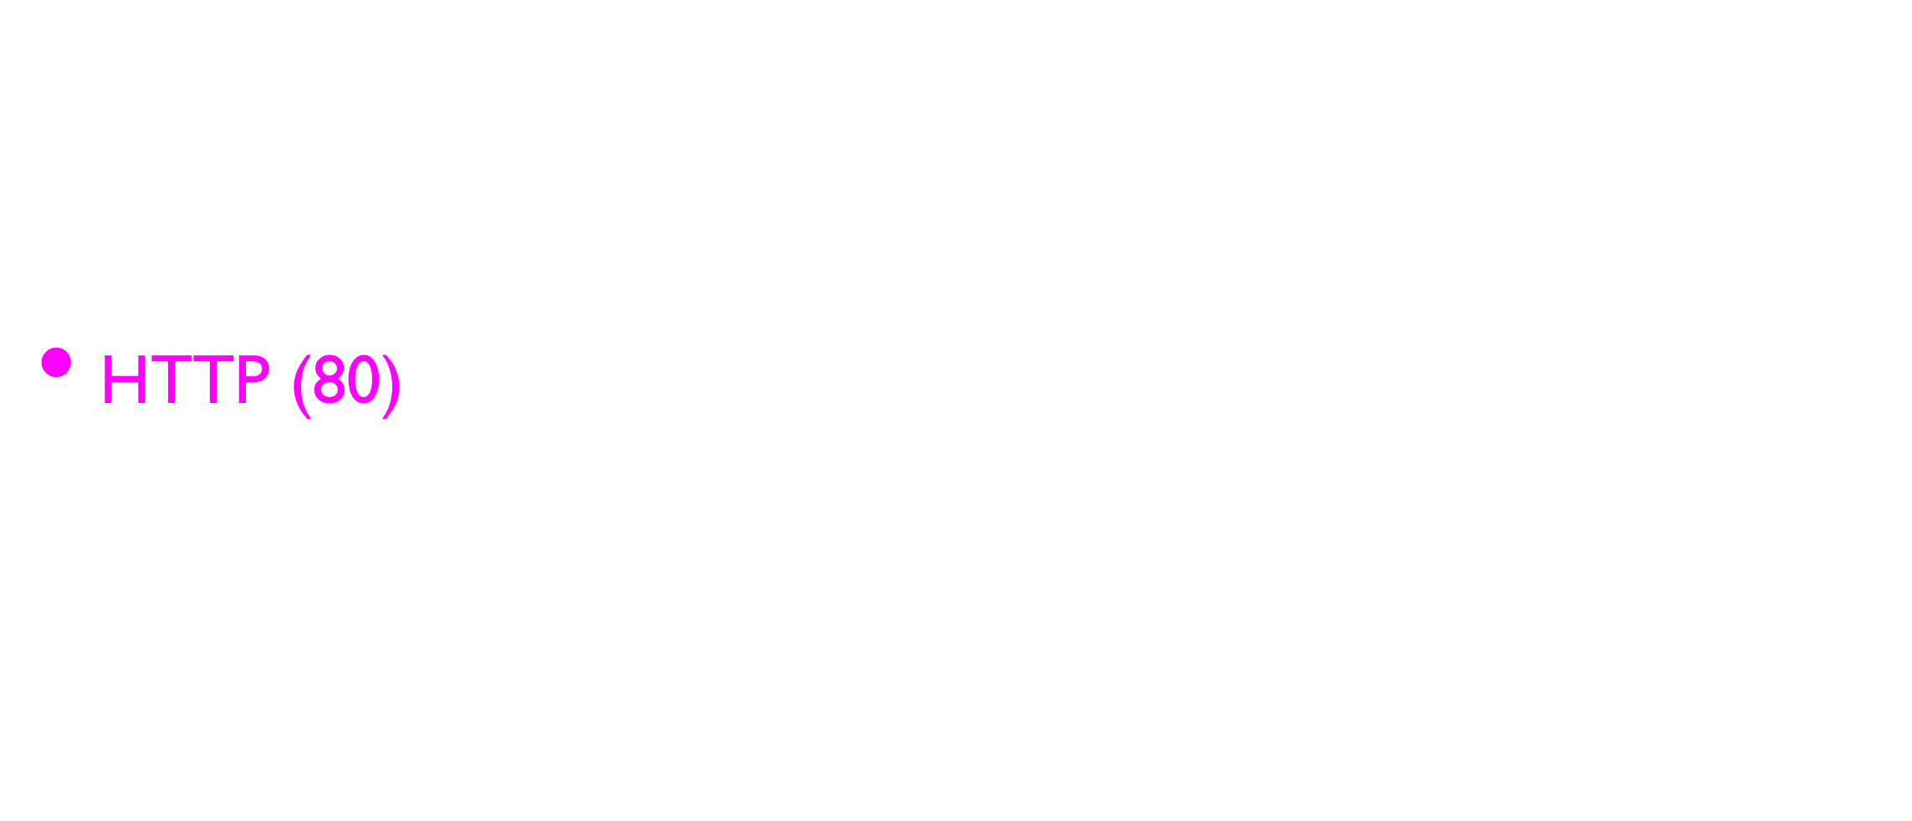
Common TCP Ports
http://en.wikipedia.org/wiki/List_of_TCP_and_UDP_port_numbers

Slide 11
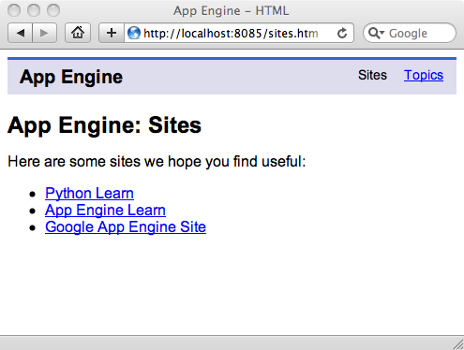
Sometimes we see the port number in the URL if the web server is running on a “non-standard” port.

Slide 12
Sockets in Python
Python has built-in support for TCP Sockets
import socket
mysock = socket.socket(socket.AF_INET, socket.SOCK_STREAM)
mysock.connect( ('www.py4inf.com', 80) )
Host
Port
http://docs.python.org/library/socket.html

Slide 13
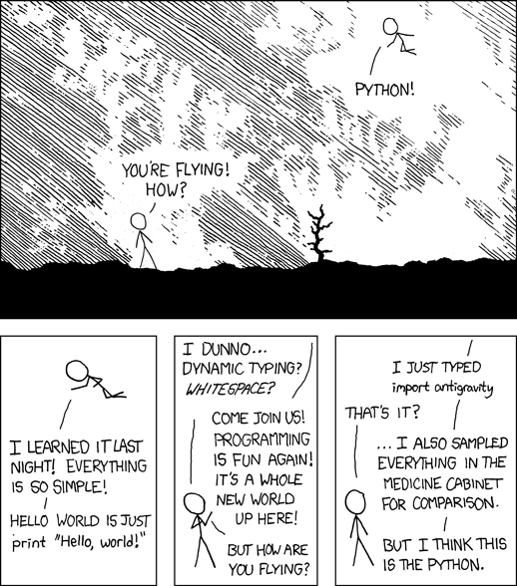
http://xkcd.com/353/

Slide 14
Application Protocol
Since TCP (and Python) gives us a reliable socket, what do we want to do with the socket? What problem do we want to solve?
Application Protocols
Mail
World Wide Web
Source: http://en.wikipedia.org/wiki/Internet_Protocol_Suite

Slide 15
HTTP - Hypertext Transfer Protocol
The dominant Application Layer Protocol on the Internet
Invented for the Web - to Retrieve HTML, Images, Documents, etc
Extended to be data in addition to documents - RSS, Web Services, etc..Basic Concept - Make a Connection - Request a document - Retrieve the Document - Close the Connection
http://en.wikipedia.org/wiki/Http

Slide 16
HTTP
The HyperText Transfer Protocol is the set of rules to allow browsers to retrieve web documents from servers over the Internet

Slide 17
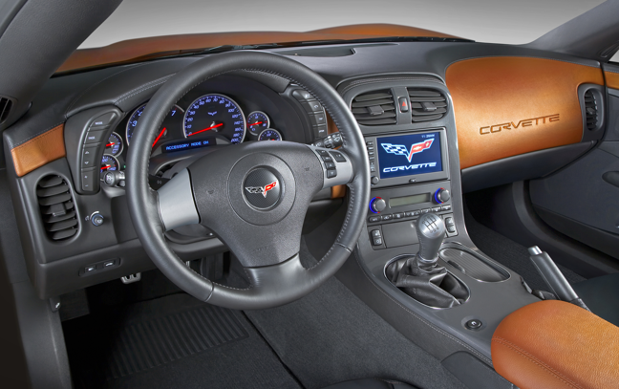
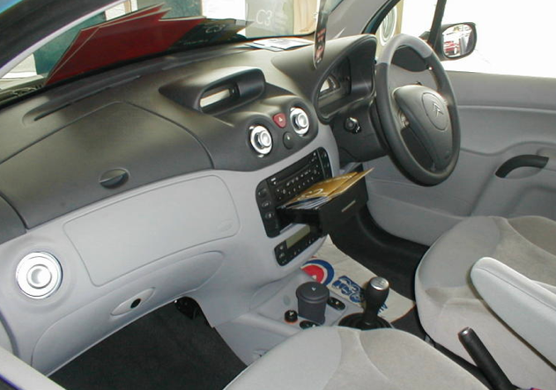
What is a Protocol?
A set of rules that all parties follow so we can predict each other’s behavior
And not bump into each other
On two-way roads in USA, drive on the right-hand side of the road
On two-way roads in the UK, drive on the left-hand side of the road

Slide 18
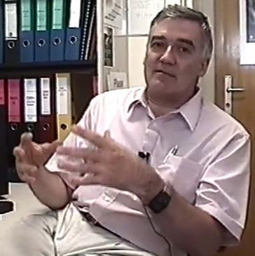
http://www.dr-chuck.com/page1.htm
protocol
host
document
http://www.youtube.com/watch?v=x2GylLq59rI
Robert Cailliau
CERN
1:17 - 2:19

Slide 19
Getting Data From The Server
Each time the user clicks on an anchor tag with an href= value to switch to a new page, the browser makes a connection to the web server and issues a “GET” request - to GET the content of the page at the specified URL
The server returns the HTML document to the browser, which formats and displays the document to the user

Slide 20
Making an HTTP request
Connect to the server like www.dr-chuck.com
a “hand shake”
Request a document (or the default document)
GET http://www.dr-chuck.com/page1.htm
GET http://www.mlive.com/ann-arbor/
GET http://www.facebook.com

Slide 21
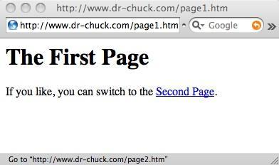

Slide 22
Browser

Slide 23
Web Server
80
Browser

Slide 24
Web Server
80
GET http://www.dr-chuck.com/page2.htm
Browser

Slide 25
Web Server
80
<h1>The Second Page</h1>
<p>If you like, you can switch back to the <a href="page1.htm">First Page</a>.</p>
GET http://www.dr-chuck.com/page2.htm
Browser

Slide 26
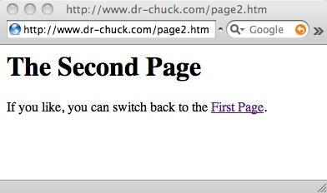
Web Server
80
<h1>The Second Page</h1>
<p>If you like, you can switch back to the <a href="page1.htm">First Page</a>.</p>
GET http://www.dr-chuck.com/page2.htm
Browser

Slide 27
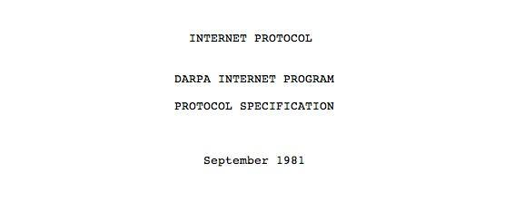
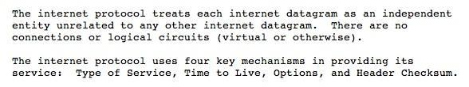
Internet Standards
The standards for all of the Internet protocols (inner workings) are developed by an organization
Internet Engineering Task Force (IETF)
www.ietf.org
Standards are called “RFCs” - “Request for Comments”
Source: http://tools.ietf.org/html/rfc791

Slide 28
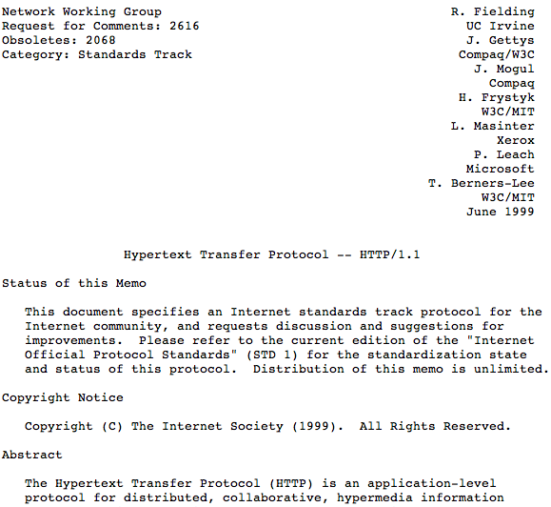
http://www.w3.org/Protocols/rfc2616/rfc2616.txt

Slide 29
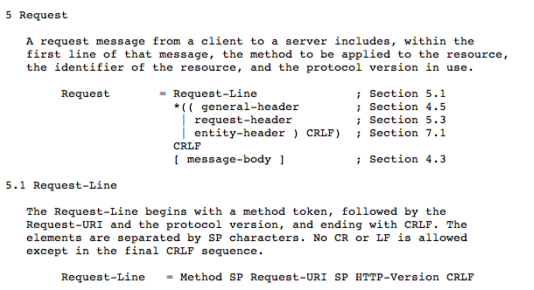

Slide 30
Making an HTTP request
Connect to the server like www.dr-chuck.com
a “hand shake”
Request a document (or the default document)
GET http://www.dr-chuck.com/page1.htm
GET http://www.mlive.com/ann-arbor/
GET http://www.facebook.com

Slide 31
“Hacking” HTTP
Web Server
HTTP
Request
HTTP
Response
$ telnet www.dr-chuck.com 80
Trying 74.208.28.177...
Connected to www.dr-chuck.com.
Escape character is '^]'.
GET http://www.dr-chuck.com/page1.htm HTTP/1.0
<h1>The First Page</h1>
<p>If you like, you can switch to the
<a href="http://www.dr-chuck.com/page2.htm">Second Page</a>.
</p>
Browser
Port 80 is the non-encrypted HTTP port

Slide 32

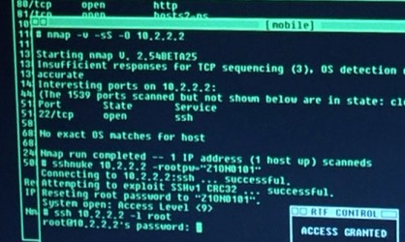
Accurate Hacking in the Movies
Matrix Reloaded
Bourne Ultimatum
Die Hard 4
...
http://nmap.org/movies.html

Slide 33
$ telnet www.dr-chuck.com 80
Trying 74.208.28.177...
Connected to www.dr-chuck.com.Escape character is '^]'.
GET http://www.dr-chuck.com/page1.htm HTTP/1.0
<h1>The First Page</h1>
<p>If you like, you can switch to the
<a href="http://www.dr-chuck.com/page2.htm">Second Page</a>.</p>
Connection closed by foreign host.

Slide 34

Hmmm - This looks kind of Complex.. Lots of GET commands

Slide 35
si-csev-mbp:tex csev$ telnet www.umich.edu 80
Trying 141.211.144.190...
Connected to www.umich.edu.Escape character is '^]'.
GET /
<!DOCTYPE html PUBLIC "-//W3C//DTD XHTML 1.0 Strict//EN" "http://www.w3.org/TR/xhtml1/DTD/xhtml1-strict.dtd"><html xmlns="http://www.w3.org/1999/xhtml" xml:lang="en" lang="en"><head><title>University of Michigan</title><meta name="description" content="University of Michigan is one of the top universities of the world, a diverse public institution of higher learning, fostering excellence in research. U-M provides outstanding undergraduate, graduate and professional education, serving the local, regional, national and international communities." />

Slide 36

...
<link rel="alternate stylesheet" type="text/css" href="/CSS/accessible.css" media="screen" title="accessible" /><link rel="stylesheet" href="/CSS/print.css" media="print,projection" /><link rel="stylesheet" href="/CSS/other.css" media="handheld,tty,tv,braille,embossed,speech,aural" />... <dl><dt><a href="http://ns.umich.edu/htdocs/releases/story.php?id=8077">
<img src="/Images/electric-brain.jpg" width="114" height="77" alt="Top News Story" /></a><span class="verbose">:</span></dt><dd><a href="http://ns.umich.edu/htdocs/releases/story.php?id=8077">Scientists harness the power of electricity in the brain</a></dd></dl>
As the browser reads the document, it finds other URLs that must be retrieved to produce the document.

Slide 37
The big picture...
<!DOCTYPE html PUBLIC "-//W3C//DTD XHTML 1.0 Strict//EN" "http://www.w3.org/TR/xhtml1/DTD/xhtml1-strict.dtd">
<html xmlns="http://www.w3.org/1999/xhtml" xml:lang="en">
<head>
<title>University of Michigan</title>
....
@import "/CSS/graphical.css"/**/;
p.text strong, .verbose, .verbose p, .verbose h2{text-indent:-876em;position:absolute}
p.text strong a{text-decoration:none}
p.text em{font-weight:bold;font-style:normal}
div.alert{background:#eee;border:1px solid red;padding:.5em;margin:0 25%}
a img{border:none}
.hot br, .quick br, dl.feature2 img{display:none}
div#main label, legend{font-weight:bold}
...

Slide 38
A browser debugger reveals detail...
Most browsers have a developer mode so you can watch it in action
It can help explore the HTTP request-response cycle
Some simple-looking pages involve lots of requests:
HTML page(s)
Image files
CSS Style Sheets
JavaScript files

Slide 39
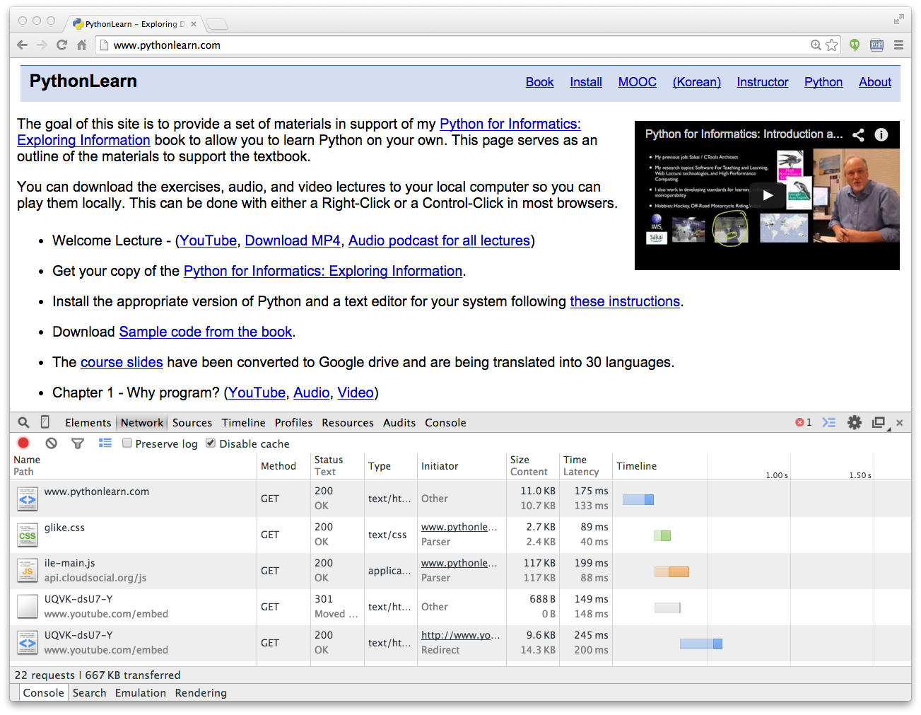

Slide 40
Let’s Write a Web Browser!

Slide 41
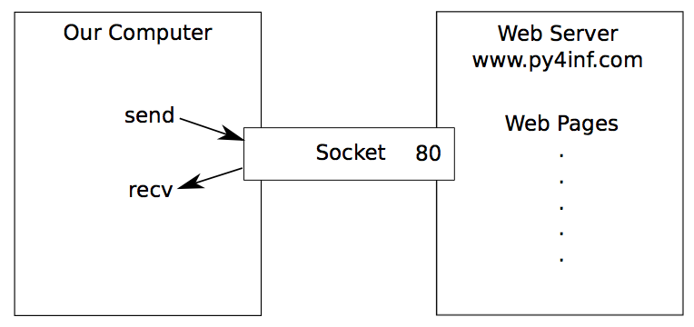
An HTTP Request in Python
import socket
mysock = socket.socket(socket.AF_INET, socket.SOCK_STREAM)
mysock.connect(('www.py4inf.com', 80))
mysock.send('GET http://www.py4inf.com/code/romeo.txt HTTP/1.0\n\n')
while True:
data = mysock.recv(512)
if ( len(data) < 1 ) :
break
print data
mysock.close()

Slide 42
HTTP/1.1 200 OK
Date: Sun, 14 Mar 2010 23:52:41 GMT
Server: Apache
Last-Modified: Tue, 29 Dec 2009 01:31:22 GMT
ETag: "143c1b33-a7-4b395bea"
Accept-Ranges: bytes
Content-Length: 167
Connection: close
Content-Type: text/plain
But soft what light through yonder window breaks
It is the east and Juliet is the sun
Arise fair sun and kill the envious moon
Who is already sick and pale with grief
HTTP Header
while True:
data = mysock.recv(512)
if ( len(data) < 1 ) :
break
print data
HTTP Body

Slide 43
Making HTTP Easier With urllib

Slide 44
Using urllib in Python
Since HTTP is so common, we have a library that does all the socket work for us and makes web pages look like a file
import urllib
fhand = urllib.urlopen('http://www.py4inf.com/code/romeo.txt')
for line in fhand:
print line.strip()
http://docs.python.org/library/urllib.html
urllib1.py

Slide 45
import urllib
fhand = urllib.urlopen('http://www.py4inf.com/code/romeo.txt')
for line in fhand:
print line.strip()
But soft what light through yonder window breaks
It is the east and Juliet is the sun
Arise fair sun and kill the envious moon
Who is already sick and pale with grief
http://docs.python.org/library/urllib.html
urllib1.py

Slide 46
Like a file...
import urllib
fhand = urllib.urlopen('http://www.py4inf.com/code/romeo.txt')
counts = dict()
for line in fhand:
words = line.split()
for word in words:
counts[word] = counts.get(word,0) + 1
print counts
urlwords.py

Slide 47
Reading Web Pages
import urllib
fhand = urllib.urlopen('http://www.dr-chuck.com/page1.htm')
for line in fhand:
print line.strip()
<h1>The First Page</h1>
<p>
If you like, you can switch to the <a href="http://www.dr-chuck.com/page2.htm">Second Page</a>.
</p>
urllib2.py

Slide 48
Going from one page to another...
import urllib
fhand = urllib.urlopen('http://www.dr-chuck.com/page1.htm')
for line in fhand:
print line.strip()
<h1>The First Page</h1>
<p>
If you like, you can switch to the <a href="http://www.dr-chuck.com/ page2.htm">Second Page</a>.
</p>

Slide 49
Google
import urllib
fhand = urllib.urlopen('http://www.dr-chuck.com/page1.htm')
for line in fhand:
print line.strip()

Slide 50
Parsing HTML (a.k.a. Web Scraping)

Slide 51
What is Web Scraping?
When a program or script pretends to be a browser and retrieves web pages, looks at those web pages, extracts information, and then looks at more web pages
Search engines scrape web pages - we call this “spidering the web” or “web crawling”
http://en.wikipedia.org/wiki/Web_scraping
http://en.wikipedia.org/wiki/Web_crawler

Slide 52
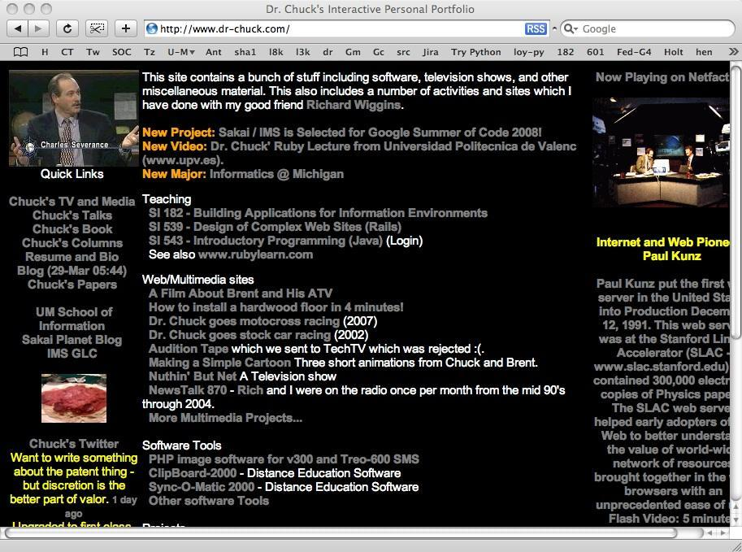
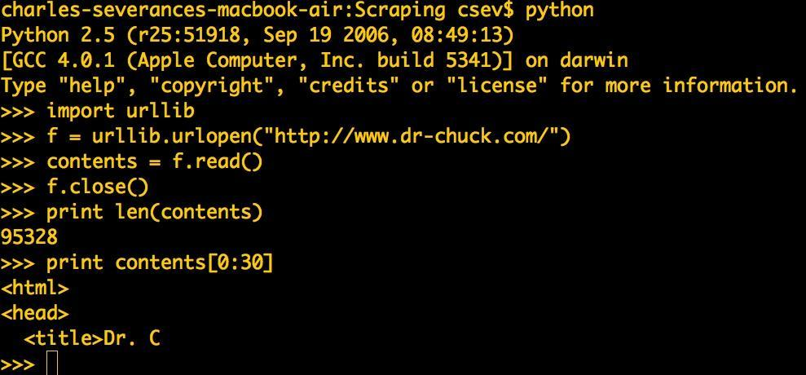
Server
GET
HTML
GET
HTML

Slide 53
Why Scrape?
Pull data - particularly social data - who links to who?
Get your own data back out of some system that has no “export capability”
Monitor a site for new information
Spider the web to make a database for a search engine

Slide 54
Scraping Web Pages
There is some controversy about web page scraping and some sites are a bit snippy about it.
Google: facebook scraping block
Republishing copyrighted information is not allowed
Violating terms of service is not allowed

Slide 55
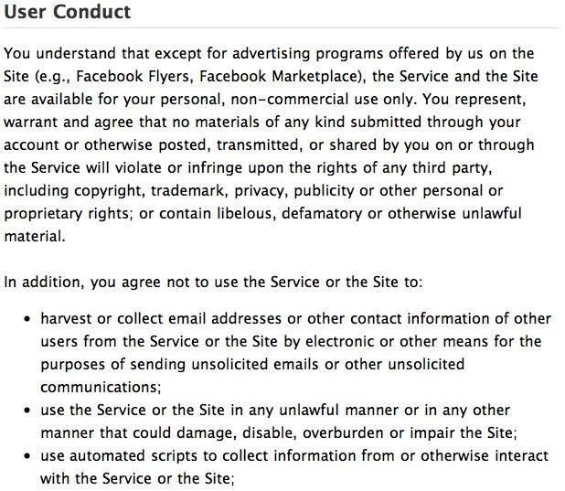
http://www.facebook.com/terms.php

Slide 56
The Easy Way - Beautiful Soup
You could do string searches the hard way
Or use the free software called BeautifulSoup from www.crummy.com
http://www.crummy.com/software/BeautifulSoup/
http://www.pythonlearn.com/code/BeautifulSoup.py
Place the BeautifulSoup.py file in the same folder as your Python code...

Slide 57
import urllib
from BeautifulSoup import *
url = raw_input('Enter - ')
html = urllib.urlopen(url).read()
soup = BeautifulSoup(html)
# Retrieve a list of the anchor tags
# Each tag is like a dictionary of HTML attributes
tags = soup('a')
for tag in tags:
print tag.get('href', None)
urllinks.py

Slide 58
<h1>The First Page</h1>
<p>If you like, you can switch to the<a href="http://www.dr-chuck.com/page2.htm">Second Page</a>.</p>
html = urllib.urlopen(url).read()
soup = BeautifulSoup(html)
tags = soup('a')
for tag in tags:
print tag.get('href', None)
python urllinks.py
Enter - http://www.dr-chuck.com/page1.htm
http://www.dr-chuck.com/page2.htm

Slide 59
Summary
The TCP/IP gives us pipes / sockets between applications
We designed application protocols to make use of these pipes
HyperText Transfer Protocol (HTTP) is a simple yet powerful protocol
Python has good support for sockets, HTTP, and HTML parsing

Slide 60
Acknowledgements / Contributions
Thes slide are Copyright 2010- Charles R. Severance (www.dr-chuck.com) of the University of Michigan School of Information and open.umich.edu and made available under a Creative Commons Attribution 4.0 License. Please maintain this last slide in all copies of the document to comply with the attribution requirements of the license. If you make a change, feel free to add your name and organization to the list of contributors on this page as you republish the materials.
Initial Development: Charles Severance, University of Michigan School of Information
… Insert new Contributors here
...

