Slide 1
Python Objects
Charles Severance
www.pythonlearn.com
http://en.wikipedia.org/wiki/Object-oriented_programming

Slide 2
Warning
This lecture is very much about definitions and mechanics for objects
This lecture is a lot more about “how it works” and less about “how you use it”
You won’t get the entire picture until this is all looked at in the context of a real problem
So please suspend disbelief and learn technique for the next 50 or so slides..

Slide 3
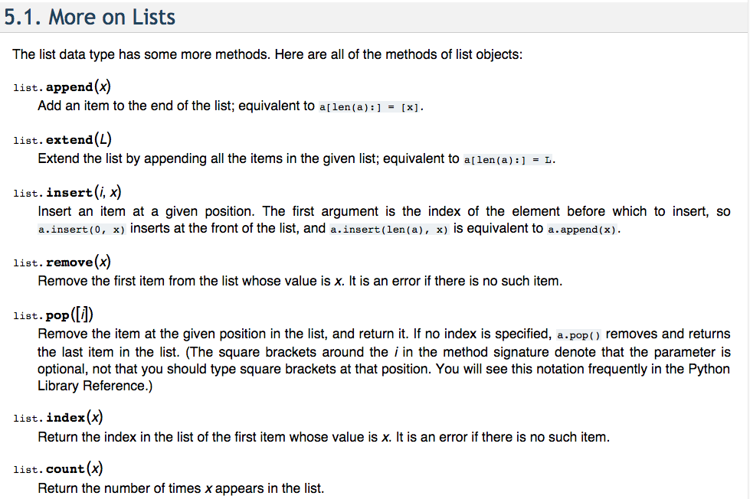
https://docs.python.org/2/tutorial/datastructures.html

Slide 4
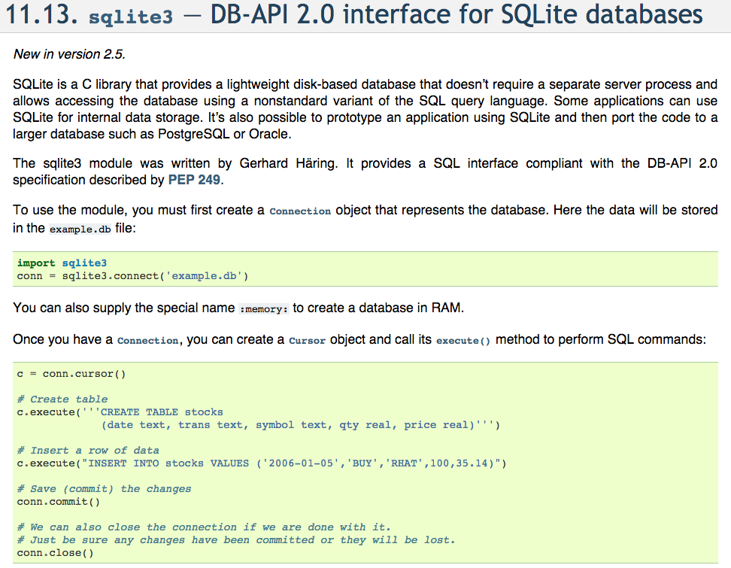
https://docs.python.org/2/library/sqlite3.html

Slide 5
Review of Programs

Slide 6
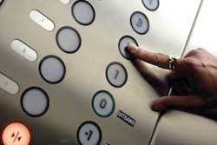
usf = input('Enter the US Floor Number: ')
wf = usf - 1
print 'Non-US Floor Number is',wf
python elev.py
Enter the US Floor Number: 2
Non-US Floor Number is 1
Input
Process
Output

Slide 7
Object Oriented
A program is made up of many cooperating objects
Instead of being the “whole program” - each object is a little “island” within the program and cooperatively working with other objects.
A program is made up of one or more objects working together - objects make use of each other’s capabilities

Slide 8

Input
Dictionary
Object
Object
String
Objects get created and used
Output

Slide 9
Input
Code/Data
Code/Data
Code/Data
Code/Data
Objects are bits of code and data
Output

Slide 10
Object
An Object is a bit of self-contained Code and Data
A key aspect of the Object approach is to break the problem into smaller understandable parts (divide and conquer)
Objects have boundaries that allow us to ignore un-needed detail
We have been using objects all along: String Objects, Integer Objects, Dictionary Objects, List Objects...

Slide 11
movies = list()
movie1 = dict()
movie1['Director'] = 'James Cameron'
movie1['Title'] = 'Avatar'
movie1['Release Date'] = '18 December 2009'
movie1['Running Time'] = '162 minutes'
movie1['Rating'] = 'PG-13'
movies.append(movie1)
movie2 = dict()
movie2['Director'] = 'David Fincher'
movie2['Title'] = 'The Social Network'
movie2['Release Date'] = '01 October 2010'
movie2['Running Time'] = '120 min'
movie2['Rating'] = 'PG-13'
movies.append(movie2)

Slide 12
movies = list()
movie1 = dict()
movie1['Director'] = 'James Cameron'
movie1['Title'] = 'Avatar'
movie1['Release Date'] = '18 December 2009'
movie1['Running Time'] = '162 minutes'
movie1['Rating'] = 'PG-13'
movies.append(movie1)
movie2 = dict()
movie2['Director'] = 'David Fincher'
movie2['Title'] = 'The Social Network'
movie2['Release Date'] = '01 October 2010'
movie2['Running Time'] = '120 min'
movie2['Rating'] = 'PG-13'
movies.append(movie2)

Slide 13
movies = list()
movie1 = dict()
movie1['Director'] = 'James Cameron'
movie1['Title'] = 'Avatar'
movie1['Release Date'] = '18 December 2009'
movie1['Running Time'] = '162 minutes'
movie1['Rating'] = 'PG-13'
movies.append(movie1)
movie2 = dict()
movie2['Director'] = 'David Fincher'
movie2['Title'] = 'The Social Network'
movie2['Release Date'] = '01 October 2010'
movie2['Running Time'] = '120 min'
movie2['Rating'] = 'PG-13'
movies.append(movie2)

Slide 14
keys = ['Title', 'Director', 'Rating', 'Running Time']
print '-----------'
print movies
print '-----------'
print keys
for item in movies:
print '-----------'
for key in keys:
print key,': ', item[key]
print '-----------'

Slide 15
keys = ['Title', 'Director', 'Rating', 'Running Time']
print '-----------'
print movies
print '-----------'
print keys
for item in movies:
print '-----------'
for key in keys:
print key,': ', item[key]
print '-----------'

Slide 16
Input
Dictionary
Object
Object
String
Objects get created and used
Output

Slide 17
Input
Code/Data
Code/Data
Code/Data
Code/Data
Objects are bits of code and data
Output

Slide 18
Input
Code/Data
Code/Data
Code/Data
Code/Data
Objects hide detail - they allow us to ignore the detail of the “rest of the program”.
Output

Slide 19
Input
Code/Data
Code/Data
Code/Data
Code/Data
Objects hide detail - they allow the “rest of the program” to ignore the detail about “us”.
Output

Slide 20
movies = list()
movie1 = dict()
movie1['Director'] = 'James Cameron'
movie1['Title'] = 'Avatar'
movie1['Release Date'] = '18 December 2009'
movie1['Running Time'] = '162 minutes'
movie1['Rating'] = 'PG-13'
movies.append(movie1)
movie2 = dict()
movie2['Director'] = 'David Fincher'
movie2['Title'] = 'The Social Network'
movie2['Release Date'] = '01 October 2010'
movie2['Running Time'] = '120 min'
movie2['Rating'] = 'PG-13'
movies.append(movie2)

Slide 21
Object
An Object is a bit of self-contained Code and Data
A key aspect of the Object approach is to break the problem into smaller understandable parts (divide and conquer)
Objects have boundaries that allow us to ignore un-needed detail
We have been using objects all along: String Objects, Integer Objects, Dictionary Objects, List Objects...

Slide 22

Definitions
Class - a template - Dog
Method or Message - A defined capability of a class - bark()
Field or attribute- A bit of data in a class - length
Object or Instance - A particular instance of a class - Lassie

Slide 23
Terminology: Class
Defines the abstract characteristics of a thing (object), including the thing's characteristics (its attributes, fields or properties) and the thing's behaviors (the things it can do, or methods, operations or features). One might say that a class is a blueprint or factory that describes the nature of something. For example, the class Dog would consist of traits shared by all dogs, such as breed and fur color (characteristics), and the ability to bark and sit (behaviors).
http://en.wikipedia.org/wiki/Object-oriented_programming

Slide 24
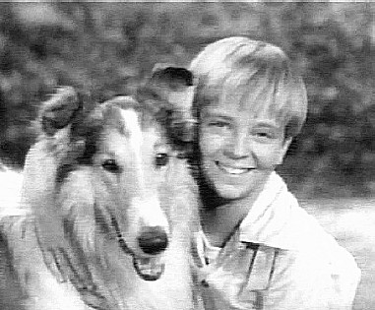
Terminology: Class
A pattern (exemplar) of a class. The class of Dog defines all possible dogs by listing the characteristics and behaviors they can have; the object Lassie is one particular dog, with particular versions of the characteristics. A Dog has fur; Lassie has brown-and-white fur.
http://en.wikipedia.org/wiki/Object-oriented_programming

Slide 25
Terminology: Instance
One can have an instance of a class or a particular object. The instance is the actual object created at runtime. In programmer jargon, the Lassie object is an instance of the Dog class. The set of values of the attributes of a particular object is called its state. The object consists of state and the behavior that's defined in the object's class.
Object and Instance are often used interchangeably.
http://en.wikipedia.org/wiki/Object-oriented_programming

Slide 26
Terminology: Method
An object's abilities. In language, methods are verbs. Lassie, being a Dog, has the ability to bark. So bark() is one of Lassie's methods. She may have other methods as well, for example sit() or eat() or walk() or save_timmy(). Within the program, using a method usually affects only one particular object; all Dogs can bark, but you need only one particular dog to do the barking
Method and Message are often used interchangeably.
http://en.wikipedia.org/wiki/Object-oriented_programming

Slide 27
A Sample Class

Slide 28
class is a reserved word.
This is the template for making PartyAnimal objects.
class PartyAnimal:
x = 0
def party(self) :
self.x = self.x + 1
print "So far",self.x
an = PartyAnimal()
an.party()
an.party()
an.party()
Each PartyAnimal object has a bit of data.
Each PartyAnimal object has a bit of code.
Create a PartyAnimal object.
Tell the object to run the party() code.
PartyAnimal.party(an)
run party() *within* the object an

Slide 29

$ python party1.py
So far 1
So far 2
So far 3
class PartyAnimal:
x = 0
def party(self) :
self.x = self.x + 1
print "So far",self.x
an = PartyAnimal()
an.party()
an.party()
an.party()
an
x
0
3
1
2
party()

Slide 30
“self” is a formal argument that refers to the object itself.
class PartyAnimal:
x = 0
def party(self) :
self.x = self.x + 1
print "So far",self.x
an = PartyAnimal()
an.party()
an.party()
an.party()
self.x is saying “x within self”
an
self
x
0
party()
self is “global within this object”

Slide 31
Definitions
Class - a template - Dog
Method or Message - A defined capability of a class - bark()
Object or Instance - A particular instance of a class - Lassie

Slide 32
Playing with dir() and type()

Slide 33
A Nerdy Way to Find Capabilities
>>> x = list()
>>> type(x)
<type 'list'>
>>> dir(x)
['__add__', '__class__', '__contains__', '__delattr__', '__delitem__', '__delslice__', '__doc__', '__eq__', '__setitem__', '__setslice__', '__str__', 'append', 'count', 'extend', 'index', 'insert', 'pop', 'remove', 'reverse', 'sort']
>>>
The dir() command lists capabilities
Ignore the ones with underscores - these are used by Python itself
The rest are real operations that the object can perform
It is like type() - it tells us something *about* a variable

Slide 34
Try dir() with a String
>>> y = “Hello there”
>>> dir(y)
['__add__', '__class__', '__contains__', '__delattr__', '__doc__', '__eq__', '__ge__', '__getattribute__', '__getitem__', '__getnewargs__', '__getslice__', '__gt__', '__hash__', '__init__', '__le__', '__len__', '__lt__', '__repr__', '__rmod__', '__rmul__', '__setattr__', '__str__', 'capitalize', 'center', 'count', 'decode', 'encode', 'endswith', 'expandtabs', 'find', 'index', 'isalnum', 'isalpha', 'isdigit', 'islower', 'isspace', 'istitle', 'isupper', 'join', 'ljust', 'lower', 'lstrip', 'partition', 'replace', 'rfind', 'rindex', 'rjust', 'rpartition', 'rsplit', 'rstrip', 'split', 'splitlines', 'startswith', 'strip', 'swapcase', 'title', 'translate', 'upper', 'zfill']

Slide 35
class PartyAnimal:
x = 0
def party(self) :
self.x = self.x + 1
print "So far",self.x
an = PartyAnimal()
print "Type", type(an)
print "Dir ", dir(an)
We can use dir() to find the “capabilities” of our newly created class.
$ python party2.py
Type <type 'instance'>
Dir ['__doc__', '__module__', 'party', 'x']

Slide 36
Object Life Cycle
http://en.wikipedia.org/wiki/Constructor_(computer_science)

Slide 37
Object Life Cycle
Objects are created, used and discarded
We have special blocks of code (methods) that get called
At the moment of creation (constructor)
At the moment of destruction (destructor)
Constructors are used a lot
Destructors are seldom used

Slide 38
Constructor
The primary purpose of the constructor is to set up some instance variables to have the proper initial values when the object is created

Slide 39
class PartyAnimal:
x = 0
def __init__(self):
print "I am constructed"
def party(self) :
self.x = self.x + 1
print "So far",self.x
def __del__(self):
print "I am destructed", self.x
an = PartyAnimal()
an.party()
an.party()
an.party()
$ python party2.py
I am constructed
So far 1
So far 2
So far 3
I am destructed 3
The constructor and destructor are optional. The constructor is typically used to set up variables. The destructor is seldom used.

Slide 40
Constructor
In object-oriented programming, a constructor in a class is a special block of statements called when an object is created
http://en.wikipedia.org/wiki/Constructor_(computer_science)

Slide 41
Many Instances
We can create lots of objects - the class is the template for the object
We can store each distinct object in its own variable
We call this having multiple instances of the same class
Each instance has its own copy of the instance variables

Slide 42
class PartyAnimal:
x = 0
name = ""
def __init__(self, nam):
self.name = nam
print self.name,"constructed"
def party(self) :
self.x = self.x + 1
print self.name,"party count",self.x
s = PartyAnimal("Sally")
s.party()
j = PartyAnimal("Jim")
j.party()
s.party()
Constructors can have additional parameters. These can be used to setup instance variables for the particular instance of the class (i.e. for the particular obect).

Slide 43
class PartyAnimal:
x = 0
name = ""
def __init__(self, z):
self.name = z
print self.name,"constructed"
def party(self) :
self.x = self.x + 1
print self.name,"party count",self.x
s = PartyAnimal("Sally")
s.party()
j = PartyAnimal("Jim")
j.party()
s.party()
s
x
0
2
1
name:
Sally
j
x
0
1
We have two independent instances.
name:
Jim
PartyAnimal.party(j)

Slide 44
Definitions
Class - a template - Dog
Method or Message - A defined capability of a class - bark()
Object or Instance - A particular instance of a class - Lassie
Constructor - A method which is called when the instance / object is created

Slide 45
Inheritance
http://www.python.org/doc/2.5.2/tut/node11.html
http://www.ibiblio.org/g2swap/byteofpython/read/inheritance.html

Slide 46
Inheritance
When we make a new class - we can reuse an existing class and inherit all the capabilities of an existing class and then add our own little bit to make our new class
Another form of store and reuse
Write once - reuse many times
The new class (child) has all the capabilities of the old class (parent) - and then some more

Slide 47
Terminology: Inheritance
‘Subclasses’ are more specialized versions of a class, which inherit attributes and behaviors from their parent classes, and can introduce their own.
http://en.wikipedia.org/wiki/Object-oriented_programming

Slide 48
class PartyAnimal:
x = 0
name = ""
def __init__(self, nam):
self.name = nam
print self.name,"constructed"
def party(self) :
self.x = self.x + 1
print self.name,"party count",self.x
class FootballFan(PartyAnimal):
points = 0
def touchdown(self):
self.points = self.points + 7
self.party()
print self.name,"points",self.points
s = PartyAnimal("Sally")
s.party()
j = FootballFan("Jim")
j.party()
j.touchdown()
FootballFan is a class which extends PartyAnimal. It has all the capabilities of PartyAnimal and more.

Slide 49
class PartyAnimal:
x = 0
name = ""
def __init__(self, nam):
self.name = nam
print self.name,"constructed"
def party(self) :
self.x = self.x + 1
print self.name,"party count",self.x
class FootballFan(PartyAnimal):
points = 0
def touchdown(self):
self.points = self.points + 7
self.party()
print self.name,"points",self.points
s = PartyAnimal("Sally")
s.party()
j = FootballFan("Jim")
j.party()
j.touchdown()
s
x
name: Sally

Slide 50
class PartyAnimal:
x = 0
name = ""
def __init__(self, nam):
self.name = nam
print self.name,"constructed"
def party(self) :
self.x = self.x + 1
print self.name,"party count",self.x
class FootballFan(PartyAnimal):
points = 0
def touchdown(self):
self.points = self.points + 7
self.party()
print self.name,"points",self.points
s = PartyAnimal("Sally")
s.party()
j = FootballFan("Jim")
j.party()
j.touchdown()
j
x
name: Jim
points

Slide 51
Definitions
Class - a template - Dog
Method or Message - A defined capability of a class - bark()
Object or Instance - A particular instance of a class - Lassie
Constructor - A method which is called when the instance / object is created
Inheritance - the ability to take a class and extend it to make a new class.

Slide 52
Summary
Object Oriented programming is a very structured approach to code reuse.
We can group data and functionality together and create many independent instances of a class

Slide 53


Acknowledgements / Contributions
Thes slide are Copyright 2010- Charles R. Severance (www.dr-chuck.com) of the University of Michigan School of Information and open.umich.edu and made available under a Creative Commons Attribution 4.0 License. Please maintain this last slide in all copies of the document to comply with the attribution requirements of the license. If you make a change, feel free to add your name and organization to the list of contributors on this page as you republish the materials.
Initial Development: Charles Severance, University of Michigan School of Information
… Insert new Contributors here
...

