Slide 1


Python Dictionaries
Chapter 9
Python for Informatics: Exploring Information
www.pythonlearn.com
Notes:
Note from Chuck. If you are using these materials, you can remove the UM logo and replace it with your own, but please retain the CC-BY logo on the first page as well as retain the entire last page.

Slide 2
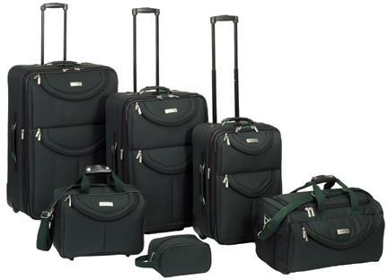
What is a Collection?
A collection is nice because we can put more than one value in it and carry them all around in one convenient package
We have a bunch of values in a single “variable”
We do this by having more than one place “in” the variable
We have ways of finding the different places in the variable
Sub SlideMasterCleanup()
Dim i As Integer
Dim j As Integer
Dim oPres As Presentation
Set oPres = ActivePresentation
On Error Resume Next
With oPres
For i = 1 To .Designs.Count
For j = .Designs(i).SlideMaster.CustomLayouts.Count To 1 Step -1
.Designs(i).SlideMaster.CustomLayouts(j).Delete
Next
Next i
End With
End Sub

Slide 3
What is not a “Collection”
Most of our variables have one value in them - when we put a new value in the variable - the old value is overwritten
$ python
Python 2.5.2 (r252:60911, Feb 22 2008, 07:57:53)
[GCC 4.0.1 (Apple Computer, Inc. build 5363)] on darwin
>>> x = 2
>>> x = 4
>>> print x
4

Slide 4
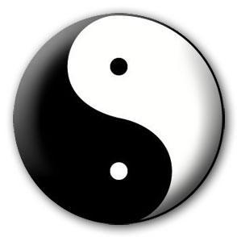


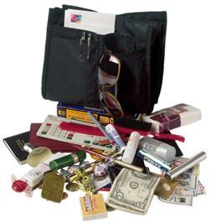
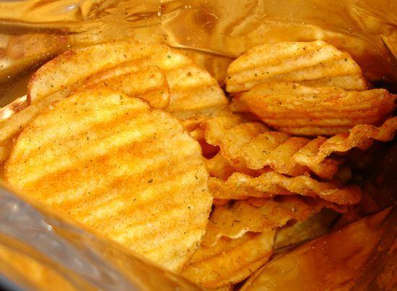
A Story of Two Collections..
List
A linear collection of values that stay in order
Dictionary
A “bag” of values, each with its own label

Slide 5
Dictionaries
tissue
calculator
perfume
money
candy
http://en.wikipedia.org/wiki/Associative_array

Slide 6
Dictionaries
Dictionaries are Python’s most powerful data collection
Dictionaries allow us to do fast database-like operations in Python
Dictionaries have different names in different languages
Associative Arrays - Perl / PHP
Properties or Map or HashMap - Java
Property Bag - C# / .Net
http://en.wikipedia.org/wiki/Associative_array

Slide 7
Dictionaries
>>> purse = dict()
>>> purse['money'] = 12
>>> purse['candy'] = 3
>>> purse['tissues'] = 75
>>> print purse
{'money': 12, 'tissues': 75, 'candy': 3}
>>> print purse['candy']
3
>>> purse['candy'] = purse['candy'] + 2
>>> print purse
{'money': 12, 'tissues': 75, 'candy': 5}
Lists index their entries based on the position in the list
Dictionaries are like bags - no order
So we index the things we put in the dictionary with a “lookup tag”

Slide 8
Comparing Lists and Dictionaries
Dictionaries are like lists except that they use keys instead of numbers to look up values
>>> ddd = dict()
>>> ddd['age'] = 21
>>> ddd['course'] = 182
>>> print ddd
{'course': 182, 'age': 21}
>>> ddd['age'] = 23
>>> print ddd
{'course': 182, 'age': 23}
>>> lst = list()
>>> lst.append(21)
>>> lst.append(183)
>>> print lst
[21, 183]
>>> lst[0] = 23
>>> print lst
[23, 183]

Slide 9
>>> lst = list()
>>> lst.append(21)
>>> lst.append(183)
>>> print lst
[21, 183]
>>> lst[0] = 23
>>> print lst
[23, 183]
List
Key
Value
[0]
21
lst
[1]
183
>>> ddd = dict()
>>> ddd['age'] = 21
>>> ddd['course'] = 182
>>> print ddd
{'course': 182, 'age': 21}
>>> ddd['age'] = 23
>>> print ddd
{'course': 182, 'age': 23}
Dictionary
Key
Value
['course']
182
ddd
['age']
21

Slide 10
Dictionary Literals (Constants)
Dictionary literals use curly braces and have a list of key : value pairs
You can make an empty dictionary using empty curly braces
>>> jjj = { 'chuck' : 1 , 'fred' : 42, 'jan': 100}
>>> print jjj
{'jan': 100, 'chuck': 1, 'fred': 42}
>>> ooo = { }
>>> print ooo
{}
>>>

Slide 12
Most Common Name?
marquard
cwen
cwen
zhen
zhen
marquard
csev
csev
zhen
marquard
zhen
csev
zhen

Slide 13
Most Common Name?

Slide 14
Most Common Name?
marquard
cwen
cwen
zhen
zhen
marquard
csev
csev
zhen
marquard
zhen
csev
zhen

Slide 15
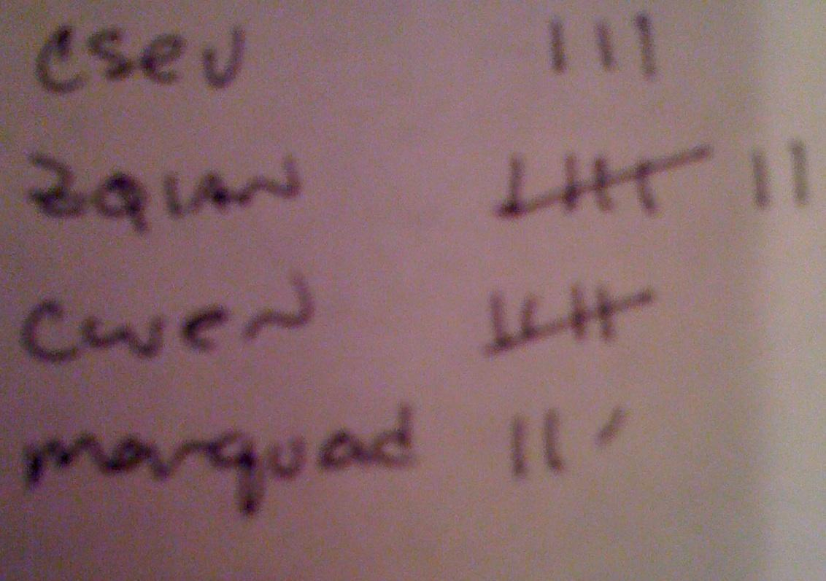
Most Common Name?
marquard
cwen
cwen
zhen
zhen
marquard
csev
csev
zhen
marquard
zhen
csev
zhen

Slide 16
Many Counters with a Dictionary
One common use of dictionary is counting how often we “see” something
Key
Value
>>> ccc = dict()
>>> ccc['csev'] = 1
>>> ccc['cwen'] = 1
>>> print ccc
{'csev': 1, 'cwen': 1}
>>> ccc['cwen'] = ccc['cwen'] + 1
>>> print ccc
{'csev': 1, 'cwen': 2}

Slide 17
Dictionary Tracebacks
It is an error to reference a key which is not in the dictionary
We can use the in operator to see if a key is in the dictionary
>>> ccc = dict()
>>> print ccc['csev']
Traceback (most recent call last):
File "<stdin>", line 1, in <module>
KeyError: 'csev'
>>> print 'csev' in ccc
False

Slide 18
When we see a new name
When we encounter a new name, we need to add a new entry in the dictionary and if this the second or later time we have seen the name, we simply add one to the count in the dictionary under that name
counts = dict()
names = ['csev', 'cwen', 'csev', 'zqian', 'cwen']
for name in names :
if name not in counts:
counts[name] = 1
else :
counts[name] = counts[name] + 1
print counts
{'csev': 2, 'zqian': 1, 'cwen': 2}

Slide 19
The get method for dictionaries
This pattern of checking to see if a key is already in a dictionary and assuming a default value if the key is not there is so common, that there is a method called get() that does this for us
if name in counts:
x = counts[name]
else :
x = 0
x = counts.get(name, 0)
Default value if key does not exist (and no Traceback).
{'csev': 2, 'zqian': 1, 'cwen': 2}

Slide 20
Simplified counting with get()
We can use get() and provide a default value of zero when the key is not yet in the dictionary - and then just add one
counts = dict()
names = ['csev', 'cwen', 'csev', 'zqian', 'cwen']
for name in names :
counts[name] = counts.get(name, 0) + 1
print counts
{'csev': 2, 'zqian': 1, 'cwen': 2}
Default

Slide 21

Simplified counting with get()
counts = dict()
names = ['csev', 'cwen', 'csev', 'zqian', 'cwen']
for name in names :
counts[name] = counts.get(name, 0) + 1
print counts
http://www.youtube.com/watch?v=EHJ9uYx5L58

Slide 22
Writing programs (or programming) is a very creative and rewarding activity. You can write programs for many reasons ranging from making your living to solving a difficult data analysis problem to having fun to helping someone else solve a problem. This book assumes that everyone needs to know how to program and that once you know how to program, you will figure out what you want to do with your newfound skills.
We are surrounded in our daily lives with computers ranging from laptops to cell phones. We can think of these computers as our ''personal assistants'' who can take care of many things on our behalf. The hardware in our current-day computers is essentially built to continuously ask us the question, ''What would you like me to do next?''
Our computers are fast and have vasts amounts of memory and could be very helpful to us if we only knew the language to speak to explain to the computer what we would like it to ''do next''. If we knew this language we could tell the computer to do tasks on our behalf that were repetitive. Interestingly, the kinds of things computers can do best are often the kinds of things that we humans find boring and mind-numbing.

Slide 23
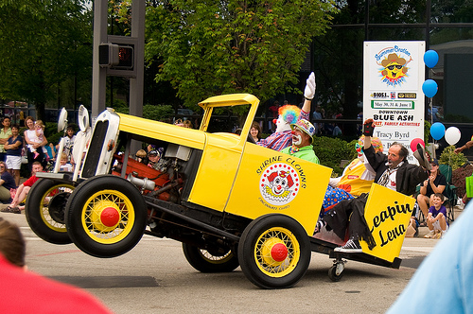
the clown ran after the car and the car ran into the tent and the tent fell down on the clown and the car

Slide 24
Counting Pattern
counts = dict()
print 'Enter a line of text:'
line = raw_input('')
words = line.split()
print 'Words:', words
print 'Counting...'
for word in words:
counts[word] = counts.get(word,0) + 1
print 'Counts', counts
The general pattern to count the words in a line of text is to split the line into words, then loop through the words and use a dictionary to track the count of each word independently.

Slide 25
Counting Words
python wordcount.py
Enter a line of text:
the clown ran after the car and the car ran into the tent and the tent fell down on the clown and the car
Words: ['the', 'clown', 'ran', 'after', 'the', 'car', 'and', 'the', 'car', 'ran', 'into', 'the', 'tent', 'and', 'the', 'tent', 'fell', 'down', 'on', 'the', 'clown', 'and', 'the', 'car']
Counting…
Counts {'and': 3, 'on': 1, 'ran': 2, 'car': 3, 'into': 1, 'after': 1, 'clown': 2, 'down': 1, 'fell': 1, 'the': 7, 'tent': 2}
http://www.flickr.com/photos/71502646@N00/2526007974/

Slide 26
python wordcount.py
Enter a line of text:
the clown ran after the car and the car ran into the tent and the tent fell down on the clown and the car
Words: ['the', 'clown', 'ran', 'after', 'the', 'car', 'and', 'the', 'car', 'ran', 'into', 'the', 'tent', 'and', 'the', 'tent', 'fell', 'down', 'on', 'the', 'clown', 'and', 'the', 'car']
Counting...
Counts {'and': 3, 'on': 1, 'ran': 2, 'car': 3, 'into': 1, 'after': 1, 'clown': 2, 'down': 1, 'fell': 1, 'the': 7, 'tent': 2}
counts = dict()
print 'Enter a line of text:'
line = raw_input('')
words = line.split()
print 'Words:', words
print 'Counting...’
for word in words:
counts[word] = counts.get(word,0) + 1
print 'Counts', counts

Slide 27
Definite Loops and Dictionaries
Even though dictionaries are not stored in order, we can write a for loop that goes through all the entries in a dictionary - actually it goes through all of the keys in the dictionary and looks up the values
>>> counts = { 'chuck' : 1 , 'fred' : 42, 'jan': 100}
>>> for key in counts:
... print key, counts[key]
...
jan 100
chuck 1
fred 42
>>>

Slide 28
Retrieving lists of Keys and Values
>>> jjj = { 'chuck' : 1 , 'fred' : 42, 'jan': 100}
>>> print list(jjj)
['jan', 'chuck', 'fred']
>>> print jjj.keys()
['jan', 'chuck', 'fred']
>>> print jjj.values()
[100, 1, 42]
>>> print jjj.items()
[('jan', 100), ('chuck', 1), ('fred', 42)]
>>>
You can get a list of keys, values, or items (both) from a dictionary
What is a 'tuple'? - coming soon...

Slide 29
Bonus: Two Iteration Variables!
We loop through the key-value pairs in a dictionary using *two* iteration variables
Each iteration, the first variable is the key and the second variable is the corresponding value for the key
>>> jjj = { 'chuck' : 1 , 'fred' : 42, 'jan': 100}
>>> for aaa,bbb in jjj.items() :
... print aaa, bbb
...
jan 100
chuck 1
fred 42
>>>
aaa
bbb
[jan]
100
[chuck]
1
[fred]
42

Slide 30
name = raw_input('Enter file:')
handle = open(name)
text = handle.read()
words = text.split()
counts = dict()
for word in words:
counts[word] = counts.get(word,0) + 1
bigcount = None
bigword = None
for word,count in counts.items():
if bigcount is None or count > bigcount:
bigword = word
bigcount = count
print bigword, bigcount
python words.py
Enter file: words.txt
to 16
python words.py
Enter file: clown.txt
the 7

Slide 31

Summary

Slide 32
Acknowledgements / Contributions
These slides are Copyright 2010- Charles R. Severance (www.dr-chuck.com) of the University of Michigan School of Information and open.umich.edu and made available under a Creative Commons Attribution 4.0 License. Please maintain this last slide in all copies of the document to comply with the attribution requirements of the license. If you make a change, feel free to add your name and organization to the list of contributors on this page as you republish the materials.
Initial Development: Charles Severance, University of Michigan School of Information
… Insert new Contributors or translation credits here
...

