Slide 1
IMPROVEMENTS ON SPEECH RECOGNITION FOR FAST TALKERS
Author :M. Richardson,M.Hwang,A. Acero, and X.D. Huang
Professor:陳嘉平
Repotor:葉佳璋

Slide 2
outline
Introduction
System Description and speech corpora Support
Speak rate Determination
The CLN Algorithm
Experimental results
Conclusion

Slide 3
Introduce
Cepstrum length normalization(CLN)
Improvements made by CLN and Maximum Likelihood Linear Regression
Improvement by using shorter window shift in computing cepstra

Slide 4
System Description and speech corpora
The speaker independent system built here consists of 6000 gender-dependent context.
The feature used were 12 mel-frequency cepstrum coefficients(MFCC).
Log energy and their fist and second order differences in 10ms time frames.
The speaker independent acoustic training corpus comes from the 284-speaker(SI-284)

Slide 5
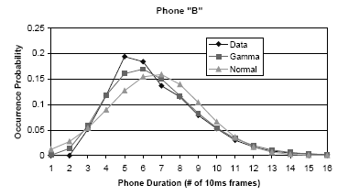
Speak rate Determination

Slide 6
Stretch the utterance
Phone-by-phone Length Stretching
Sentence-by-Sentence Length Streching

Slide 7
Phone-by-phone Length Stretching
Gamna distribution
Mean
variance
Length-stretching factor

Slide 8
Sentence-by-Sentence Length Stretching
Average peak

Slide 9
The CLN Algorithm
Inserting/dropping frames uniformly in the speech segment.
Repeating/deleting represent the steady state of each phone segment.
Creating new frames by interpolating neighboring frames

Slide 10
Experimental resuts
CLN on the test data of fast Speech
CLN on the test data of normal speech

Slide 11
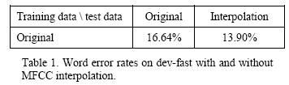
CLN on the test data of fast Speech

Slide 12
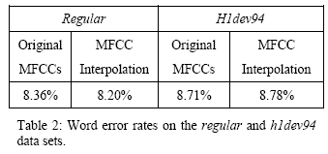
CLN on the test data of normal Speech

Slide 13
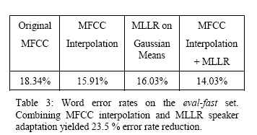
Evaluation and MLLR

Slide 14
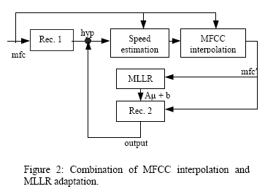
figure2

Slide 15
Shringking Hamming Window Shift
Use a smaller window shift in generating the cepstrum
New window shift is inversely proportional to speed factor

