Slide 1

BioDoopDetective:
Predictive Analysis on Risk Factors associated with Obesity/overweight using BioDoopDetective
Presentation By:
DIVYANSH GADWAL
MSDSM Batch-1
(2104107017)
Notes:
Biodoop is a revolutionary combination of bioinformatics and Hadoop that transforms the analysis of biological data. It effectively utilizes the scalability and distributed processing capabilities of Hadoop to handle vast amounts of genomic and biological datasets. By harnessing the parallel processing power of Hadoop, Biodoop empowers researchers and scientists to efficiently analyze and interpret intricate biological information.

Slide 2

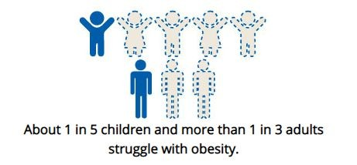
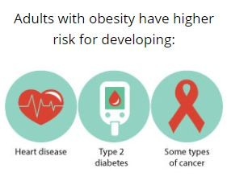
Current Knowledge/ Gaps
Obesity constitutes a major public health concern in the U.S. and Globally
About 1 in 5 children and more than 1 in 3 adults struggle with obesity in the U.S. (CDC)
Adults with obesity have a higher risk for developing Heart disease, Type 2 diabetes, and some types of cancer (CDC)
According to the “World Health Organization” (WHO), 30% of global deaths will be caused by lifestyle diseases by 2030.
There are limited studies using machine learning to analyze obesity/overweight-related datasets in the U.S.
Objective:
This project aims to analyze the relationship between obesity/overweight and various risk factors, including BMI, race, gender, physical activities, mental health, education level, etc. The dataset is stored using Hadoop's MapReduce paradigm, which enables parallel processing of data across a cluster of nodes. This capability can significantly expedite the analysis of the dataset, particularly when conducting complex calculations or running machine learning algorithms that can be parallelized.

Slide 3
Research Questions/Approach
Research Questions:
Which variables are risk factors related to obesity/overweight?
What are the correlations between different risk factors and BMI?
Is mental health an important factor that correlates with obesity/overweight?
Which machine learning model can classify and conduct regression of the dataset?
Approach:
Conduct EDA to find the relationship of different factors and produce visualizations
Find the most accurate model for our dataset.
Classification and Regression models (e.g Random Forest, Support Vector Machines (SVM), Logistic Regression, and Decision Trees)

Slide 4
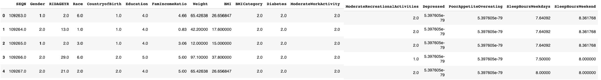
Dataset
Source:
CDC - National Center for Health Statistics. National Health and Nutrition Examination Survey March 2017 to 2020 Pre-pandemic
Data type (numerical & categorical):
Demographics data, examination data, laboratory data, & questionnaire data including; Respondent sequence number, Gender, Race, Country of birth, Education level, Ratio of family income to poverty, Body measures(Weight, Height, BMI, BMI category), Diabetes status, Physical activity(Moderate work activity, recreational activity), Mental health(Depressed, Poor appetite or overeating), and Sleep disorders(Sleep hours on weekdays and weekends).
Dataset size:
12.4MB - XPT. files / Zipped data file:1.4 MB
Dataset size: 12.4MB - XPT. files
Zipped data file:1.4 MB

Slide 5
Milestone
Phase 1
Phase 2
S.No. | Date | Topic
1. | 1st December 2023 to 9th December 2023 | Initial Project Implementation (Gathering the datasets) Preprocessing and cleaning the acquired data to handle missing values, outliers, and inconsistencies.
2. | 10th December 2023 to 18th December 2023 | Phase-1: Developing the algorithms, Training & Testing the model on a well-curated dataset
3. | 19th December 2023 to 21st December 2023 | Initial Project Report Documentation
S.No. | Date | Topic
1. | 22nd December 2023 to 31st December 2023 | Phase-2: Developing the algorithms, Training & Testing the model on a well-curated dataset
2. | 1st January 2024 to 15th January 2024 | Work on Dashboard implementation
3. | 15th January 2024 to 25th January 2024 | Finalization of the project and submission

Slide 6
Novelty/ Previous Work
Skillset:
Proficient in CNN-RNN Architecture for video classification.
Expertise in the Hadoop ecosystem.
Skilled in Tableau as well as in PowerBI for data visualization.
Advanced user of MS Excel for data analysis.
Experience in managing databases using MongoDB.
Experience in Hands-on ETL tools like PuttyGen, PostgreSQL, and Hive.
Achievements:
The Video Classification project was successfully completed.
Contributed to the successful implementation of data integration projects at Mastercard UK.

