Slide 1

LAN Switching and VLAN

Slide 2

Table of Contents
Switching
The Spanning-Tree Protocol
VLAN
Introduction of VLAN
VLAN Architecture
VLAN Implementation
Routing Between VLANs

Slide 3
Switch Operation
Switches perform two basic functions:
Building and maintaining switching tables (similar to a bridge table) based on MAC addresses
Switching frames out the interface to the destination

Slide 4
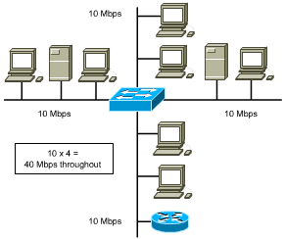
Symmetric Switching
symmetric switching provides switched connections between ports with the same bandwidth (10/10 Mbps or 100/100 Mbps)
can cause bottlenecks as users try to access servers on other segments.
potential bottlenecks
Notes:
Cisco catalyst 都是非对称的

Slide 5
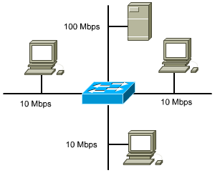
Asymmetric Switching
asymmetric switching reduces the likelihood of a potential bottleneck at the server by attaching the segment with the server to a higher bandwidth port (100 Mbps)
asymmetric switching requires memory buffering in the switch

Slide 6
Memory Buffering
Area of memory in a switch where destination and transmission data are stored until it can be switched out the correct port.
Port-based memory buffering
packets are stored in a queue on each port
possible for one packet to delay transmission of other packets because of a busy destination port
Shared memory buffering
common memory buffering shared by all ports
allows packets to be RX on one port and TX out another port without changing it to a different queue.
Notes:
Port-based memory buffering可能会由于目的端口堵塞而导致源端口的帧不得转发而耽误源端口后面的帧不得正常发送。
Shared memory buffering动态分配各个端口所需要的缓存内存量

Slide 7
Switching Methods
Store-and-Forward
The switch receives the entire frame, calculating the CRC at the end, before sending it to the destination
Cut-through
A switch adds latency. It can be reduced by using cut-through switching method
Fast forward switching--only checks the destination MAC before immediately forwarding the frame
Fragment Free--reads the first 64 bytes to reduce errors before forwarding the frame

Slide 8
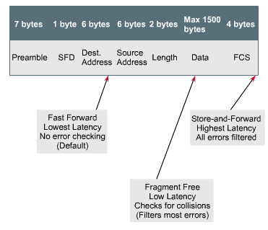
Two Switching Methods

Slide 9
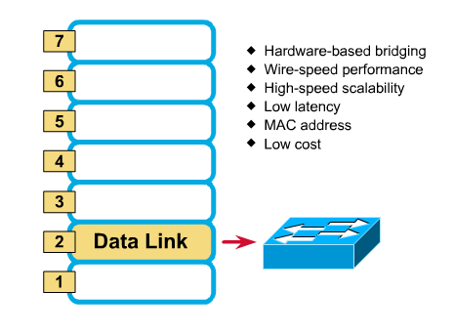
Layer 2 Switching
Notes:
二层交换机：一个mac 三层交换机：一个端口一个mac 路由器：一个以太网口一个mac，桥接口、串行口没有mac

Slide 10
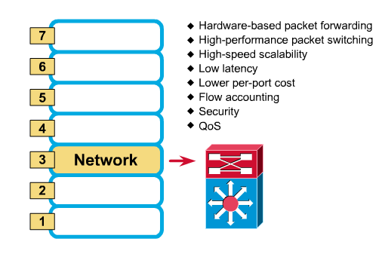
Layer 3 Switching

Slide 11
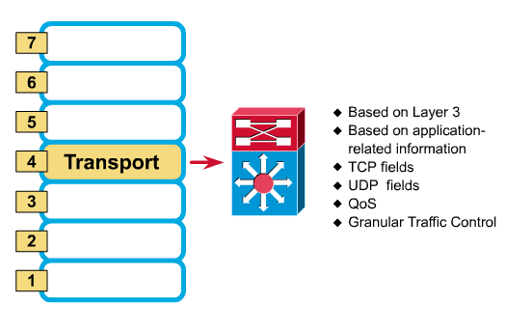
Layer 4 Switching

Slide 12
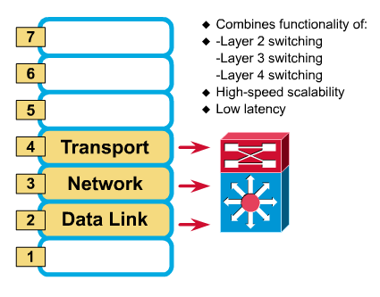
Multilayer Switching

Slide 13
Table of Contents
Switching
The Spanning-Tree Protocol
VLAN
Introduction of VLAN
VLAN Architecture
VLAN Implementation
Routing Between VLANs

Slide 14
Bridging Loops
Loops may occur in a network for a variety of reasons.
Usually loops in networks are the result of a deliberate attempt to provide redundancy.
Can also occur by configuration error
Two primary reasons loops can be absolutely disastrous in a bridged network:
broadcast loops
bridge-table corruption

Slide 15
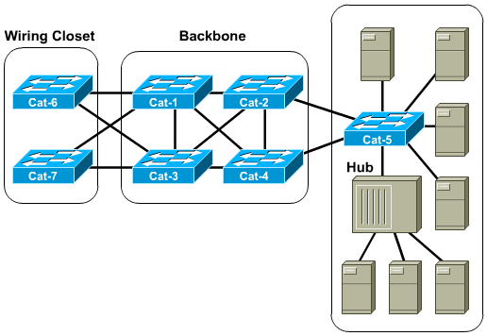
Redundancy Creates Loops

Slide 16
L2 Loops
Broadcasts and Layer 2 loops can be a dangerous combination.
Ethernet frames have no TTL field
After an Ethernet frame starts to loop, it will probably continue until someone shuts off one of the switches or breaks a link
The switches will flip flop the bridging table entry for Host A (creating extremely high CPU utilization).

Slide 17
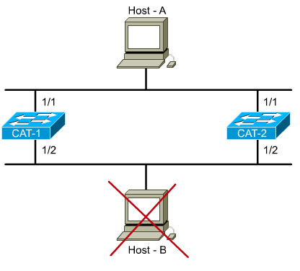
L2 Loops - Flooded unicast frames
Where’s Host B? FLOOD
Where’s Host B? FLOOD
Where’s Host B? FLOOD
Where’s Host B? FLOOD
And the floods continue
Uh oh.
Removed from the network

Slide 18
Overview of STP
Elements of the Spanning Tree Protocol
Main function: allow redundant paths in a switched/bridged network without incurring latency from the effects of loops.
STP prevents loops by calculating a stable spanning-tree network topology
Spanning-tree frames (called bridge protocol data units--BPDUs) are used to determine the spanning-tree topology

Slide 19
STP Decision Sequence
Spanning Tree always uses the same four-step decision sequence:
Lowest root BID (Bridge Identification)
Lowest path cost to root bridge
Lowest sender BID
Lowest port ID

Slide 20
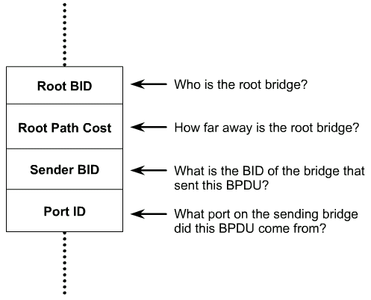
BPDUs
STP establishes a root node, called the root bridge
The resulting tree originates from the root bridge.
Redundant links that are not part of the shortest path tree are blocked.
Data frames received on blocked links are dropped.
The message that a switch sends, allowing the formation of a loop free logical topology, is BPDU
BPDUs are switch-to-switch traffic; they do not carry end-user traffic.

Slide 21
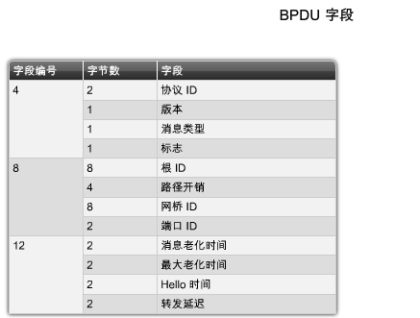
STP BPDU

Slide 22
Bridge Identification/BID
A Bridge ID (BID): 8 bytes
The high-order BID subfield(2 bytes): bridge priority
2¹⁶ possible values: 0-65,535 (default: 32,768)
Typically expressed in a decimal format
The low-order subfield(6 bytes): a MAC address assigned to the switch
Expressed in hexadecimal format
STP cost values: lower costs are better.

Slide 23
Electing the Root Switch
The switches elect a single root switch by looking for the switch with the lowest BID (often referred to as a root war).
If all the switches are using the default bridge priority of 32,768, the lowest MAC address serves as the tie-breaker.

Slide 24
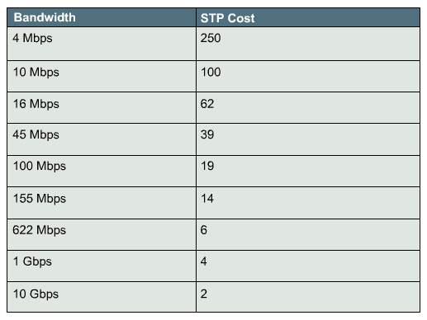
Path Cost
Bridges use the concept of cost to evaluate how close they are to other bridges.

Slide 25
Five STP States
States are established by configuring each port according to policy
Then the STP modifies the states based on traffic patterns and potential loops
The default order of STP states are:
Blocking--no frames forwarded, BPDUs heard
Listening--no frames forwarded, listening for data frames
Learning--no frames forwarded, learning addresses
Forwarding--frames forwarded, learning addresses
Disabled--no frames forwarded, no BPDUs heard
blocking
20s
15s
15s
forwarding

Slide 26
Initial STP Convergence
When the network first starts, all the bridges flood the network with a mix of BPDU information.
Immediately, they apply the decision sequence allowing them to hone in on the set of BPDUs that form a single spanning tree for the entire network.
(Step 1) Root switch decision: A single root bridge is elected to act as the central point of this network
(Step 2) Electing the root ports: All the remaining bridges calculate a set of root ports
(Step 3) Electing the designated ports: All the remaining bridges calculate a set of designated ports
Notes:
Hone：磨练

Slide 27
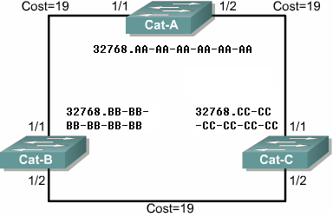
Step1: Root Switch Decision
Announce itself as the root
Checking all BPDUs received on the port as well as the BPDU that would be sent on that port
For each arrived BPDU, if it is lower in value than the existing BPDU saved for the port
The old value is replaced
The sender of BPDU is accepted as the new root
Root

Slide 28
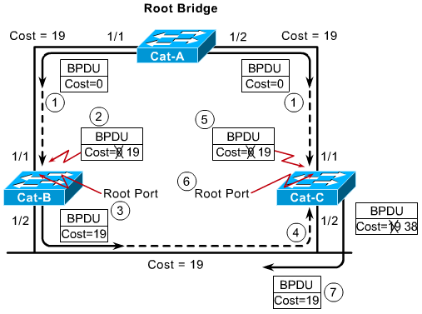
Step2: Electing the Root Ports
Every non-root bridge must select one root port.
The root port of a bridge is the port that is closest to the root bridge.
The root path cost is the cumulative cost of all links to the root bridge.
STP costs are incremented as BPDUs are received on a port, not as they are sent out a port.
Notes:
ROOT port选择时可能要比较端口号，可以配置交换机各个端口的优先级。默认是128

Slide 29
Step3: Electing Designated Ports(I)
Each segment has one designated port
Functions as the single bridge /switch port that both sends and receives traffic to and from that segment and the root bridge.
The bridge/switch containing the designated port for a given segment is referred to as the designated bridge for that segment.
All the bridges/switches will block the non-designated ports on them
Every active port on the root bridge becomes a designated port

Slide 30
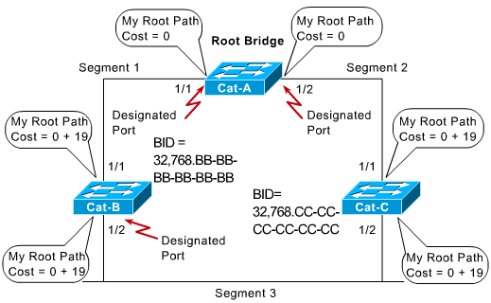
Step3: Electing Designated Ports(II)
Blocked
Notes:
比较BID

Slide 31
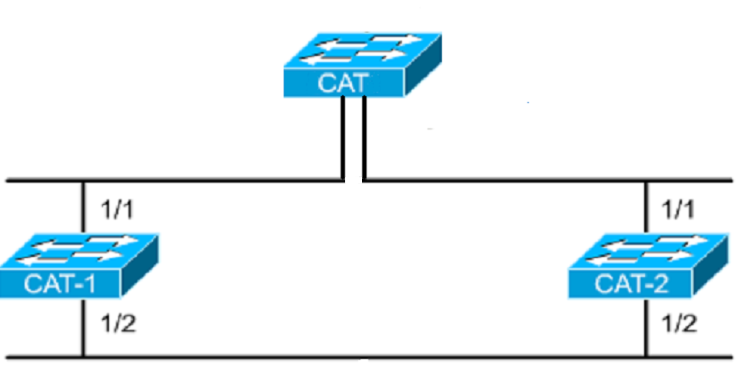
An Example of STP
MAC: 0c00c8111110
Priority: 32768
Root switch
Designated port
Designated port
Root port
100BaseT
Root port
MAC: 0c00c8111111
Priority: 32768
MAC: 0c00c8211112
Priority: 32768
Blocked
Designated port
10BaseT
Non-designated port

Slide 32
Table of Contents
Switching
The Spanning-Tree Protocol
VLAN
Introduction of VLAN
VLAN Architecture
VLAN Implementation
Routing Between VLANs

Slide 33
Existing Shared LAN Configurations
In a typical shared LAN...
Users are grouped physically based on the hub they are plugged into
Routers segment the LAN and provide broadcast firewalls
In VLANs...
you can group users logically by function, department or application in use
configuration is done through proprietary software

Slide 34
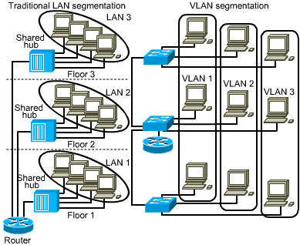
Differences between LANs & VLANs
VLANs...
work at Layer 2 & 3
control network broadcasts
allow users to be assigned by net admin.
provide tighter network security. How?
Notes:
安全
成本降低
性能提高
广播风暴防范
提高IT员工的效率
简化项目管理或应用管理

Slide 35
VLANs (IEEE 802.1q)
Characteristics
A logical grouping of network devices or users that are not restricted to a physical switch segment.
The devices or users in a VLAN can be grouped by function, department, application, and so on, regardless of their physical segment location.
A VLAN creates a single broadcast domain that is not restricted to a physical segment and is treated like a subnet.
VLAN setup is done in the switch by the network administrator using the vendor’s software.

Slide 36
Grouping Users
VLANs can logically segment users into different subnets (broadcast domains)
Broadcast frames are only switched between ports on the switch or switches with the same VLAN ID.
Users can be logically group via software based on:
port number
MAC address
protocol being used
application being used

Slide 37
Table of Contents
Switching
The Spanning-Tree Protocol
VLAN
Introduction of VLAN
VLAN Architecture
VLAN Implementation
Routing Between VLANs

Slide 38
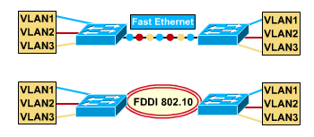
VLANs Across the Backbone
VLAN configuration needs to support backbone transport of data between interconnected routers and switches.
The backbone is the area used for inter-VLAN communication
The backbone should be high-speed links, typically 100Mbps or greater

Slide 39
Router’s Role in a VLAN
A router provides connection between different VLANs
For example, you have VLAN1 and VLAN2.
Within the switch, users on separate VLANs cannot talk to each other (benefit of a VLAN!)
However, users on VLAN1 can email users on VLAN2 but they need a router to do it.

Slide 40
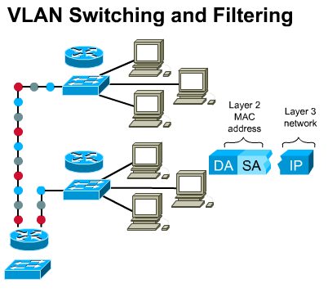
How Frames are Used in a VLAN
Switches make filtering and forwarding decisions based on data in the frame.
There are two techniques used.
Frame Filtering--examines particular information about each frame (MAC address or layer 3 protocol type)
Frame Tagging--places a unique identifier in the header of each frame as it is forwarded throughout the network backbone.

Slide 41
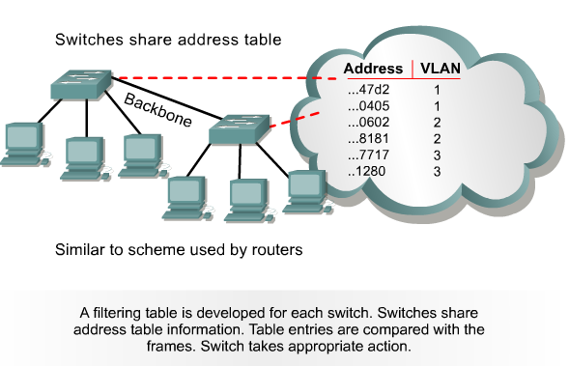
Frame Filtering

Slide 42
Frame Tagging
Frame tagging implementation process:
Places a VLAN identifier in the header of each frame as it is forwarded throughout the network backbone.
The identifier is understood and examined by each switch.
When the frame exits the network backbone, the switch removes the identifier before the frame is transmitted to the target end station.
Frame tagging functions at Layer 2 and requires little processing or administrative overhead.

Slide 43
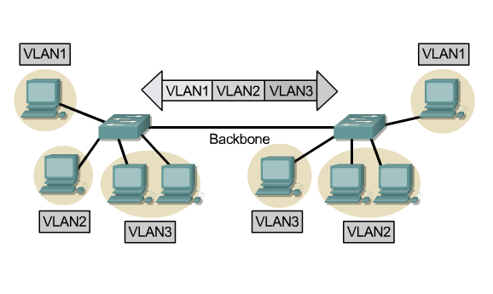
Frame Tagging

Slide 44
Frame Tagging– IEEE802.1Q and ISL
IEEE802.1Q
IEEE Standard, insert a label of VLAN to the header to identify the VLAN belonging to. (Frame Tagging)。
ISL(Inter-Switch Link)
Cisco proprietary. ISL add a header of 26 bytes in front of the data frame, and appends a CRC(4 byte) at the end.
Name | Encapsulation | Label | Media
802.1Q | No | Yes | Ethernet
ISL | Yes | No | Ethernet

Slide 45
Table of Contents
Switching
The Spanning-Tree Protocol
VLAN
Introduction of VLAN
VLAN Architecture
VLAN Implementation
Routing Between VLANs

Slide 46
Ports, VLANs, and Broadcasts
Methods for implementing VLANs
Static
Dynamic
Each switched port can be assigned to a VLAN. This...
ensures ports that do not share the same VLAN do not share broadcasts.
ensures ports that do share the same VLAN will share broadcasts.

Slide 47
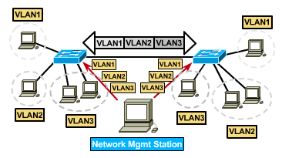
Static VLANs

Slide 48
Static VLANs
Defined
Static VLANs are when ports on a switch are administratively assigned to a VLAN
Benefits
secure, easy to configure and monitor
works well in networks where moves are controlled

Slide 49
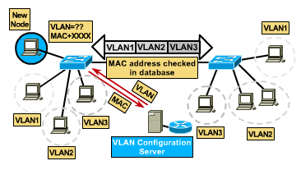
Dynamic VLANs

Slide 50
Dynamic VLANs
When a station is initially connected to an unassigned port, the switch checks an entry in the table and dynamically configures the port with the right VLAN
Benefits
less administration (more upfront) when users are added or move
centralized notification of unauthorized user
Notes:
Upfront:前期

Slide 51
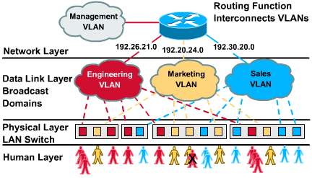
Port-Centric VLANs
3 Port-Centric VLANs

Slide 52
Benefits of Port-Centric VLANs
All nodes in the same VLAN are attached to the same router interface
Makes management easier because...
Users are assigned by router port
VLANs are easy to admin.
provides increased security
packets do not “leak” into other domains

Slide 53
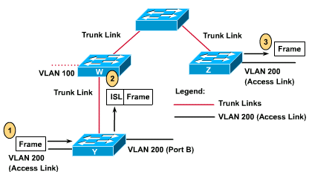
Access and Trunk Links

Slide 54
Access Links
An access link is a link on the switch that is a member of only one VLAN.
This VLAN is referred to as the native VLAN of the port.
Any device that is attached to the port is completely unaware that a VLAN exists.

Slide 55
Trunk Links
A trunk link is capable of supporting multiple VLANs.
Trunk links are typically used to connect switches to other switches or routers.
Switches support trunk links on both Fast Ethernet and Gigabit Ethernet ports.
Access and trunk links exist, too

Slide 56
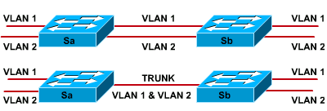
Trunk Links
Without trunking
With trunking
A trunk is a point-to-point link that supports several VLANs
A trunk is to saves ports when creating a link between two devices implementing VLANs

Slide 57
Trunk Links
A trunk link does not belong to a specific VLAN.
Acts as a conduit for VLANs between switches and routers.
The trunk link can be configured to transport all VLANs or to transport a limited number of VLANs.
A trunk link may, however, have a native VLAN.
The native VLAN of the trunk is the VLAN that the trunk uses if the trunk link fails for any reason.

Slide 58
Configuration in Switch 29xx
The following guidelines must be followed when configuring VLANs on Cisco 29xx switches:
The maximum number of VLANs is switch dependent.
VLAN 1 is one of the factory-default VLANs.
VLAN 1 is the default Ethernet VLAN.
Cisco Discovery Protocol (CDP) and VLAN Trunking Protocol (VTP) advertisements are sent on VLAN 1.
The Catalyst 29xx IP address is in the VLAN 1 broadcast domain by default.

Slide 59
VLAN Configuration
Step1: The steps necessary to create the VLAN. A VLAN name may also be configured, if necessary.
Switch# vlan database Switch(vlan)# vlan vlan_number Switch(vlan)# exit
Step2: Assign the VLAN to one or more interfaces:
Switch(config)# interface fastethernet 0/9 Switch(config-if)# switchport access vlan vlan_number

Slide 60
Adding a VLAN Example
cat2950#vlan database
cat2950(vlan)#vlan 9 name switchlab90
VLAN 9 added:
Name: switchlab90
cat2950(vlan)#?
VLAN database editing buffer manipulation commands:
abort Exit mode without applying the changes
apply Apply current changes and bump revision number
exit Apply changes, bump revision number, and exit mode
reset Abandon current changes and reread current database
cat2950(config)#interface fa 0/2
cat2950(config-if)# switchport access vlan 9

Slide 61
Verifying a VLAN
Switch# show vlan [vlanid]
cat2950#sh vlan
VLAN Name Status Ports
---- ------------------------ ------------ ------------
Default active Fa0/1, Fa0/3
9 switchlab90 active Fa0/2
1002 fddi-default active
1003 token-ring-default active
1004 fddinet-default active
1005 trnet-default active
Notes:
Layer 1 of 2

Slide 62
Deleting VLANs
When a VLAN is deleted any ports assigned to that VLAN become inactive. The ports will, however, remain associated with the deleted VLAN until assigned to a new VLAN.
switch(vlan)# no vlan vlanid [name vlan-name]
cat2950(vlan)#no vlan 9
Deleting VLAN 9...
cat2950(vlan)#exit
APPLY completed.
Exiting....
cat2950#

Slide 63
Table of Contents
Switching
The Spanning-Tree Protocol
VLAN
Introduction of VLAN
VLAN Architecture
VLAN Implementation
Routing Between VLANs

Slide 64
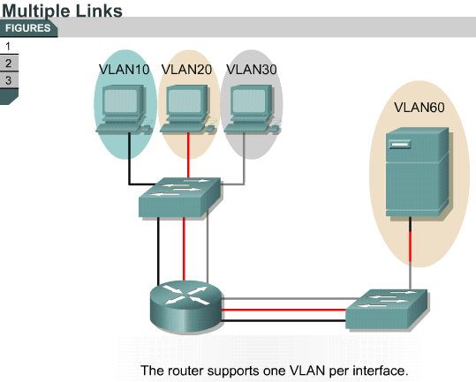
Routing Between VLANs

Slide 65
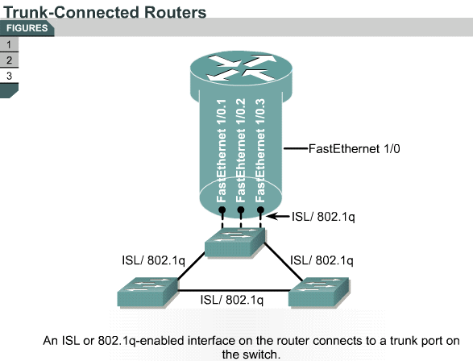
Routing Between VLANs

Slide 66
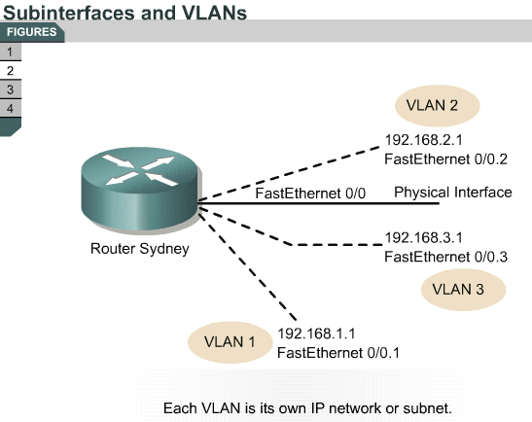
Subinterfaces

Slide 67
Configuring Inter-VLAN Routing
Step1: Identify the interface.
Router(config)#interface fastethernet port-number. subinterface-number
Step2: Define the VLAN encapsulation.
Router(config-if)#encapsulation dot1q vlan-number
Step3: Assign an IP address to the interface
Router(config-if)#ip address ip-address subnet-mask

Slide 68
Configuring Inter-VLAN Routing
Sydney(config)#interface FastEthernet 0/0
Sydney(config-if)#full duplex
Sydney(config-if)#no shut
Sydney(config-if)#interface FastEthernet 0/0.1
Sydney(config-subif)#encapsulation 802.1q 1
Sydney(config-subif)#ip address 192.168.1.1 255.255.255.0
Sydney(config-if)#interface FastEthernet 0/0.2
Sydney(config-subif)#encapsulation 802.1q 20
Sydney(config-subif)#ip address 192.168.2.1 255.255.255.0
Sydney(config-if)#interface FastEthernet 0/0.3
Sydney(config-subif)#encapsulation 802.1q 30
Sydney(config-subif)#ip address 192.168.3.1 255.255.255.0

Slide 69


谢 谢！

