Slide 1

Week III
Introduction of HTML

Slide 2
Computer programming
is the process that professionals use to write code that instructs how a computer, application or software program performs. At its most basic, computer programming is a set of instructions to facilitate specific actions.
Notes:
Computer programming languages allow us to give instructions to a computer in a language the computer understands. Just as many human-based languages exist, there are an array of computer programming languages that programmers can use to communicate with a computer.

Slide 3

What Is Coding and What Is It Used For?
Coding acts as a translator. Code converts human input into numerical sequences that computers understand. Once computers receive these messages, they complete assigned tasks such as changing font colors or centering an image.
Notes:
Electronic devices like cell phones, laptops, and tablets require code to function properly. Coding allows humans to communicate with these devices. Modern technology such as traffic lights, calculators, smart TVs, and cars use internal coding systems.
Since computers do not communicate like humans, coding acts as a translator. Code converts human input into numerical sequences that computers understand. Once computers receive these messages, they complete assigned tasks such as changing font colors or centering an image.

Slide 4

How Does Coding Work?
Computer programming languages, developed through a series of numerical or alphabetic codes, instruct machines to complete specific actions. Computer coding functions much like a manual.
Notes:
A programmer or developer writes instructions describing the information and tasks needed to create a visual or to perform a task. Computers scan extensive coded manuals very quickly, executing the tasks that create and run a successful website or application. Displaying an image or section of text, changing font styles, and opening emails all require instructions included in the coded manua

Slide 5
Users interact with websites and apps with the help of these coded instructions. The code itself does not show up on the screen. Instead, people see the words and images a developer or programmer asks the computer to display.
Coding tells a machine which actions to perform and how to complete tasks. Programming languages provide the rules for building websites, apps, and other computer-based technologies. Each programming language helps humans accurately communicate with machines.

Slide 6
What is Coding Used For?
Developers use a variety of programming languages to build websites and applications. Front-end developers typically use HTML, CSS, or JavaScript code to create website layouts and design functions.
Websites with user accounts, like Facebook, Instagram, or LinkedIn, require back-end developers to write computer code that connects websites to databases. Back-end developers often write code using languages such as SQL, Java, and Python.
Developers use other languages like Python, Objective-C, C#, Swift, or Ruby on Rails to create apps for cell phones and computer software.

Slide 7
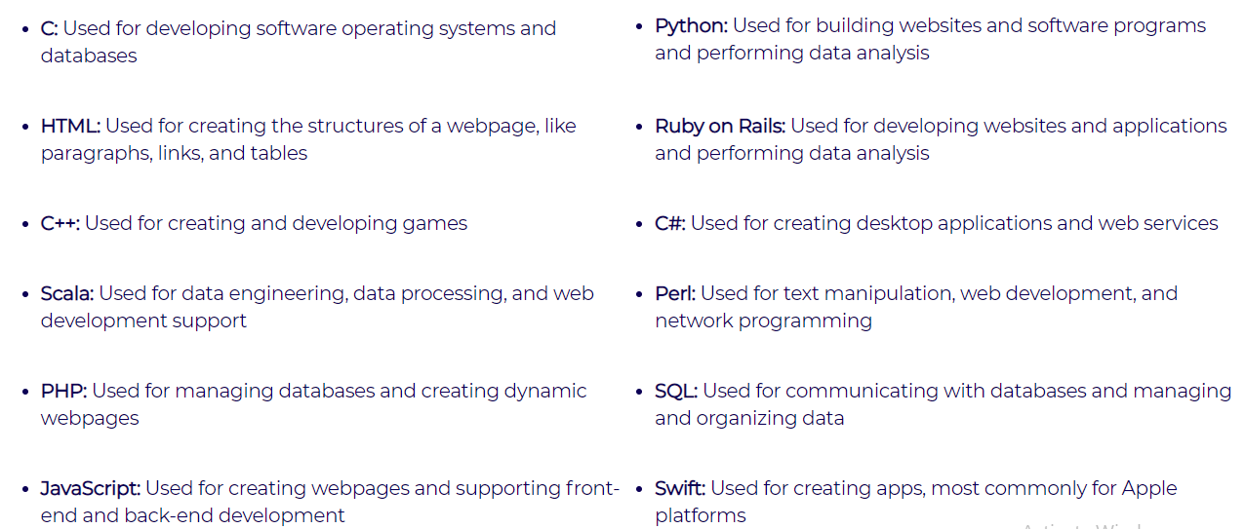

Slide 8

What is HTML?
HTML stands for Hyper Text Markup Language
HTML is the standard markup language for creating Web pages
HTML describes the structure of a Web page
HTML consists of a series of elements
HTML elements tell the browser how to display the content
HTML elements label pieces of content such as "this is a heading", "this is a paragraph", "this is a link", etc.

Slide 9
HTML Tags
<
>
HTML tags are like keywords which defines that how web browser will format and display the content. With the help of tags, a web browser can distinguish between an HTML content and a simple content. HTML tags contain three main parts: opening tag, content and closing tag. But some HTML tags are unclosed tags.

Slide 10
When a web browser reads an HTML document, browser reads it from top to bottom and left to right. HTML tags are used to create HTML documents and render their properties. Each HTML tags have different properties.
An HTML file must have some essential tags so that web browser can differentiate between a simple text and HTML text. You can use as many tags you want as per your code requirement.
All HTML tags must enclosed within < > these brackets.
Every tag in HTML perform different tasks.
If you have used an open tag <tag>, then you must use a close tag </tag> (except some tags)

Slide 11
What is an HTML Element?
An HTML element is defined by a start tag, some content, and an end tag:
<tagname>Content goes here...</tagname>
The HTML element is everything from the start tag to the end tag:
<h1>My First Heading</h1>
<p>My first paragraph.</p>

Slide 12
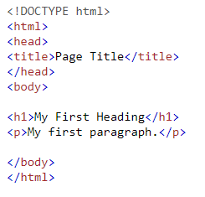
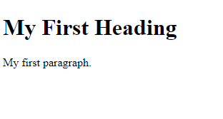
A Simple HTML Document

Slide 13
Example Explained
The <!DOCTYPE html> declaration defines that this document is an HTML5 document
The <html> element is the root element of an HTML page
The <head> element contains meta information about the HTML page
The <title> element specifies a title for the HTML page (which is shown in the browser's title bar or in the page's tab)
The <body> element defines the document's body, and is a container for all the visible contents, such as headings, paragraphs, images, hyperlinks, tables, lists, etc.
The <h1> element defines a large heading
The <p> element defines a paragraph

Slide 14
HTML Formatting Elements Formatting elements were designed to display special types of text:
<b> - Bold text
<strong> - Important text
<i> - Italic text
<u> underline text
<em> - Emphasized text
<mark> - Marked text( highlight)
<small> - Smaller text
<del> - Deleted text
<ins> - Inserted text
<sub> - Subscript text
<sup> - Superscript text

Slide 15
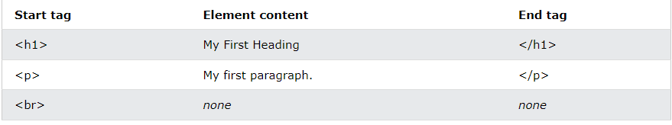
Note: Some HTML elements have no content (like the <br> element). These elements are called empty elements. Empty elements do not have an end tag!

Slide 16

Supported Browser
Note: You should always include the lang attribute inside the <html> tag, to declare the language of the Web page. This is meant to assist search engines and browsers.

Slide 17
HTML Attributes
HTML attributes provide additional information about HTML elements.
All HTML elements can have attributes
Attributes provide additional information about elements
Attributes are always specified in the start tag
Attributes usually come in name/value pairs like: name="value"

Slide 18
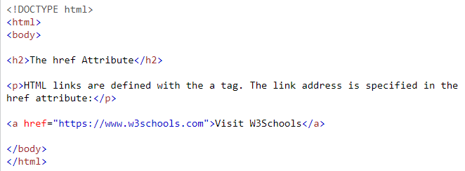
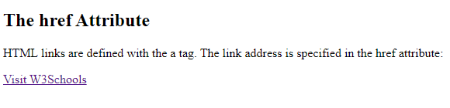
The href Attribute
The <a> tag defines a hyperlink. The href attribute specifies the URL of the page the link goes to:

Slide 19
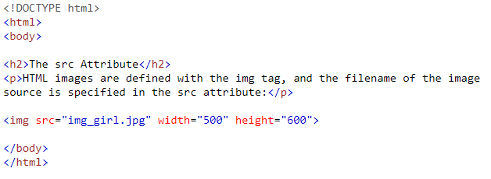
The src Attribute
The <img> tag is used to embed an image in an HTML page. The src attribute specifies the path to the image to be displayed:

Slide 20
There are two ways to specify the URL in the src attribute:
1. Absolute URL - Links to an external image that is hosted on another website. Example: src="https://www.w3schools.com/images/img_girl.jpg".
Notes: External images might be under copyright. If you do not get permission to use it, you may be in violation of copyright laws. In addition, you cannot control external images; it can suddenly be removed or changed.

Slide 21
There are two ways to specify the URL in the src attribute:
2. Relative URL - Links to an image that is hosted within the website. Here, the URL does not include the domain name. If the URL begins without a slash, it will be relative to the current page.
Example: src="img_girl.jpg". If the URL begins with a slash, it will be relative to the domain. Example: src="/images/img_girl.jpg".
Tip: It is almost always best to use relative URLs. They will not break if you change domain.

Slide 22
The width and height Attributes
The <img> tag should also contain the width and height attributes, which specifies the width and height of the image (in pixels):

Slide 23
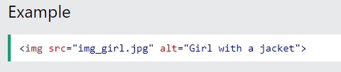
The alt Attribute
The required alt attribute for the <img> tag specifies an alternate text for an image, if the image for some reason cannot be displayed. This can be due to slow connection, or an error in the src attribute, or if the user uses a screen reader.

Slide 24
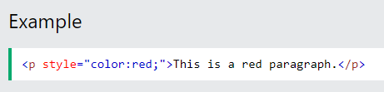
The style Attribute
The style attribute is used to add styles to an element, such as color, font, size, and more.

Slide 25
HTML Multimedia
Multimedia on the web is sound, music, videos, movies, and animations.
Multimedia Formats
Multimedia elements (like audio or video) are stored in media files.
The most common way to discover the type of a file, is to look at the file extension.
Multimedia files have formats and different extensions like: .wav, .mp3, .mp4, .mpg, .wmv, and .avi.
Notes:
Browser Support
The first web browsers had support for text only, limited to a single font in a single color.
Later came browsers with support for colors, fonts, images, and multimedia!

Slide 26
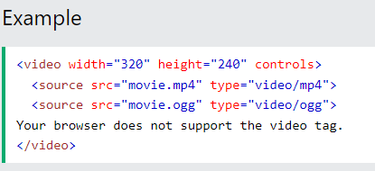
HTML Video
The HTML <video> element is used to show a video on a web page.
The HTML <video> Element
To show a video in HTML, use the <video> element:

Slide 27
How it Works
The controls attribute adds video controls, like play, pause, and volume.
It is a good idea to always include width and height attributes. If height and width are not set, the page might flicker while the video loads.
The <source> element allows you to specify alternative video files which the browser may choose from. The browser will use the first recognized format.
The text between the <video> and </video> tags will only be displayed in browsers that do not support the <video> element.

Slide 28
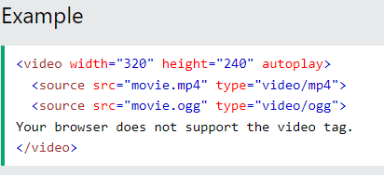
HTML <video> Autoplay
To start a video automatically, use the autoplay attribute:
Note: Chromium browsers do not allow autoplay in most cases. However, muted autoplay is always allowed.

Slide 29
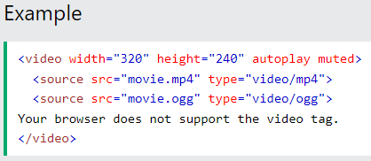
Add muted after autoplay to let your video start playing automatically (but muted):

Slide 30
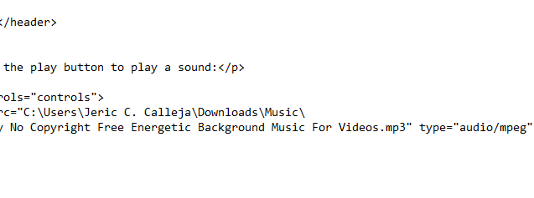
HTML Audio
The HTML <audio> element is used to play an audio file on a web page.

Slide 31
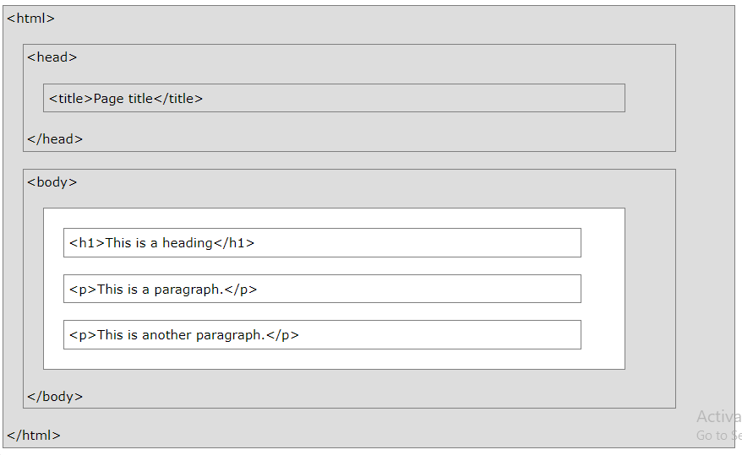
HTML Page Structure

Slide 32
Thank You

Slide 33
Reference
https://www.w3schools.com/html/

