Slide 1
PIBO REGISTRATION
REGISTRATION WALK THROUGH FOR PRODUCERS, IMPORTERS AND BRAND OWNERS

Slide 2
READINESS CHECKLIST FOR PIBOS
Prior to filling up Application form, it shall be ensured that Applicant is readily available with the following documents
in pdf/jpg/png file.
Additional documents for Brand Owner registration
Consents issued by SPCB/ PCC (if unit has a production facility)
Additional documents for Importer registration
IEC of the Company
Additional documents for Producer registration
Process flow diagram
Consents issued by SPCB/ PCC
Required Documents for PIBOs
PAN, GST, CIN of the Company
Aadhaar, PAN of Authorized person
DIC Registration (if unit registered with DIC)
Copy containing details of products (type and quantity) produced/marketed.
Representative Picture of packaging
Covering letter
Scanned copy of signatures of authorized persons.
Document regarding any other information which the unit wishes to provide.

Slide 3
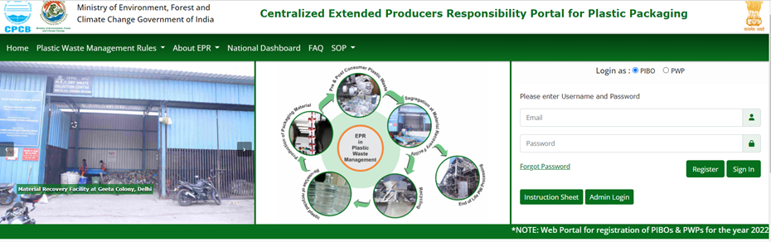
REGISTERING FOR SIGNUP – PIBO
Go to Centralized EPR Portal for Plastic Packaging (cpcbeprplastic.in) webpage for registration and then signup using the 'Register' option by filling your email and password.

Slide 4
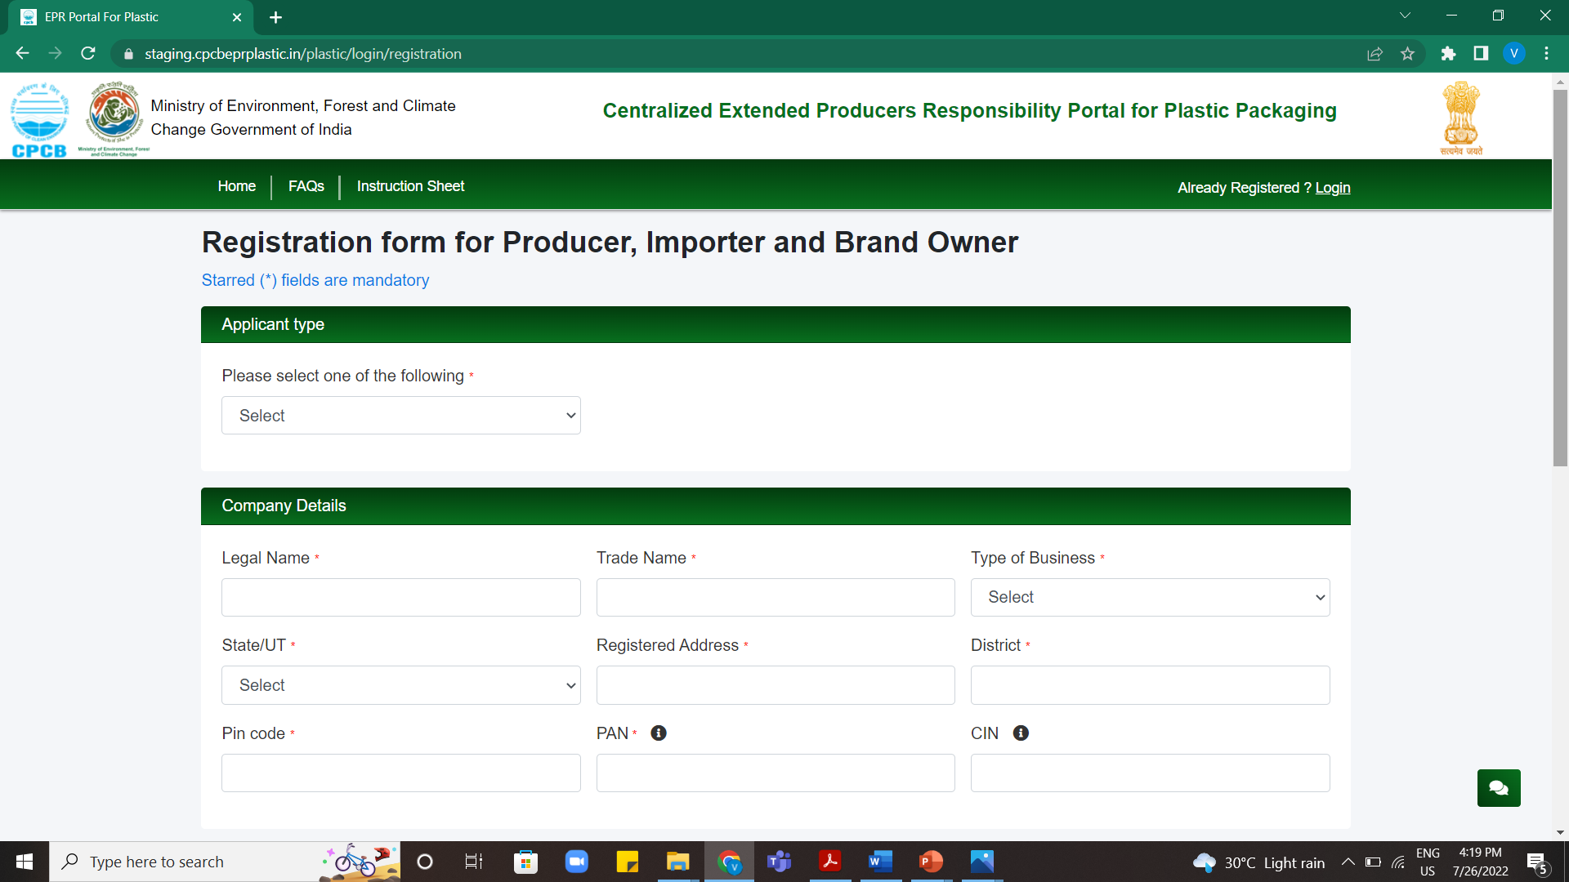
PIBO – REGISTRATION PAGE
Signup form for new registration opens up. Information about the applicant type, Company details, authorized person and login details are to be provided.

Slide 5
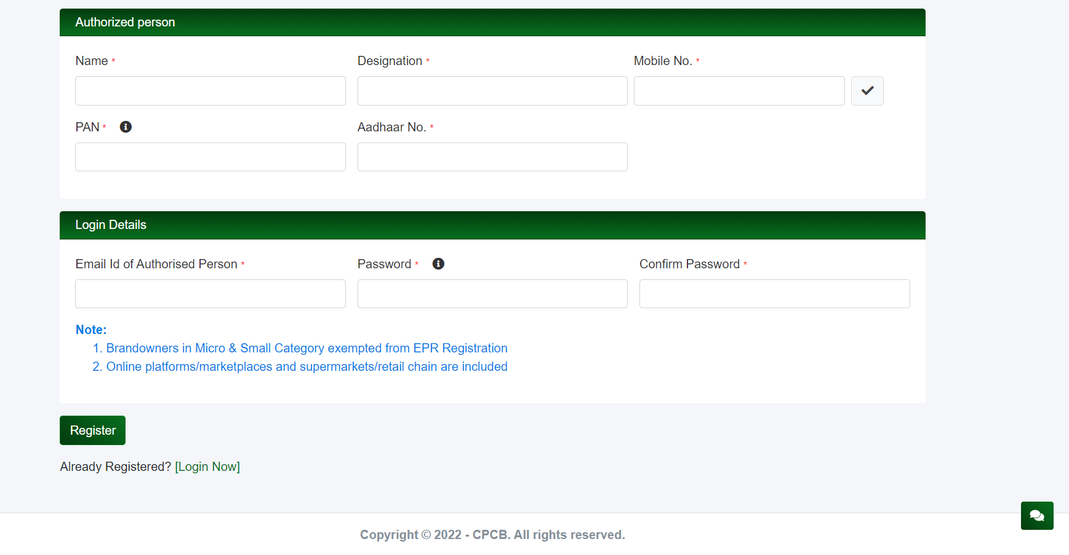
PIBOS – REGISTRATION PAGE
Signup form for new registration opens. Information about the applicant type, Company details, authorized person and login details are to be provided.

Slide 6
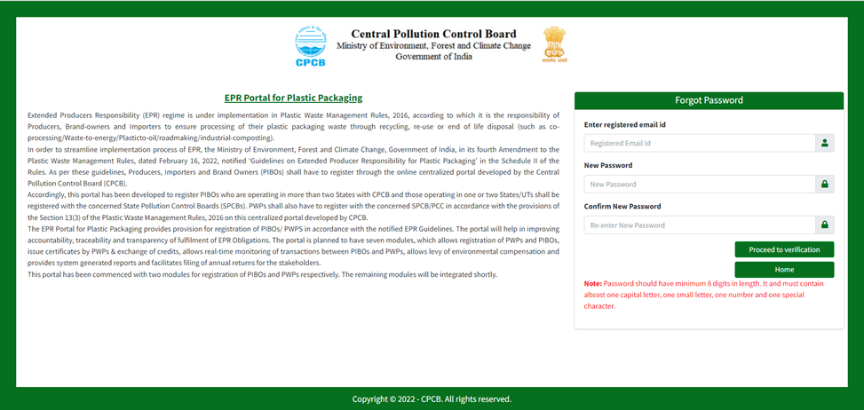
IN CASE YOU 'FORGOT PASSWORD'

Slide 7
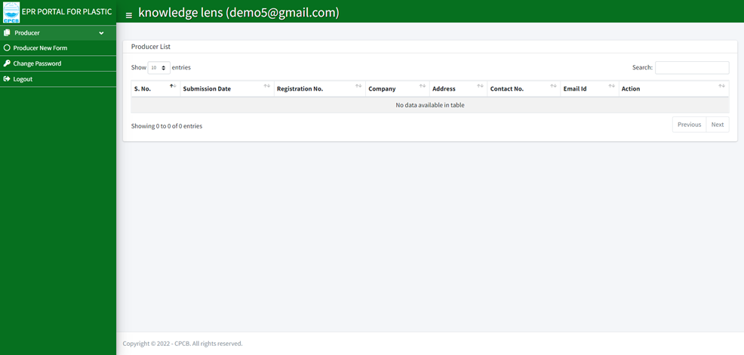
LOGIN - PRODUCER DASHBOARD
After login with new credentials, a new page displaying producer dashboard opens up. Fill in the details to get going once again.

Slide 8
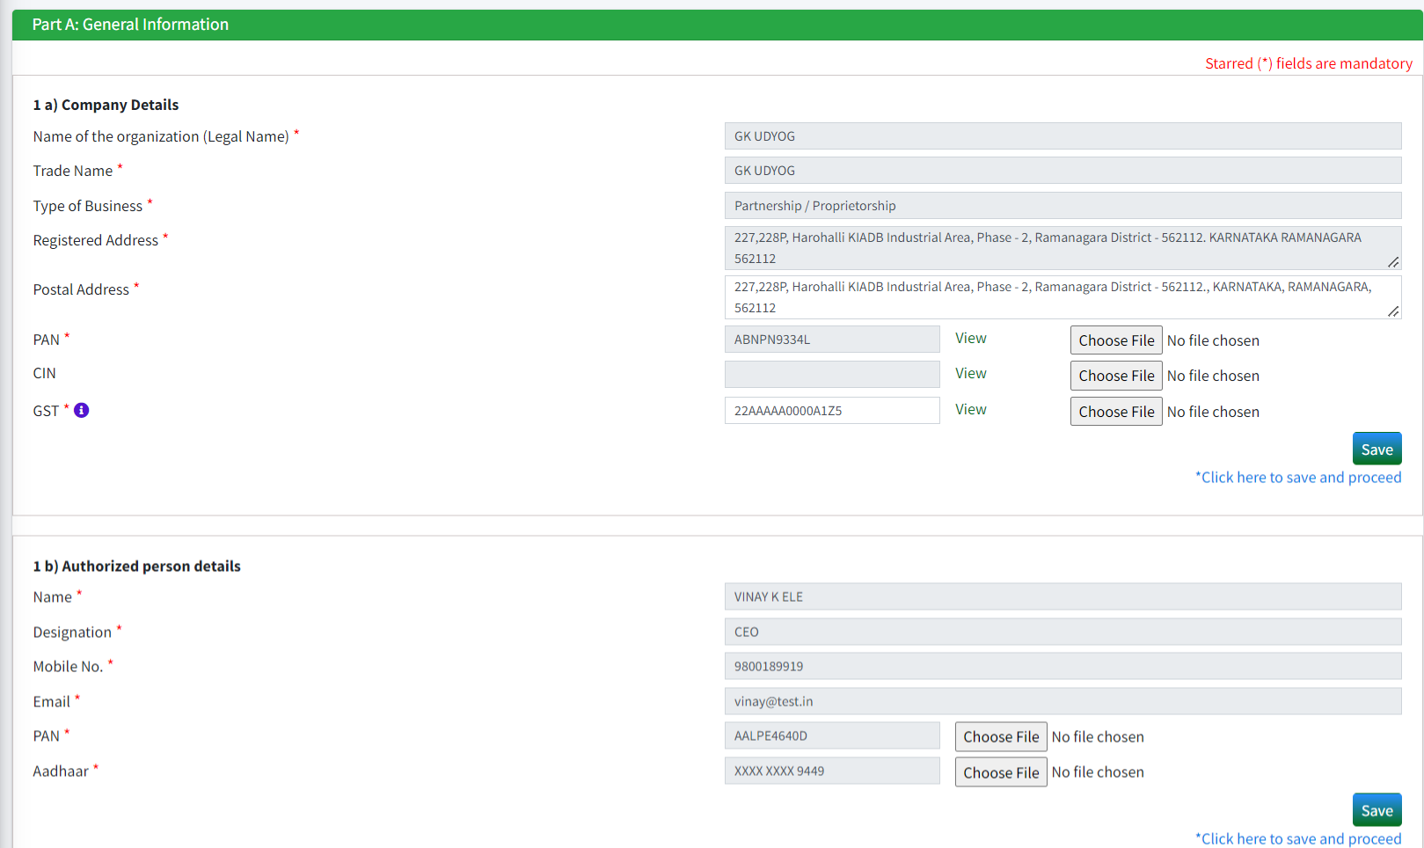
PRODUCER FORM
Part wise information is required to be entered.
Part A: General Information for Producer.
Note: All mandatory fields marked in red asterisk are to be filled in so that you can move forward. Make sure to save the section at each stage so that you do not lose any data.

Slide 9
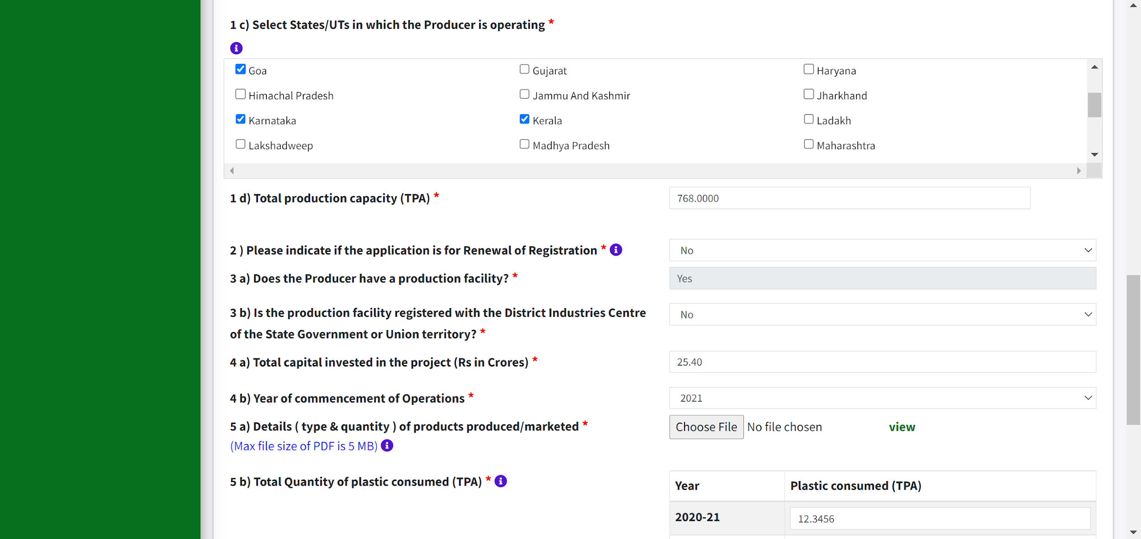
PRODUCER FORM
Part A: General Information for Producer. Please note that ​if you are operating (having Manufacturing units) out of 1 or 2 states then the application will be processed by the respective SPCBs. If you are operating in 3 or more states in the country, then the application will be processed by the CPCB.
Similarly, for Brand Owners and Importers if they are operating (selling) in 1 or 2 states then the application will be processed by the respective SPCBs. If you are operating in 3 or more states in the country, then the application will be processed by the CPCB

Slide 10
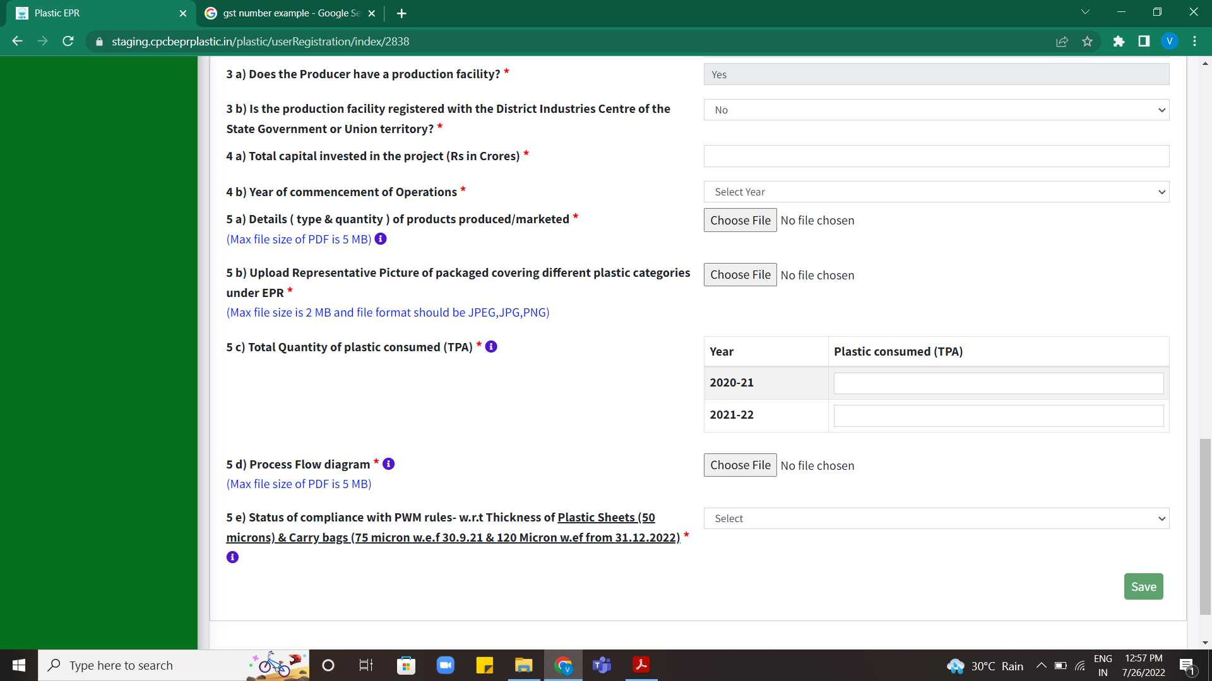
PRODUCER FORM
Part A: General Information for Producer.
Please note that if the year of commencement of operations is 2022, then 5(c) will be ZERO.
Note: All mandatory fields marked in red asterisk are to be filled in so that you can move forward. Make sure to save the section at each stage so that you do not lose any data.

Slide 11
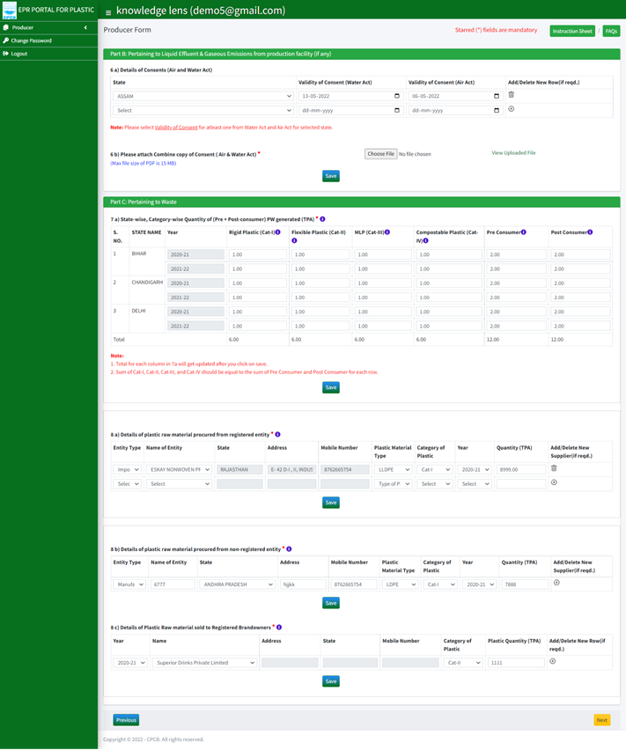
PRODUCER FORM
Part B & C: Pertaining to Liquid Effluent & Gaseous Emissions; category wise plastic waste information are required to be filled for each state where you have placed your product on the market.

Slide 12
PRODUCER FORM
Year-wise details of
plastic raw material procured from registered and non-registered entities are required to be filled

Slide 13
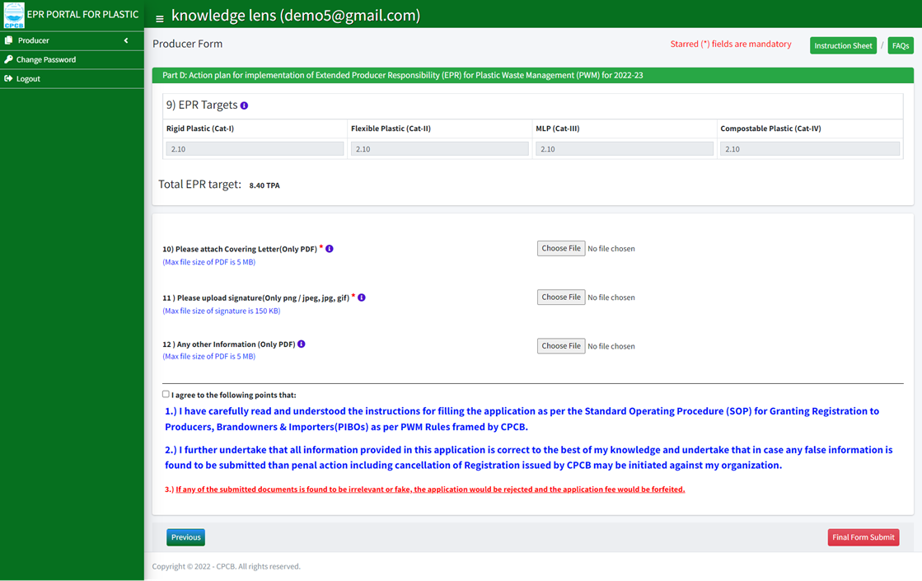
PRODUCER FORM
Information regarding action plan for implementation of Extended Producer Responsibility(EPR) for plastic waste management is required in Part D. Details include EPR targets, covering letter, signature and other information with agreement check box.

Slide 14
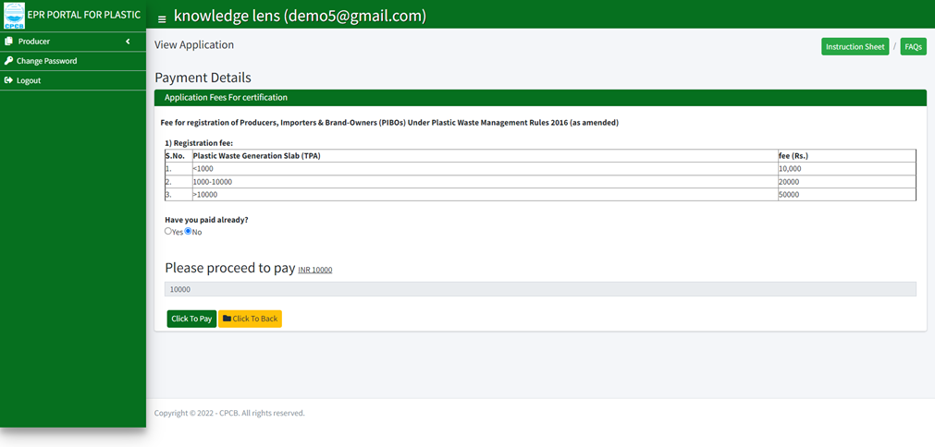
PRODUCER – PAYMENT PAGE
Payment of registration fees based on target for plastic waste channelization is to be made as application fee for certification

Slide 15
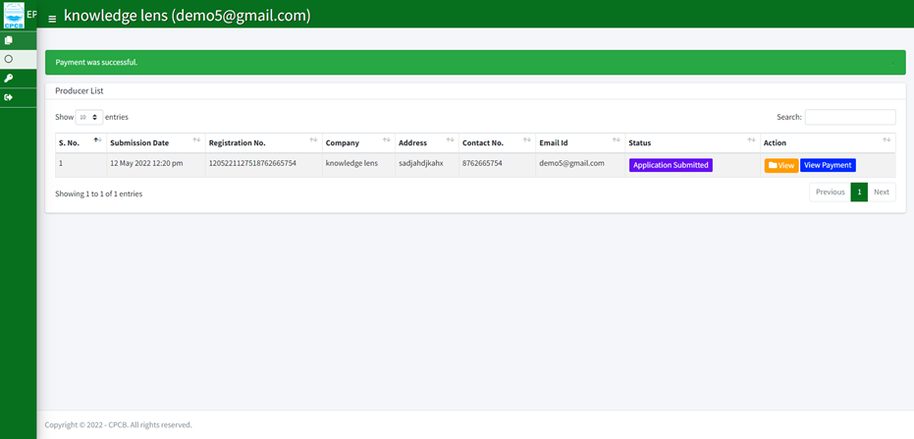
PRODUCER – AFTER PAYMENT DISPLAY PAGE
Once the payment is successful, dashboard displays the information with 'Application Submitted' and 'View Payment' details. All action being undertaken on the form and stage wise processing is displayed on the PIBO personal dashboard.

