Slide 1
PWP Registration
Registration walk through for plastic waste processors

Slide 2
READINESS CHECKLIST
Prior to filling up Application form, it shall be ensured that Applicant is readily available with the following documents
in pdf/jpg/png file.
PAN, GST, GIN of the Company
Aadhaar, PAN of Authorized person
Copy of registration if already registered with SPCBs.
Process flow diagram
Consents under Air/ Water Act & Authorization under HWM Rules issued by SPCB/PCC.
Geo-tagged pictures of raw material storage area, production area and product dispatch area
Geo-tagged pictures of plant machinery
Video link of the unit.
Copy of Electricity Bill
Copy of Analysis report of characterization of waste generated
Copy of documents giving Occupational safety and health aspects
Copy of document giving details of pollution control measures
Copy of onsite /offsite Disaster management plant
Document regarding any other information which the unit wishes to provide
Covering letter

Slide 3
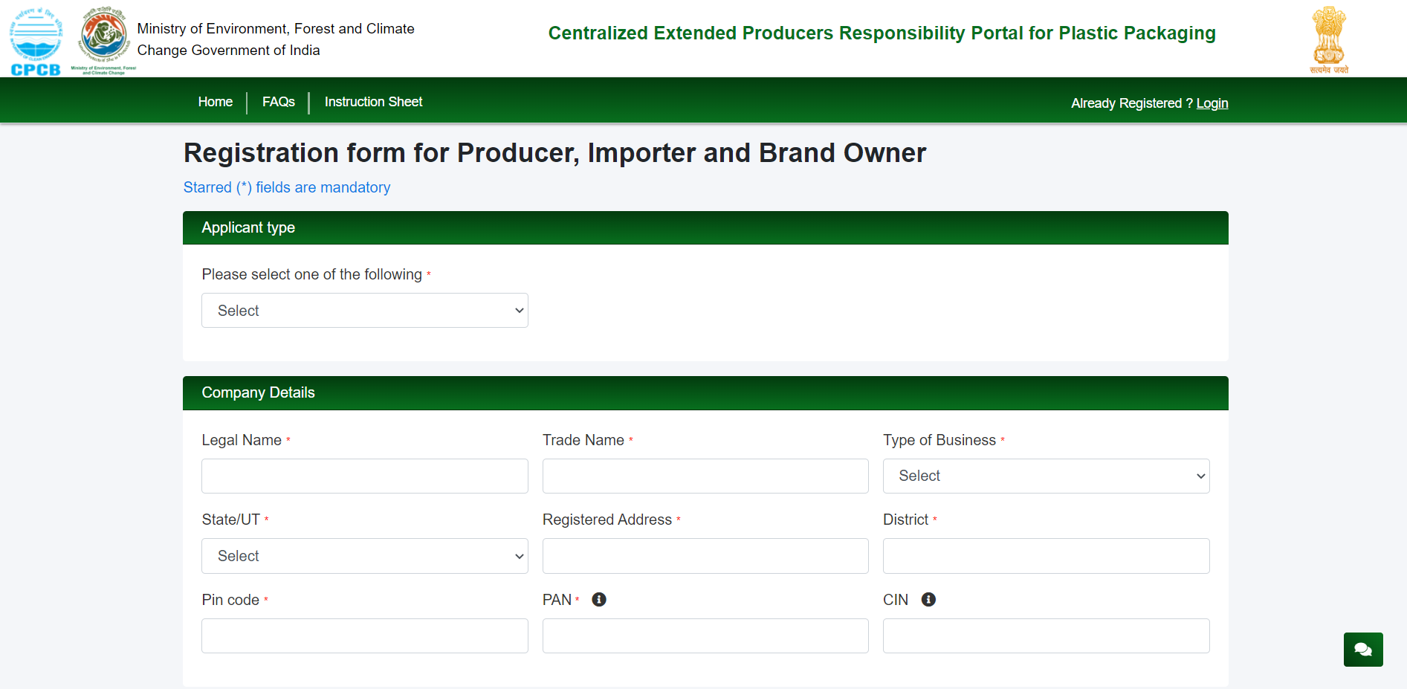
PWP Registration page
Signup form for new registration opens and process of login with information on company and authorized persons if to be shared. Create the login account during the registration process and once registered can proceed to the login page.

Slide 4
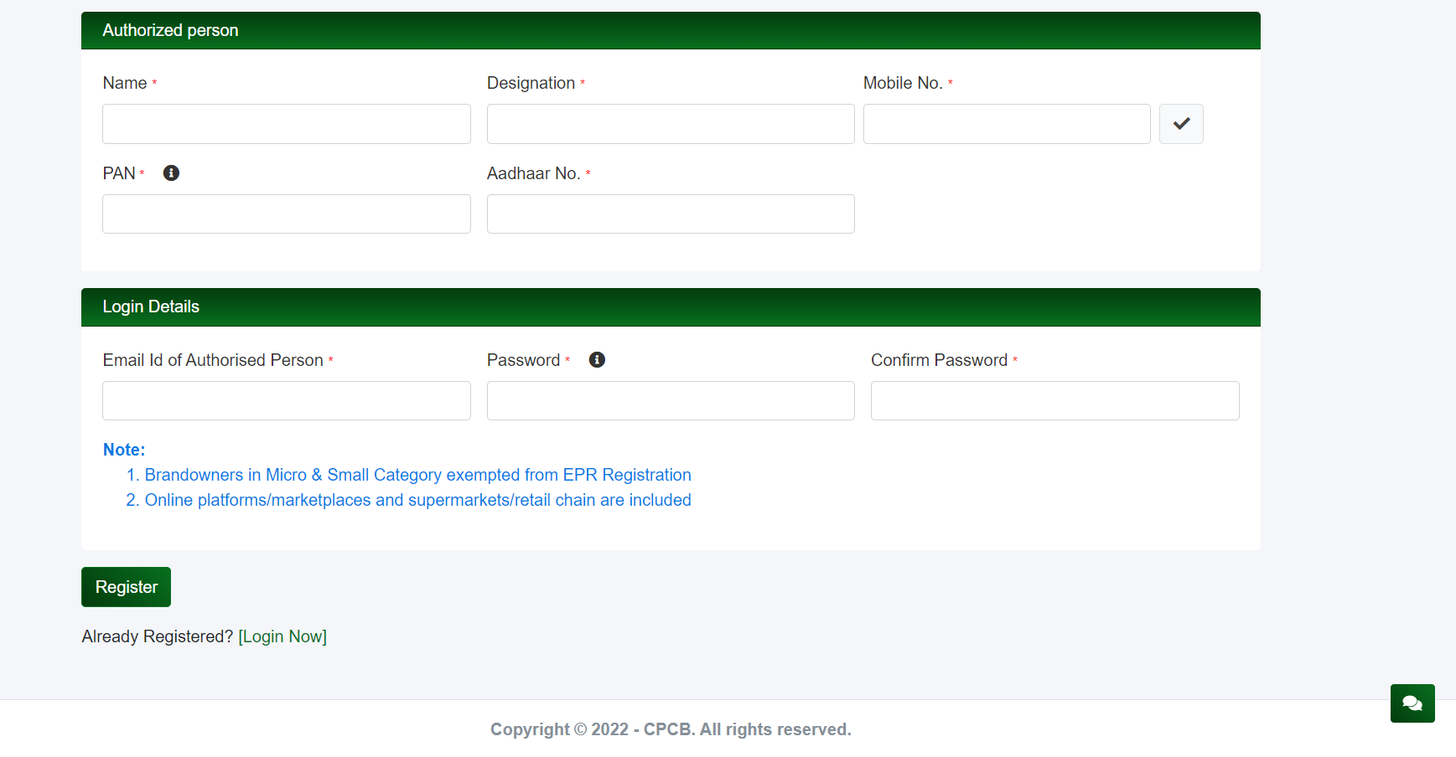
PWP Registration page
Signup form for new registration opens and process of login with information on company and authorized persons if to be shared. Create the login account during the registration process and once registered can proceed to the login page.

Slide 5
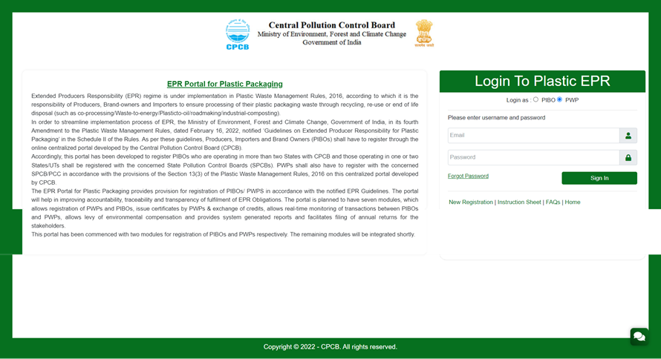
PWP – active selection for login
Login page for PWP with new signup details to be entered. In case you forget the password, please click on the link and follow the process to generate a new password. OTP authorization would be required so keep the registered mobile number handy to receive the SMS.

Slide 6
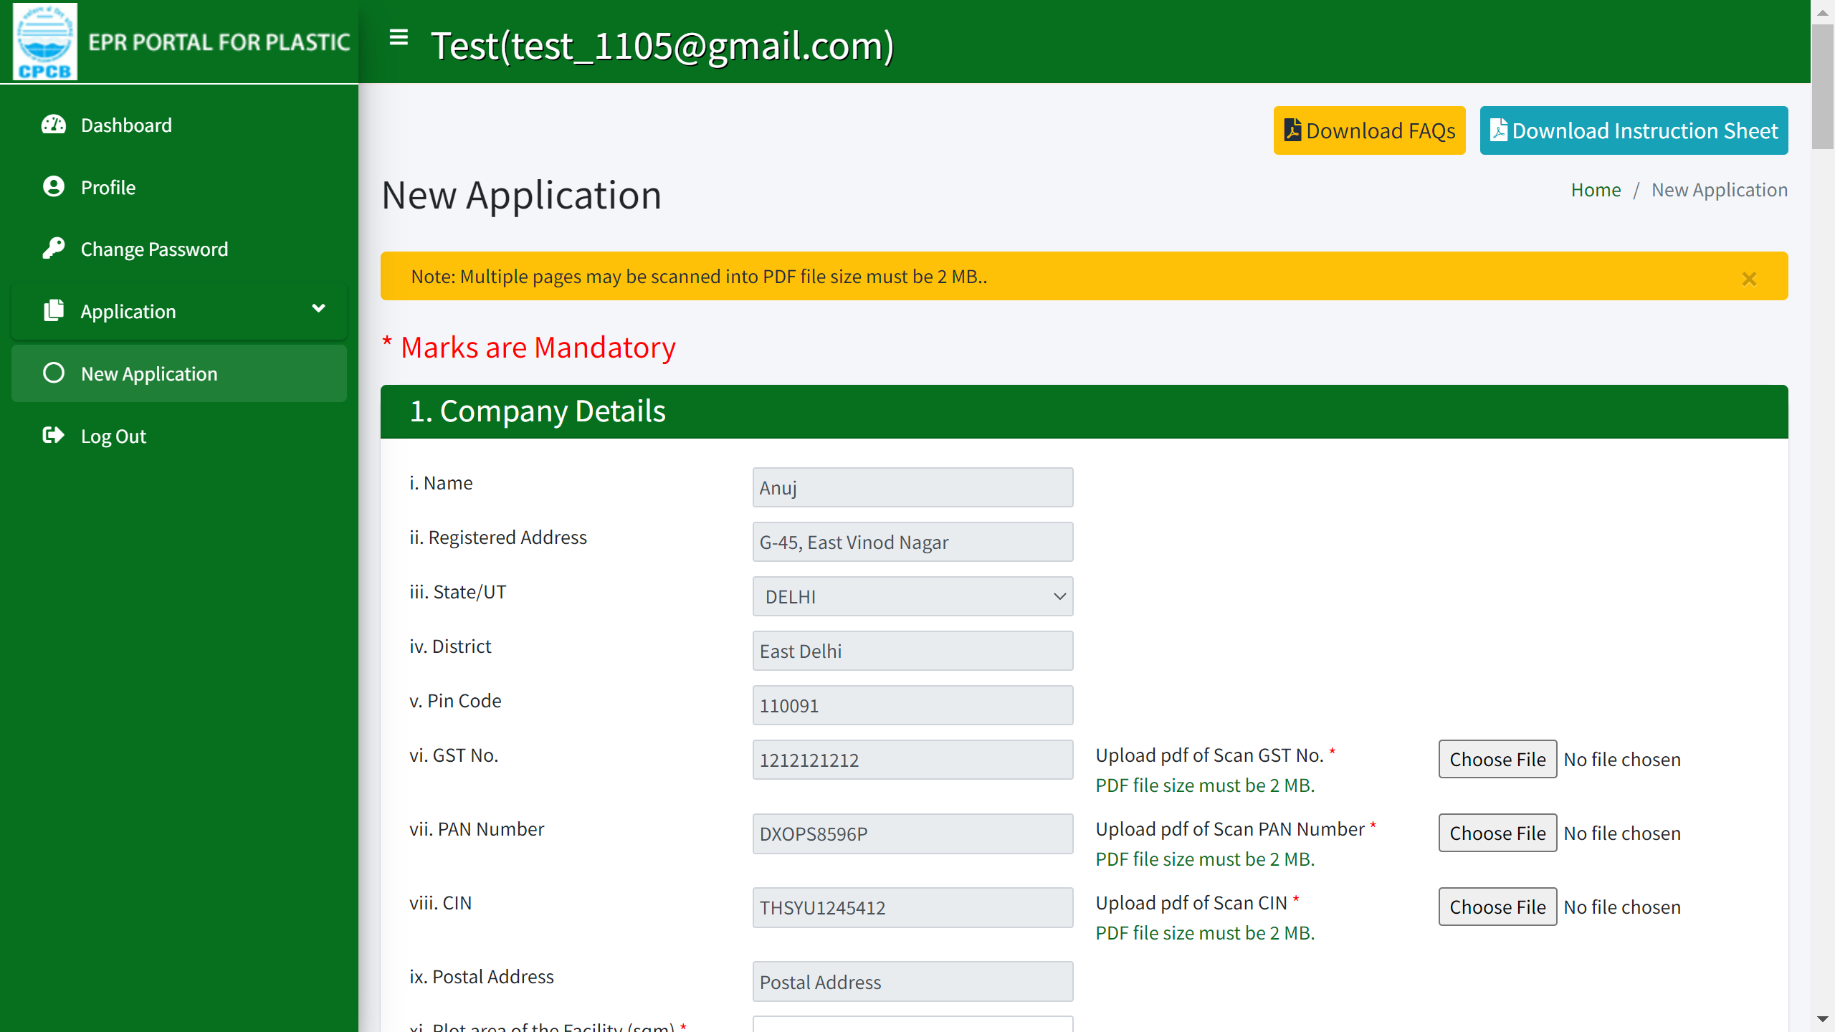
PWP Application
Company details are required to be filled in new application from the 'New Application' tab option. Documents required are GST, PAN and CIN.
All fields marked in red asterisk are mandatory. Please ensure that all data entered is true or else the application may be cancelled even at a later date.

Slide 7
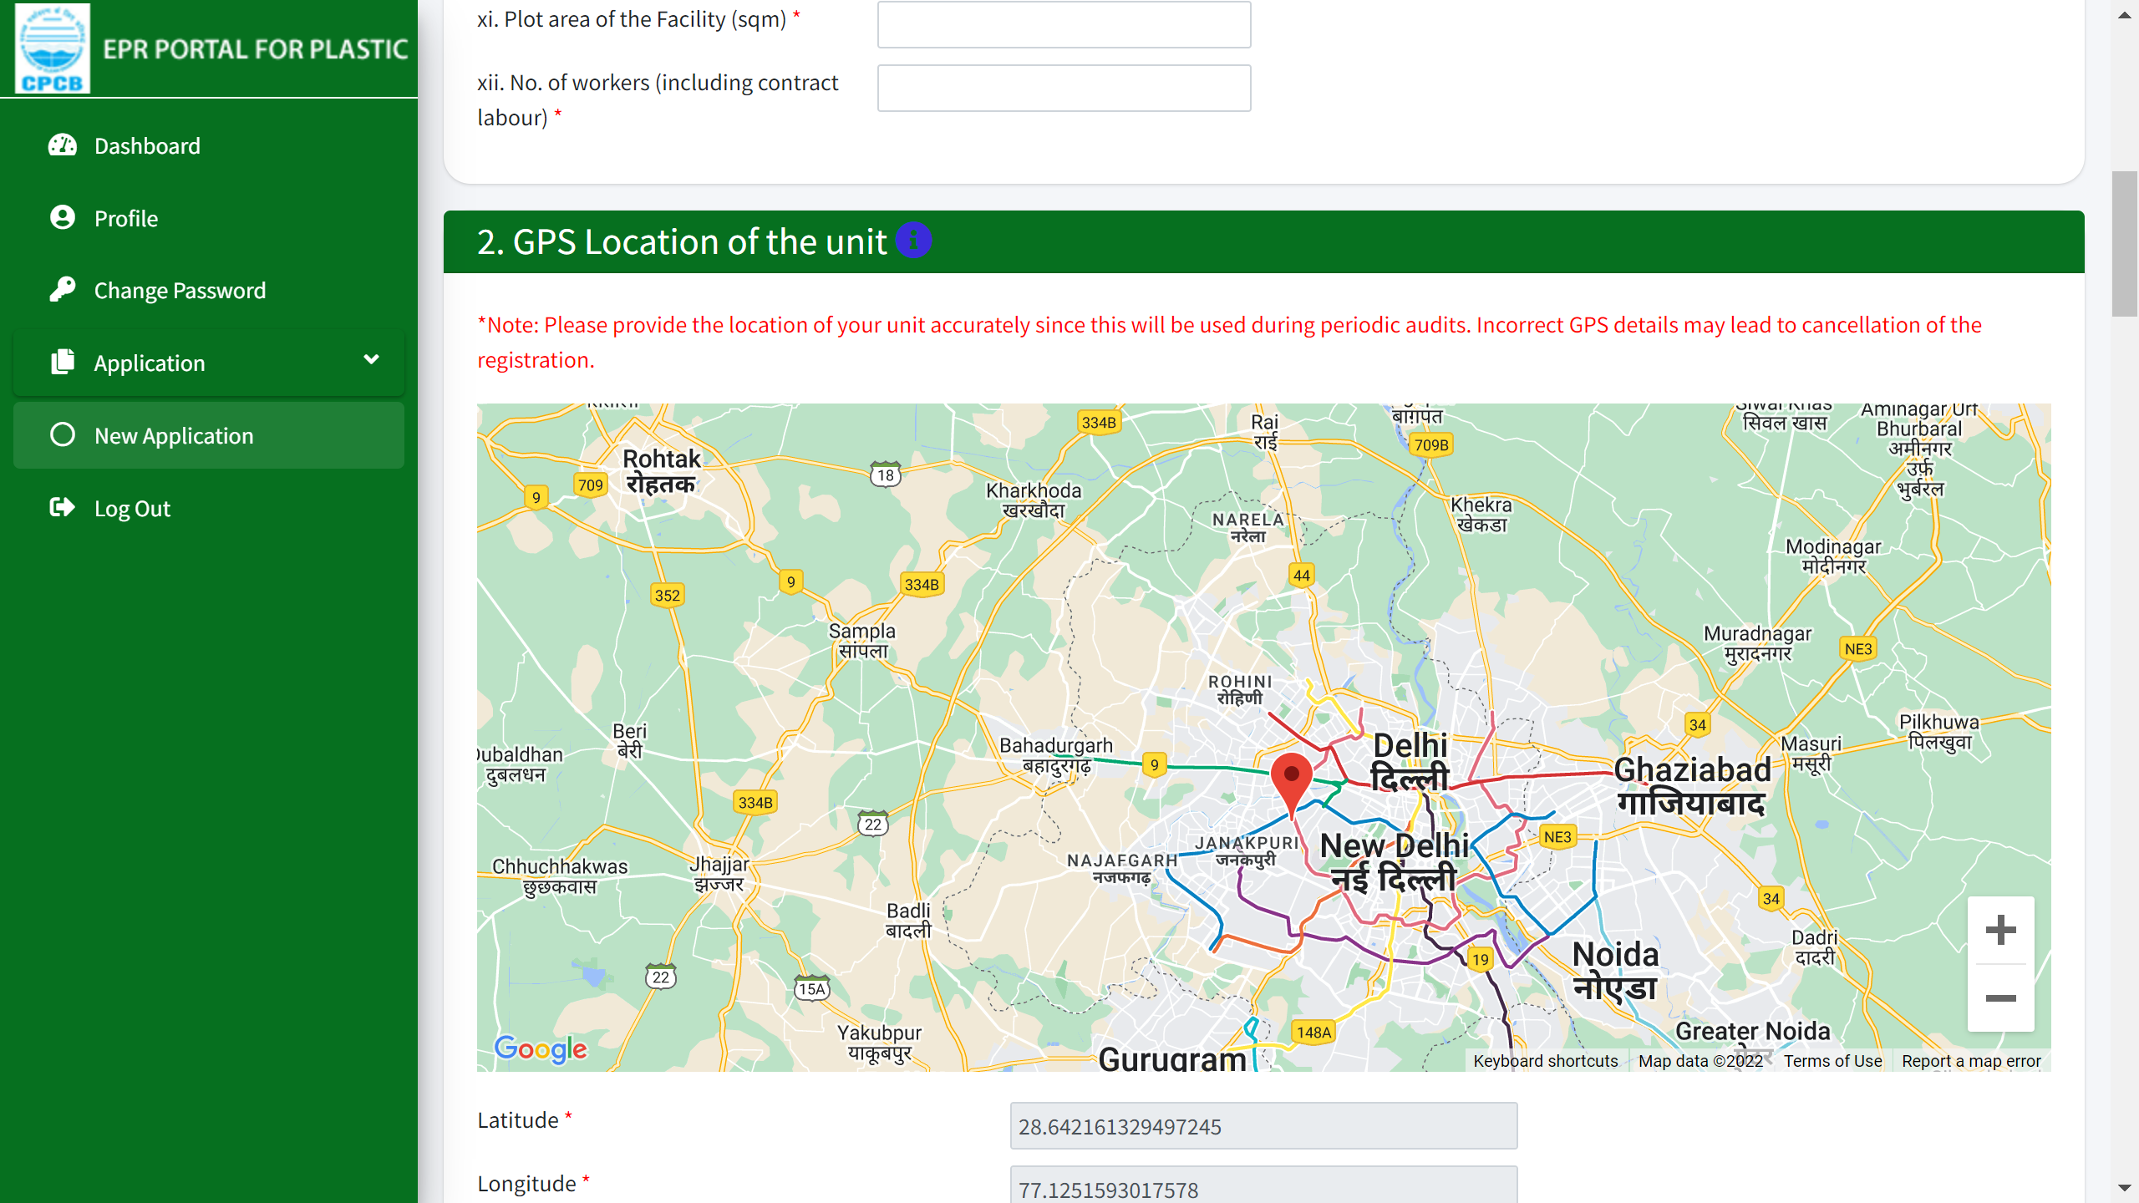
PWP Application
Precise location of the unit is required to be added using GPS selection in the map. You may move the locator on the map to get the exact location.
The Google map should be zoomed to the maximum possible resolution while marking the location.

Slide 8
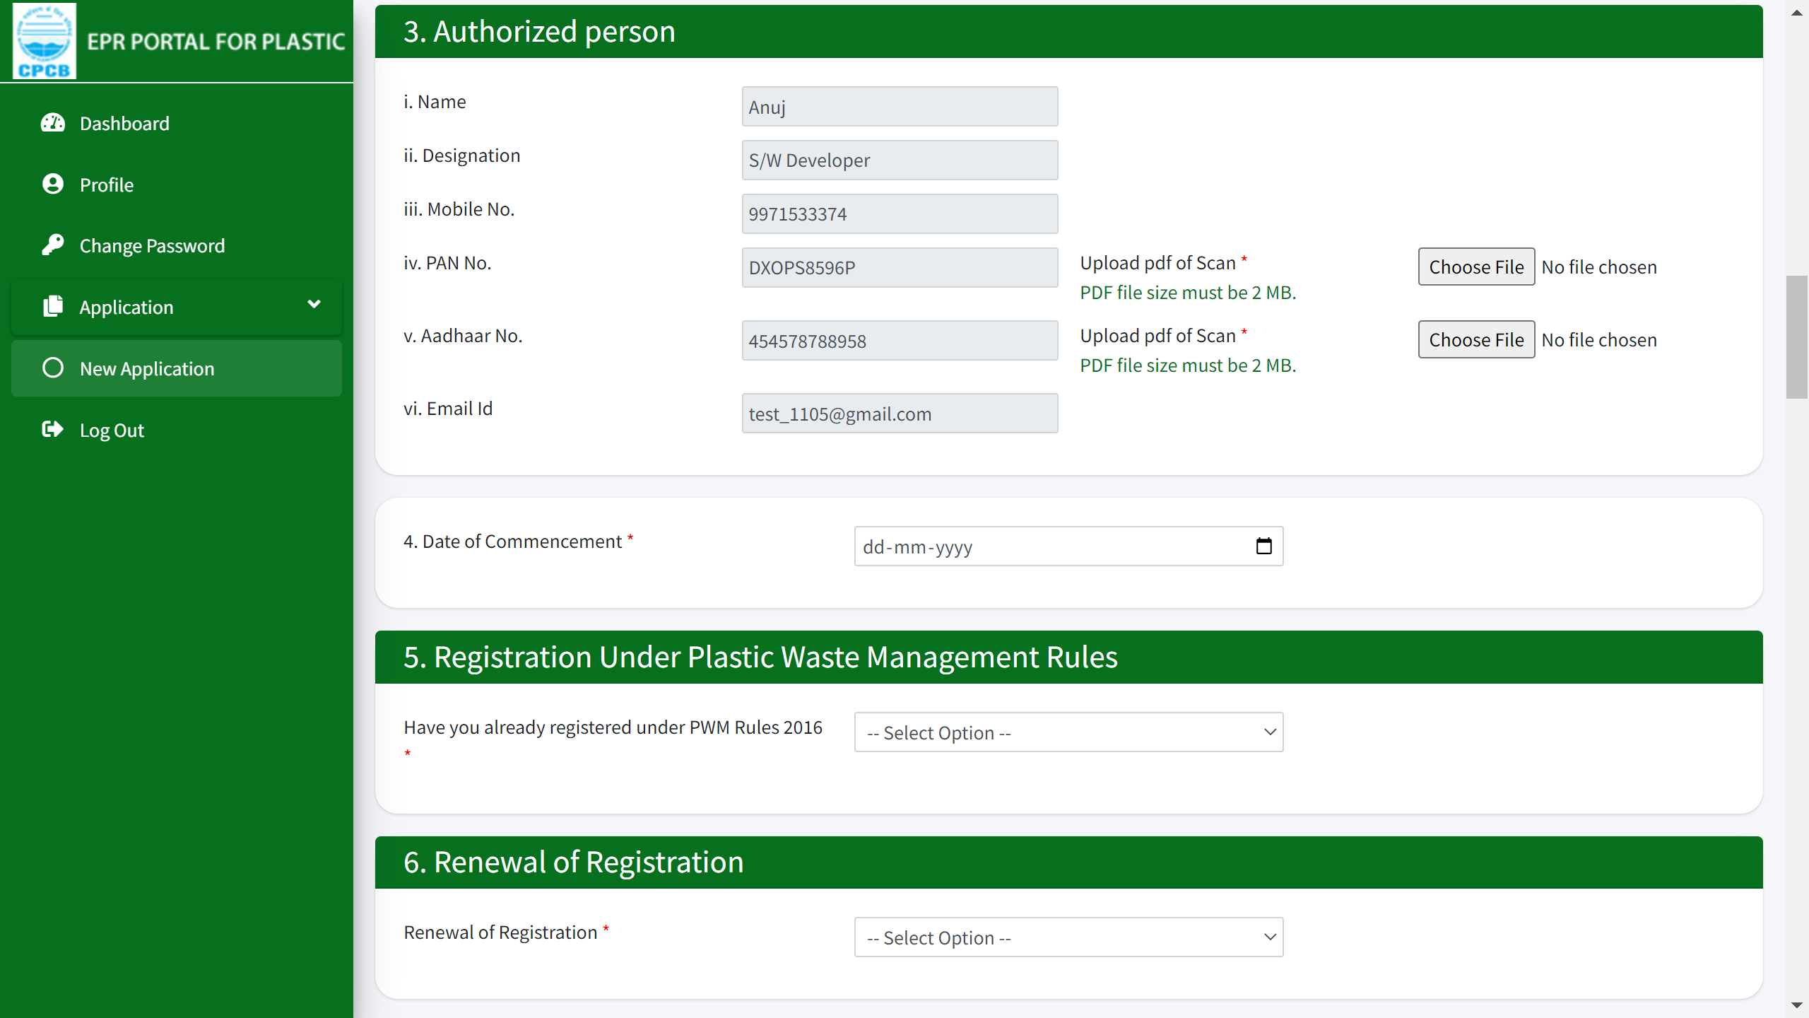
PWP Application
Authorized person details are required along with registration under PWM rules 2016 and the renewal of registration from 3-6.
PDF copy of the registration to be provided in case already registered with SPCBs in section 5.
PDF copy of old Registration to be provided in section 6.

Slide 9
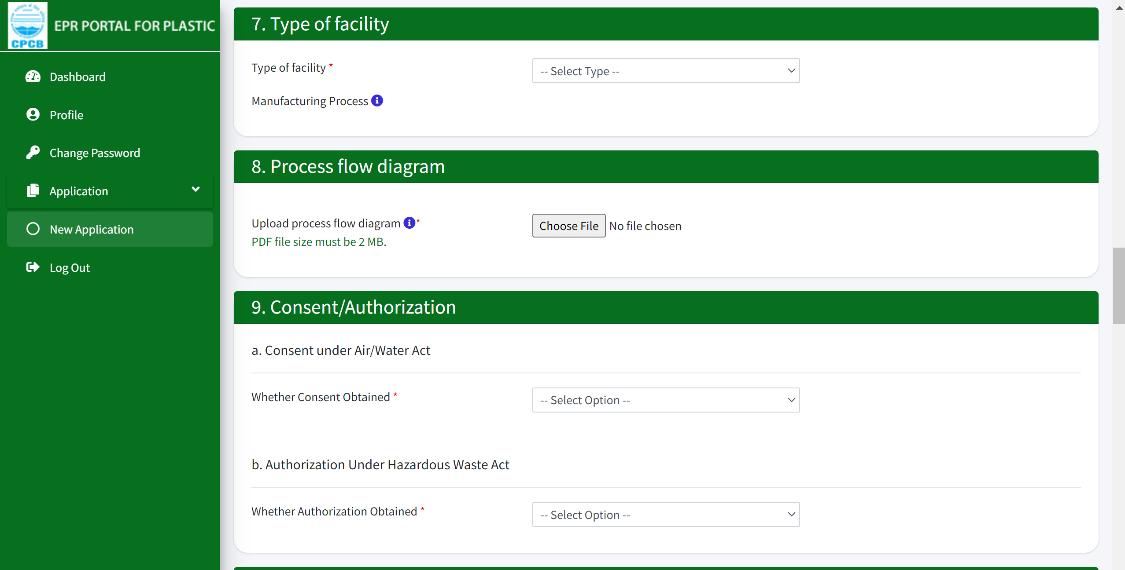
PWP Application
7-9: Type of facility, pdf file for process flow diagram, consents & authorization documents need to be submitted. Please note that the size of the files to be uploaded and the type are mentioned and have to be followed to complete the process.

Slide 10
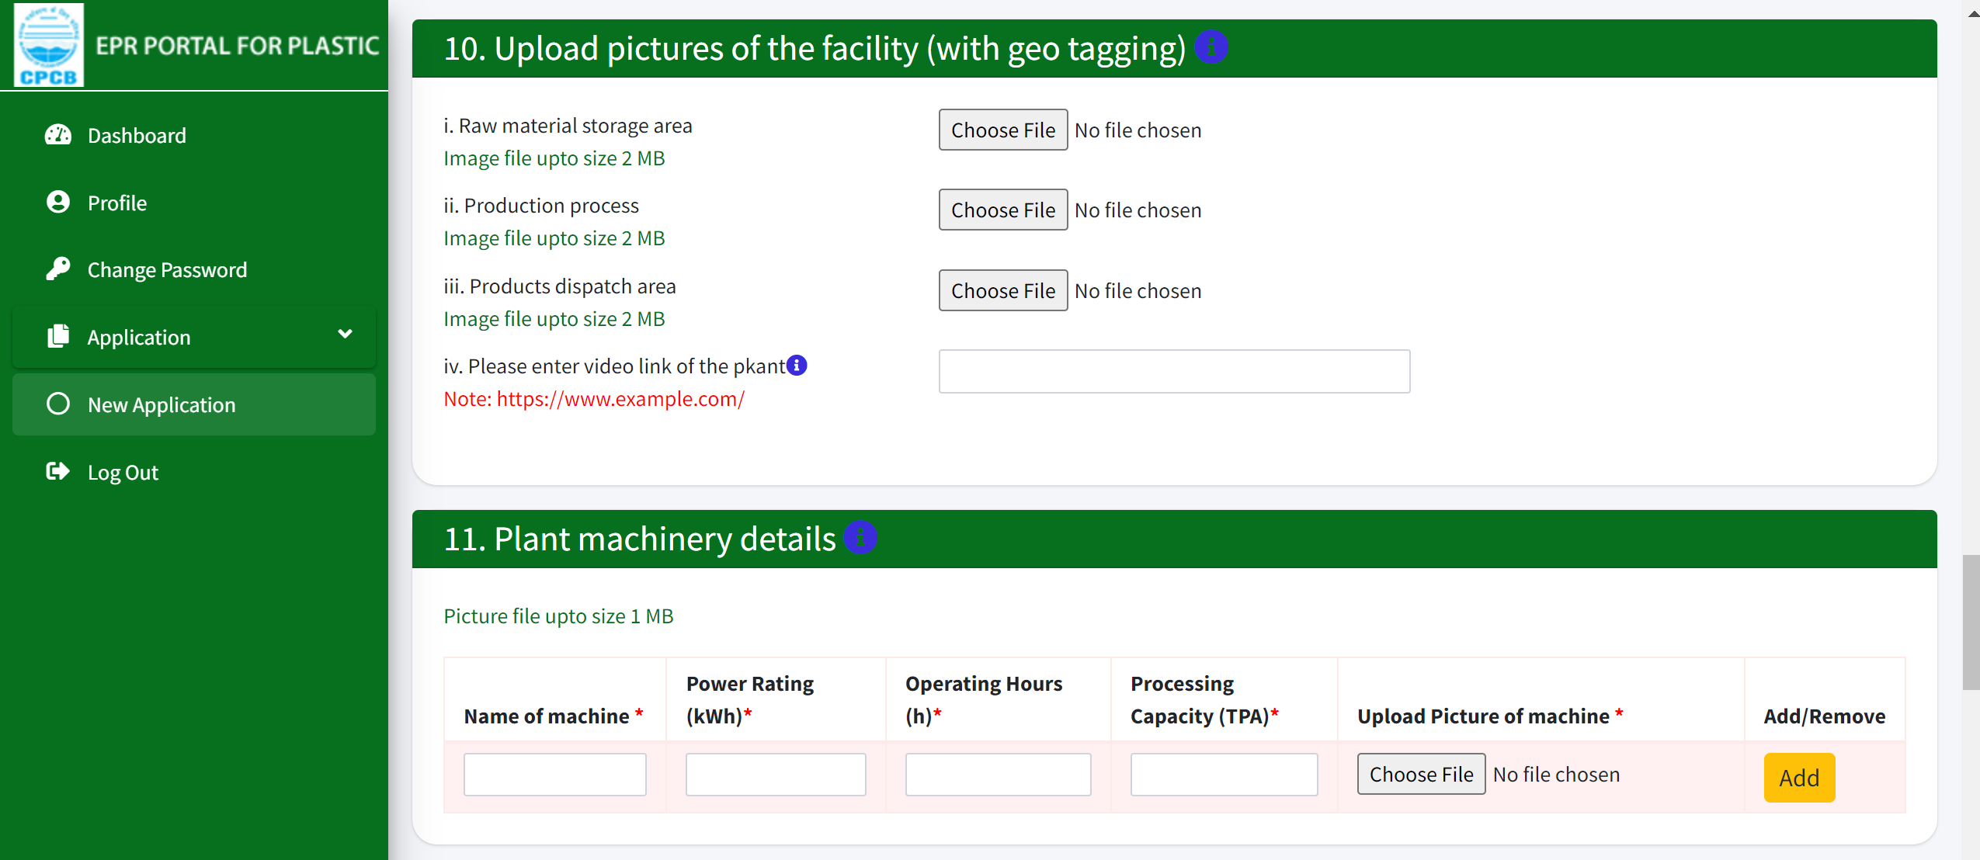
PWP Application
10 & 11: Pictures of the facility with geo-tagging are required to be uploaded process wise along with the plant video link. Plant machinery details are to be submitted with operational details.

Slide 11
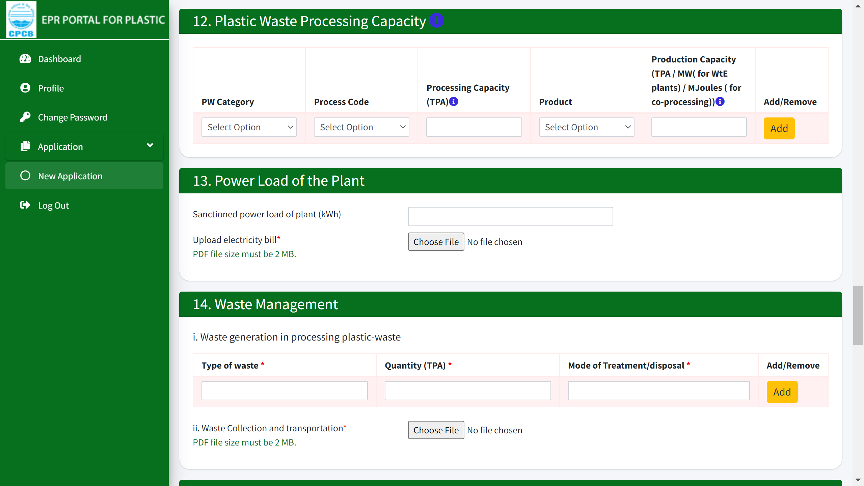
PWP Application
12-14: Plastic waste processing capacity and power load needs to be provided with uploading of documents. Waste management including mode of treatment needs to be entered in the fields of 14(I).

Slide 12
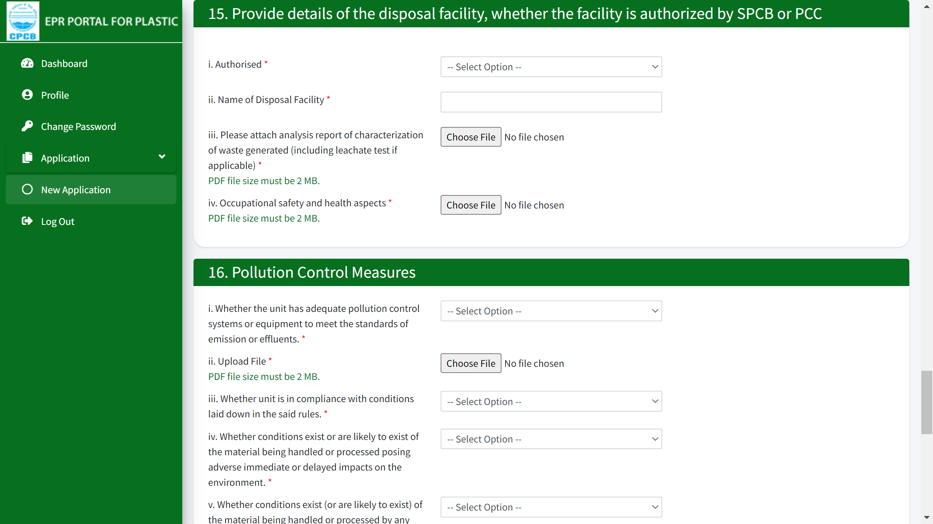
PWP Application
15 & 16: Details of facility and its authorization status is required to be submitted with waste characterization report. Pollution control measures with adequate systems meeting the standards need to be provided with document file.

Slide 13
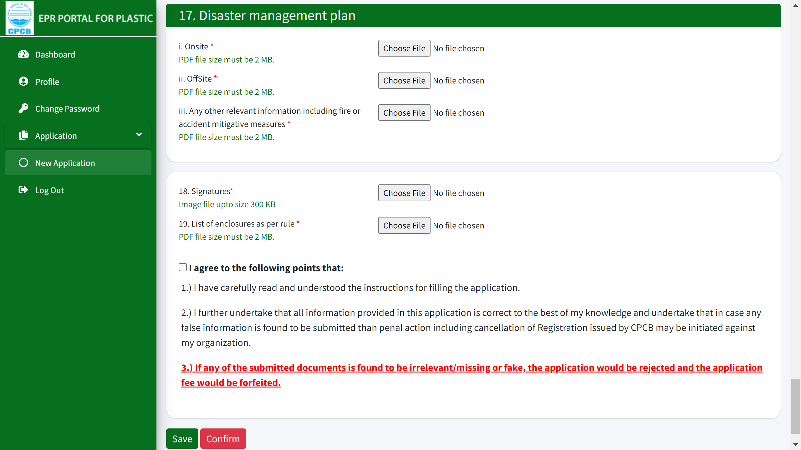
PWP Application
Disaster management plan needs to be submitted with documents to be uploaded for onsite and offsite status. Lastly, along with signature and agreement, form can be completed and saved.

Slide 14
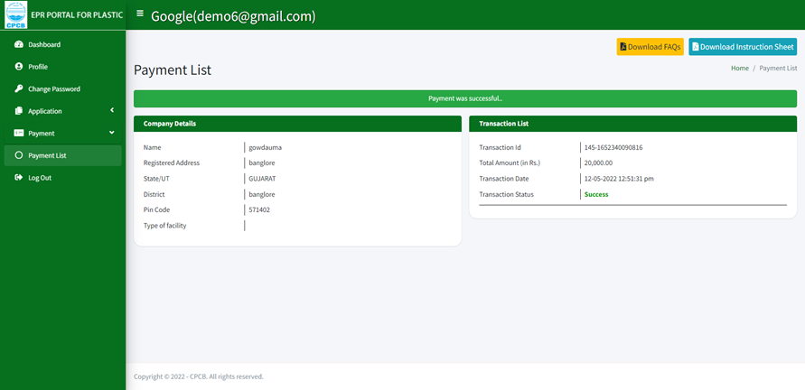
PWP - after payment display page
Display page upon successful payment in the 'Payment List' tab.

Slide 15
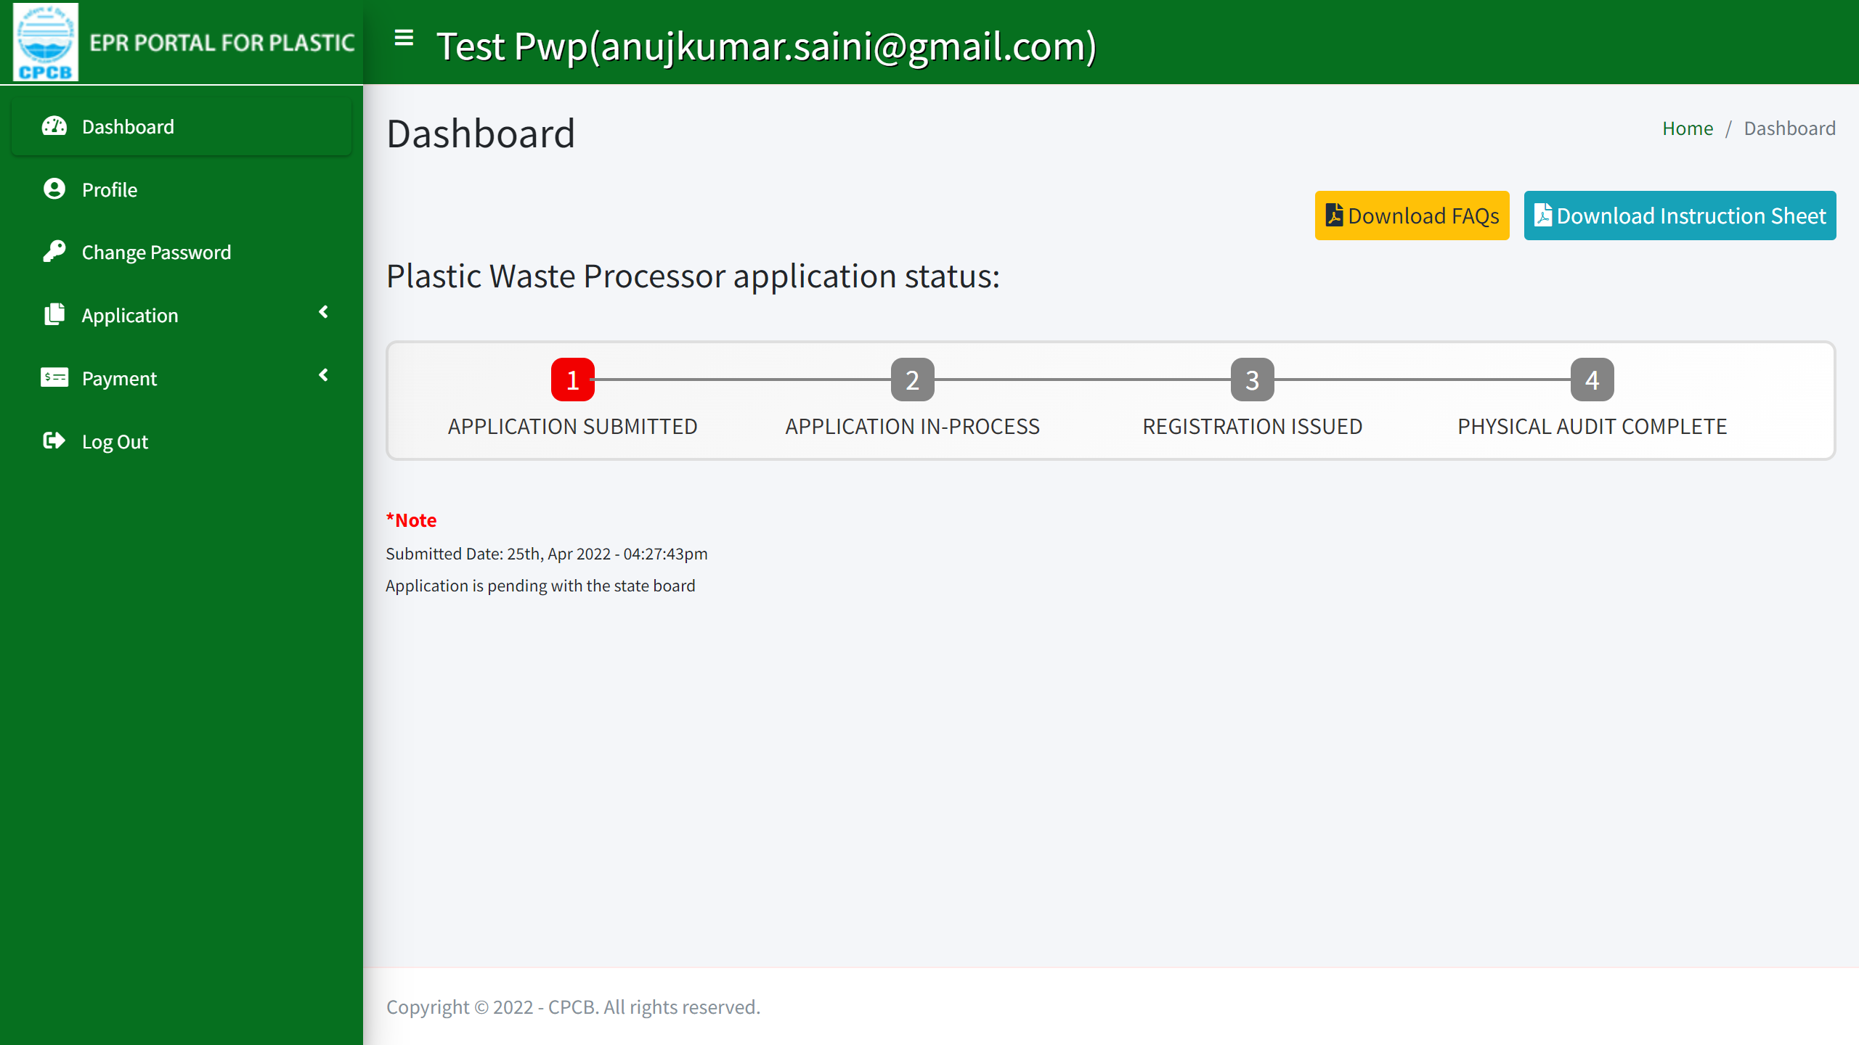
Submitted Application
Status of submitted application on the dashboard is displayed. This can be checked till the registration has been approved by the SPCB.

Slide 16
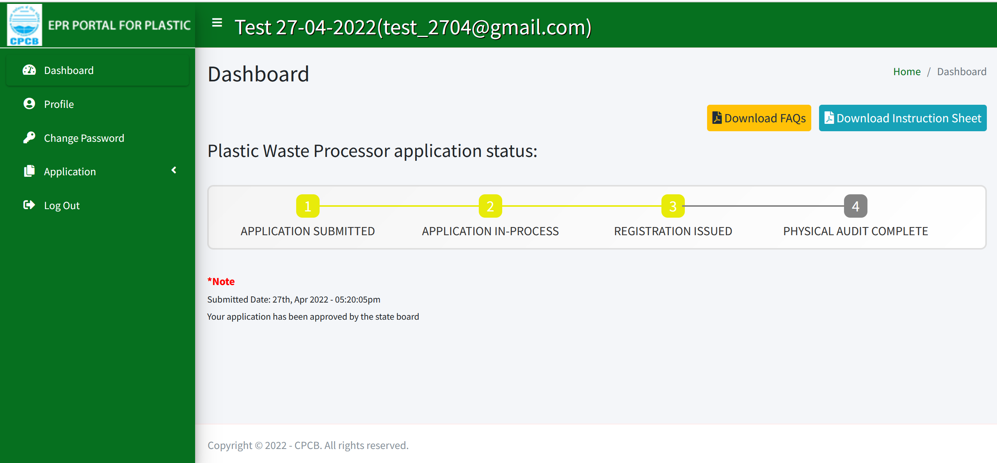
Registration issued
Issuance of registration for PWP.

