Slide 1
PROCESSING OF PIBOs APPLICATIONS
Scrutiny of applications by authorities

Slide 2
Application screening
This presentation is for the effective screening by authorities for PIBOs to expedite the process of approval of applications.
In order to address the key checkpoints within the scrutiny of applications, this presentation addresses specific points to be checked by the authorities.

Slide 3
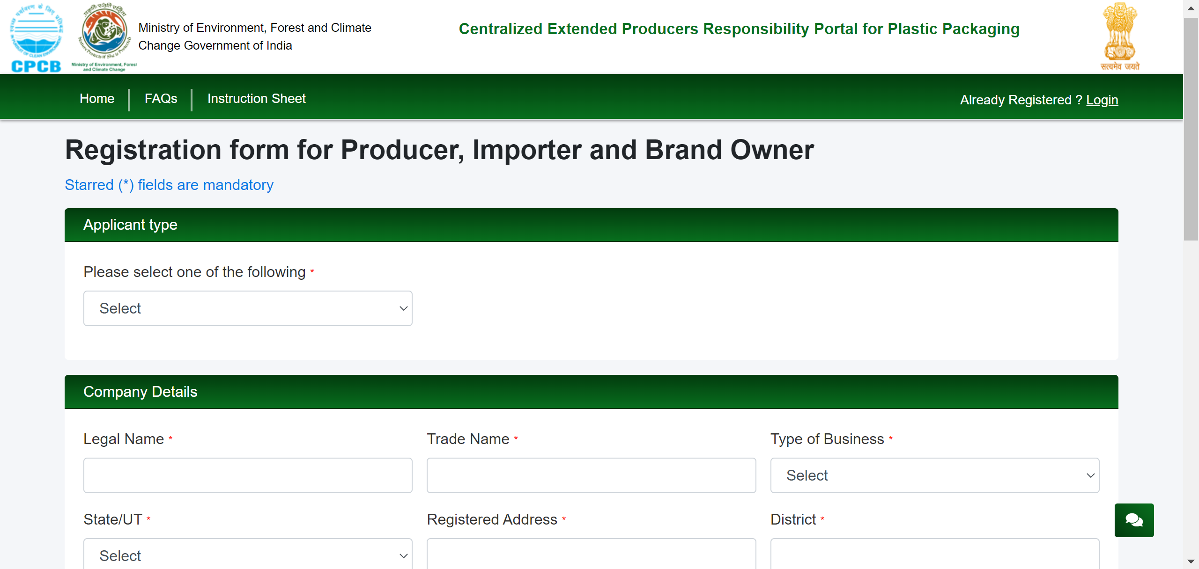
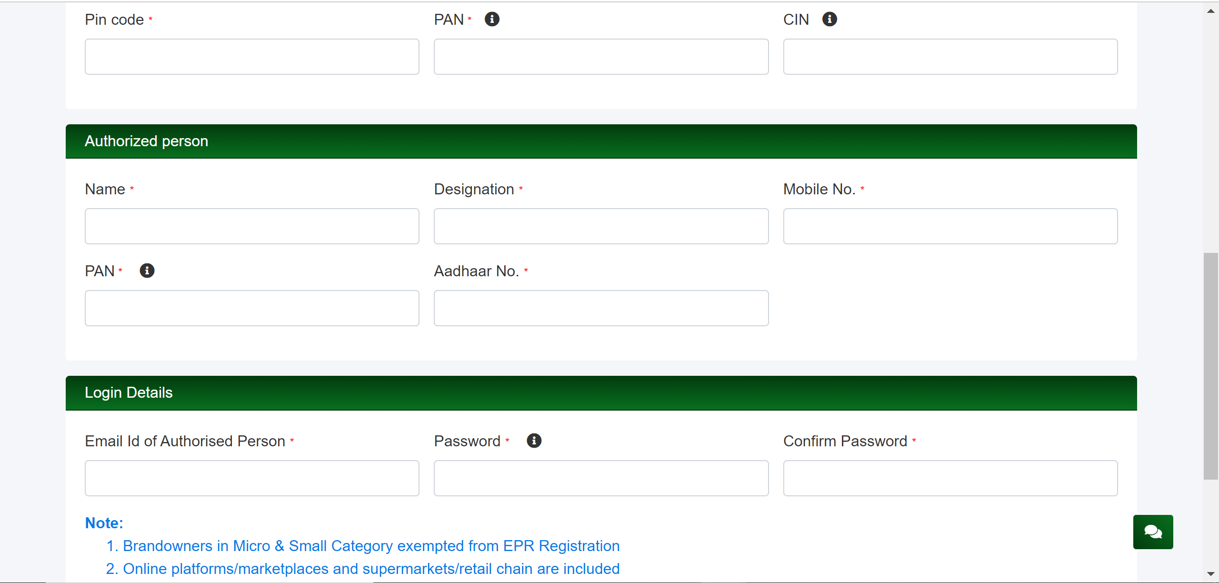
REGISTRATION FORM FOR PIBOs
Company details as well as the authorized person details are mandatory to be filled.
Legal name and trade name need to be examined in line with the GST certificate.

Slide 4
BRAND OWNER APPLICATION

Slide 5
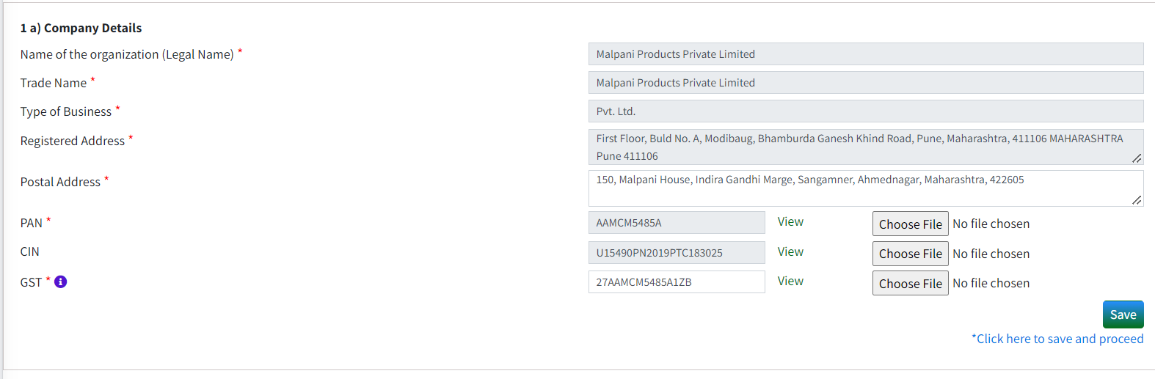
Application by brand owners
1(a) – Essential Details to be checked like GST, PAN, CIN
The file uploaded by the Brand Owner and details filled in the box must be same.
Registered address should be same as provided in the GST document.

Slide 6
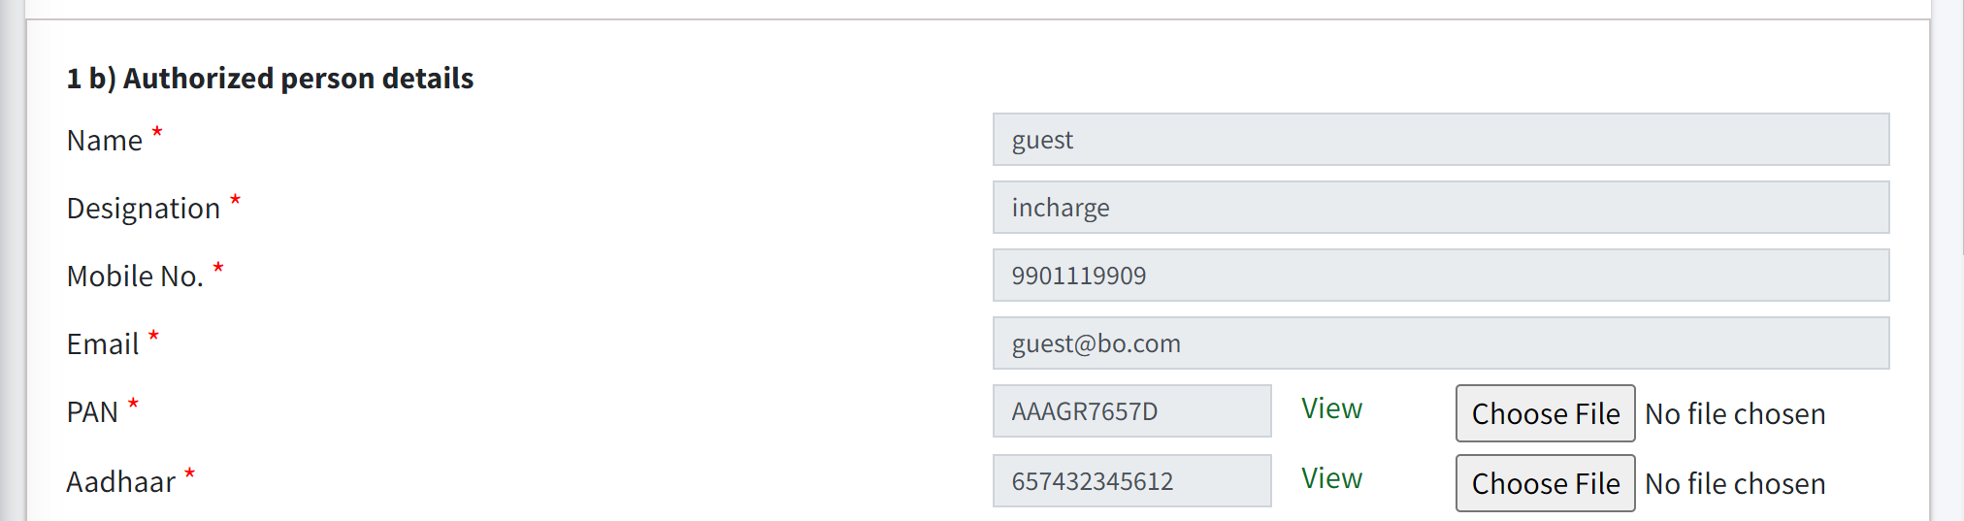
Application by brand owners
1(b) – PAN and Aadhaar of authorised person.
The file uploaded by the Brand Owner and the details filled in the box must be same.

Slide 7
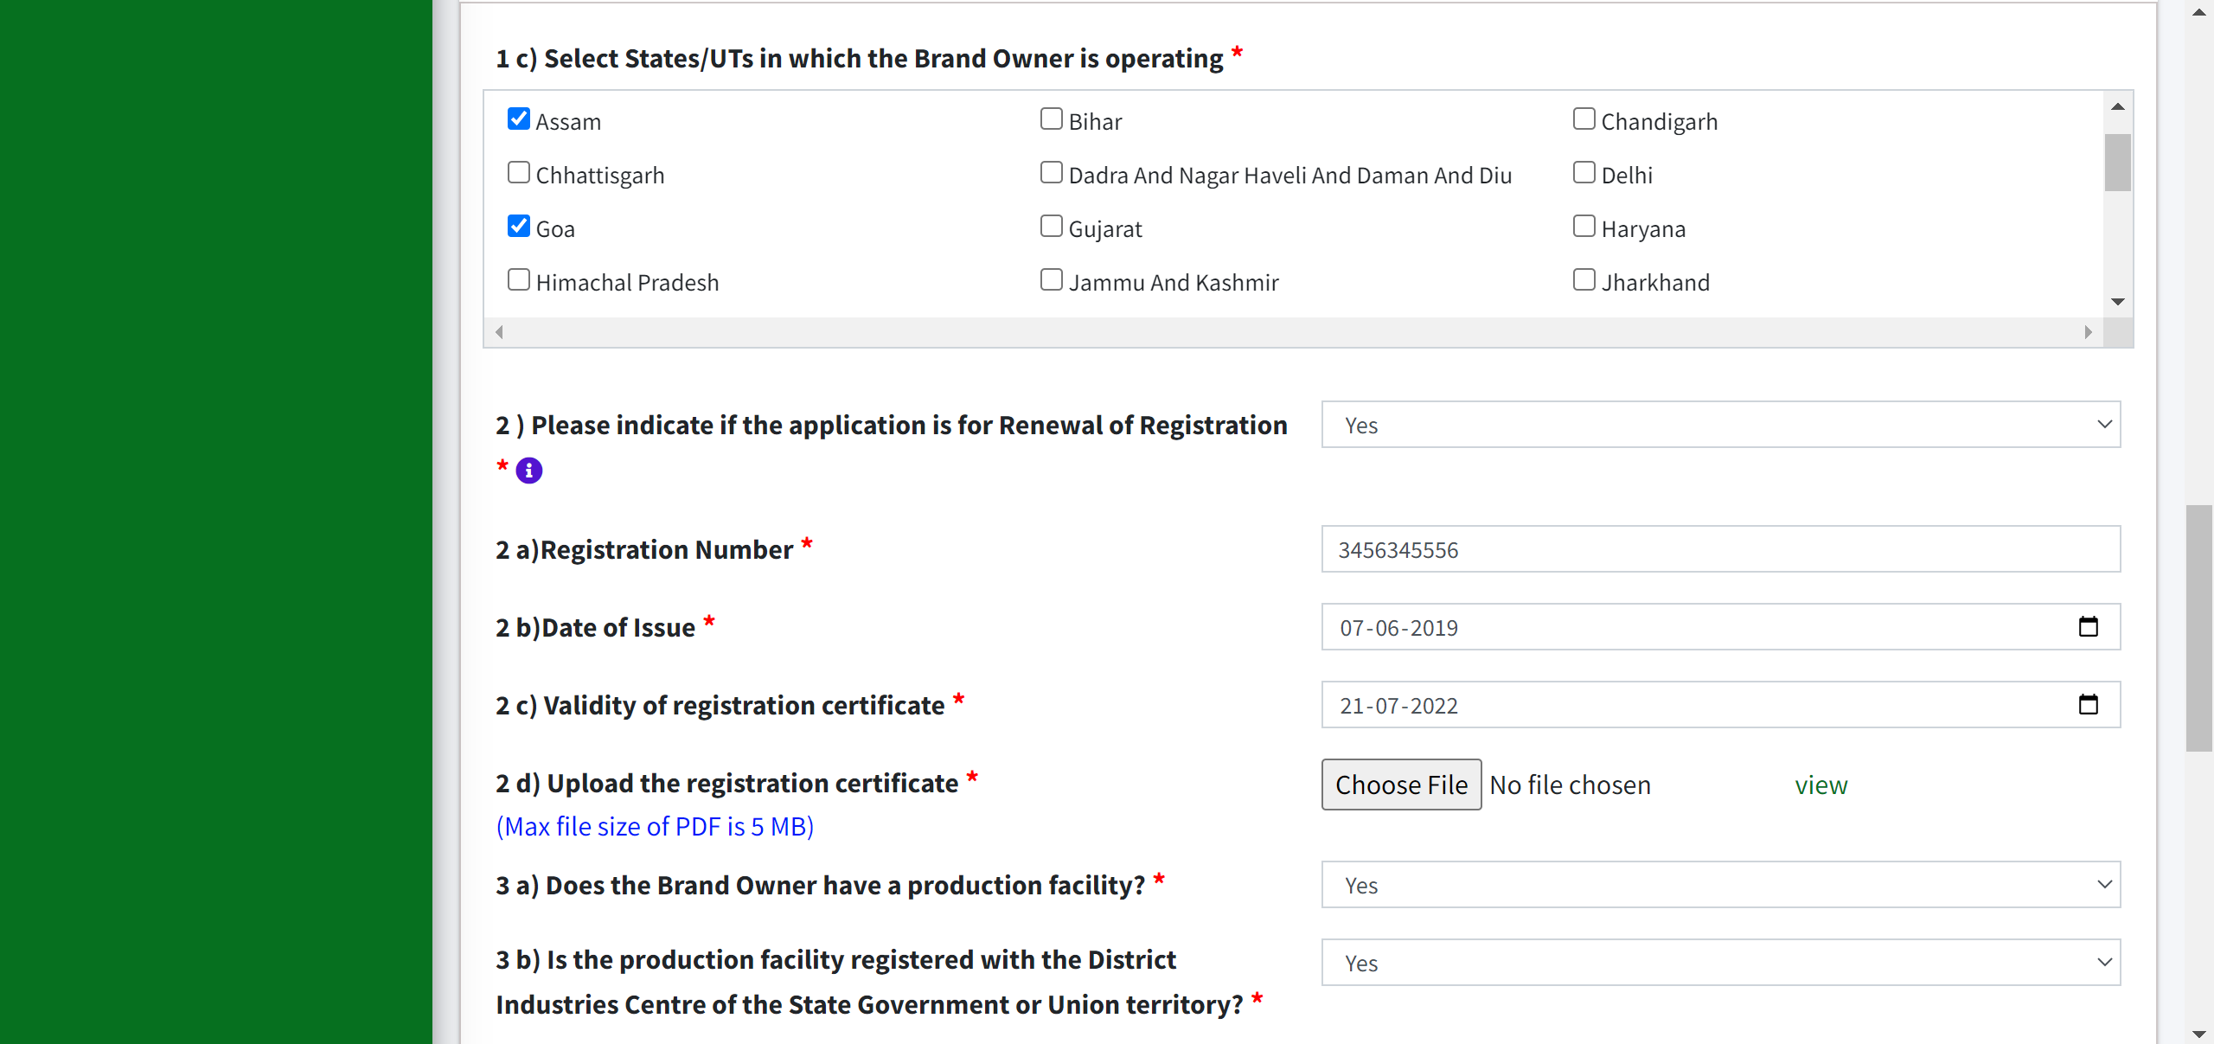
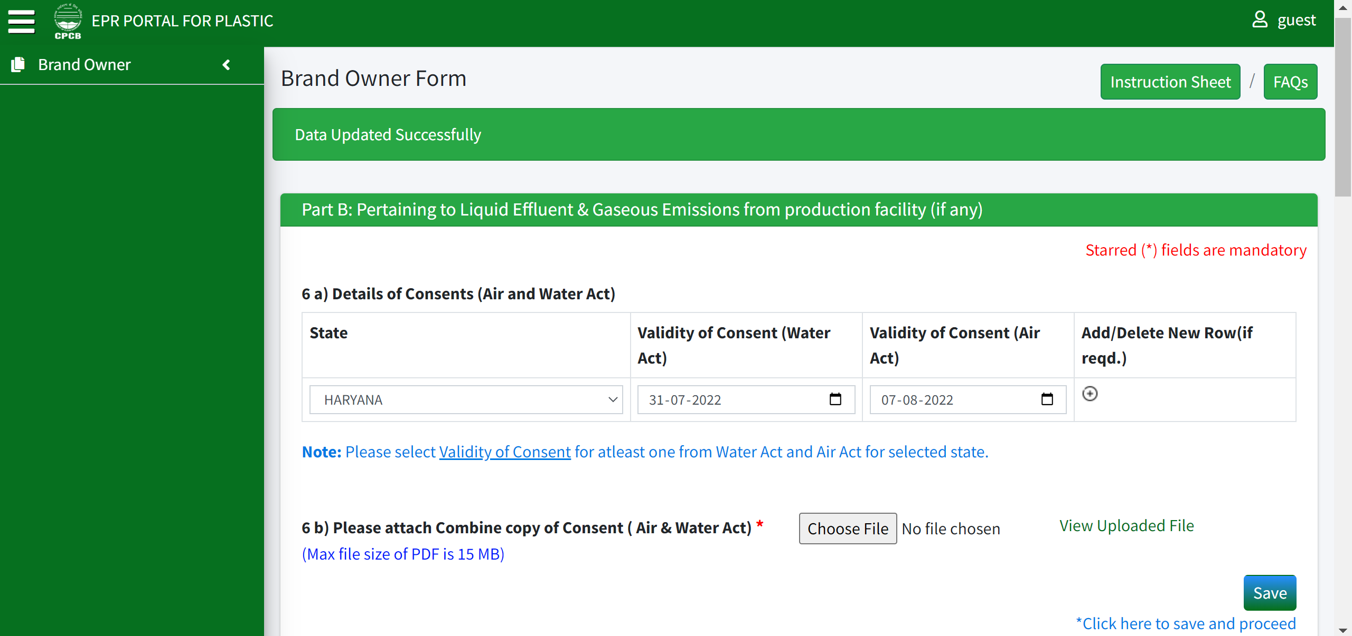
Application by brand owners
1(c) – check and verify with the state in which the Brand Owner is selling.
Notes:
NOT TO BE INCLUDED

Slide 8
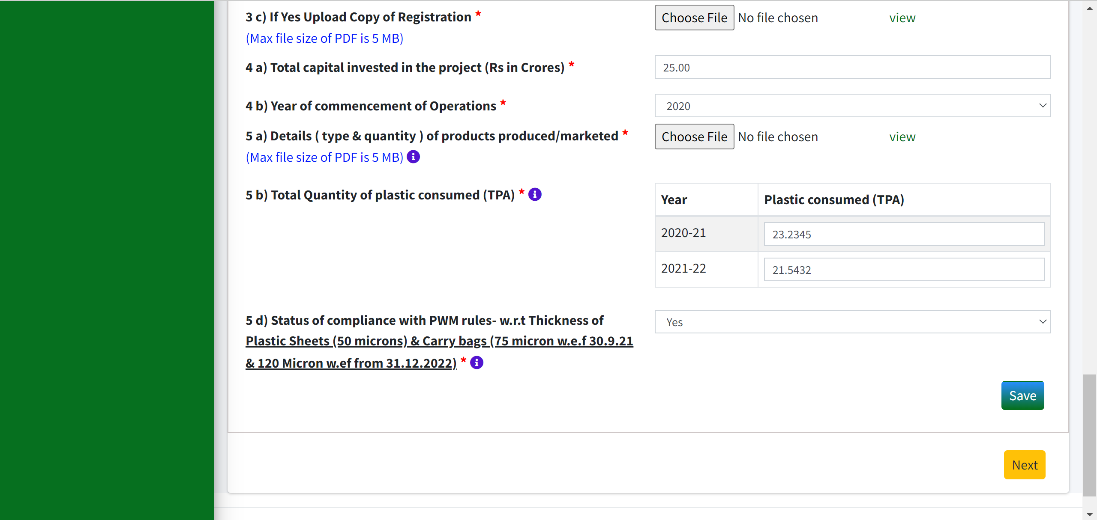
Application by brand owners
3(b) – District Industries Centre(DIC) registration – to be verified by checking manufacturing capacity; whether it lies in small MSME or not. Needs to be documented if ‘yes’.
If 3(b) is documented ‘yes’, then check whether copy of registration is uploaded in 3(c).

Slide 9
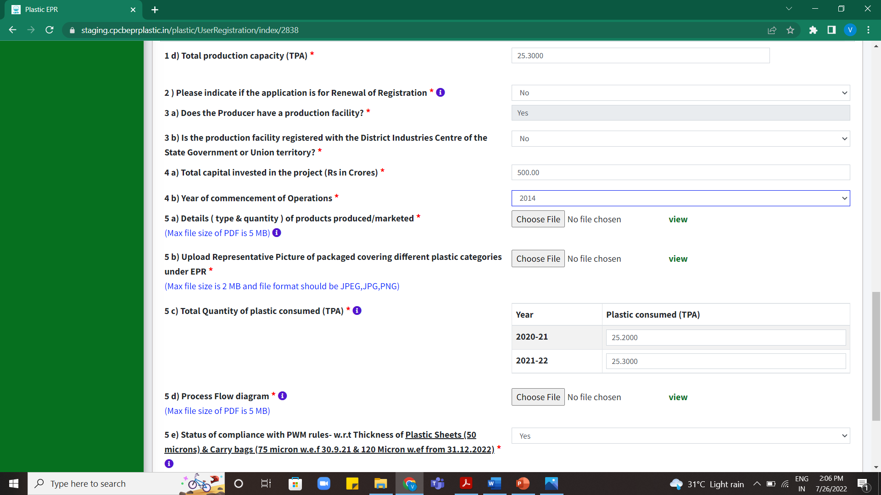
Application by brand owners
5(a)- Uploaded picture of the product also needs to be verified with product capacity given in the product specifications in the file uploaded.
5 (b)- Uploaded representative picture of packaging to be checked and verified.

Slide 10
Application by brand owners
5(c) – if the total quantity of plastic consumed is zero, check the commencement year of operations of 4(b) to be 2022.

Slide 11
Application by brand owners
6(a) – Check consent. If 3(a) is documented as ‘Yes’, then consent must be provided by the Brand Owner.
Check and verify the consent with the file uploaded in 6(b).

Slide 12
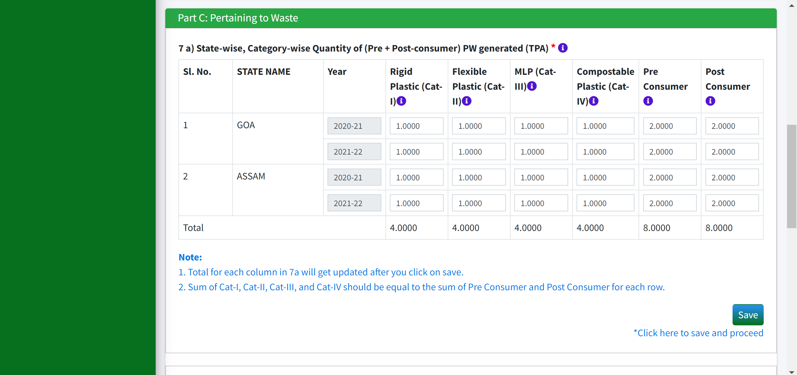

Application by brand owners
7(a): Quantity (Plastic waste generated) should be less than or equal to quantity (plastic consumed) written in 5(b).
$$≤$$

Slide 13
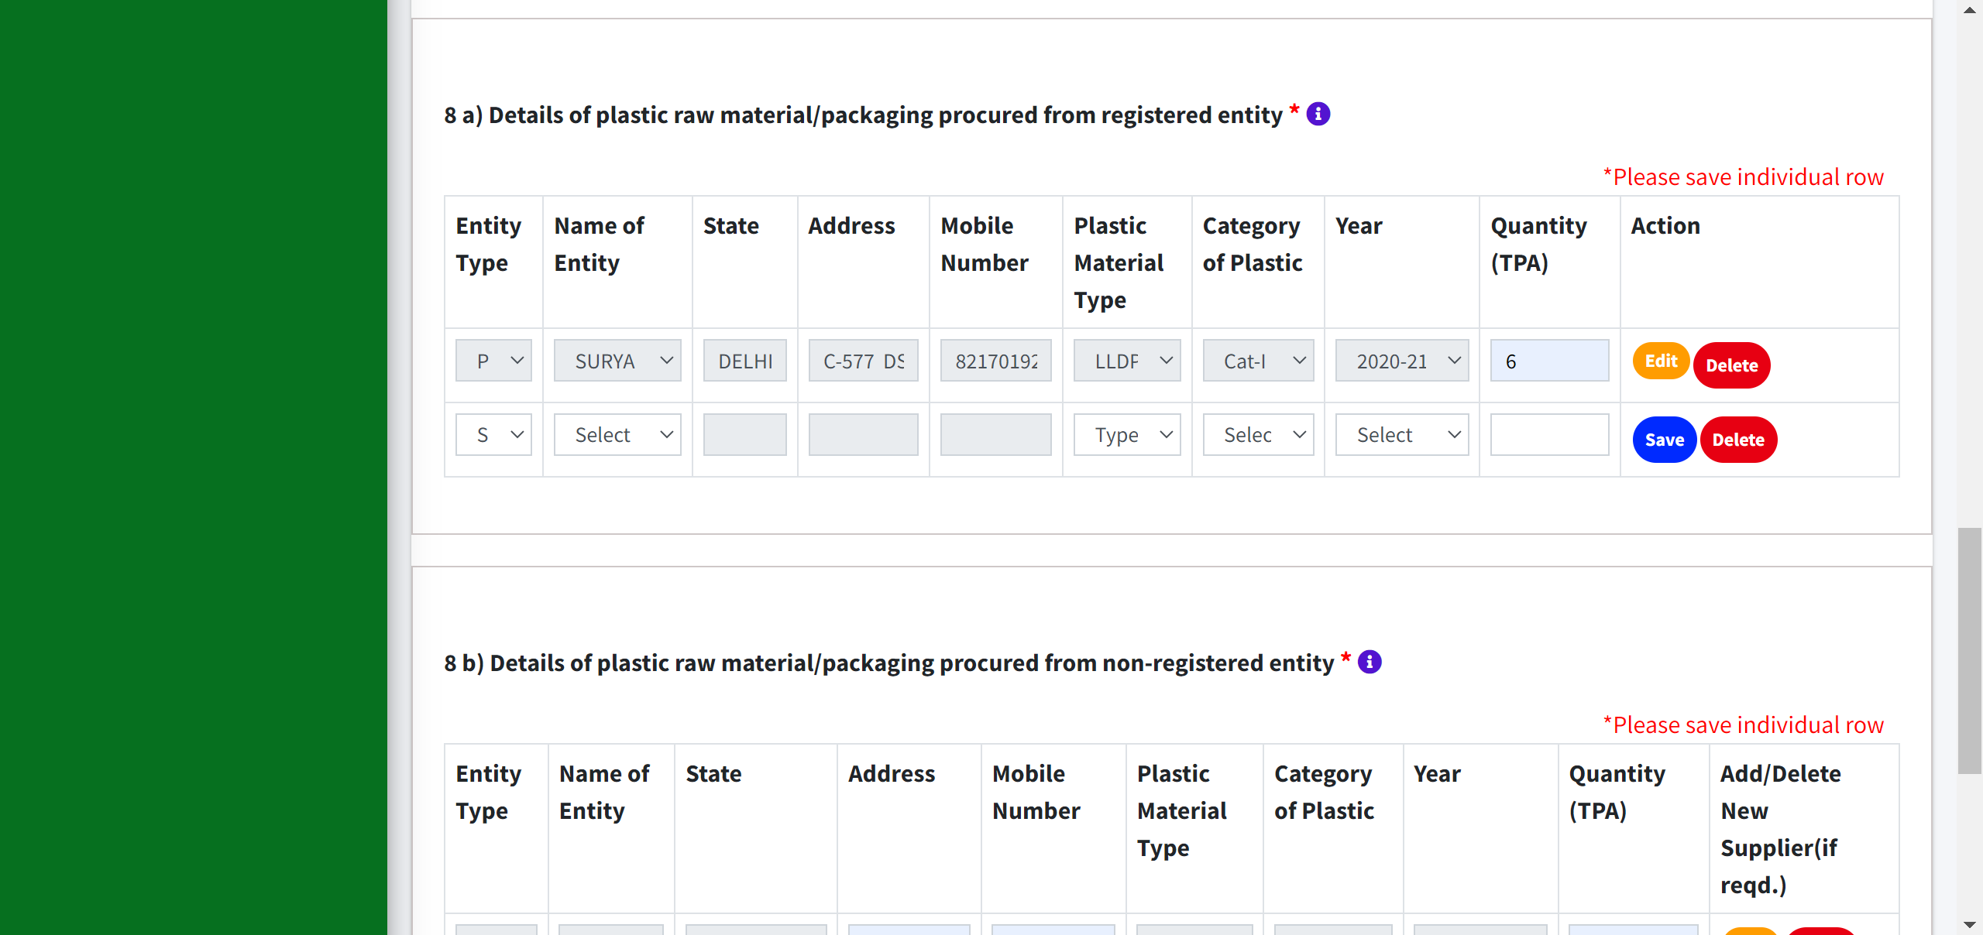
Application by brand owners
8(a) – Whether selling quantity is generated as being procured.
Category of plastic waste generated to be checked (to be compatible) from the plastic material used from the picture uploaded in 5(b).

Slide 14
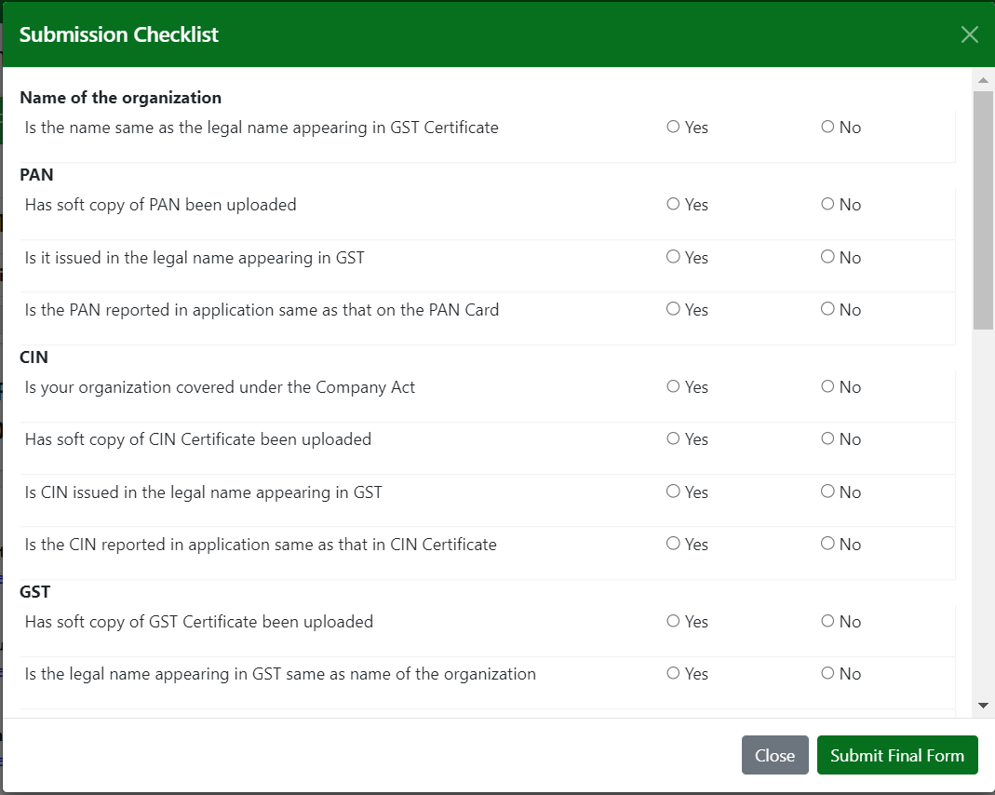
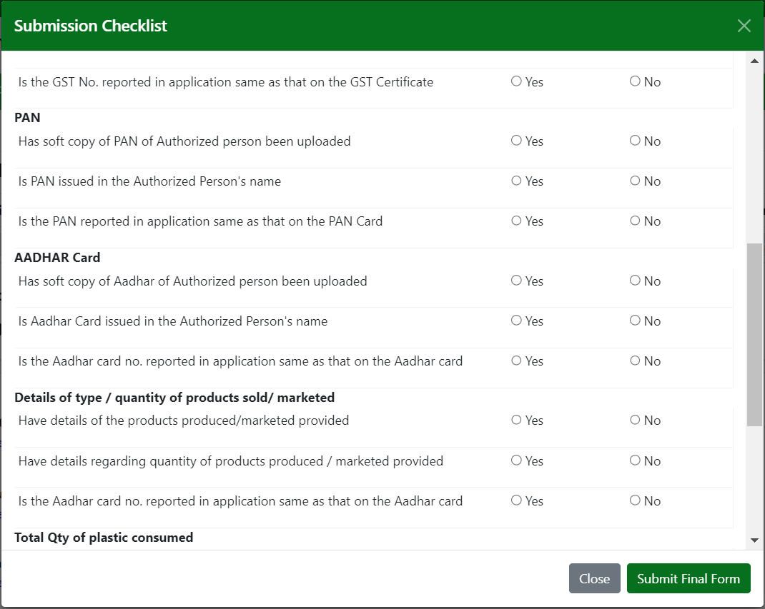
Application by brand owners
Submission Checklist to be marked carefully. It must match with the documents uploaded by the Brand Owners.
Notes:
To be completed

Slide 15
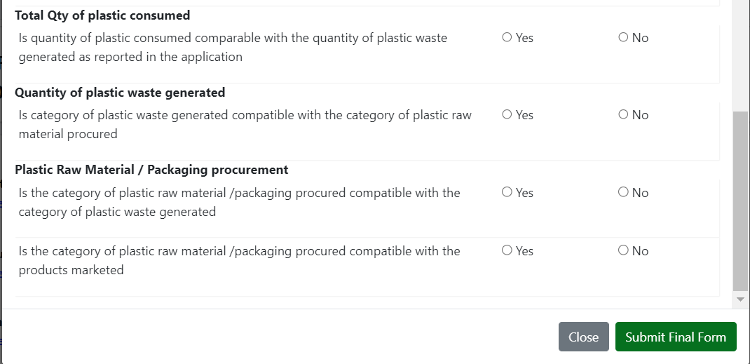
Application by brand owners
Submission Checklist to be marked carefully. It must match with the documents uploaded by the Brand Owners.

Slide 16
IMPORTER APPLICATION

Slide 17
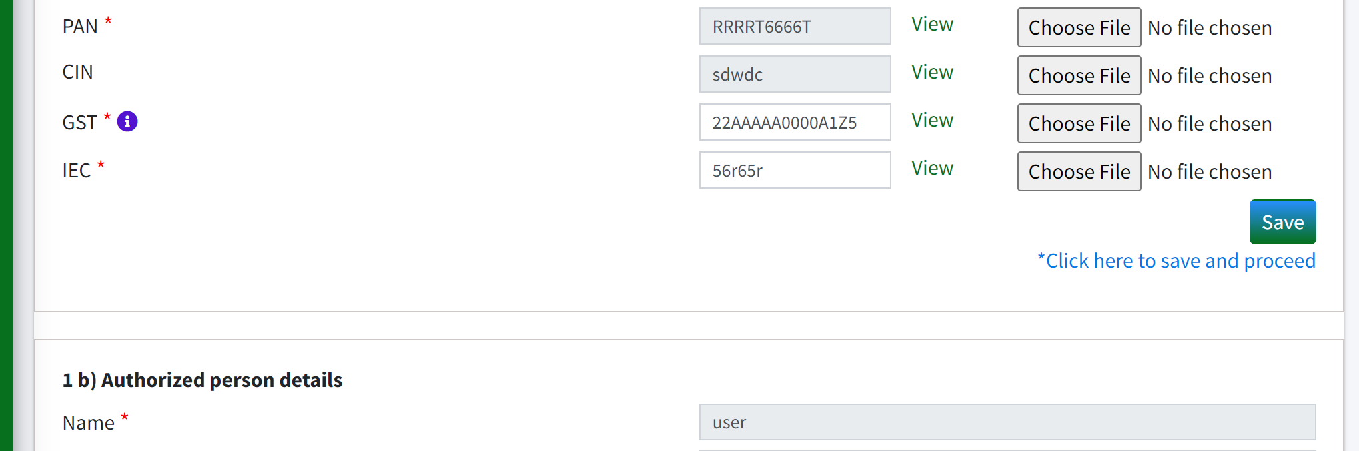
Application by Importers
In 1(a), IEC is additional to be provided by Importers.

Slide 18
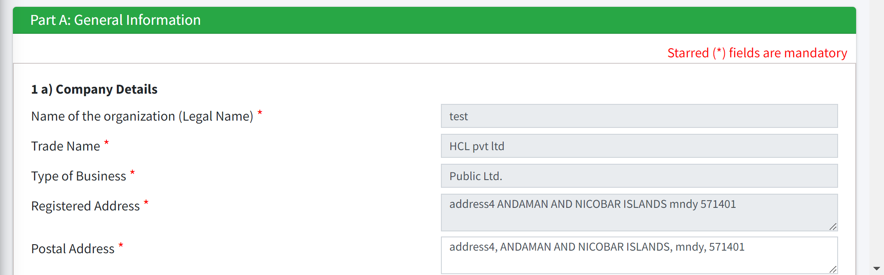
Application by Importers
In 1(a), Proprietorship should be checked (Legal and trade name should be checked in line with the GST certificate).
Notes:
Legal name is the name registered with a state govt. and includes legal ending, such as an LLC or LLP, after the title.
Trade name is name used for advertising and sale purpose.

Slide 19
Application by Importers
Check commencement of operations in 4(b). Year of commencement reflects the year from when the import started.

Slide 20
Application by Importers
In 5(a), check for SUP in product type: There will be a picture being uploaded.

Slide 21
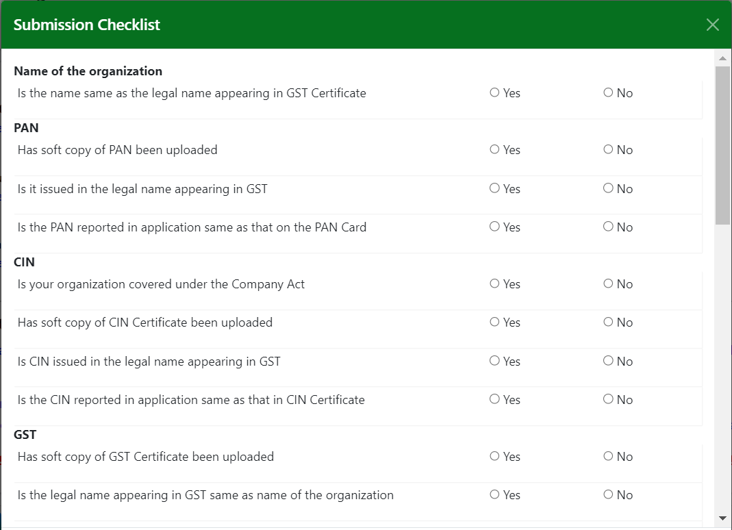
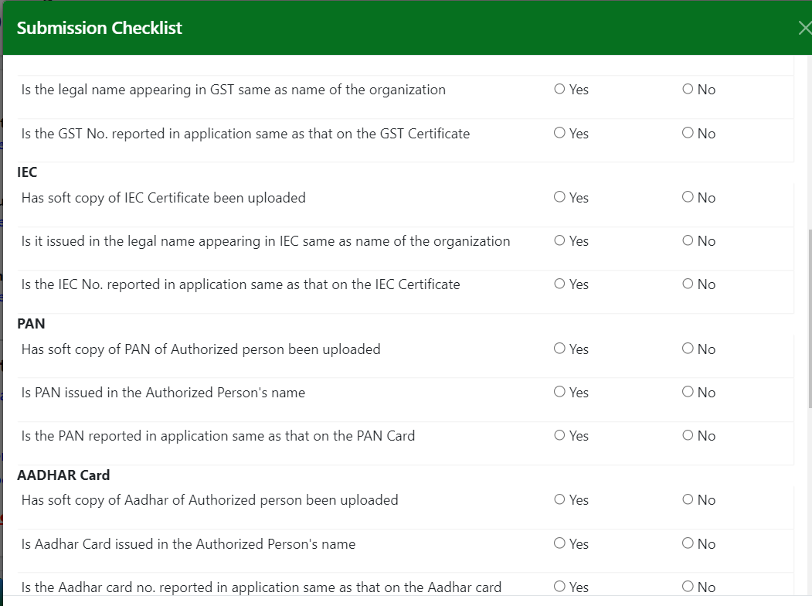
Application by Importers
Submission Checklist to be marked carefully. It must match with the documents uploaded by the Importers.

Slide 22
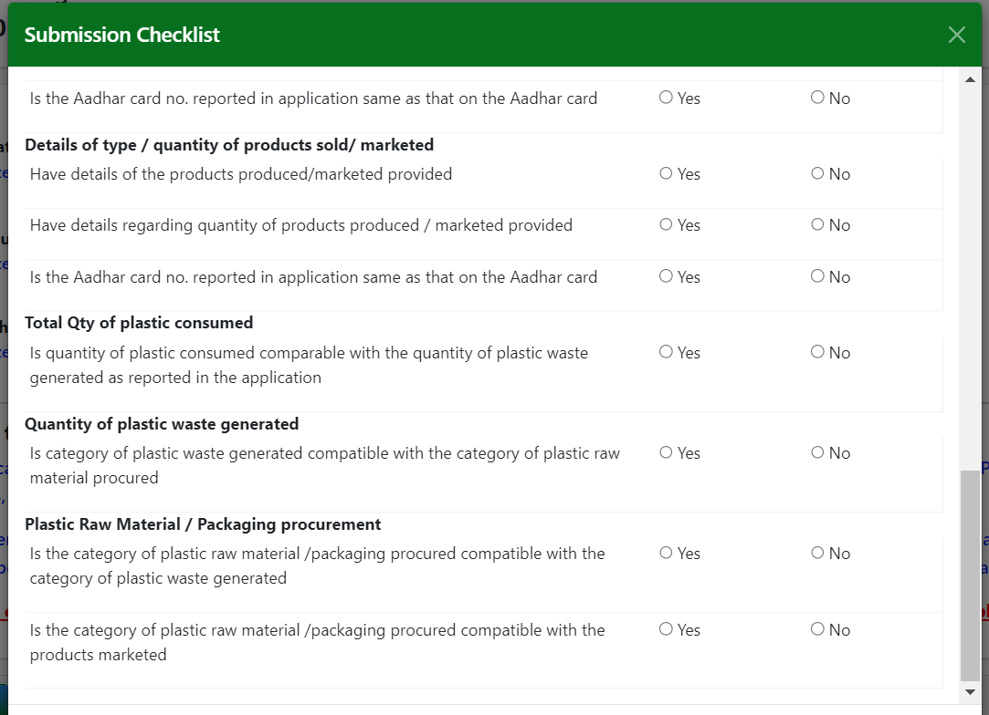
Application by Importers
Submission Checklist to be marked carefully. It must match with the documents uploaded by the Importers.

Slide 23
PRODUCER APPLICATION

Slide 24
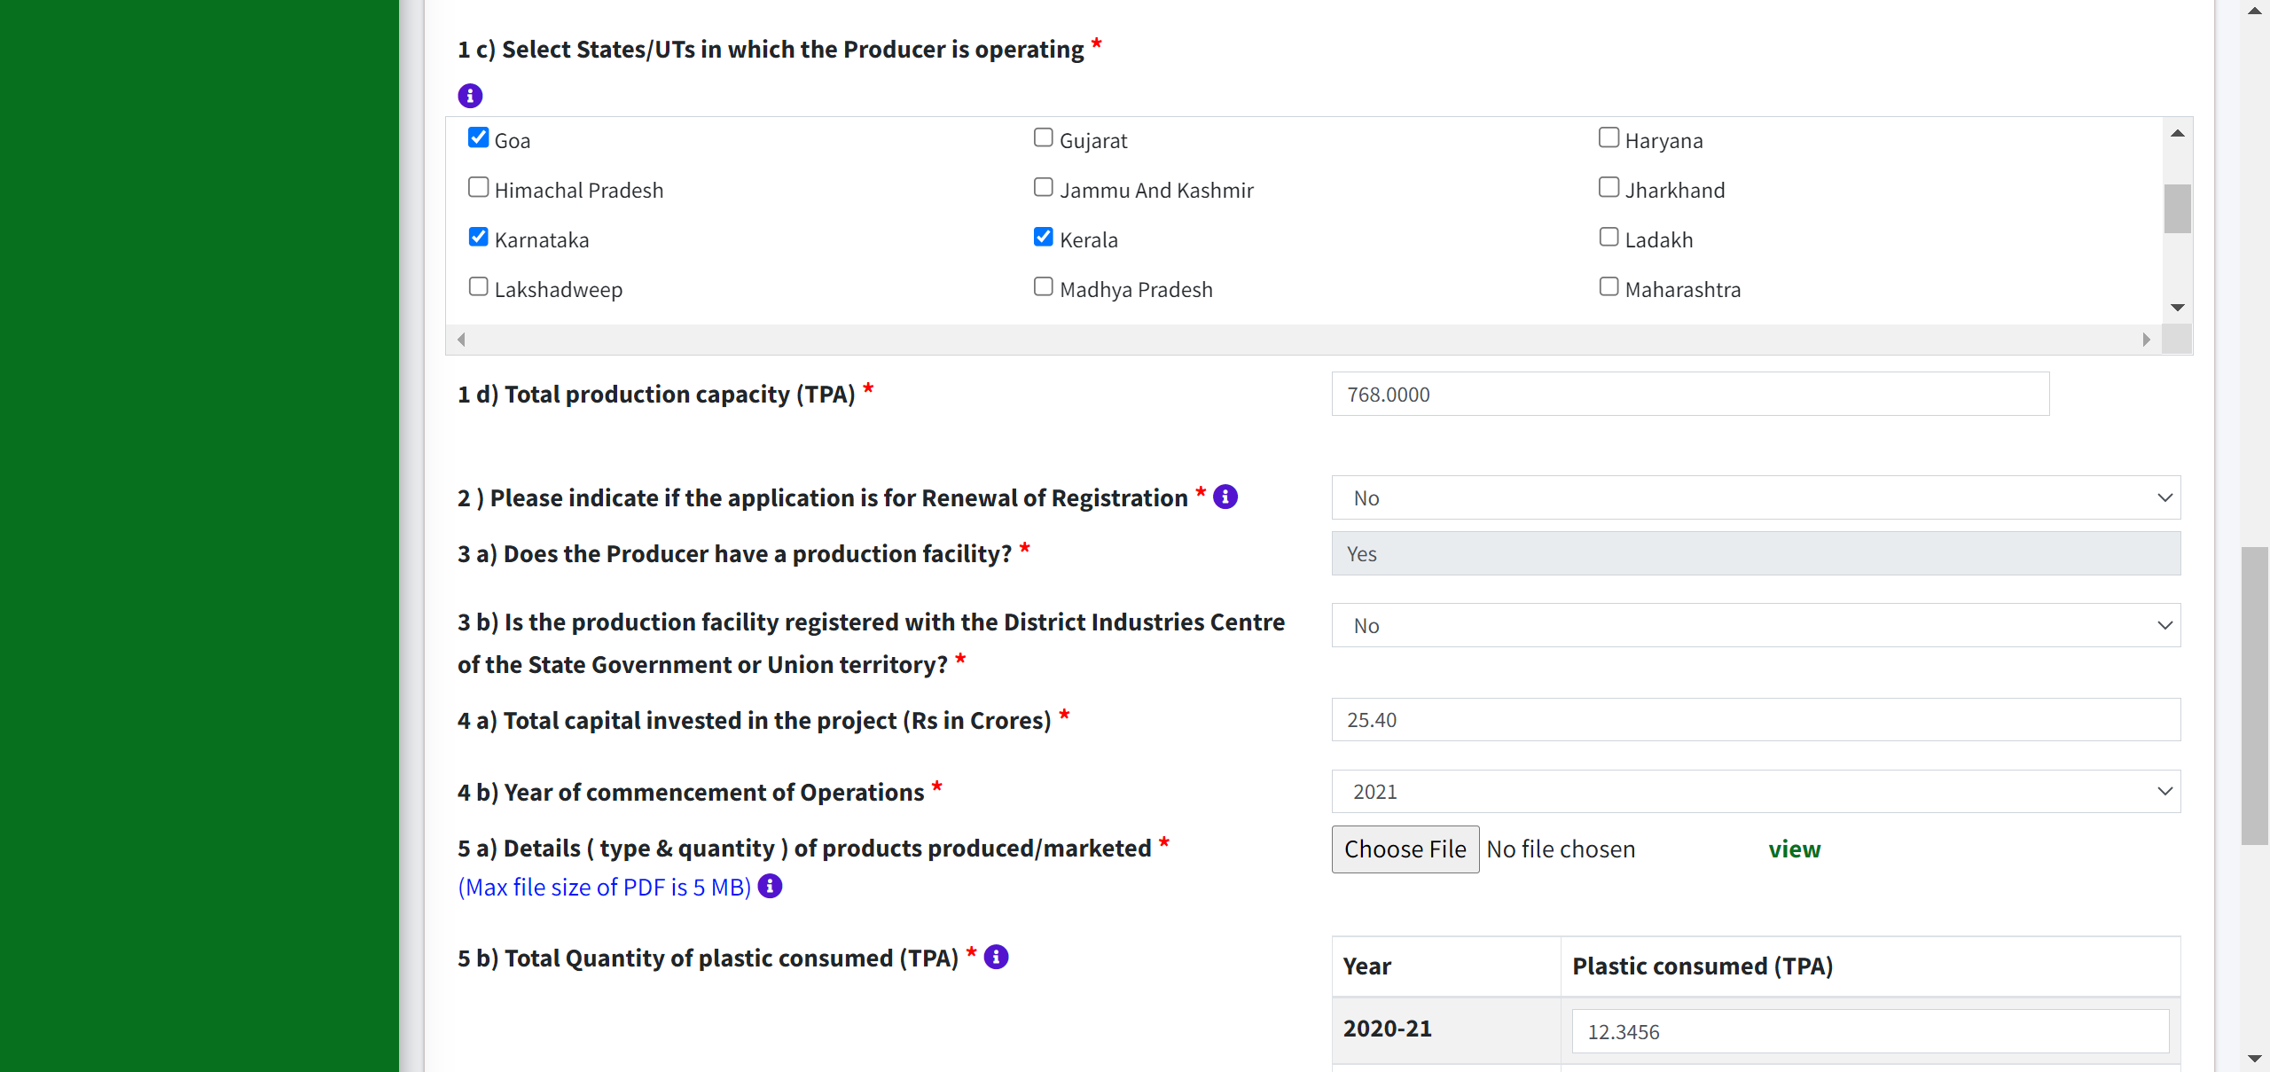
Application by Producers
I (c) to be checked. Operating means the location of manufacturing units. If there are more than 2 states, then application will go to CPCB.

Slide 25
Application by Producers
Part A: 5 (c) – Check and verify the year of commencement from 4(b). If the total quantity of plastic consumed is zero, check the commencement year of operations of 4(b) to be 2022.

Slide 26
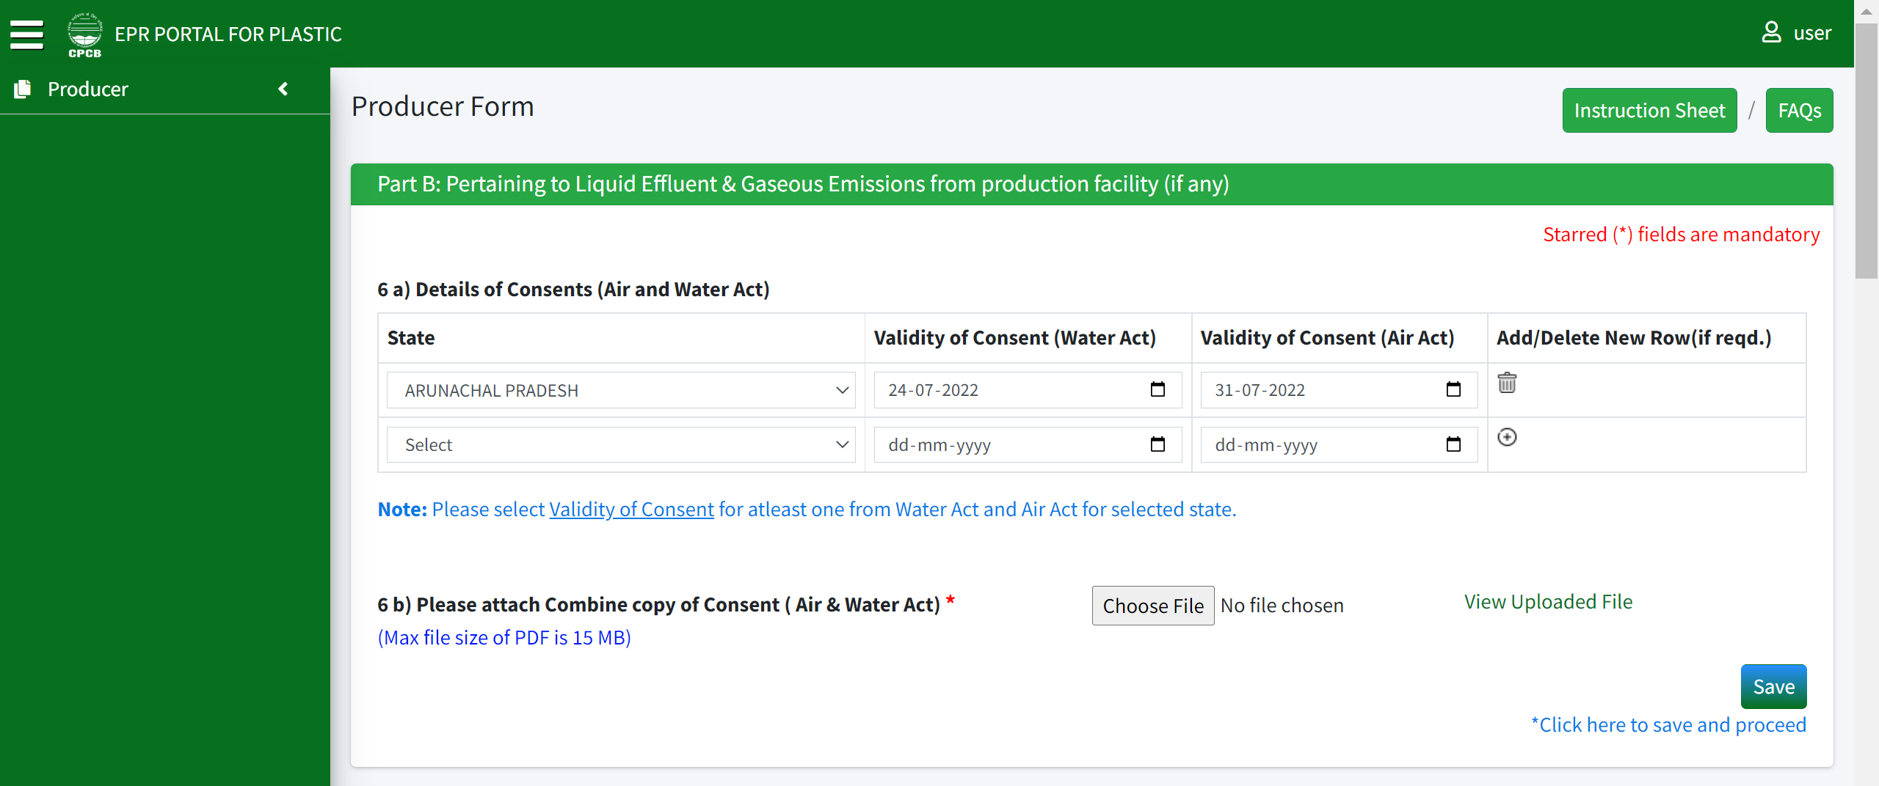
Application by Producers
Part B: Check for License.
Check for license within the copy of consent.

Slide 27
Application by Producers
Part B: 6 (a) Consent document to be checked and verified – products to be checked including SUP in 5(a) (for SPCBs to check).

Slide 28
Application by Producers
Part B: 6(a) and 6(b) are mandatory for producers to fill.
Check consent validity and whether SUP is being manufactured from the file attached in 6(b) and state selected in 1(c) (Data for all the states selected in 1(c) must be filled in 6(a)).

Slide 29
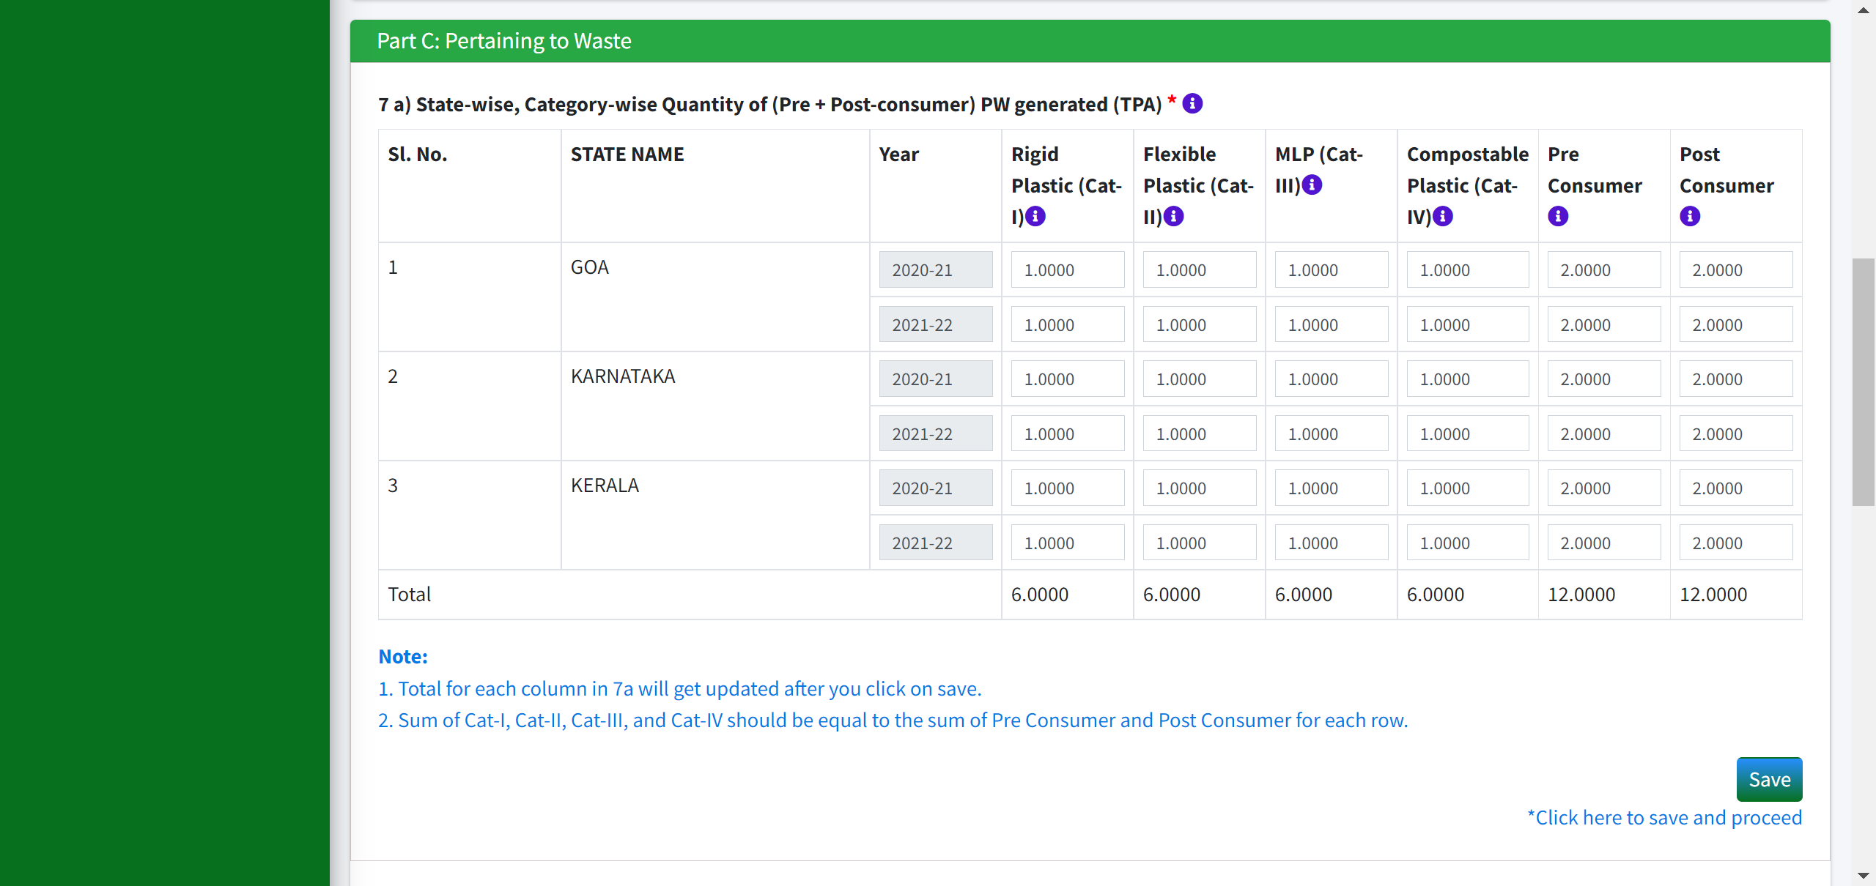
Application by Producers
Category I: Rigid Plastic packaging which includes PET, HDPE etc.
Part C: 7(a) is mandatory to be filled
Category II: Flexible packaging of single layer or multilayer (more than one layer with different types of plastic), plastic sheets or like and covers made of plastic sheet, carry bags, plastic sachet or pouches which include LLDPE, LDPE, PP, PE, PS, etc.
Category III: Multilayer plastic packaging (atleast one layer of plastic and material other than plastic).
Category IV: Compostable Plastic Sheet/Carry bags
Plastic packaging waste generated in the form of reject or discard at the stage of manufacturing of plastic packaging and during the packaging of product including reject, discard, before the plastic packaging reaches the end-use consumer of the product.
Plastic packaging waste generated by the end-use consumer after the intended use of packaging is fully completed.

Slide 30
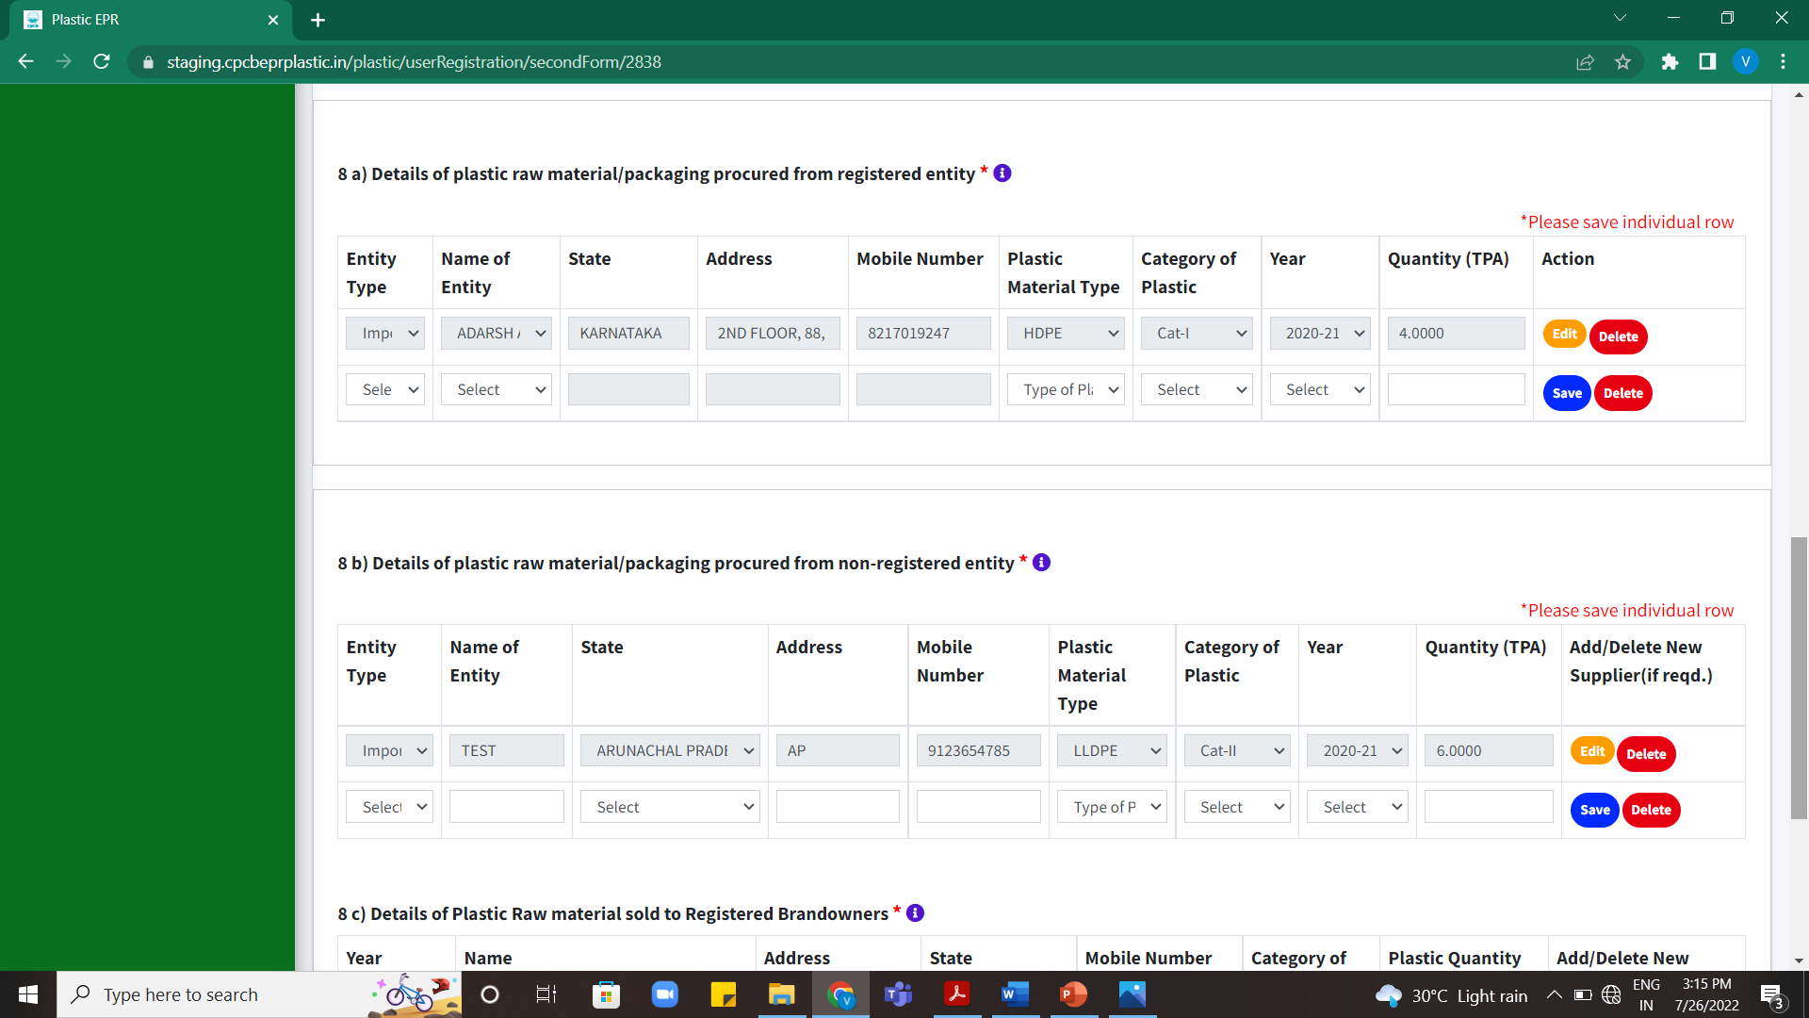
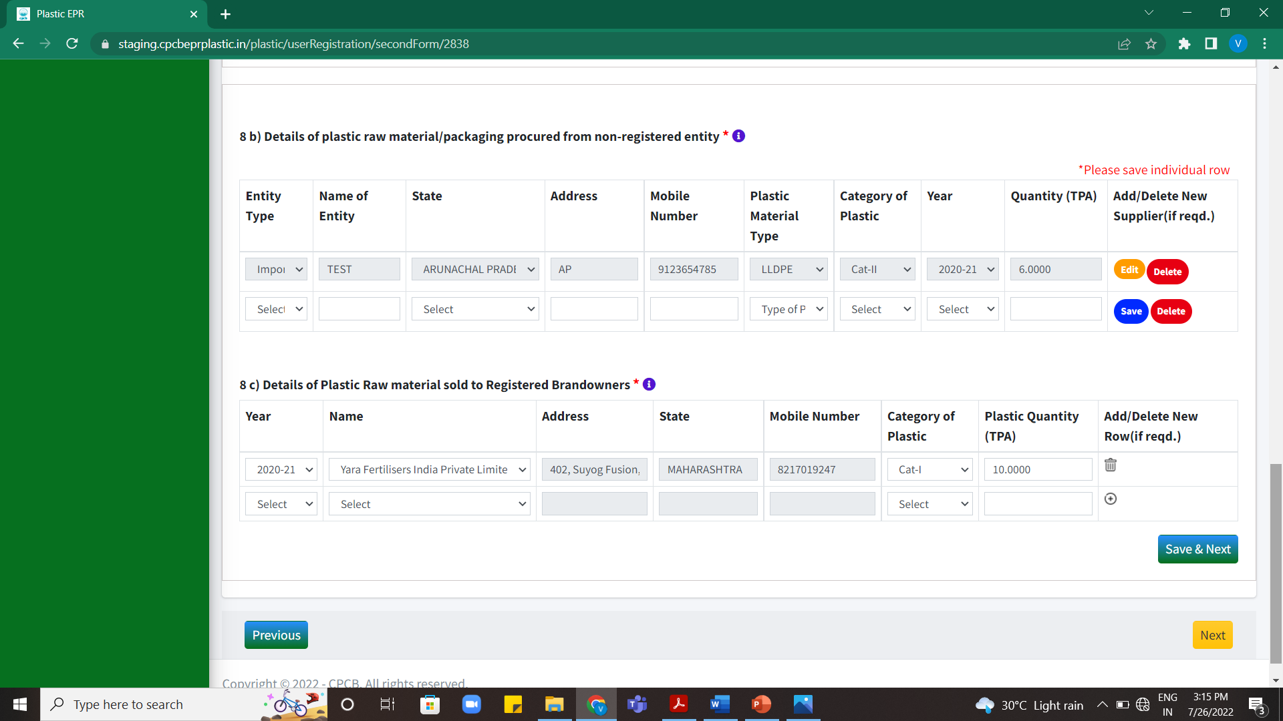
Application by Producers
Please input the year wise quantity of plastic raw material/packaging procured from registered entities (Producer/Importer/Recyclers) for the last two years.
8 (a), (b) and (c) is mandatory to be filled.
Please input the year wise quantity of plastic raw material/packaging procured from non-registered entities (Producer/Importer/Recyclers) for the last two years.
Year wise/category wise details of plastic sold to the Registered brand owner is to be provided in the specified format.

Slide 31
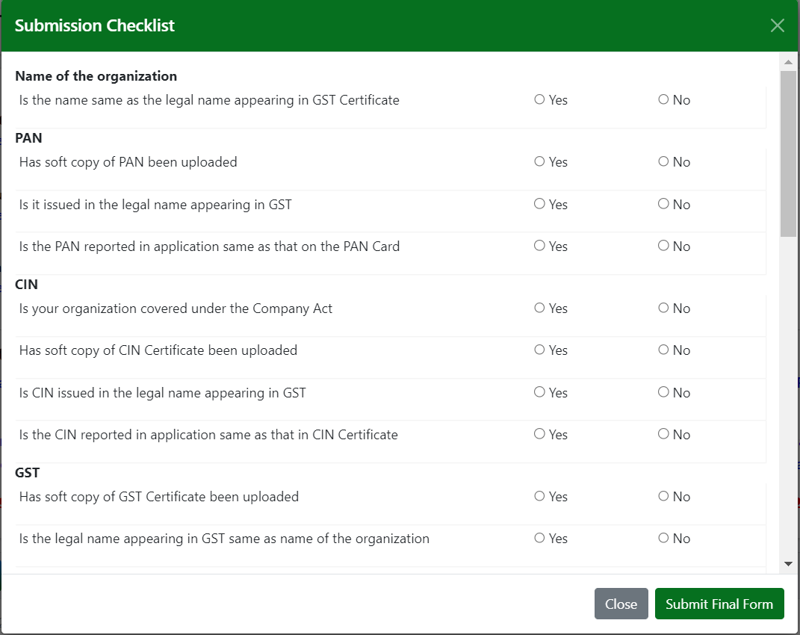
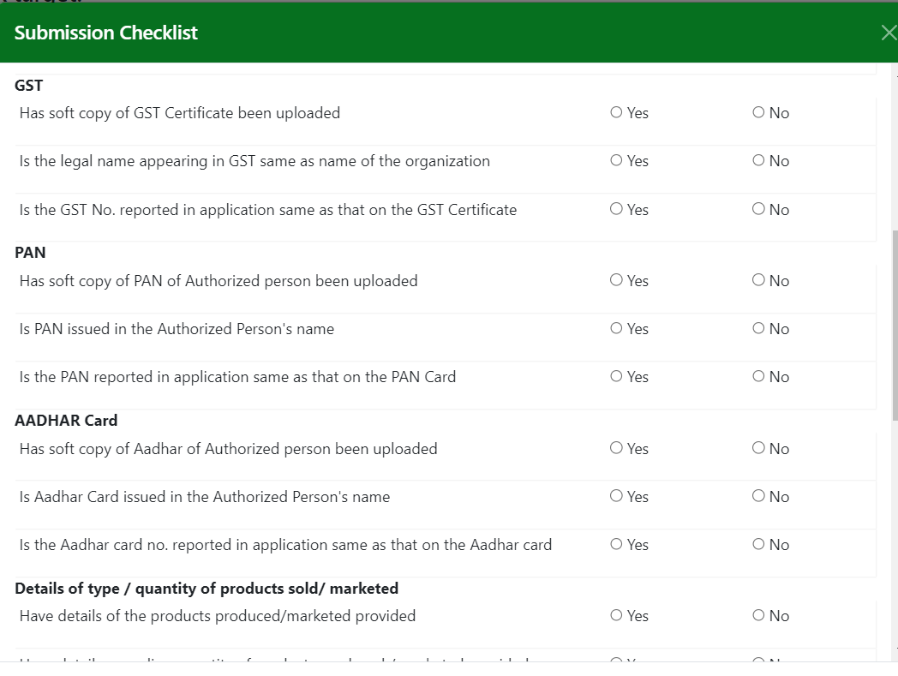
APPLICATION BY PRODUCERS
Submission Checklist to be marked carefully. It must match with the documents uploaded by the Producers.

Slide 32
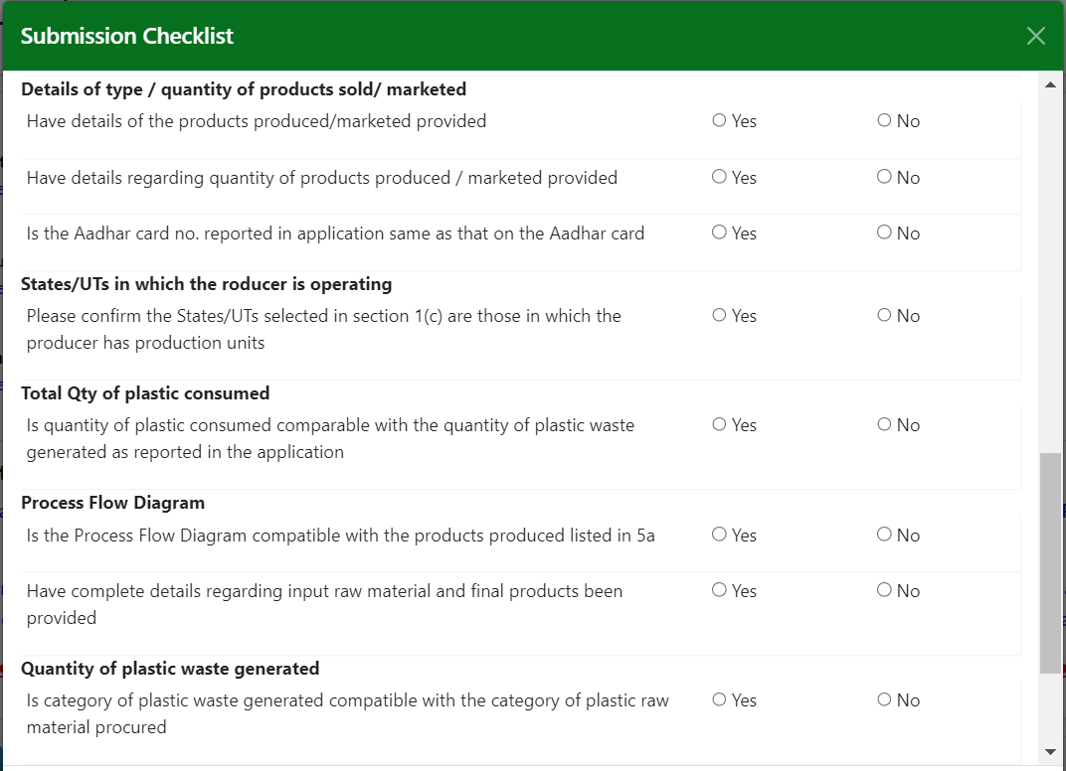
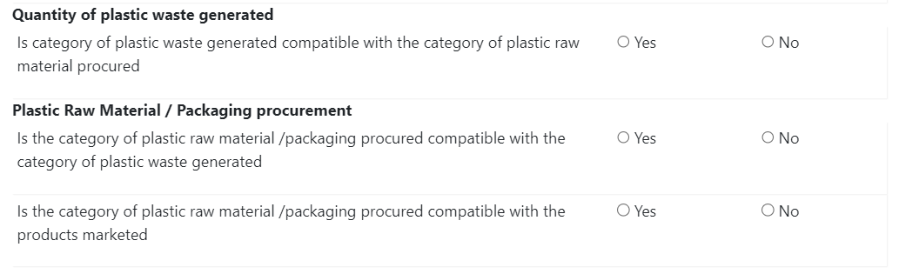
APPLICATION BY PRODUCERS
Submission Checklist to be marked carefully. It must match with the documents uploaded by the Producers.

