Slide 1
Processing of pwps application
Scrutiny of applications by authorities

Slide 2
Application screening
This presentation is for the effective screening by authorities for PWPs to expedite the process of approval of applications.
In order to address key checkpoints within the scrutiny of applications, this presentation addresses specific points to be checked by authorities.

Slide 3
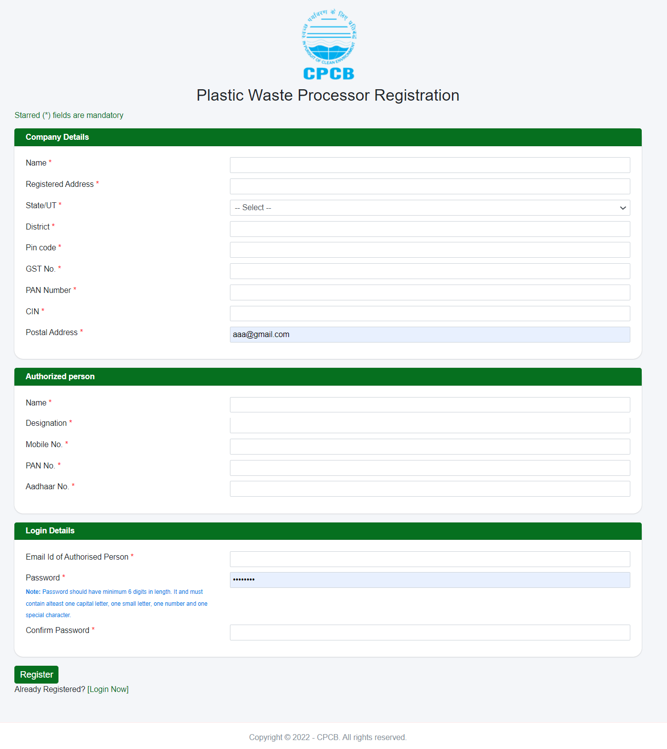
REGISTRATION FORM FOR PWPs
Company details as well as the authorized person details are mandatory to be filled.
Notes:
Complete it

Slide 4
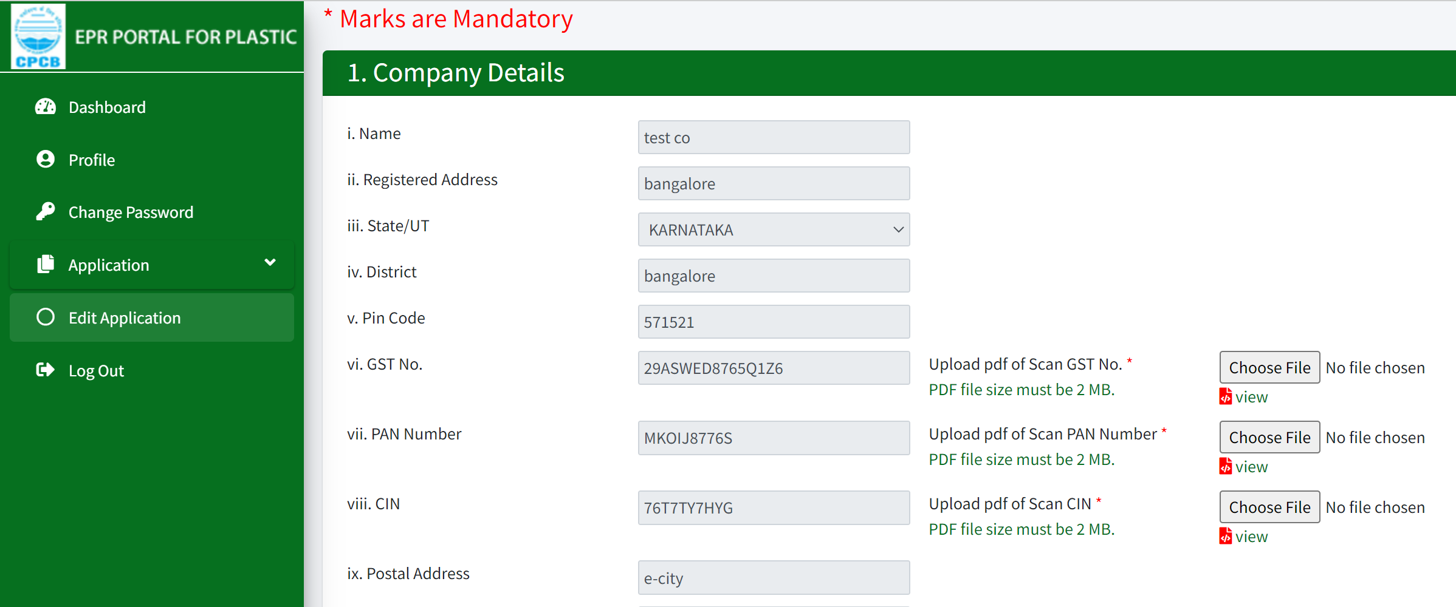
Application by pwps
1- Essential details to be checked in Company details like GST, PAN, CIN.
Check and verify the details provided in the box with the file uploaded by PWPs.

Slide 5
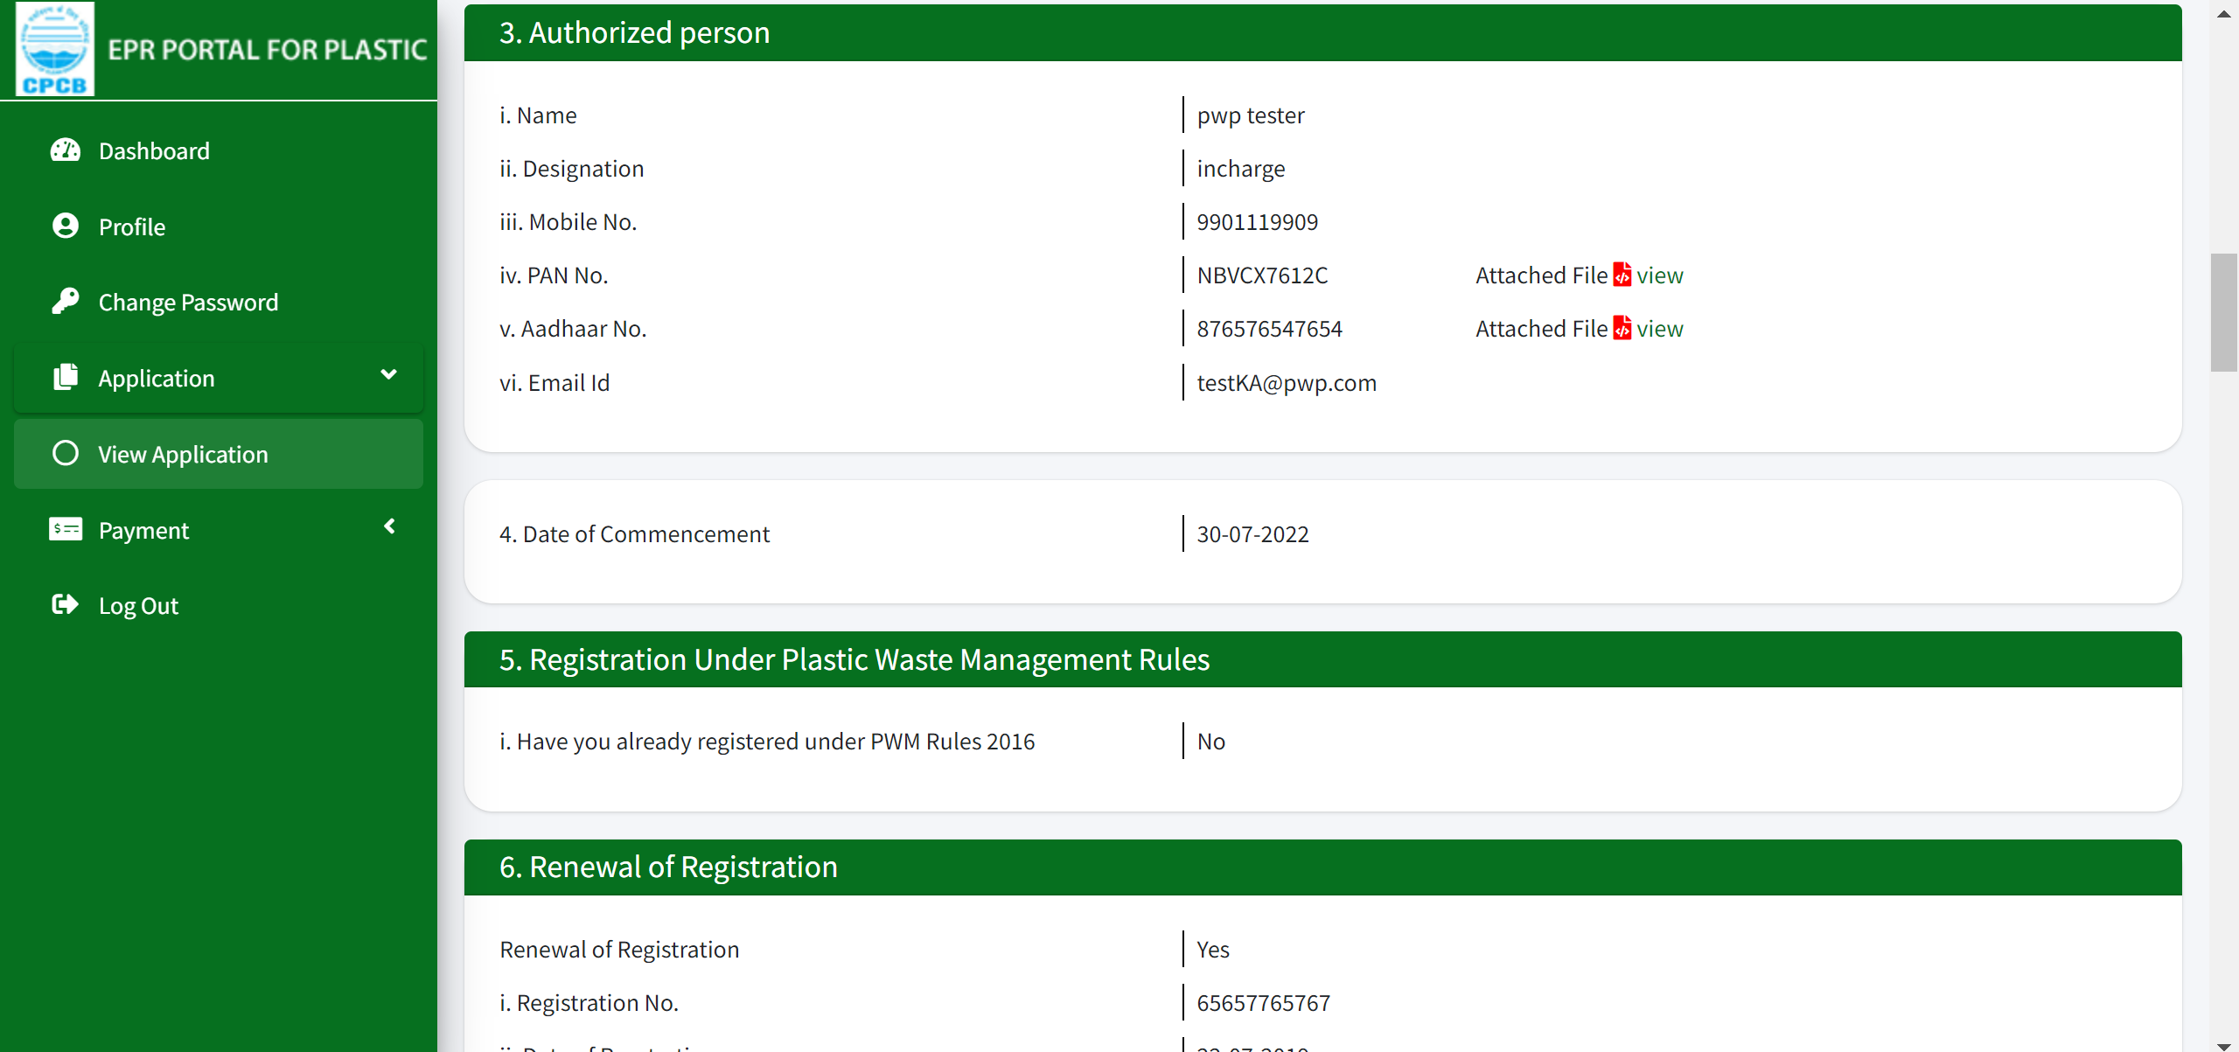
Application by pwps
3- Check and verify PAN No. and Aadhaar No. in the Authorized person details with the file uploaded.

Slide 6
Application by pwps
5- If 5(i) is documented as ‘Yes’, then check the details of registration.

Slide 7
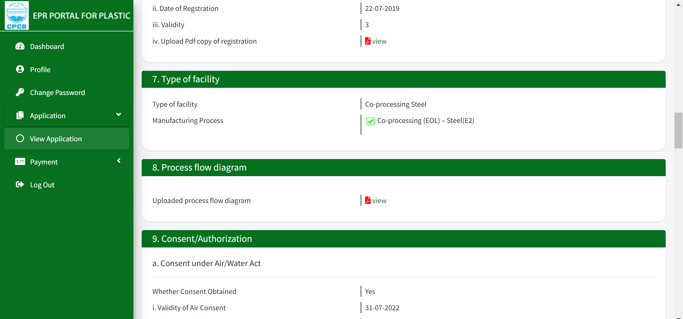
Application by pwps
6- Check and verify the details provided in Renewal of Registration (6) with the file uploaded in 6(iv).

Slide 8
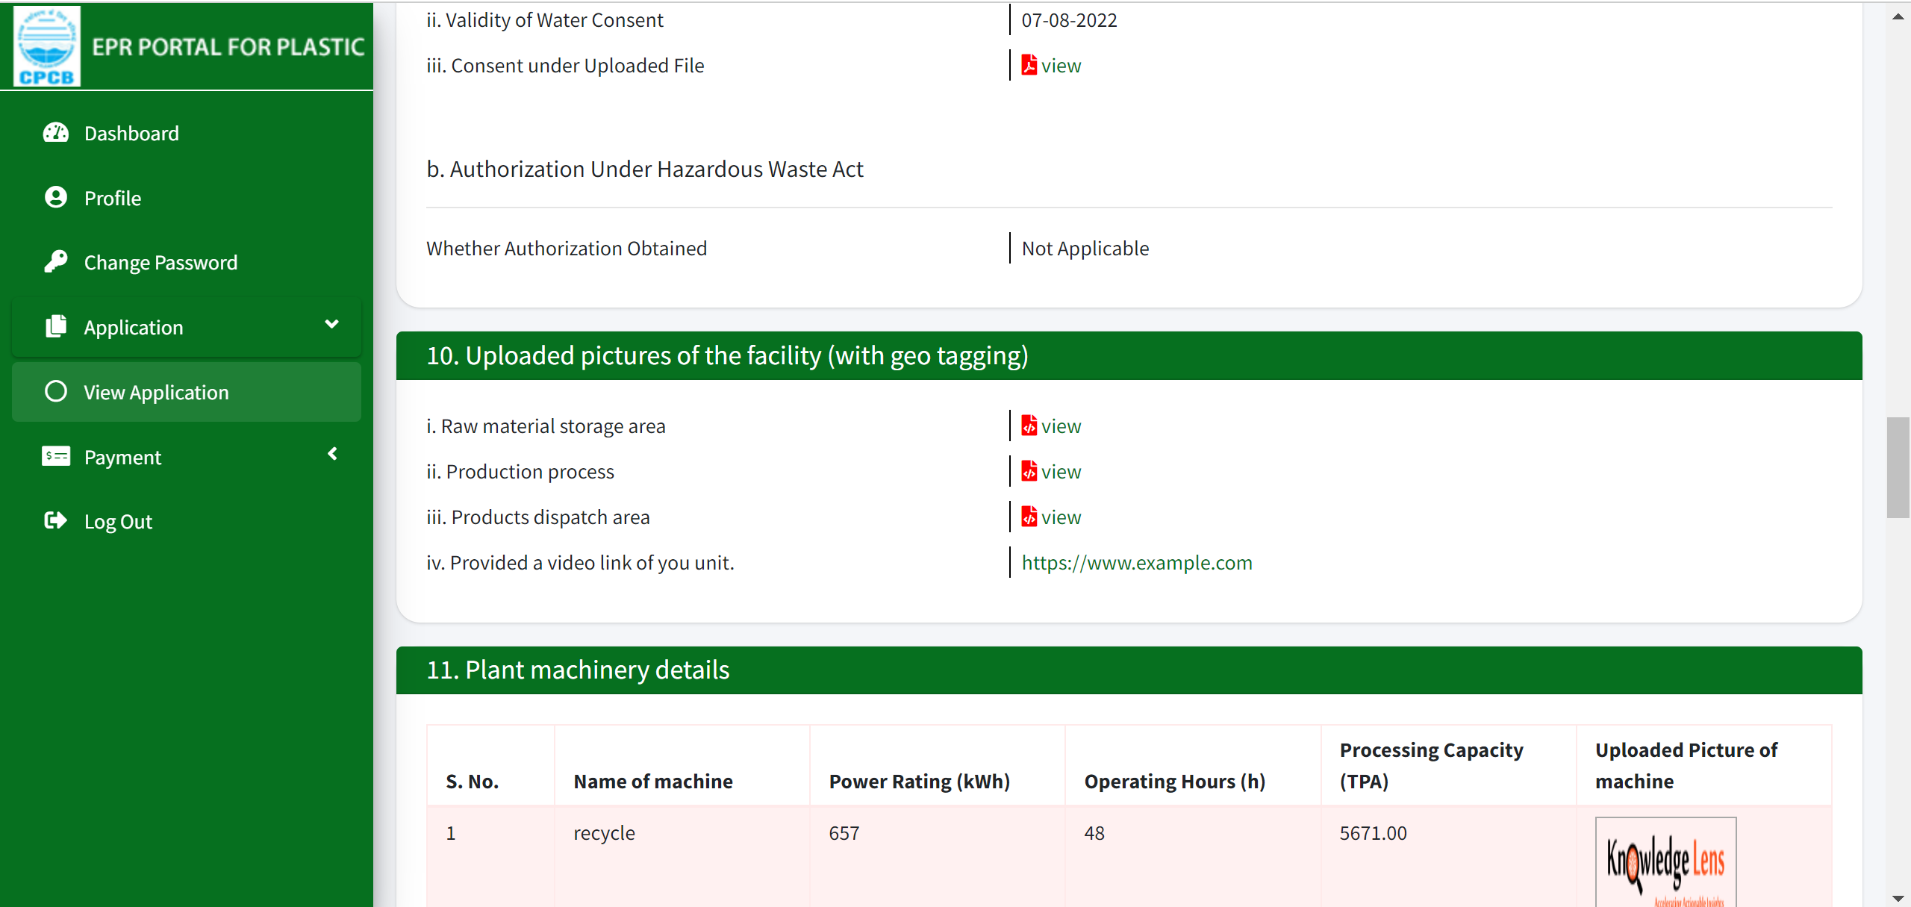
Application by pwps
9(a) – Check consent. Verify the consent details in the file uploaded in 9(iii).

Slide 9
Application by pwps
10(i-iii)- Check the pictures uploaded of the facility. Check if the pictures have geo tagging.
10(iv)- Check the video link provided of the unit whether it is compatible or not with the facility details provided.

Slide 10
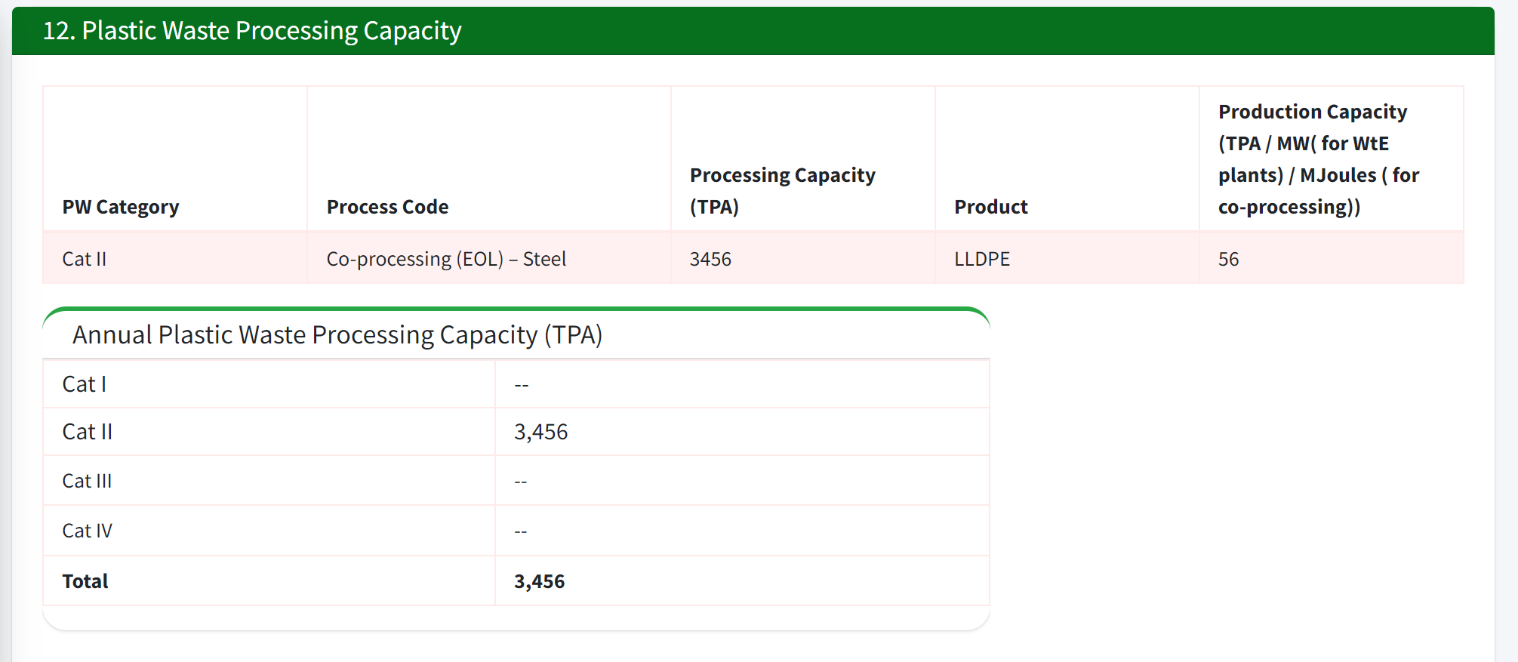
Application by pwps
12- Check whether the Annual Plastic Waste Processing Capacity quantity is same as provided in the table above.

Slide 11
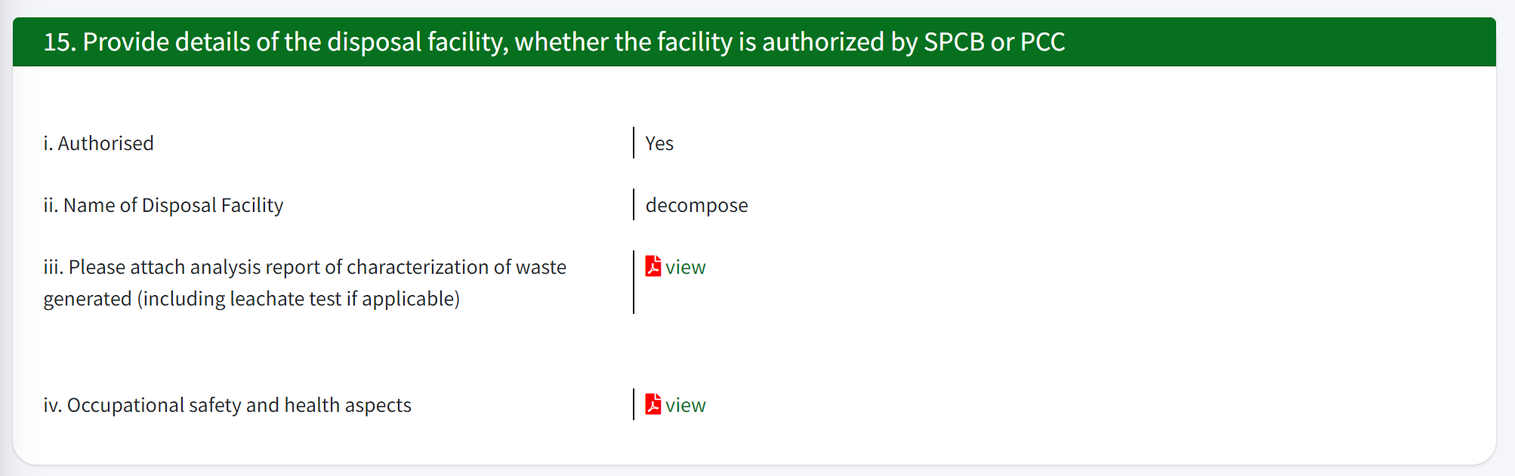
Application by pwps
15- If the disposal facility is authorized, check and verify the files uploaded.

Slide 12
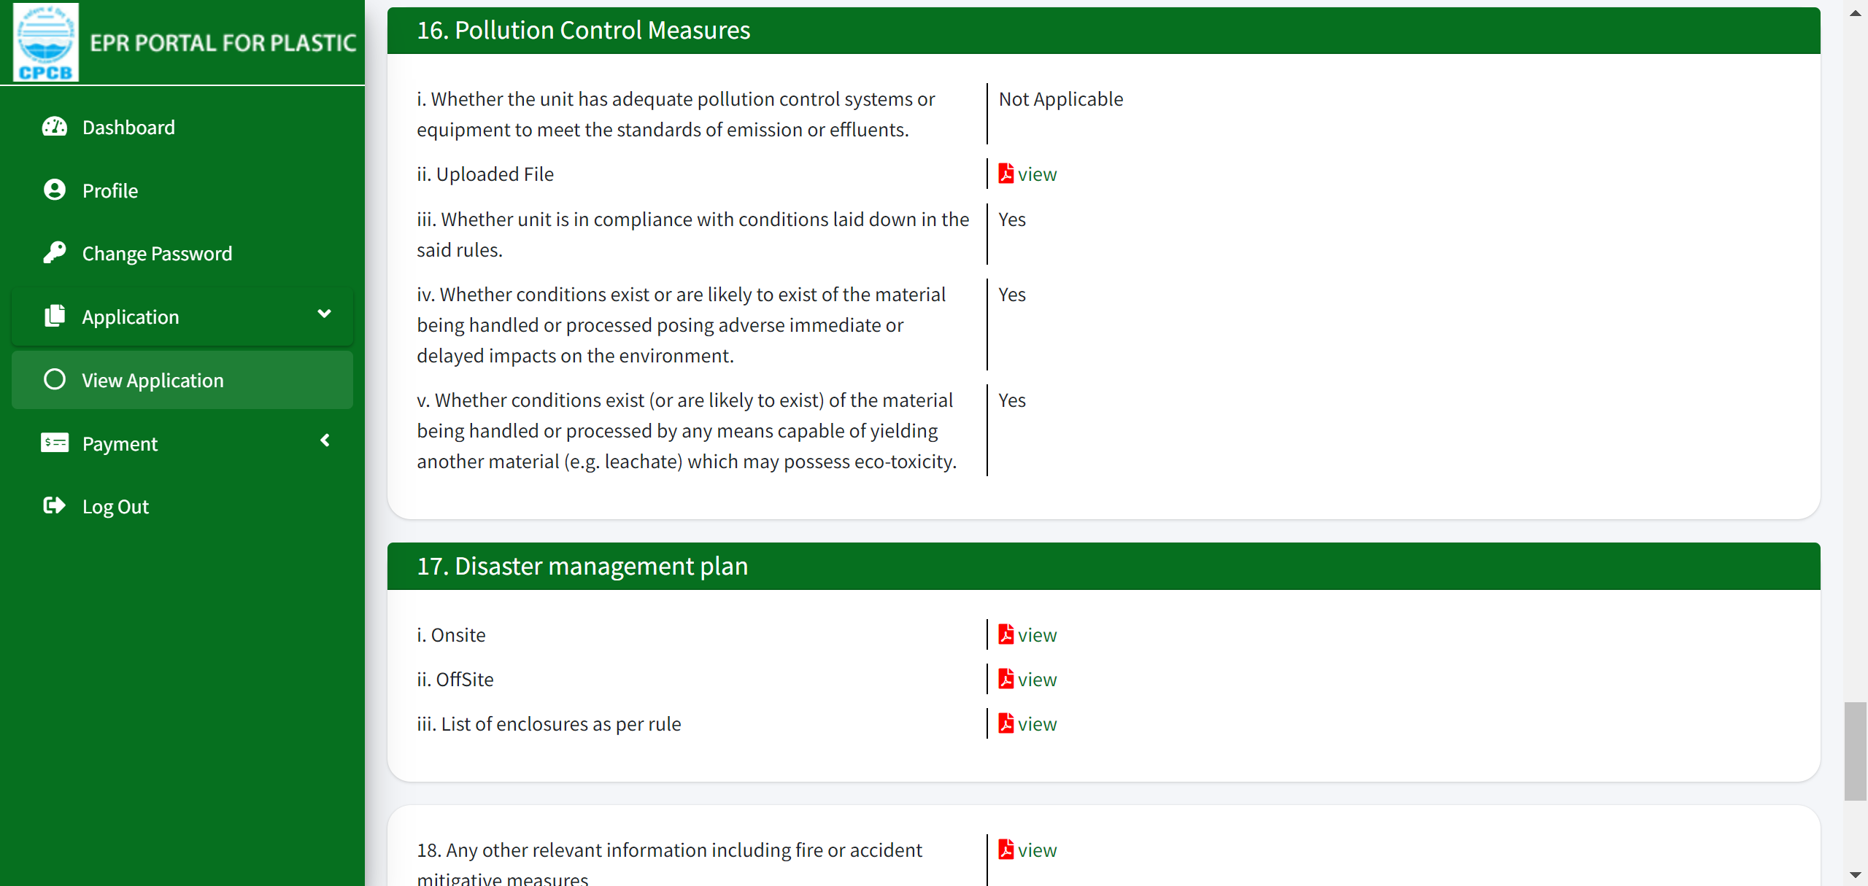
Application by pwps
16(ii)- Check pollution control measures’ details in the file uploaded.

Slide 13
Application by pwps
17- Check the files uploaded in 17 (i), 17 (ii) and 17 (iii).

Slide 14
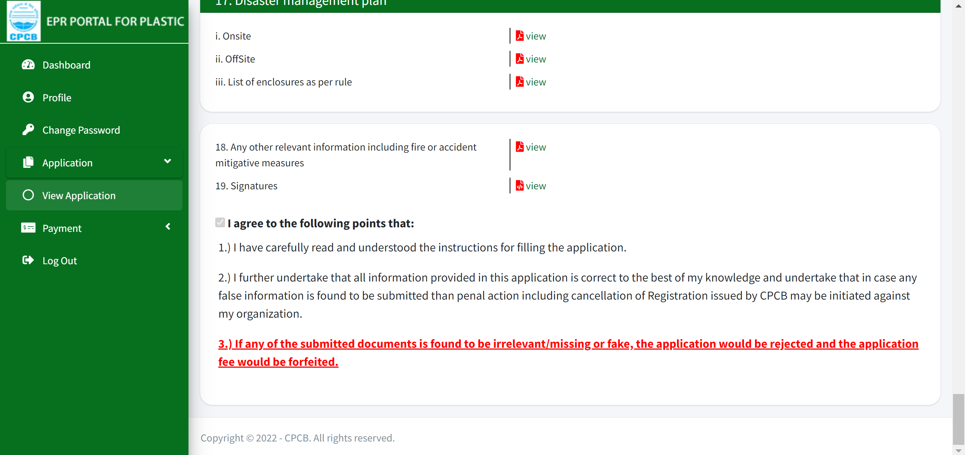
Application by pwps
18- Check if any other relevant information is given by viewing the file uploaded.
19- Check the Signatures from the file uploaded.

Slide 15
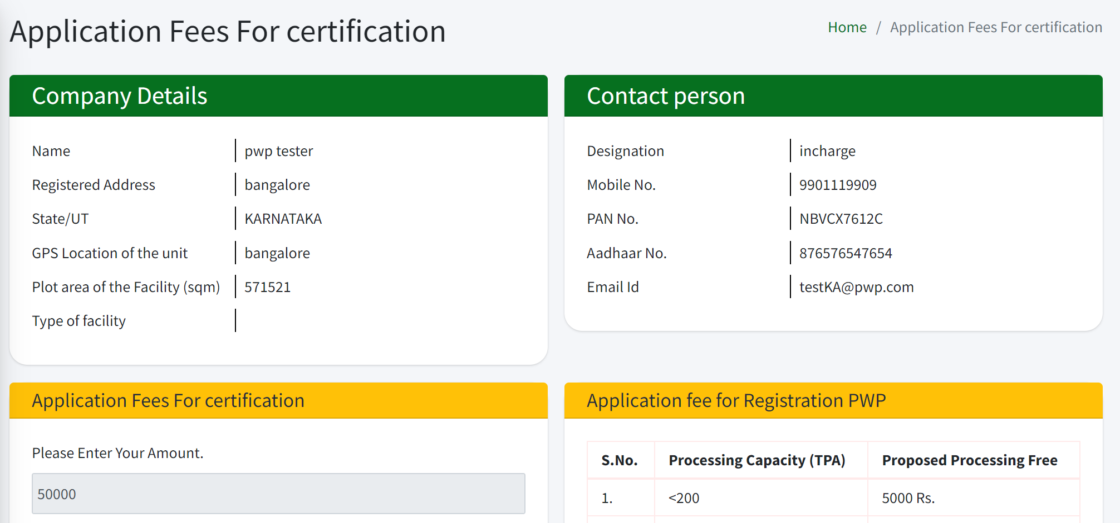
Application FEES FOR CERTIFICATION
Check and verify the Company details and Contact person details.

