Slide 1
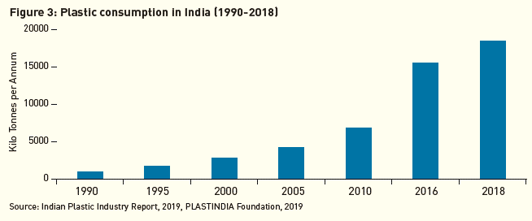
Plastic Consumption in India
Plastic consumption in India has increased over decades.
India’s plastic waste generation is 5th highest in World

Slide 2
Plastic Waste Issue in India
Plastic waste management has been a global issue and data suggests that India generates around 4 Million tonnes of Plastic waste every year,
In the total plastic waste generated in India, 43% of it is plastic packaging waste. (Fact sheet on plastic waste in India, Teri, 2018)
Successful implementation of EPR would address a big share of the plastic waste problem in the country.
Currently in India, plastic waste, the one with some value like PET, HDPE, is collected by informal and formal collection stakeholders, who channelize it to aggregators and then finally to recycling or recovery as suitable.
The ones with no or low value (SUPS and low-value non-recyclable plastics), are littered and then collected through municipal collection systems ending in dumpsites or incinerated for energy recovery.

