Slide 1
EPR definition
EPR is defined as ‘an environmental policy approach in which a producer's responsibility, physical and/ or financial, for a product is extended to the post-consumer stage of a product's life cycle.
Shifting of responsibility upstream towards the producer and away from municipalities
Providing of incentives to producers to include environmental considerations in their product design, such as
a) reducing material consumption,
b)using more secondary material,
c)promoting product eco-design (DfE)

Slide 2
EPR in Germany – A global context
Germany was one of the first countries to set up an EPR system for packaging
In Germany, Producers pay to national organization called as producer responsible organization, who further communicates, manages and pays to waste management operators and other stakeholder in the value chain to fulfil the Producers obligation.
The system for charging fees has moved towards a model based on the types and weights of material in the system.
All expenses associated with the collection, sorting and recycling of packaging waste is supposed to be covered by fees paid by obliged companies, who have to join a central register and pay fees to a PRO of their choice

Slide 3
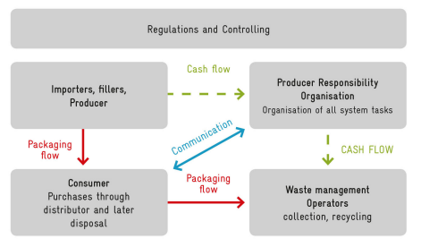
EPR in Germany - Overview

Slide 4
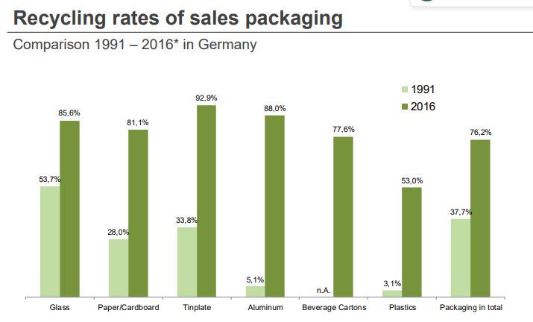
Impact on recycling of EPR in Germany

Slide 5
Different Tools used worldwide under EPR strategy
Administrative tools
Economic tools
Informative tools
Agreements
Collection and/or take back
Recycling and reuse targets
Emission Limit
Recovery Obligation
Standards
Material/ Product Taxes (Pay as you throw)
Subsidies
Advanced disposal fee system
Deposit- refund system
Upstream Tax/Subsidy
Recycler/ Producer credits
Environmental reports/labelling
Information provision to recyclers
Consultation with authorities about collection network
Social contracts
Gentlemen’s agreement
Source: Gupt,2015

